Slide 1
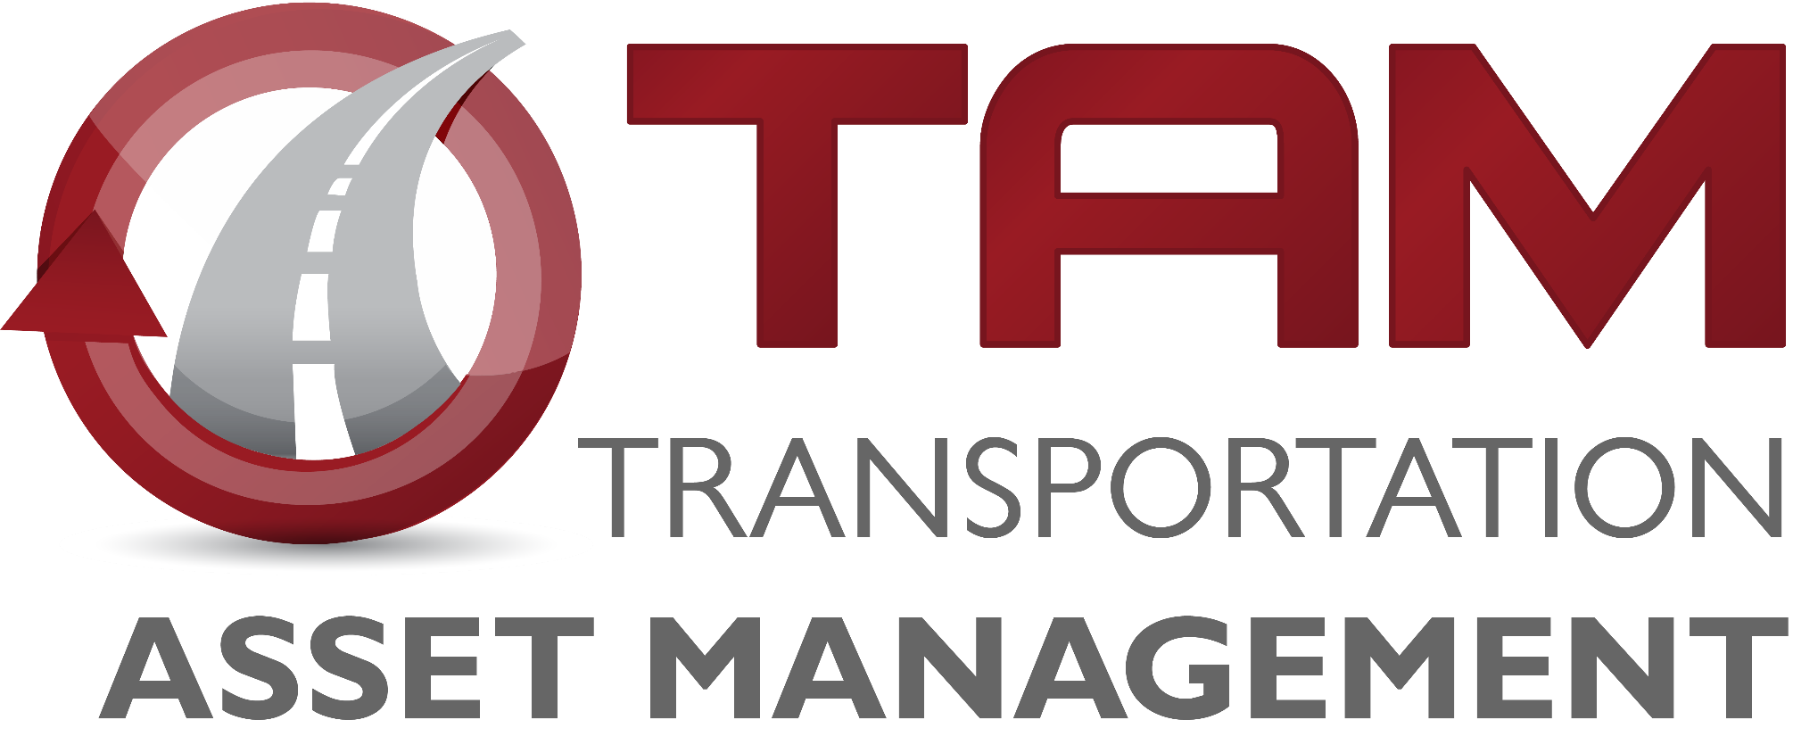
Transportation Commission Workshop
March 10, 2020
Matt Haubrich
Strategic Performance Division

Slide 2
Transportation Asset Management

Slide 3
Information to Inform Decisions
Dec-2019 – Bridge Management, Interstate Plan, and Prioritization Weighting
Jan-2020 – Pavement Management & Prioritization Weighting
Feb-2020 – TSMO Options
Mar-2020 – Investment Alternatives
Apr-2020 – Mobility Strategies (ICM)
May-2020 – Draft Program Asset Management Summary

Slide 4
Program Trade-off Analysis

Slide 5
Program Summary
Table below adapted from program development materials presented in previous Commission workshops
Key assumptions:
Flat revenue in outer years
Interstate investment will be funded at approximately $330M per year
Program targets for future years will be adopted by future Commission action
Year | 2021 | 2022 | 2023 | 2024 | 2025 | 2026 | 2027 | 2028 | 2029 | 2030
Revenue (forecast from March 2020) | 722 | 669.9 | 693.2 | 688.7 | 688.7 | 688.7 | 688.7 | 688.7 | 688.7 | 688.7
Non-Interstate Pavement Modernization (3R) | 105 | 115 | 140 | 145 | 150 | 155 | 165 | 175 | 185 | 190
Non-Interstate Bridge Modernization (BR) | 57.3 | 64.7 | 101 | 110 | 125 | 140 | 155 | 170 | 185 | 190
Safety Specific (SR) | 25 | 25 | 25 | 25 | 25 | 25 | 25 | 25 | 25 | 25
Non-Interstate Stewardship | 187.3 | 204.7 | 266 | 280 | 300 | 320 | 345 | 370 | 395 | 405
Interstate Stewardship (4R) | 239.8 | 184.7 | 144.8 | 128.7 | 165 | 170 | 175 | 180 | 185 | 190
Major Interstate (MI) | 204 | 194.7 | 106.1 | 83.1 | 158.8 | 160 | 155 | 150 | 145 | 140
Interstate Programs | 443.8 | 379.4 | 250.9 | 211.8 | 328.8 | 330 | 330 | 330 | 330 | 330
Non-Interstate Capacity/Enhancement (NR) | 118.5 | 91.2 | 202.4 | 204.1 | 89.8 | 63.4 | 40.1 | 30 | 30 | 30
Total Expenditures | 749.6 | 675.3 | 719.3 | 695.9 | 726.5 | 713.4 | 715.1 | 730 | 755 | 765
Net | (27.6) | (5.4) | (26.1) | (7.2) | (37.8) | (24.7) | (26.4) | (41.3) | (66.3) | (76.3)
Notes:
Make sure to mention the assumptions

Slide 6
Stewardship Funding Scenarios
Notes:
Only difference is the Non-Interstate Stewardship

Slide 7
Stewardship Performance Comparison
Notes:
Removed the 75% scenario that we showed last year.

Slide 8
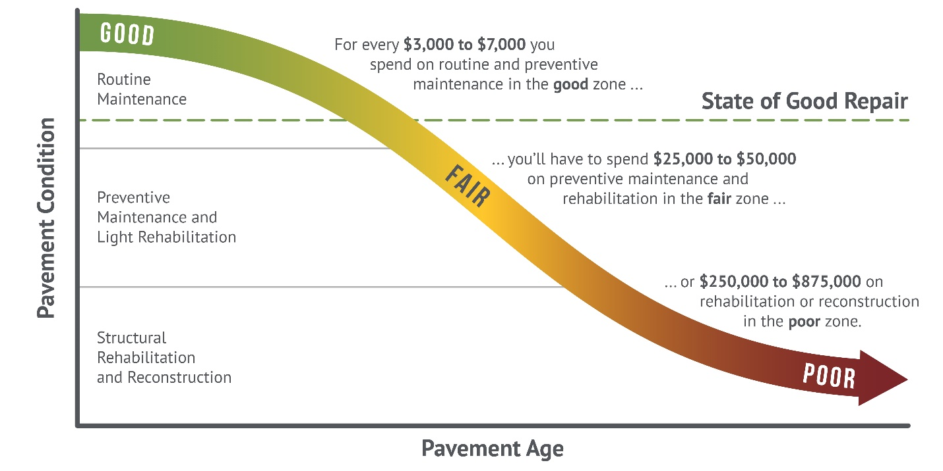
How We Set Targets
Good roads cost less. If we maintain assets in good condition, we can minimize their lifecycle cost. In the long run, this allows us to invest in other priorities.
Notes:
This graphic came from the Pavement LCP report done by HDR and APTech. It’s an update of the old Byron Shire Council graphic that we had been using.

Slide 9
Cost Comparisons for Alternatives
1 mile of new expressway at $11.1M would buy over 24 miles of 2-lane pavement resurfacing
$30M can get us:
Not quite 3 miles of new expressway
14+ miles of 2-lane pavement reconstruction
65 miles of pavement resurfacing
10 bridge replacements
From previous presentations:
We have a “wave” of bridges built in the 1960s and 1970s that are all getting to the point where major rehab or replacement is needed
At current replacement rates, we’re implicitly expecting pavements to last over 100 years (40-year design life)
Notes:
Using average costs from the 2020 Office of Design “Transportation Construction Costs” fact sheet., Scott Neubauer gave bridge estimates (replacement = $3M each).

Slide 10
Summary & Recommendations
Significant deterioration of pavements and bridges is forecast to occur without steady growth in stewardship spending.
Based on these forecasts, prior scenario analysis, the Commission’s long-range transportation plan Iowa In Motion 2045, and the Transportation Asset Management Plan, staff recommends program objectives that:
Increase funding for contract maintenance to adjust for lost purchasing power over time ($2M each for Bridge and Pavement recommended in this Program cycle)
Limit future capacity expansion to locations with forecast congestion that cannot be addressed effectively through operational improvements
Target steady growth in overall stewardship spending in order to maintain a state of good repair across the primary highway system.

