Slide 1

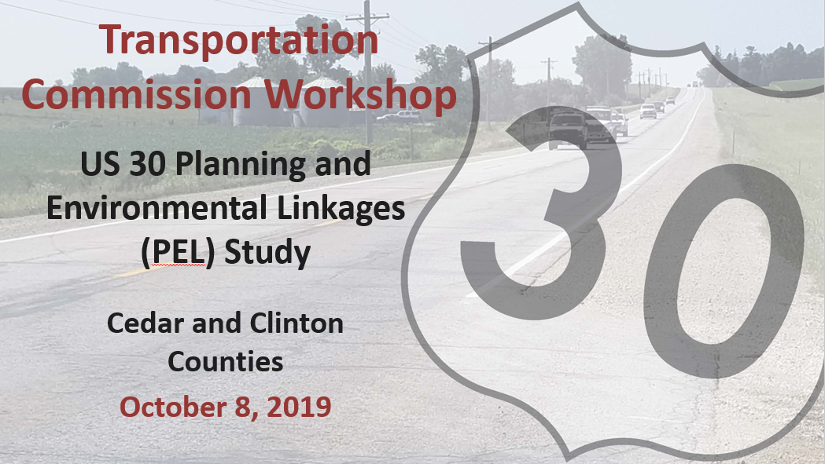
March 10, 2020
Notes:
This study is a result of collaboration between Iowa DOT and local stakeholders throughout the project corridor and at the request of the DOT Commission. I want to acknowledge the tremendous work on this study by our consultant, Jacobs, out of DsM to help expedite the study in a timely fashion.

Slide 2
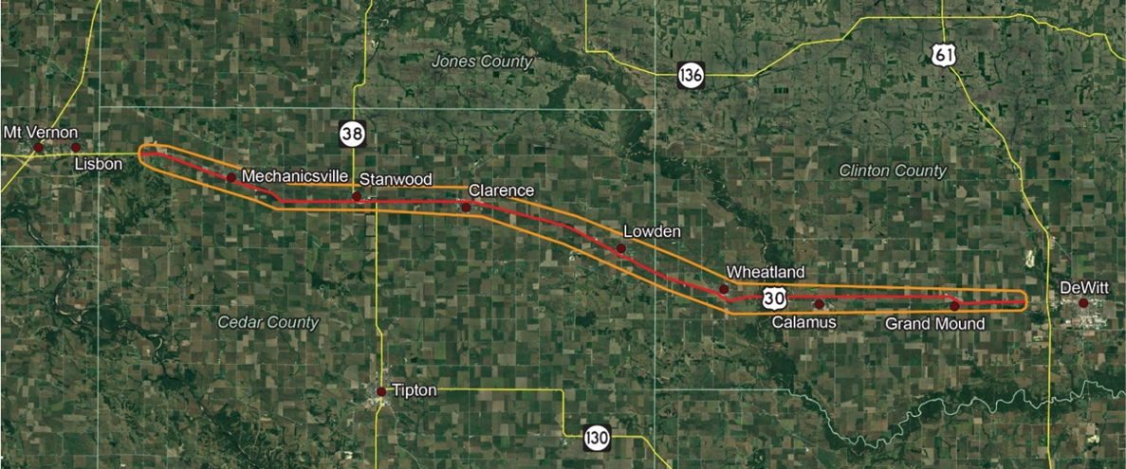
US 30 PEL Study Area
Early planning level study of US 30 between Lisbon and DeWitt
Notes:
The study corridor is approximately 40 miles in length beginning near Charles Avenue just east of Lisbon and ending at 260th Street just west of DeWitt.
The Study Area of this planning study is outlined here. The corridor includes the communities of Mechanicsville, Stanwood, Clarence, Lowden, Wheatland, Calamus, and Grand Mound and a crossing of the Wapsipinicon River. As a reminder, The DOT Commission identified this as a targeted corridor for study and is why we initiated this PEL study last year.

Slide 3
PEL Study and the
Project Development Process
A Planning and Environmental Linkages - or PEL Study, allows early planning-level decisions to be carried forward into subsequent projects.
PEL
Study
Environmental Planning
Engineering
Construction*
*There are currently no corridor-wide improvement projects funded
We are Here
Notes:
Really in the early stages of a typical planning study…After this comes the environmental field work to determine what’s really out there in the corridor…then the engineering to design the roadway and bridges… and finally construction…
Iowa DOT does not have projects currently programmed for this corridor, aside from a couple of bridge replacement projects and other typical maintenance and rehabilitation work.

Slide 4

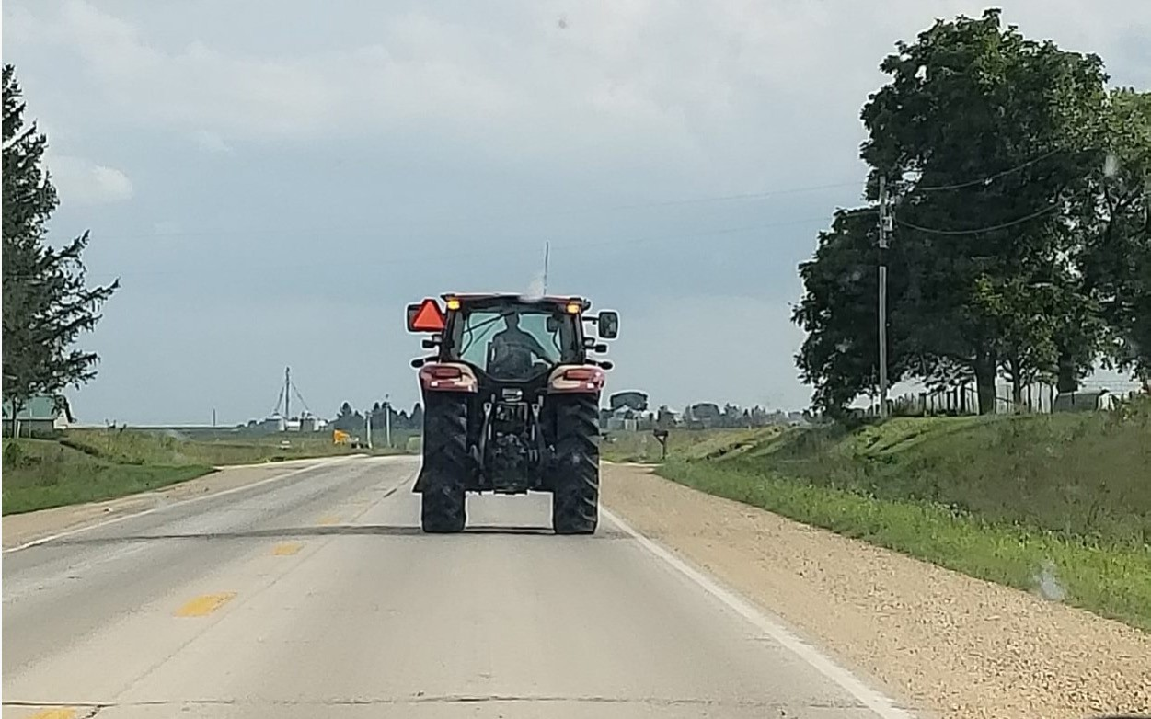

Why Improvements are Recommended
US 30 is a critical roadway to Iowa’s rural economy
Presence of slow-moving farm and agricultural equipment common throughout the year
Vehicle backups can occur
Slow moving trucks and agricultural equipment can be found throughout the US 30 corridor.
Public input supports enhancement of the corridor
Improvement focus
  Decrease conflicts with slow-moving vehicles and turning vehicles
  Increase safe passing opportunities to promote safer, reliable and consistent travel

Slide 5
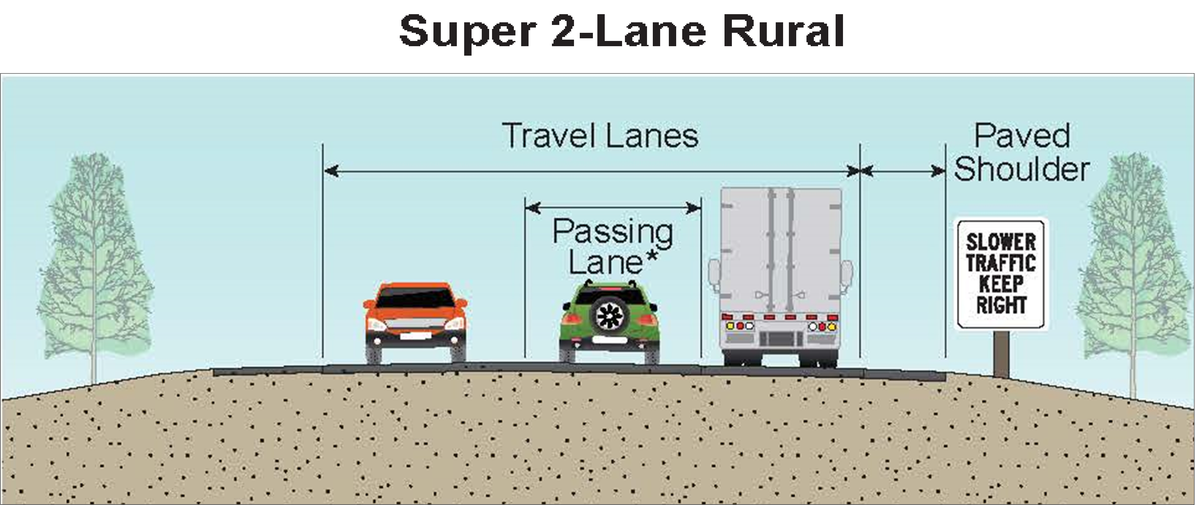

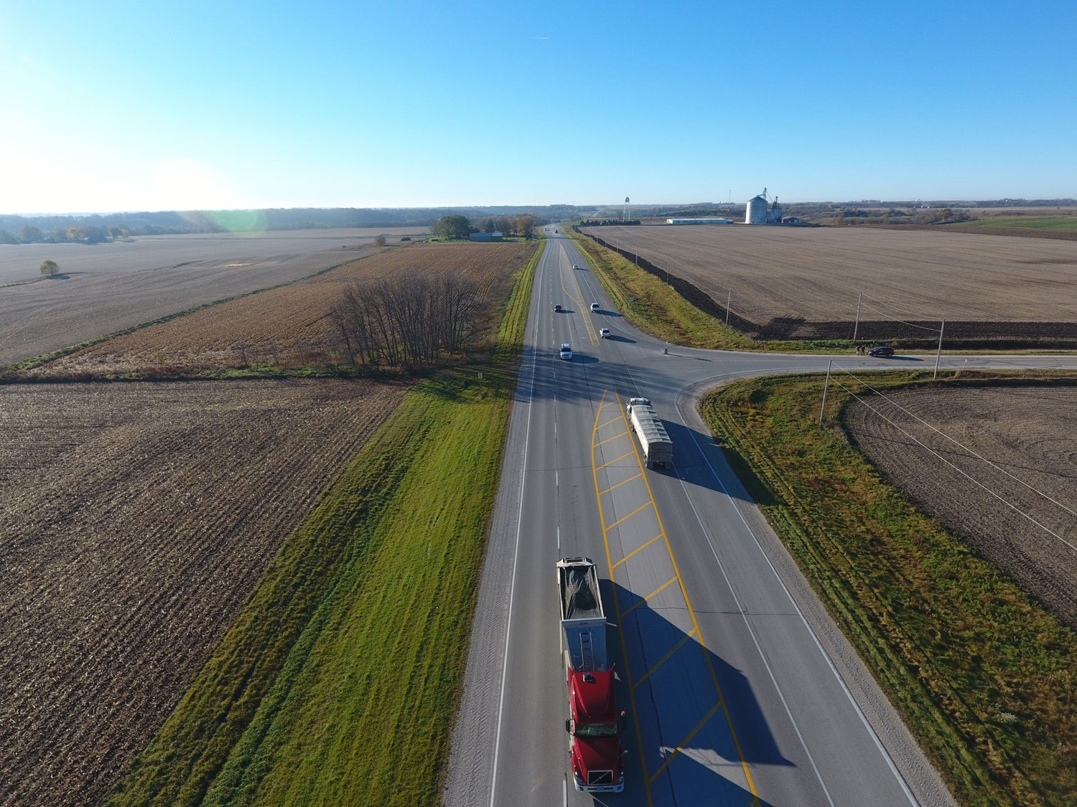
Recommended Roadway Section Super-2 Highway (Between Communities)
U.S. 169 Fort Dodge, IA to Humboldt, IA
*Passing lanes can be in either direction, are non-continuous, and spaced at established intervals along a corridor.
–Improves opportunity to safely pass slower moving vehicles
–Passing lanes where appropriate and needed, generally every 4 to 5 miles
–Typical passing lane length: 0.5-1.75 miles
Notes:
A Super-2 is a two-lane rural highway with characteristics that improve traffic flow and safety performance, most notably through the addition of passing lanes along the corridor in both directions of travel.

Slide 6
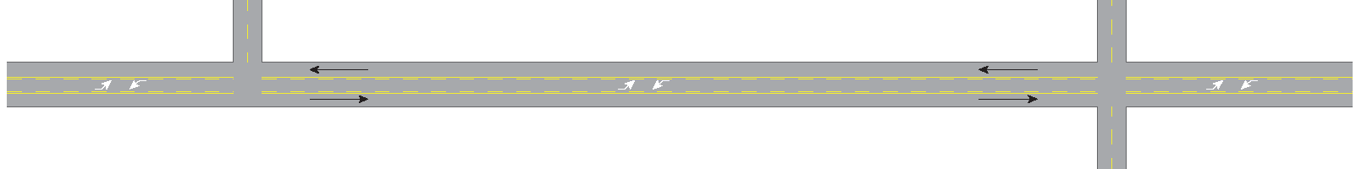

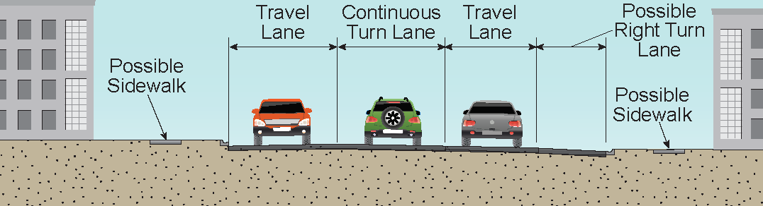
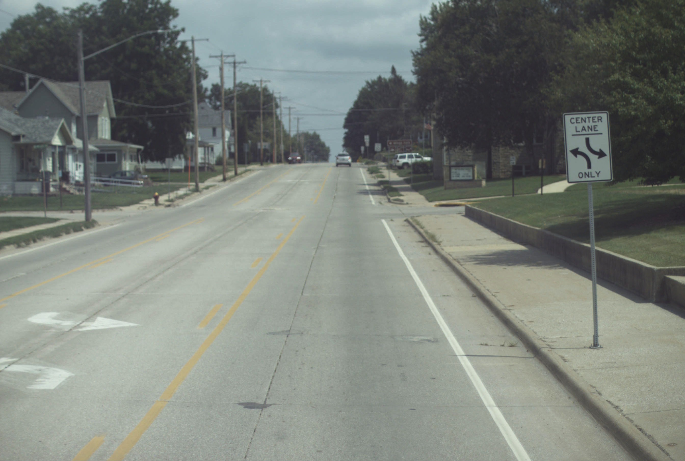

Recommended Roadway Section Super-2 Highway (Through Communities)
–Turn lanes separate turning traffic from US 30 traffic flow
–Reduces travel delays through communities
–Center left turn lane and right turn lanes provided at locations with minimal impact and cost
Example of Center Two-Way Left-Turn Lanes (TWLTL) in Oelwein, Iowa.
Notes:
In an urban setting, a Super-2 highway concept may include a two-way-left-turn lane (like in the bottom photo) to remove turning vehicles from the main traffic flow resulting in higher safety and less delay through town.

Slide 7
Recommendations
Super-2 design is recommended, rather than four-lanes to meet existing and future traffic needs
Bypasses are not recommended as part of this Super-2 configuration
Include passing lanes to improve opportunities to safely pass slower moving vehicles
Two-way left turn lanes and right turn lanes through town to reduce travel delays on US 30
Notes:
So, in our final analysis, the….

Slide 8
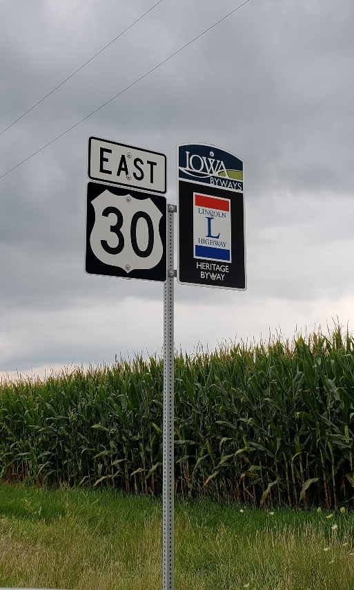
Next Steps
Vision document in April 2020
PEL Study findings will be incorporated into future environmental and engineering studies
Potential Super-2 project between Lisbon and Mechanicsville
Notes:
Our consultant is finishing an Economic Technical Memo this month for our review, and this and the other tech memos related to safety, existing conditions, and operations will be rolled into a final Vision document to be completed in November. It will provide a roadmap for future environmental and engineering work in the corridor.

Slide 9
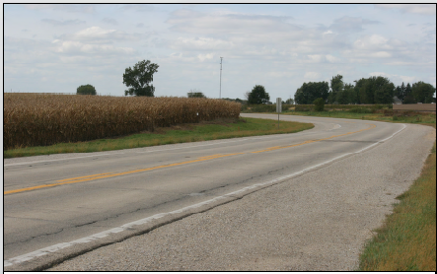
Investment Strategy 1 – Stewardship Only
Continue routine maintenance in the future
Make improvements to the roadway and bridges when necessary
Farm and slow-moving
traffic would continue
Delay and safety concerns
with RR crossings remain
Notes:
So, in our final analysis, the….

Slide 10
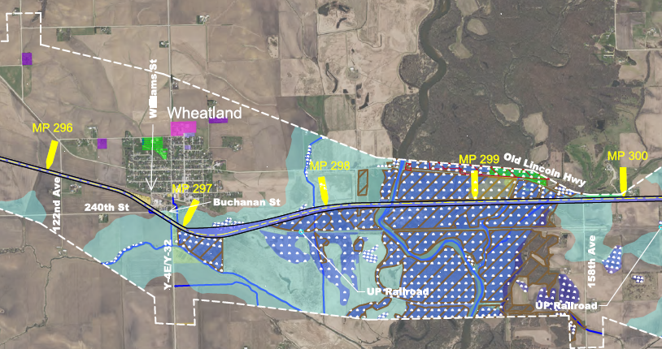
Investment Strategy 2 – 4-lane
More impacts to farmland and natural resources
Will raise environmental documentation and coordination requirements with federal agencies
Section 404 permit (Clean Water Act) requires us to choose least damaging and practicable alternative
Higher posted speed limit on 4-lanes may increase at-grade intersection crash severity.
Notes:
So, in our final analysis, the….

Slide 11
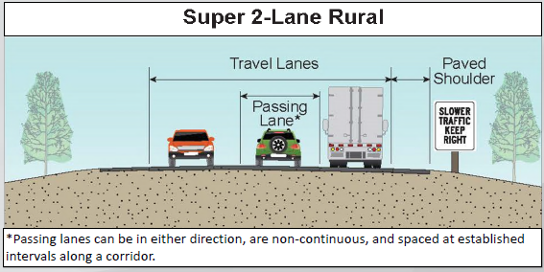
Investment Strategy 3 – Super-2
Minimal impacts to farmland and natural resources
Can accommodate existing and future traffic efficiently
Less cost and faster implementation of improvements
Safety enhancements that include passing lanes between cities and turn lanes in towns.
Notes:
So, in our final analysis, the….

Slide 12
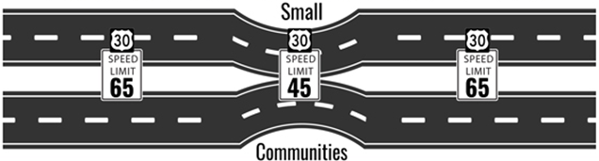
“Rural 4” Concept
4-lane facility in rural sections
65 mph speed limit
No interchanges or community bypasses
Notes:
I borrowed this graphic from the US 30 Coalition, but to be fair, I do not believe they are recommending 4-lanes through the towns.

Slide 13
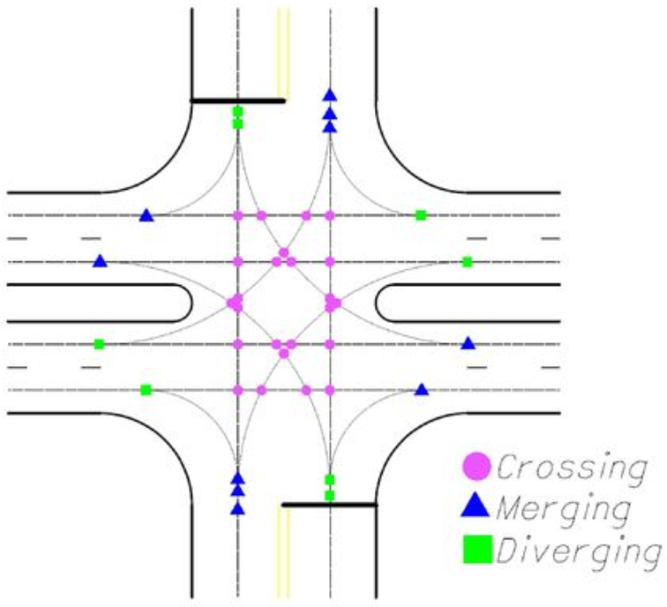
“Rural 4” Safety
10 additional conflict points at each 4-legged intersection
(42 compared to 32 with a 2-lane facility)
Without closing accesses, up to 20 such intersections between communities
10 x 20 = 200 additional conflict points that do not currently exist
  Does not include additional conflicts
  at 3-legged intersections

Slide 14
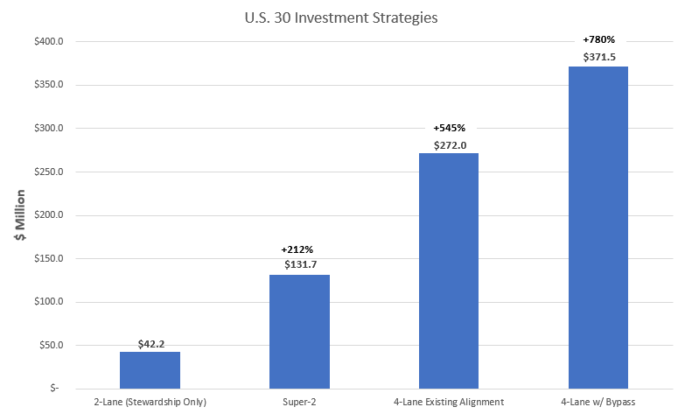
Investment Strategy Planning-Level Costs
Notes:
So, in our final analysis, the….

Slide 15
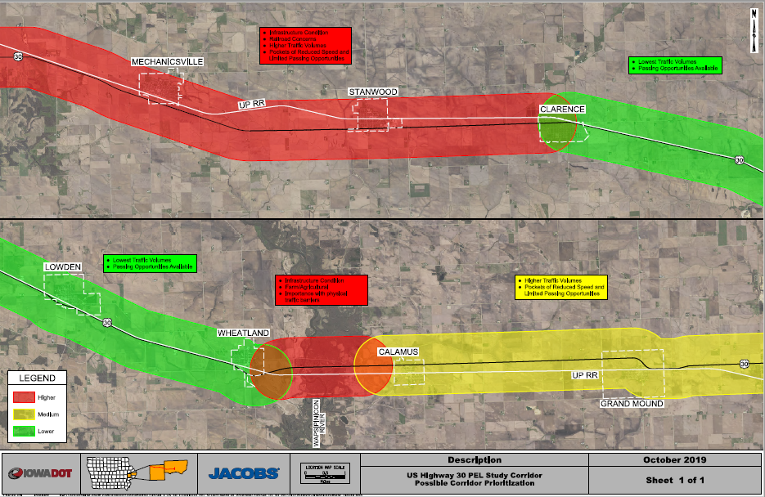
Prioritization

Slide 16
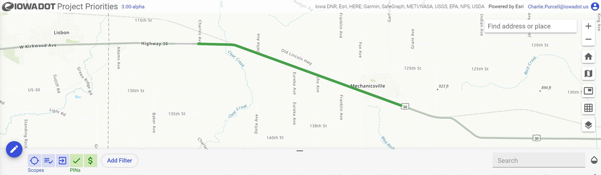
Potential Super-2 Project
Lisbon to Mechanicsville – 4.7 miles and $17.4 M
Notes:
So, in our final analysis, the….

Slide 17
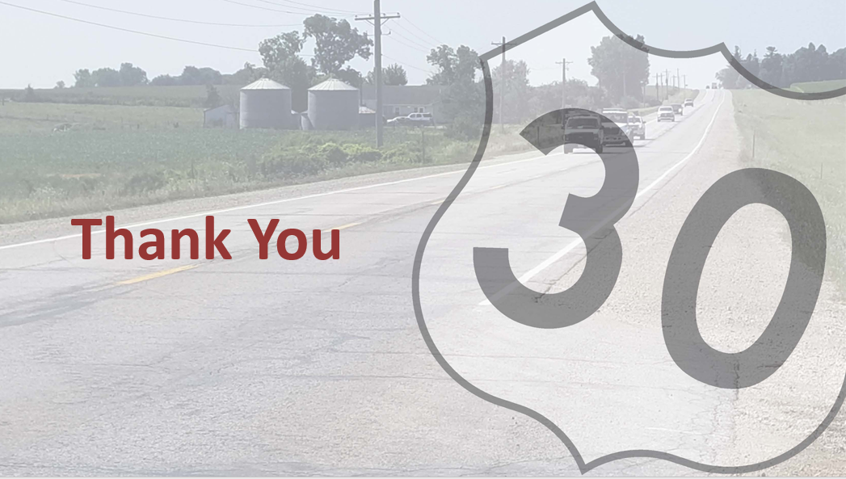

Slide 18
Current and Future Conditions
US 30 Travel is Reliable and Consistent
CURRENT SPEED AND TRAVEL TIME West of Mechanicsville to East of Grand Mound
Weekday Time Period | Eastbound Travel |  | Westbound Travel
 | Speed (mph) | Time (minutes) | Speed (mph) | Time (minutes)
Full Day: 12 AM – 11 PM | 54.2 | 47.5 | 54.4 | 47.5
Daytime: 7 AM – 9 PM | 54.4 | 47.4 | 54.4 | 47.5
Overnight: 10 PM – 6 AM | 54.1 | 47.7 | 54.3 | 47.6
Morning Commute: 7 AM – 9 AM | 54.6 | 47.3 | 54.6 | 47.3
Afternoon Commute: 4 PM – 6 PM | 54.7 | 47.2 | 54.7 | 47.3
Note – The values above include driving through communities with reduced speed limits. Accounting for the reduced posted speed limit sections, data suggests that current travel speeds are at or above the posted speed limits for the corridor.
Future (2045) Estimated Travel Speed and Time Compared to Existing Conditions
Alternative | Speed Change (mph) | Travel Time (minutes)
No-Build | -0.2 | +0.3
Super-2 | +1.7 | -0.3
Possible Travel Time Savings With Bypasses (All Communities)*
Assumed Posted Speed Limit (mph) | Est. Travel Time Change (minutes)
55 | 1
60 | 5
65 | 8
*Based on time required to travel a given distance (estimated 42- mile bypass length) at a constant given speed; times are not necessarily representative of a certain number of travel lanes.
Notes:
First chart shows current speeds and travel times…What’s interesting is that the average speeds, both east and westbound, are right at the posted 55 mph speed limit, meaning folks are driving faster than the speed limit to make up for the slower speeds through the towns…
Also, if we decided to bypass all seven towns and impact hundreds of acres of farmland with a 4-lane highway, even with a 65 mph speed limit, it would only save 8 minutes of travel time in this corridor.

Slide 19
Why Super-2 Highway Recommended
A Super-2 highway compared to a 4-lane highway
  Is a lower cost solution
  Is a better return on taxpayer investment
  Has less farmland, private property, and natural resource impacts
  Affects travel patterns, access to existing businesses, and potential railroad conflicts less
US 30 Super-2 Highway vs. 4-Lane Highway
Construction Cost Difference | When compared to the cost of simply reconstructing an existing 2-lane highway, the additional cost to upgrade to a Super-2 is about 15% to 20% of the cost to upgrade to a 4-lane highway.
Right-of-Way and Farmland Impacts | Super-2 impacts are about 1/3 of the those expected with a 4-lane highway and bypasses
Super-2 highway style improvements can provide significant safety benefits where safety problems exist
  US 169 Fort Dodge to Humboldt – 67% crash decrease
  US 63 Oskaloosa to New Sharon – 49% crash decrease
Notes:
…Looking strictly at construction costs on existing alignment, where we can add passing lanes between the towns and turning lanes in the towns, we could do this for 15%-20% of the cost to build a new 4-lane highway with bypasses around the towns.
In terms of impacts to ROW and farmland, this means it would take 1/3 of the total land to build a Super-2 highway versus new 4-lanes with bypasses.

Slide 20
Why Super-2 Highway Recommended – A Super-2 Will Reliably Meet Expected Future Traffic Needs
A 2-lane highway can effectively manage between 8,000 to 14,300 vehicles/day and provide smooth traffic flow
Existing traffic for US 30 ranges from 2,220 to 5,580 vehicles/day
It is projected that 3,000 to 12,500 vehicles/day will use US 30 by 2045:
a 2-lane highway will still efficiently manage future traffic on US 30
Transition to a Super-2 highway can improve safety, reliability, and enhance capacity to meet future transportation needs of a corridor

Slide 21





















Economic Considerations
Analysis suggests that adequate highways support economic growth but four-lane expansion will not create economic growth on its own
Economic growth depends on additional drivers
Local Policies
Population growth
Presence of an educated workforce
Proximity to markets
Local economic development policies
Amenities
Educated Workforce
Transportation
Economic Growth
Population Growth
Super-2 highway investments can improve the safety, reliability, and consistency of travel.
Available Amenities
Proximity to Markets
Notes:
The economic analysis done shows that 4-lane expansion on its own will not create economic growth, but other growth drivers are key to development in the state – like….

Slide 22
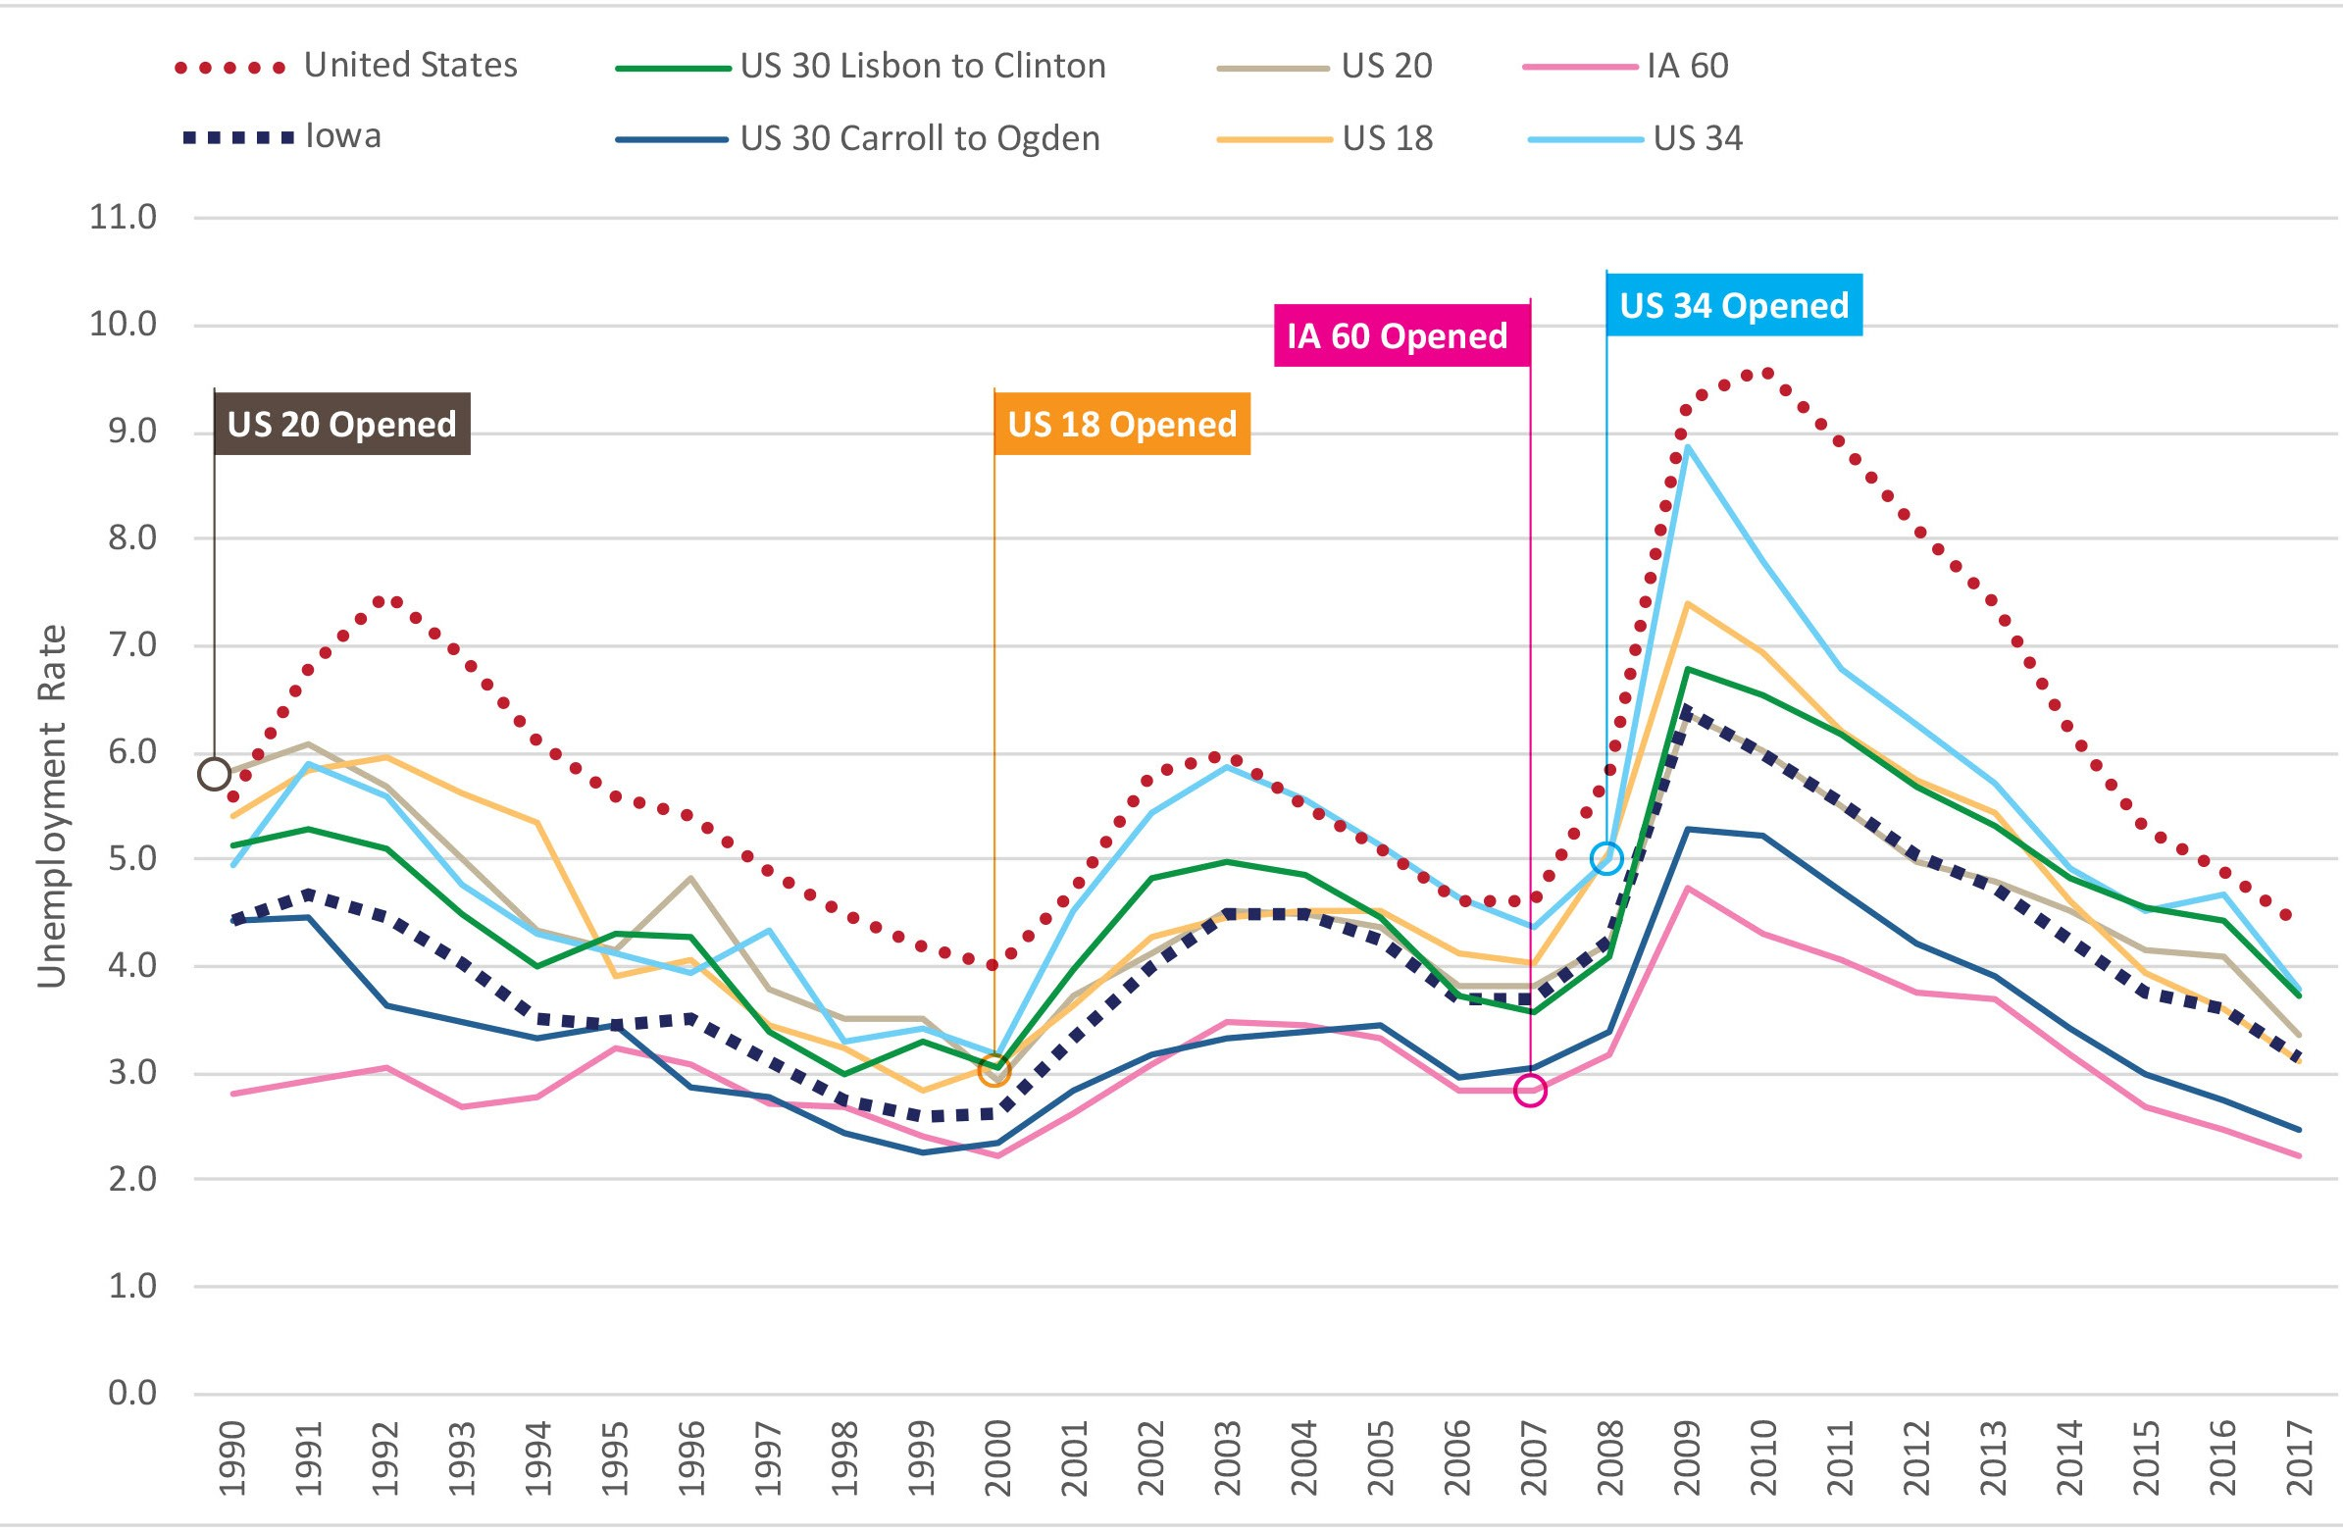

Economic Considerations – Data Trends
Economic performance along 2-lane highway corridors is similar to, or, in some
instances, better than 4-lane highways
Unemployment
4-Lane Highways Represented in the Tables
US 20 – Waterloo to Dubuque
US 18 – I-35 to
Charles City
IA 60 – LeMars to Sibley
US 34 – Ottumwa to Mt. Pleasant
*Income data was studied for a 10-year period before and after highway expansion; these charts reflect the 20 years of before-and-after data studied for each of the 4-lane case study corridors.
Notes:
This study also takes an honest look at the economic trend of expanding 2-lane highways, similar to US 30, to 4-lanes. These existing 4-lane projects are US 20 in eastern IA, US 18 in north central IA, IA 60 in NW IA, and US 34 in SE IA…
The base comparison is that of existing 2-lane US 30 in eastern IA and west central IA… The general trend over time, whether 2-lane or 4-lane, is that economic performance in IA seems to track right along with state and national employment data. So much so, that the unemployment rate actually went up for several years after opening a new 4-lane highway… This was quite interesting.

Slide 23
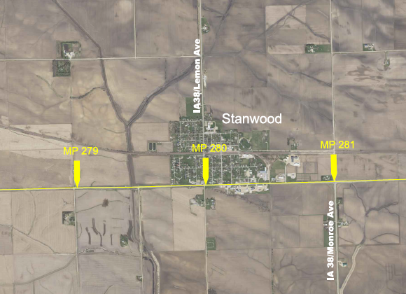
To Bypass Or Not to Bypass?
Bypasses are costly and impactful
Minimal impact expected in communities with Super-2 highway
Following existing US 30 has less impact on farmland and environmental resources
Following existing US 30 does not change local travel patterns or railroad crossing needs
Locations where a shift of US 30 could be considered
Notes:
Just like Shakespeare in a way, do we bypass or not bypass – that was one of our questions…

