Slide 1
FFY 2020 Transit Capital Programs

Slide 2
Section 5339 Grants for Bus and Bus Facilities Formula Program
Purpose: Federal Transit Administration (FTA) program that provides funding to states and transit agencies through a statutory formula to replace, rehabilitate and purchase buses and related equipment and to construct bus-related facilities

Slide 3
Section 5339 Grants for Bus and Bus Facilities Formula Program
5339 Direct Apportionments:
Urban (50-200K population) – $1,214,771
Statewide – $3,500,000
Council Bluffs – $1,037,981
Davenport (IA/IL) - $536,423
Des Moines – $856,010

Slide 4
Section 5339 Grants for Bus and Bus Facilities Formula Program
State Apportionments:
Urban (50-200K population) – $1,214,771
One transit systems, three vehicles
Statewide – $3,500,000
Fourteen transit systems, forty-four vehicles

Slide 5
Congestion Mitigation Air Quality Program (CMAQ)
Purpose: To fund transportation projects in non-attainment or maintenance areas of Clean Air Act Standards. States that have no nonattainment or maintenance areas receive a minimum apportionment of CMAQ funding for either air quality projects or other elements of flexible spending. Funds may be used for any transit capital expenditures otherwise eligible for FTA funding as long as they have an air quality benefit
FY 2020 allocation: $3,000,000
Ten transit systems, twenty-six vehicles

Slide 6
Summary
Total capital funds available: $7,714,771
Twenty transit systems will be able to purchase seventy-three vehicles

Slide 7
Project Distribution Criteria
Funds are distributed for bus replacement based on the Public Transit Management System (PTMS) process and the availability of local match
Prioritizes vehicle replacements based on the degree to which each vehicle exceeds the useful life for that particular vehicle type in terms of both age and accumulated mileage
The age, vehicle type, and mileage are maintained for all vehicles within the PTMS database

Slide 8
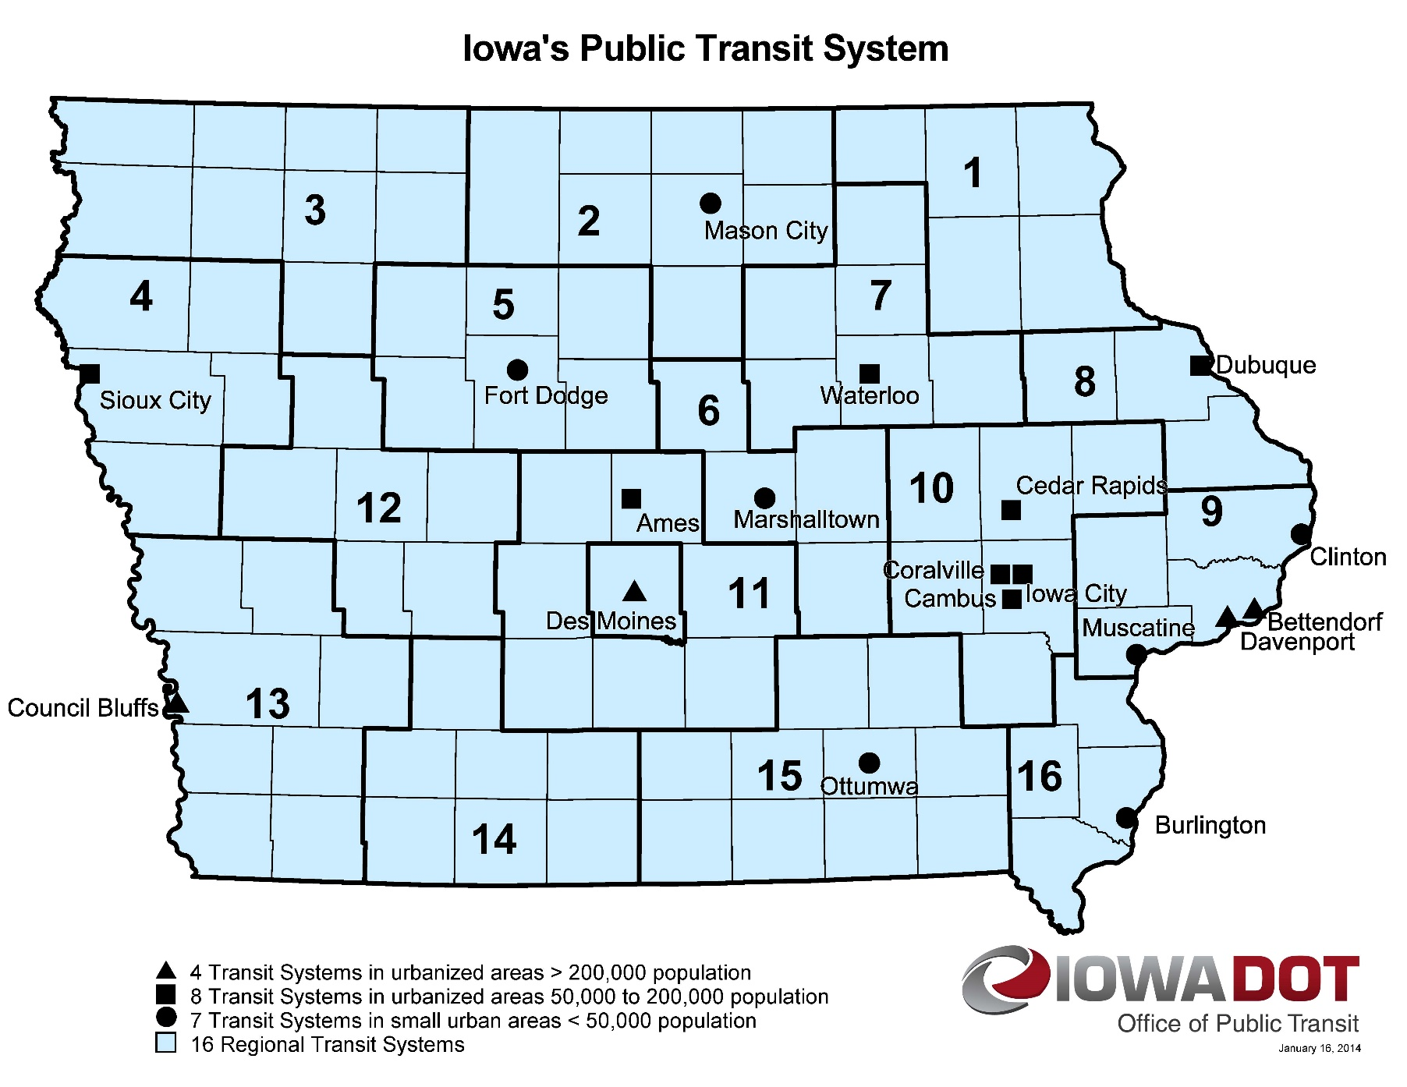
Transit System Vehicle Replacements
Notes:
18 Transit Systems

Slide 9
QUESTIONS?
For more information on Iowa’s public transit and intercity bus programs, visit
www.iowadot.gov/transit

