Slide 1
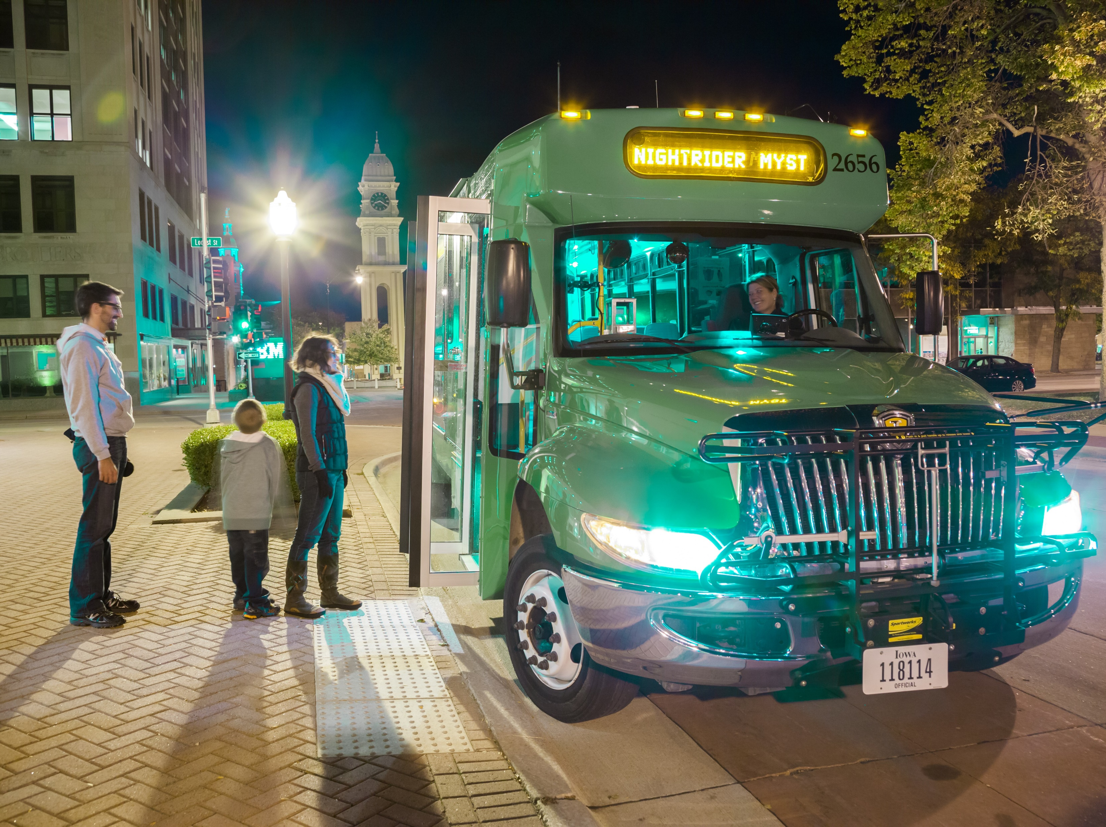
JOE DRAHOS
SYSTEMS PLANNING BUREAU | PASSENGER PLANNING
PLANNING, PROGRAMMING & MODAL DIVISION
Iowa Department of Transportation
800 Lincoln Way, Ames, IA 50010
Office: 515.239.1772 Email: joseph.drahos@iowadot.us
Iowa Public Transit Long Range Plan
Transportation Commission Meeting
March 10, 2020

Slide 2
Agenda
Iowa Public Transit Long Range Plan
Outline
Identifying Issues
Brainstorming Ideas
Getting Feedback
Public Survey
Transit Dependency Analysis

Slide 3
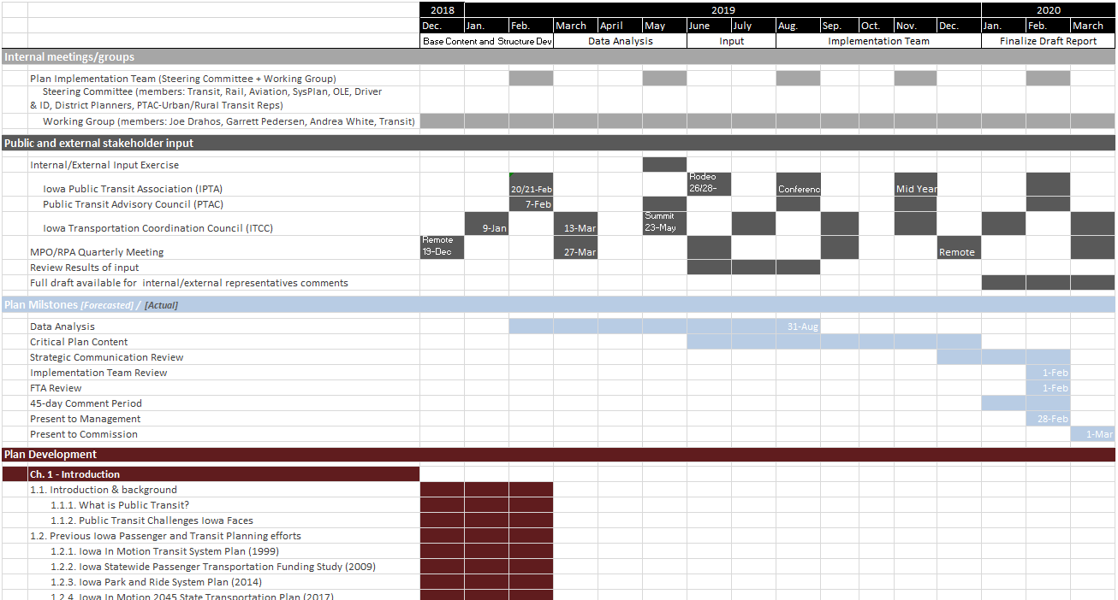
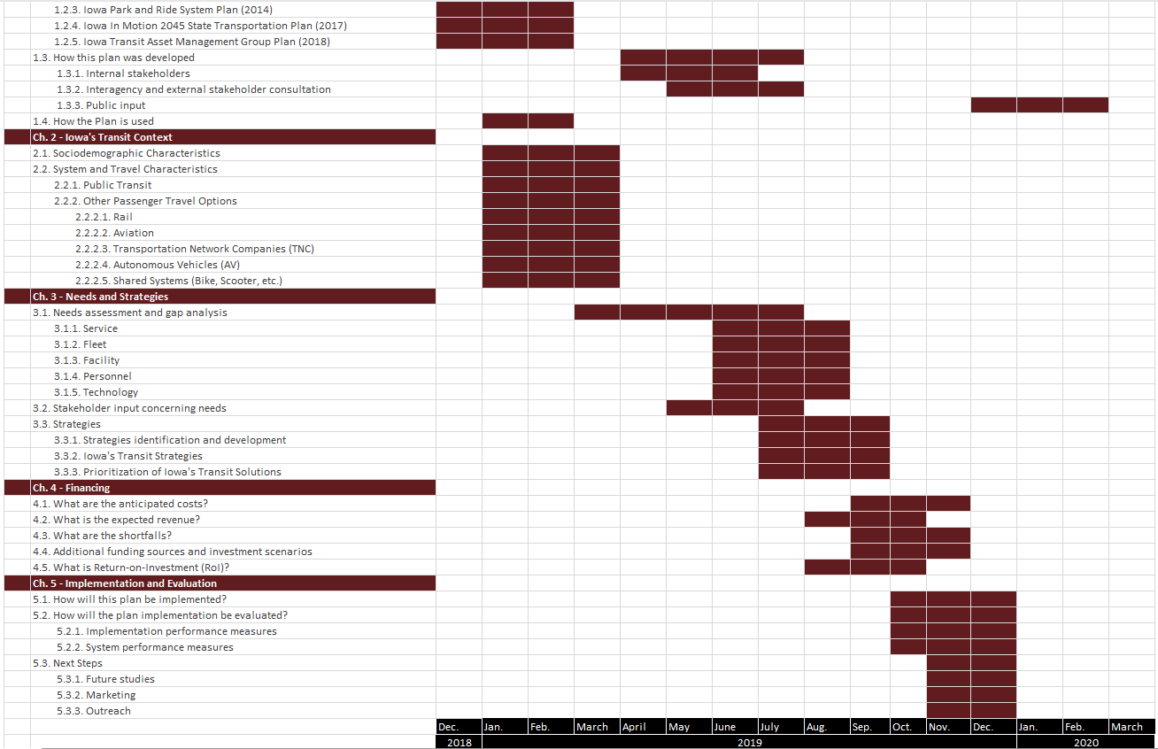
Outline
Iowa Public Transit Long Range Plan
Planning Horizon (2020 – 2050):
Begin
December 2018
Benchmarks
Data analysis by summer of 2019
Strategies by fall of 2019
Final draft by summer of 2020
Complete
July 2020
Inform update of State Long Range Transportation Plan

Slide 4
Roadmap
Iowa Public Transit Long Range Plan
2019
2020
March
October
Spring
Analyze Data
Survey Results
Transit Dependency
Funding and Cost Trends
Brainstorm Ideas
IPTA Legislative Conference
Passenger Transportation Summit
2018
December
2020
July
Identify Issues
Transit Needs Survey
Service
Fleet
Facility
Personnel
Technology
Get Feedback
Stakeholder Meeting
Transit Plan Website
Public Survey
Develop Content
Draft chapters
Introduction
Iowa’s Transit Context
Needs and Strategies
Financing
Implementation and Evaluation
May
November

Slide 5
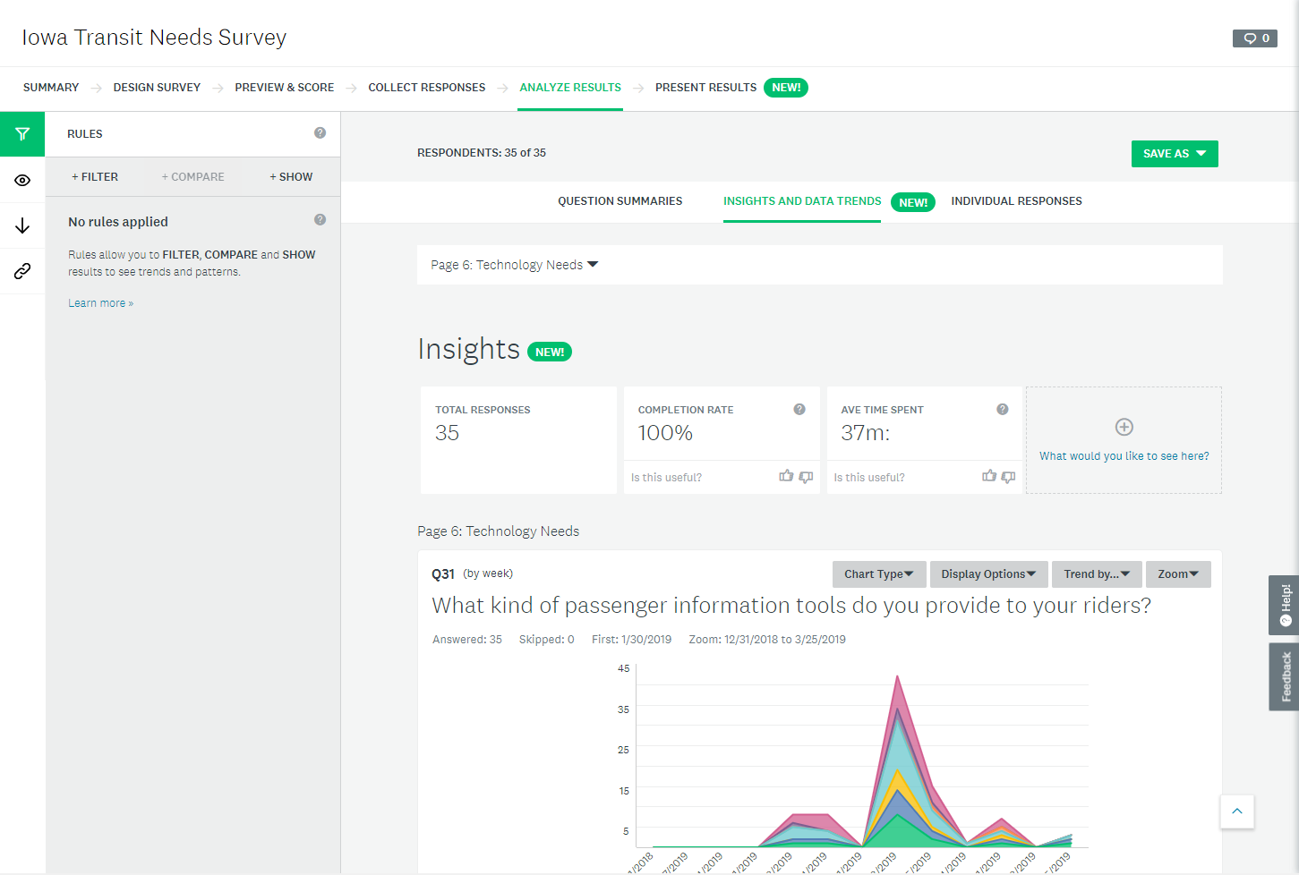
Needs Survey
Iowa Public Transit Long Range Plan
Iowa Transit Needs Survey
Opened 1 February 2019 – closed 29 March 2019 via Survey Monkey
100% of transit agencies (35 of 35) responded
The purpose of this survey was to identify gaps or needs in the public transit services throughout the state. These needs were then analyzed and incorporated into the Iowa DOT’s Public Transit Plan.
Divided into 6 sections
Section 1: Agency Information
Section 2: Service Needs
Section 3: Fleet Needs
Section 4: Facility Needs
Section 5: Personnel Needs
Section 6: Technology Needs

Slide 6
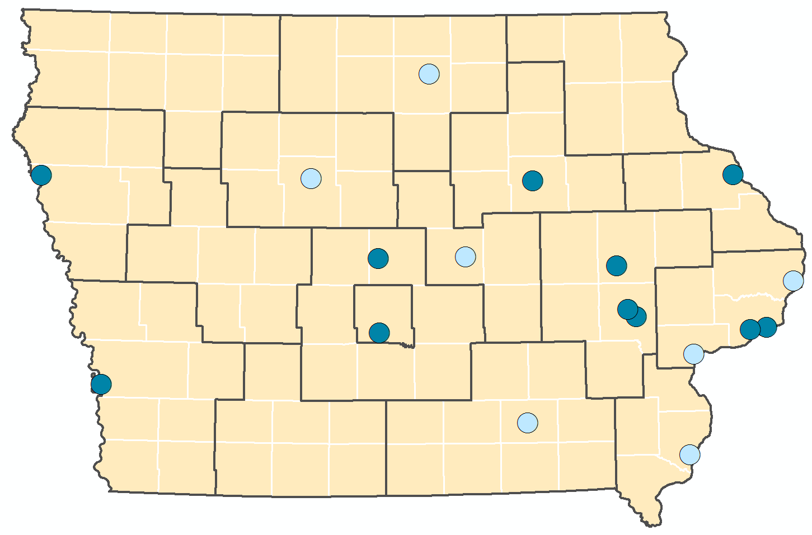
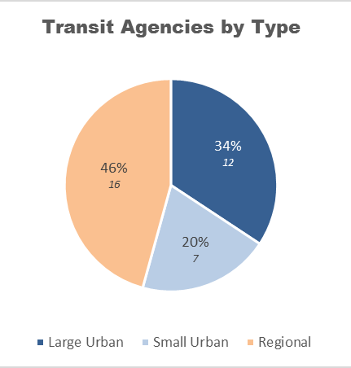
Survey Results
Iowa Public Transit Long Range Plan
Mason City
Sioux City
Waterloo
Dubuque
Fort Dodge
Marshalltown
Cedar Rapids
Ames
Clinton
Coralville
Bettendorf
Iowa City
Davenport
Council Bluffs
Des Moines
Muscatine
Large Urban: greater than 50,000 population
Small Urban: 20,000 - 49,999 population
Regional: Rural areas outside Urban
Ottumwa
Burlington

Slide 7
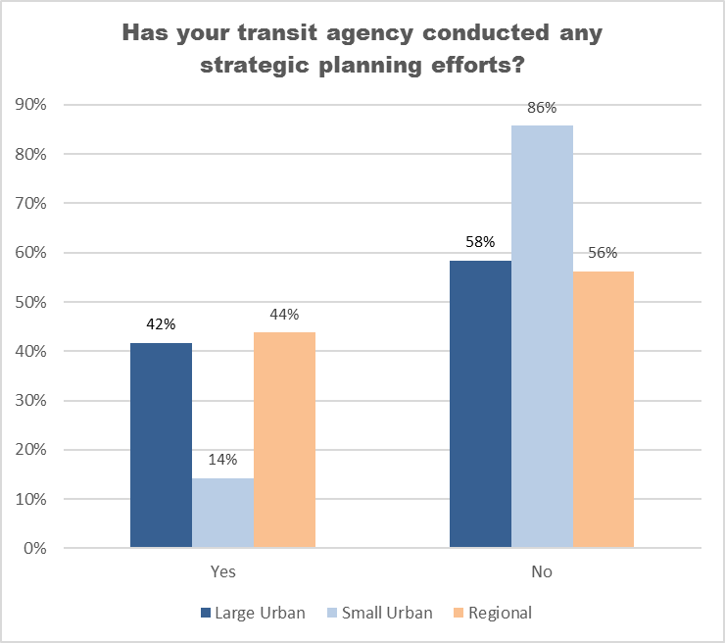
Survey Results – Agency Info
Iowa Public Transit Long Range Plan
Notes:
Lack of strategic plans necessitates a broader state strategic approach

Slide 8
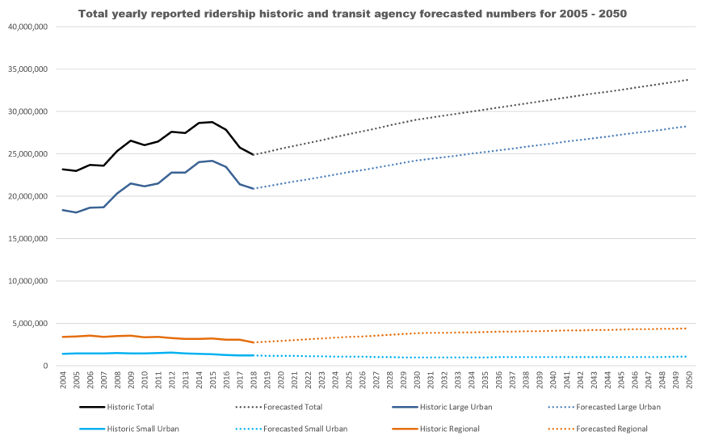
Survey Results – Service Needs
Iowa Public Transit Long Range Plan
Notes:
Uber/Lyft/Medicaid rides causing the decrease
Many agencies investigating new ways to meet needs, innovate, efforts to attract new riders/impact ridership

Slide 9
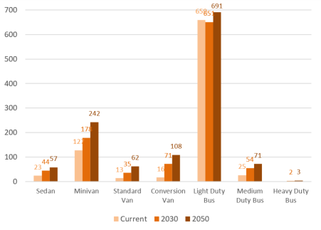
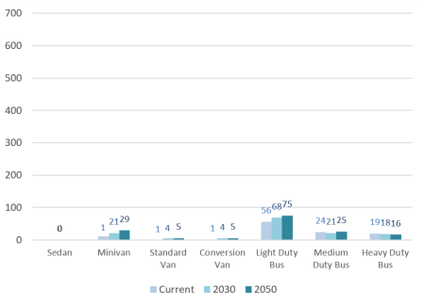
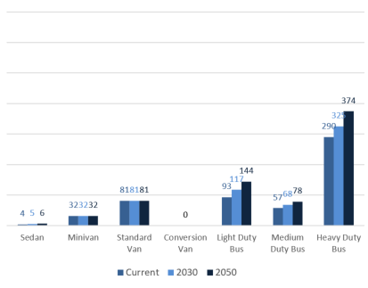
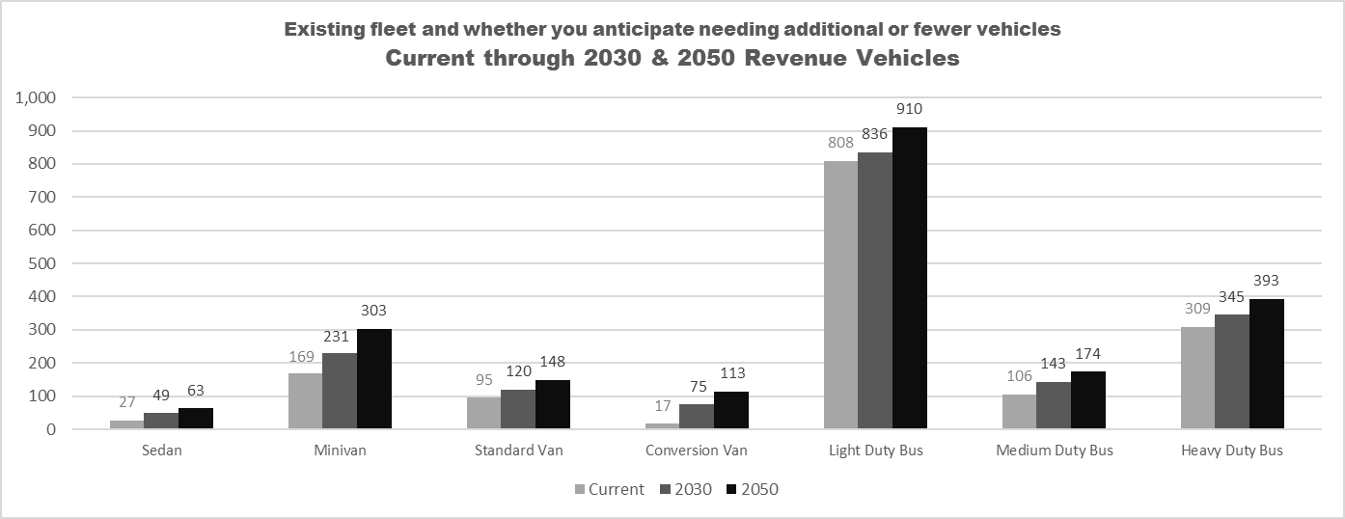
Survey Results – Fleet Needs
Iowa Public Transit Long Range Plan
Regional
Small Urban
Large Urban
Notes:
Tie in the commission is likely already familiar with this, because they are involved in bus grants/public transportation funding each year

Slide 10
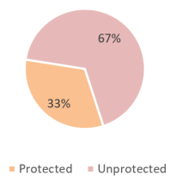
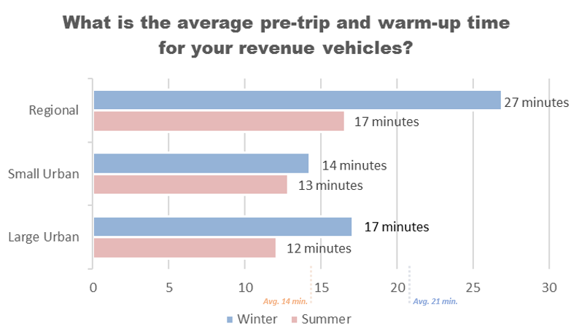
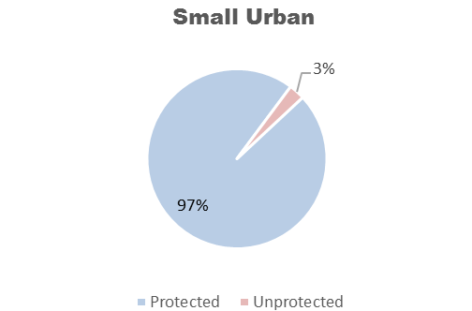
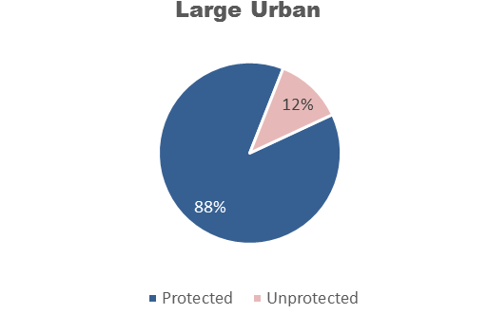
Survey Results – Facility Needs
Iowa Public Transit Long Range Plan

Slide 11
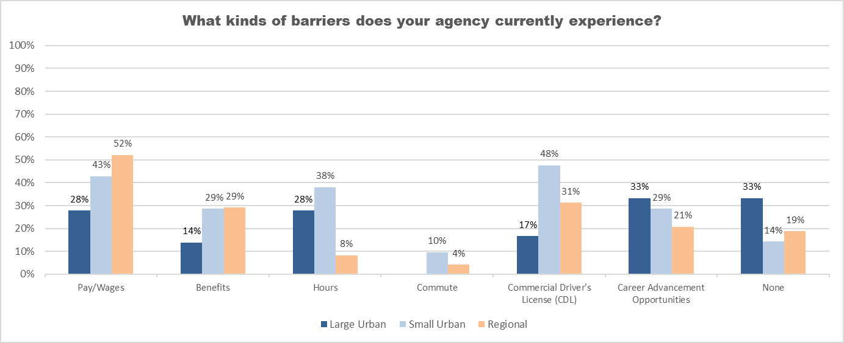
Survey Results – Personnel Needs
Iowa Public Transit Long Range Plan

Slide 12
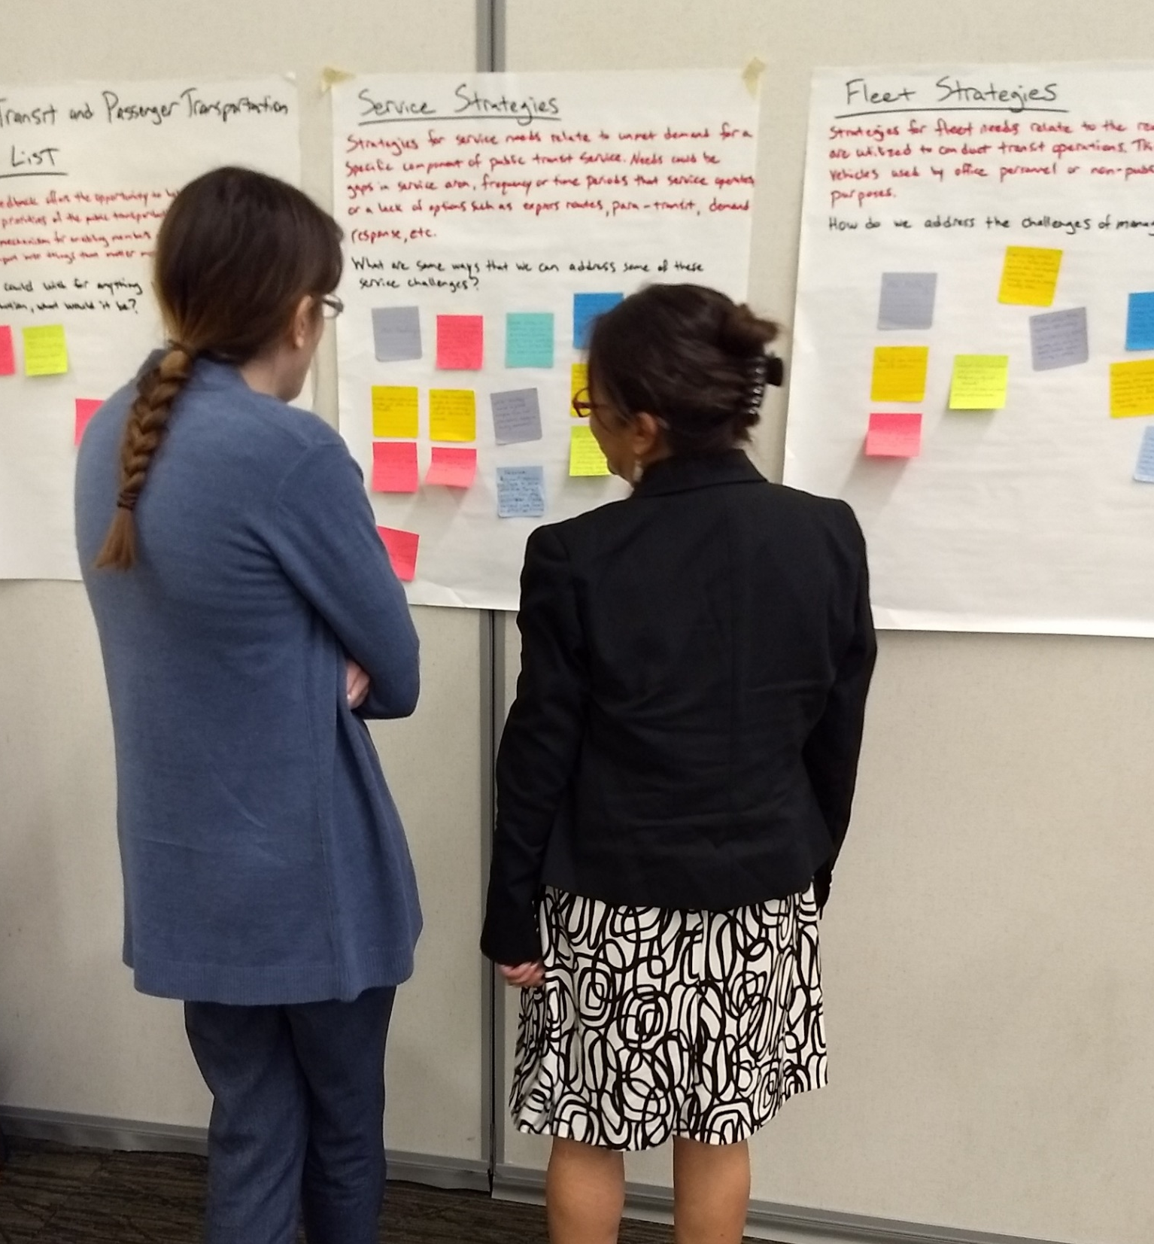
Brainstorm Exercise
Iowa Public Transit Long Range Plan
Early start to develop strategies
(April 2019) Iowa Public Transit Association meeting
(May 2019) Passenger Transportation Summit
Used post-it’s to write down ideas
Stick the post-it under one of the needs areas
Needs Areas: Service, Fleet, Facility, Personnel, Technology, Wish List
Derived from the refined strategies
A broad vision statement that captures the overall vision for Iowa’s future public transit system:
A public transit system that supports the physical, social, and economic wellbeing of Iowans, provides enhanced mobility and travel choices, and accommodates the unique needs of dependent and choice riders through rightsized solutions
Overarching goal areas within which actions will be defined to implement the system vision:
Service
Partnering
Facility, Fleet, and Personnel
Funding
An action plan that defines how the vision will be implemented through specific strategies/actions.

Slide 13
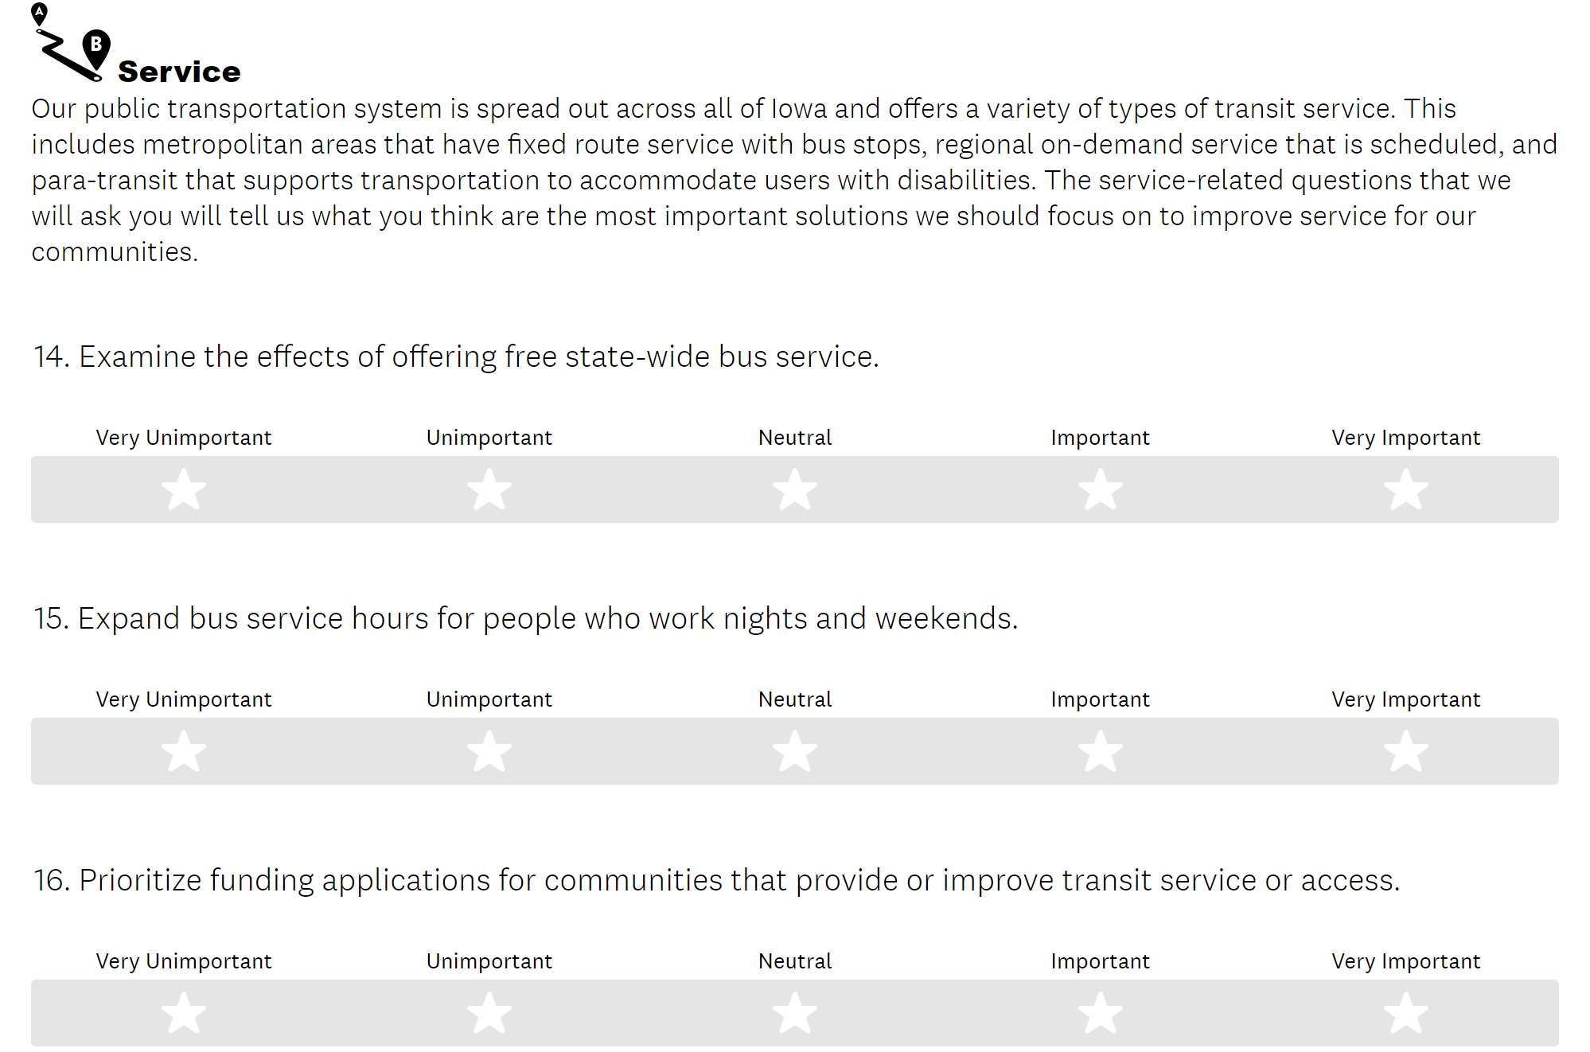
Public Survey
Iowa Public Transit Long Range Plan
Website
(October 2019) Host information on the planning effort. Launch point for the public survey.
https://iowadot.gov/iowainmotion/Modal-Plans/Public-Transit-Plan
Digital, Hardcopy, English, Spanish

Slide 14
Beyond the Public Survey
Iowa Public Transit Long Range Plan
Stakeholders
External Stakeholder Meeting to discuss the public survey results, transit dependency factor analysis, funding analysis.
Internal Stakeholder Meeting with select Iowa DOT staff.
Analysis
Analysis of transit factors based on a study by the Mineta Transportation Institute.
Analysis of historic and forecasted expenses and revenue in order to determine shortfalls. Using feedback from survey in March to help forecast personnel, facility, vehicle needs out to 2050.
External Stakeholder Membership
Cedar Rapids Transit
Marshalltown Transit
Southwest Iowa Transit Agency (SWITA)
AARP
American Cancer Society
University Centers for Excellence in Developmental Disabilities (UCEDD)
Veteran’s Affairs
Iowa State University – Extension & Outreach
Iowa Department of Public Health
Internal Stakeholder Membership
Aviation
Rail Transportation
Location & Environment
Driver & Identification Services
District Planner
Notes:
San José State University (SJSU): https://transweb.sjsu.edu/research/investigating-determining-factors-transit-travel-demand-bus-mode-us-metropolitan
Transportation Research Board (TRB): https://apps.trb.org/cmsfeed/TRBNetProjectDisplay.asp?ProjectID=3622
(October) Consolidated analysis weighting feedback from Transit Agencies. 15 total responses; same ratio of large : small : regional.

Slide 15
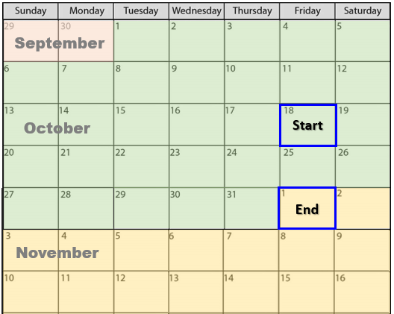
Survey Timeline
Iowa Public Transit Long Range Plan
Responses
578 responses collected via Survey Monkey
+ 5 responses collected via hardcopy
583 total
Notes:
Survey Monkey: https://www.surveymonkey.com/r/BHVH2J6
Webpage: https://iowadot.gov/iowainmotion/Modal-Plans/Public-Transit-Plan

Slide 16
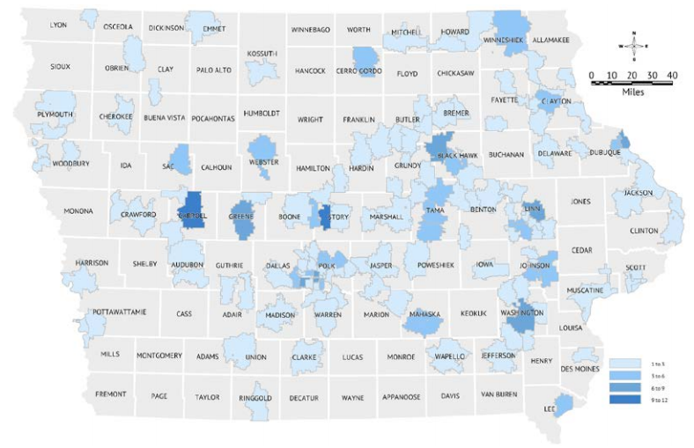
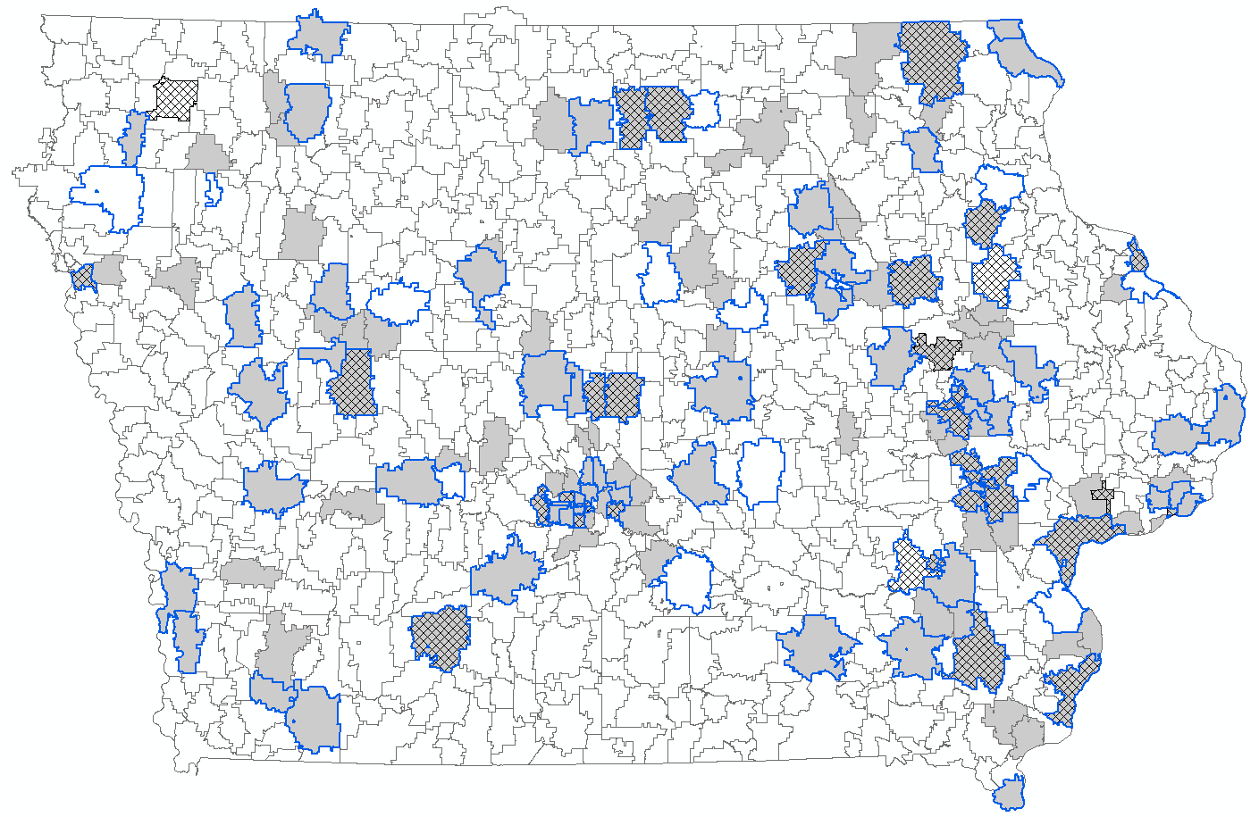
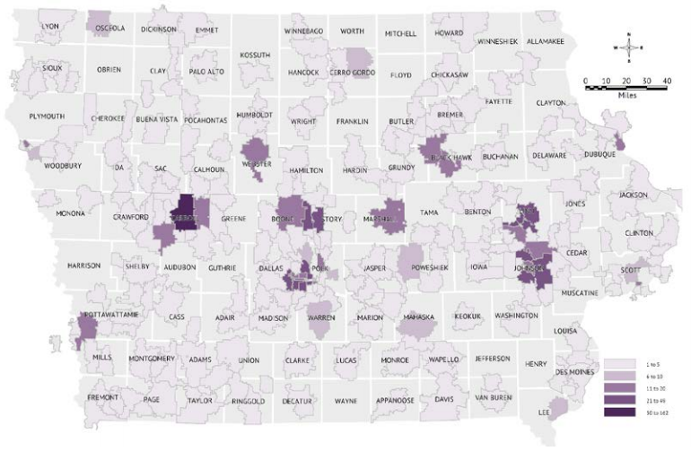
Survey Results – Distribution
Iowa Public Transit Long Range Plan
2016 Long Range Plan Survey
February 2016
2019 Public Transit Survey
2016 Long Range Plan Survey
September 2016
Work
School
Home
Notes:
How often do you use public transit?
21.15% - I’m a regular transit rider (1-5 times per week)
28.49% - occasional (few times per month or year)
50.36% - never ride

Slide 17
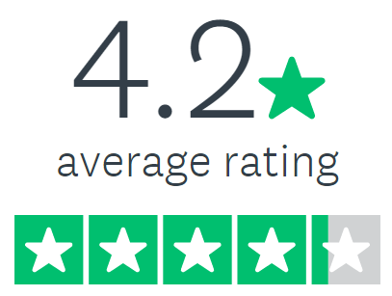
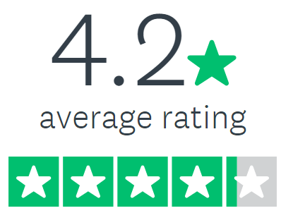
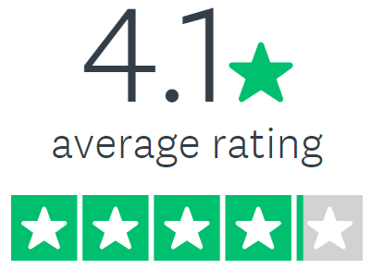
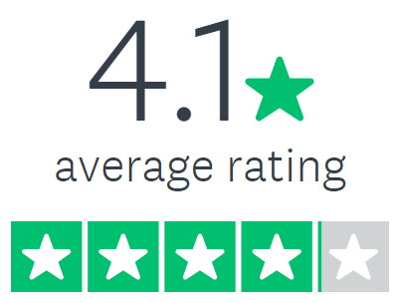
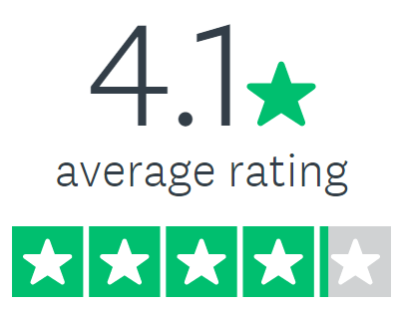
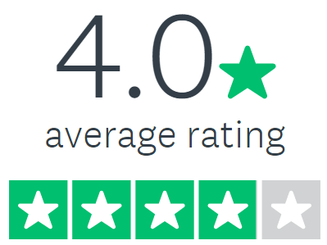
Survey Results – Strategies
Iowa Public Transit Long Range Plan
Highest Priority Strategies | Score
Expand bus service hours for people who work nights and weekends.
Improve accessibility of all transit information, service notifications, and bus route information to ensure they are easy to understand for older adults, multilingual riders, and riders with audio, visual, or cognitive impairments.
Improve workforce development by partnering with businesses to help employees get to work.
Partner with non-profit organization (such as American Cancer Society, Veteran’s Affairs, and hospitals) to help people get to their medical appointments on time.
Improve sidewalks and connecting infrastructure by working with state agencies, local government, and private organizations to improve access to bus stops and transit services.
Work with businesses to create transportation options for their employees by offering subsides, bus passes, or incentives such as tax breaks.
Prioritize funding applications for communities that provide or improve transit service or access.
Continue existing services and establish new inter-regional services along commuter routes (such as Interstate 380 between Cedar Rapids and Iowa City, Interstate 35 between Ames and Des Moines, and Interstate 74 between Davenport and Illinois).
Enable all buses and transit agencies in the state to accept digital fares or electronic payment formats, while still allowing for cash payments.
Decrease maintenance costs by focusing resources on replacing transit vehicles that are beyond their useful life.
Notes:
VRU AS A SAFETY STRATEGY, INCORPORATE WITH STRATEGY #29
FUTURE READY IOWA – incorporate term

Slide 18
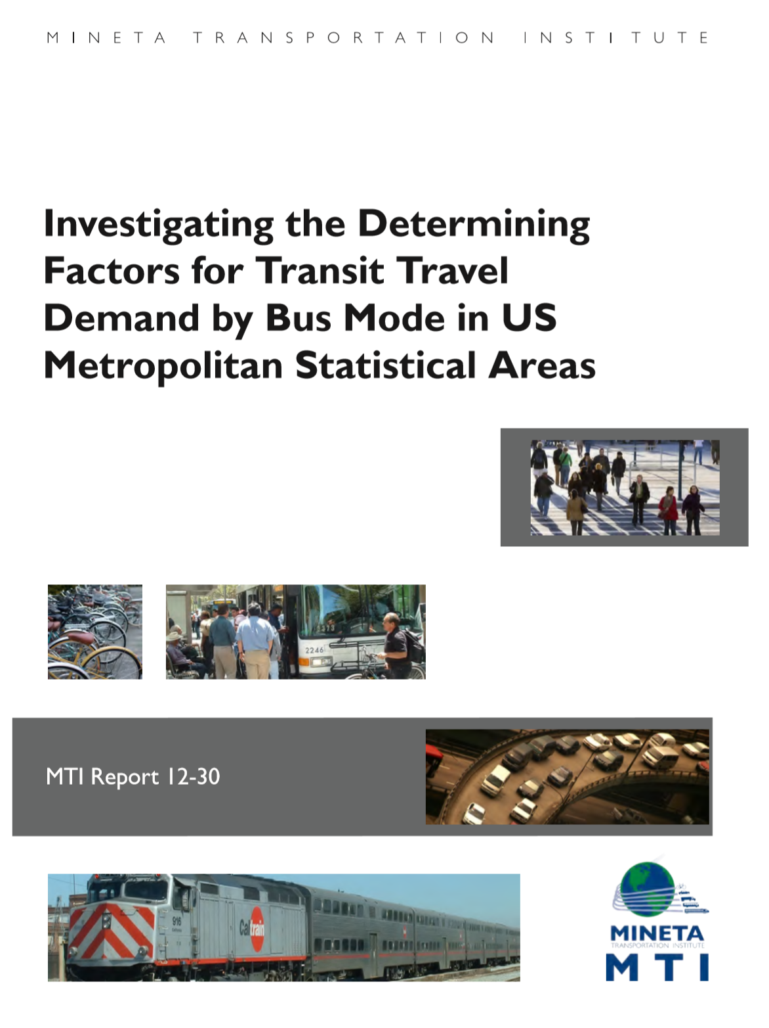
Transit Dependency Analysis
Iowa Public Transit Long Range Plan
Goals
Measure transit ‘need’
Where are there gaps in the system?
Mineta Transportation Institute
“Investigating the Determining Factors for Transit Travel Demand by Bus Mode in US Metropolitan Statistical Areas”, San José State University, May 2015
Attempt to determine general conclusions to provide policy recommendations regarding public transit.
Go beyond specific studies on the uniqueness of a single or a few transit systems.
Transit Agency Feedback
Consolidated analysis weighting feedback from Transit Agencies. 15 total responses; same ratio of large : small : regional.
San José State University (SJSU): https://transweb.sjsu.edu/research/investigating-determining-factors-transit-travel-demand-bus-mode-us-metropolitan
Transit Dependency Analysis Factors
Gas Prices
Household Income
Carless Households
Language
Race
Enrolled in College
Population Density
Notes:
Removed]
Rail Transit
Too limited in Iowa. Mostly a single line that runs east-west in southern Iowa.
Vehicles per Household
Similar to Percent of Carless Households
Metro Sprawling Index, MSAs in the South
Wanted to look at urban and rural areas
Sprawl not relevant
MSA boundaries not relevant
Midwest, not the South
[Changed]
Percent of African American Population
Broadened to be all non-white population
Percent of Immigrant Population
Initially used foreign-born, then settled on non-English speaking

Slide 19
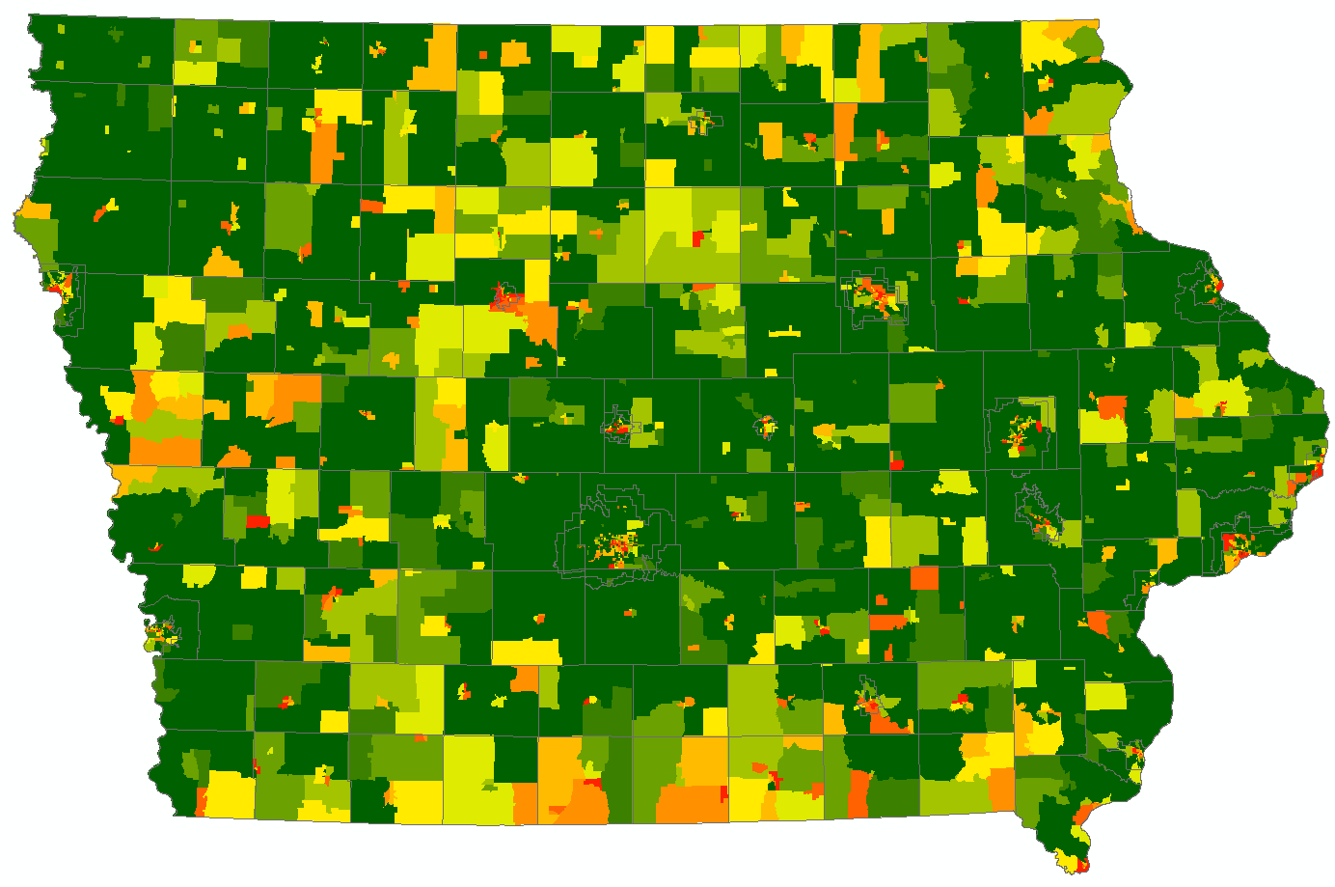
Example Factor – Median Household Income
Iowa Public Transit Long Range Plan
Mason City
Le Mars
Sioux City
Waterloo
Dubuque
Fort Dodge
Ames
Marshalltown
Cedar Rapids
Clinton
Iowa City
Des Moines
Davenport
More Transit Dependent
Muscatine
Council Bluffs
Ottumwa
Shenandoah
Fort Madison
Less Transit Dependent

Slide 20
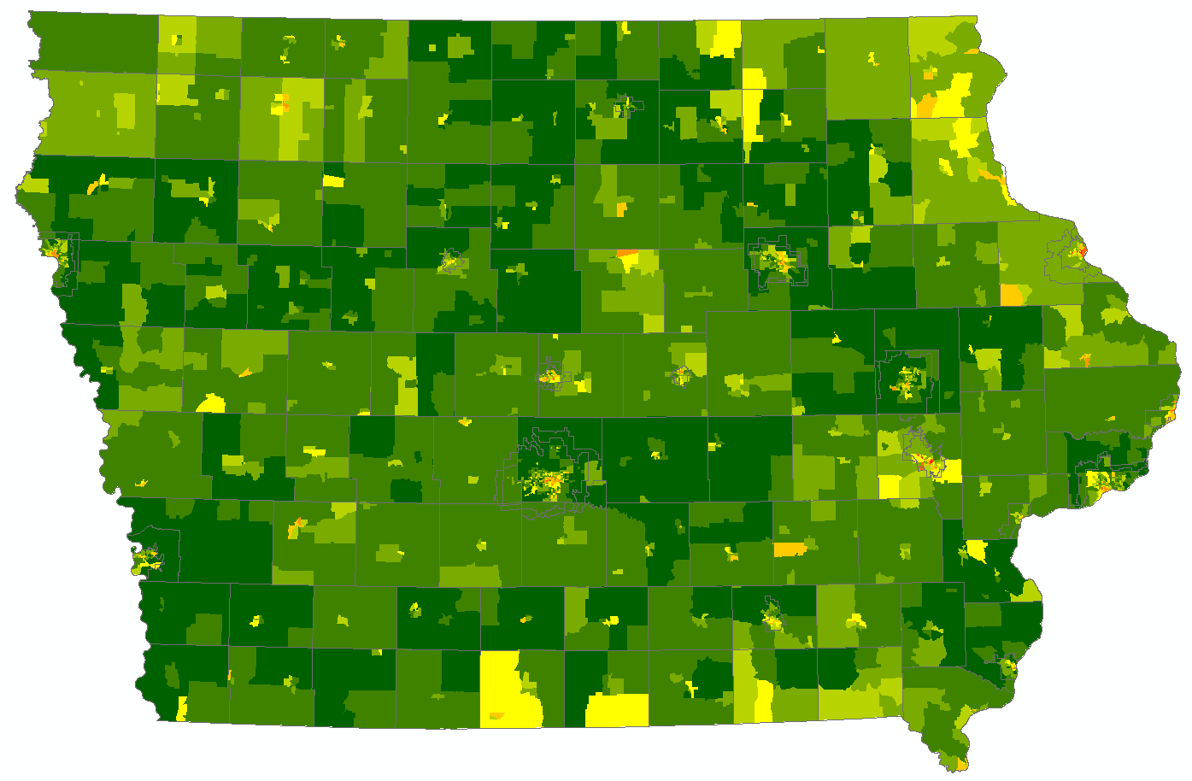
Example Overall Composite
Iowa Public Transit Long Range Plan
Mason City
Le Mars
Sioux City
Waterloo
Dubuque
Fort Dodge
Ames
Marshalltown
Cedar Rapids
Clinton
Iowa City
Des Moines
Davenport
More Transit Dependent
Muscatine
Council Bluffs
Ottumwa
Shenandoah
Fort Madison
Less Transit Dependent

Slide 21
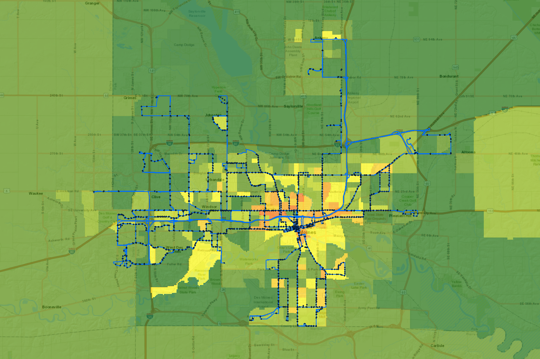
Example Application of Overall Composite
Iowa Public Transit Long Range Plan
More Transit Dependent
Less Transit Dependent
Notes:
Des Moines area with GTFS stops and routes overlaid on top of the Weighted Regional (All) Average

Slide 22
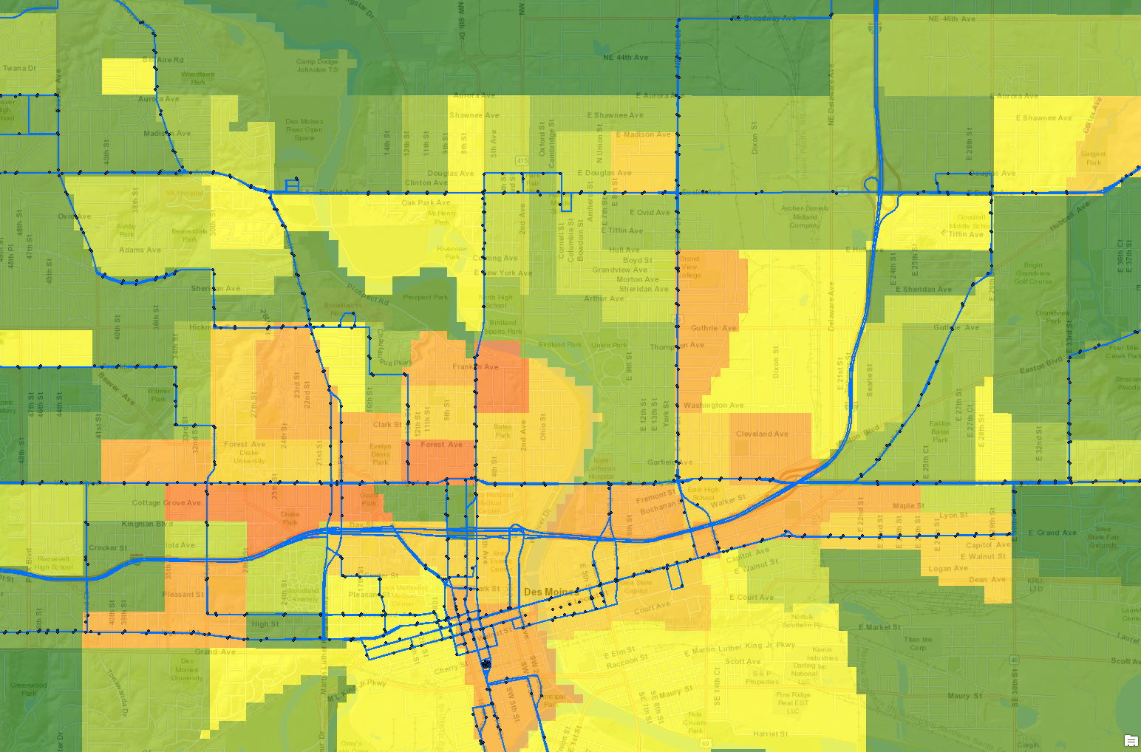
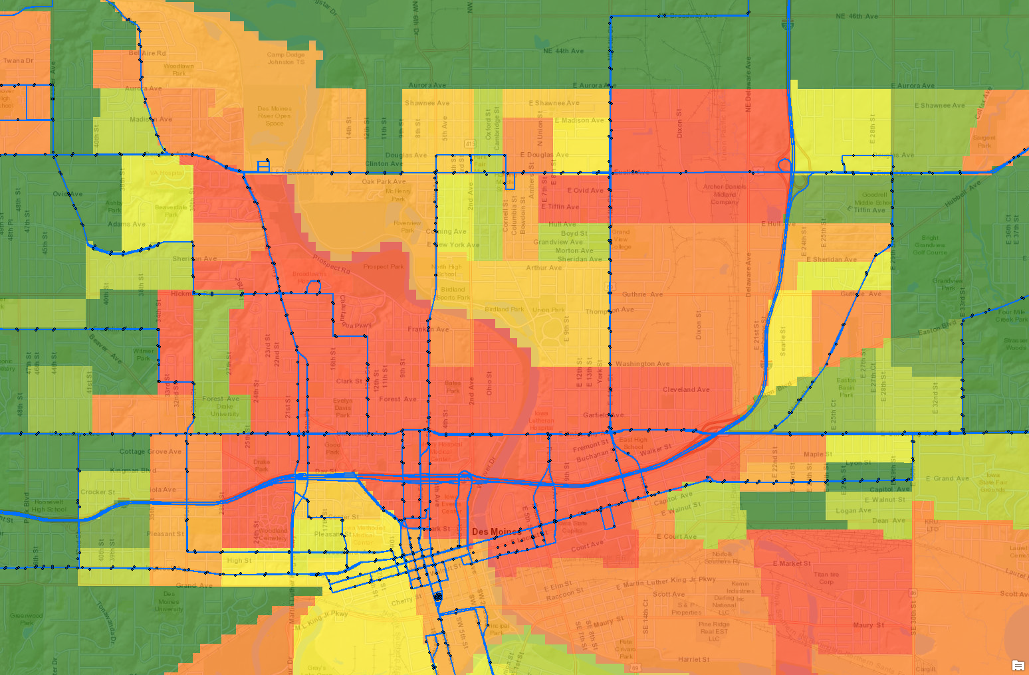
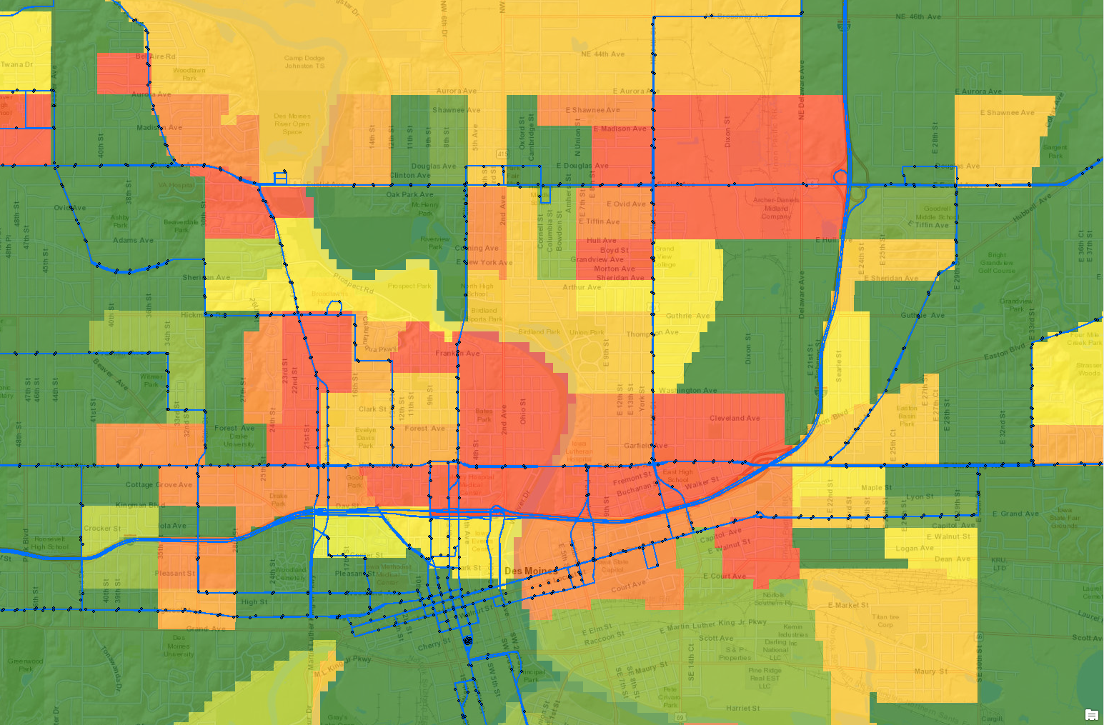
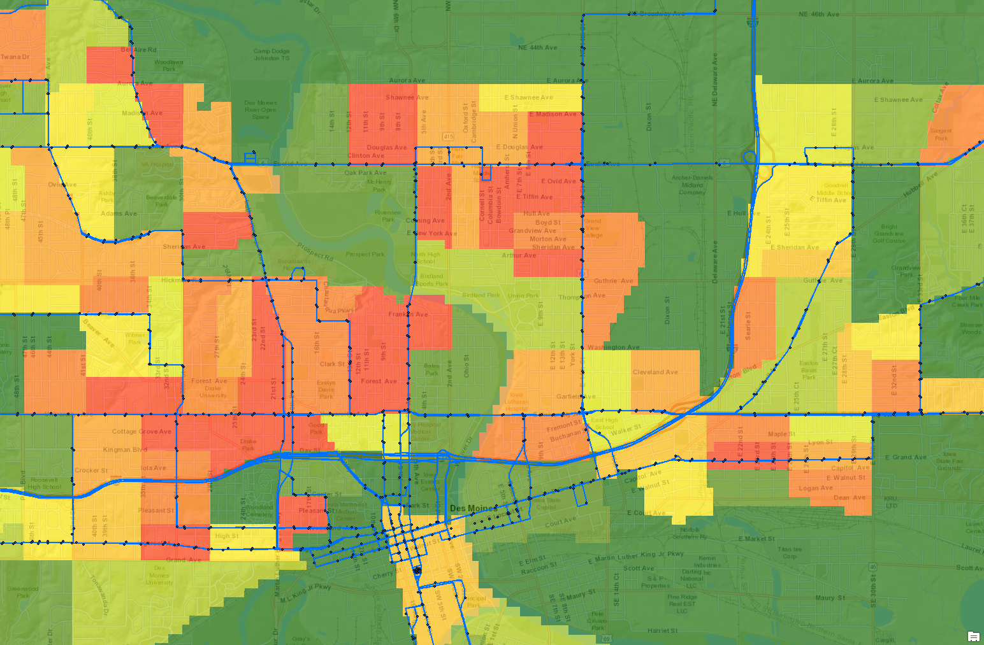
Example Application of Overall Composite
Iowa Public Transit Long Range Plan
Non-Weighted Factors
Race
Language
More Transit Dependent
Population Density
Less Transit Dependent
Notes:
Des Moines area with GTFS stops and routes overlaid on top of the Weighted Regional (All) Average
Zoomed-in to downtown Des Moines
Highlighted a few specific, individual non-weighted external factors i.e. Race, Language, Population, Density
To show how the same areas differ based on those criteria
The overall weighted results sometimes don’t tell the whole story about what those neighborhoods look like
These specific factors could be considerations to focus certain strategies

Slide 23
Roadmap
Iowa Public Transit Long Range Plan
2019
2020
March
October
Spring
Analyze Data
Survey Results
Transit Dependency
Funding and Cost Trends
Brainstorm Ideas
IPTA Legislative Conference
Passenger Transportation Summit
2018
December
2020
July
Identify Issues
Transit Needs Survey
Service
Fleet
Facility
Personnel
Technology
Get Feedback
Stakeholder Meeting
Transit Plan Website
Public Survey
Develop Content
Draft chapters
Introduction
Iowa’s Transit Context
Needs and Strategies
Financing
Implementation and Evaluation
May
November
Notes:
SLIDE OR VERBALIZE – INITIATING PUBLIC COMMENT PERIOD/SOMETIME IN MAY/COMEBACK TO COMMISSION IN JULY TO SHARE RESULTS

Slide 24
THANK YOU
Questions
Iowa Public Transit Long Range Plan
FOR YOUR ATTENTION
What are your questions?

