Slide 1
Corridor Preservation
I-380 from North Liberty to Cedar Rapids
I-80 from US 169 to Grand Prairie Parkway
Transportation Commission Workshop
March 9, 2021

Slide 2
What is a corridor preservation?
Corridor preservation is not a legal encumbrance on the property or an exercise of eminent domain, but is instead a right of notice.
Corridor preservation avoids inconsistent development of property needed for highway right-of-way, by allowing us to receive notice of intended development of property within the proposed right-of-way and giving us the opportunity to take action to acquire it before the development occurs.

Slide 3
Legal authority for corridor preservation
The legal authority for corridor preservation comes from section 306.19(5) of the Iowa Code, which authorizes the Iowa DOT to “notify a city or county that a road under the jurisdiction or control of the department will be established, improved, relocated, or maintained and that the department may need to acquire additional right-of-way or property rights within an area described by the department.”

Slide 4
Iowa DOT process for Commission approval
We present the proposed CPZ to the Commission at a monthly workshop for initial guidance. Initial guidance is not formal action or approval, but only the opportunity to informally determine whether the Commission has interest in considering the use of CPZ for the project.
If the Commission’s initial guidance shows interest in considering the use of CPZ, we will mail an initial written notice to the affected city or county and property owners. The initial written notice is not an exercise of preservation of authority under section 306.19(5), but only notice that the Commission will consider the proposed CPZ at a workshop at least 60 days after the date the written notice was issued.

Slide 5
Iowa DOT process for Commission approval (cont.)
Affected cities or counties and property owners are given the opportunity to comment. The initial notice includes instructions for obtaining information and submitting or presenting comments to the Commission.
After expiration of the 60 day comment period, we present the proposed CPZ to the Commission at the appointed monthly workshop. The presentation would include any comments or information submitted or presented by the affected city or county and property owners.

Slide 6
Iowa DOT process for Commission approval (cont.)
The proposed CPZ is presented to the Commission for formal action at the next monthly business meeting. Any personal presentation or comments by affected cities, counties, or property owners would typically occur as part of the business meeting.
If approved, we follow the usual and required process for formal notice established by section 306.19(5), which includes written notice to the affected city or county and published notice in the newspaper. We will also continue with blog notices in conjunction with the published notice, and in addition will send a final notice to affected property owners.

Slide 7
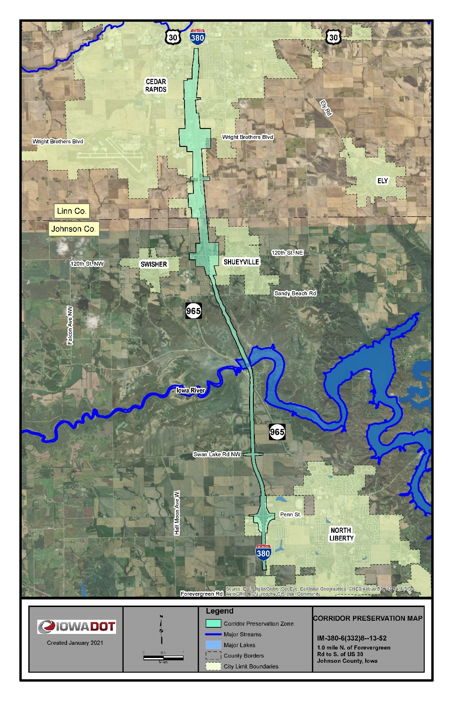
New I-380 CPZ
Approximately 12 miles long
Includes three interchanges
Expected future growth in traffic and housing/commercial development
Expansion to 6 lanes
Improve mobility, safety, and efficiency

Slide 8
Next Steps (I-380 Johnson/Linn):
Seek initial guidance from Commission for new I-380 Corridor Preservation Zone (CPZ)
Mail an initial written notice to the affected city or county and property owners
Affected cities or counties and property owners are given the opportunity to comment
After expiration of the 60 day comment period, we present the proposed CPZ to the Commission at the June monthly workshop
The proposed CPZ is presented to the Commission for formal action at the next monthly business meeting (July)
We send a final notice to affected property owners

Slide 9
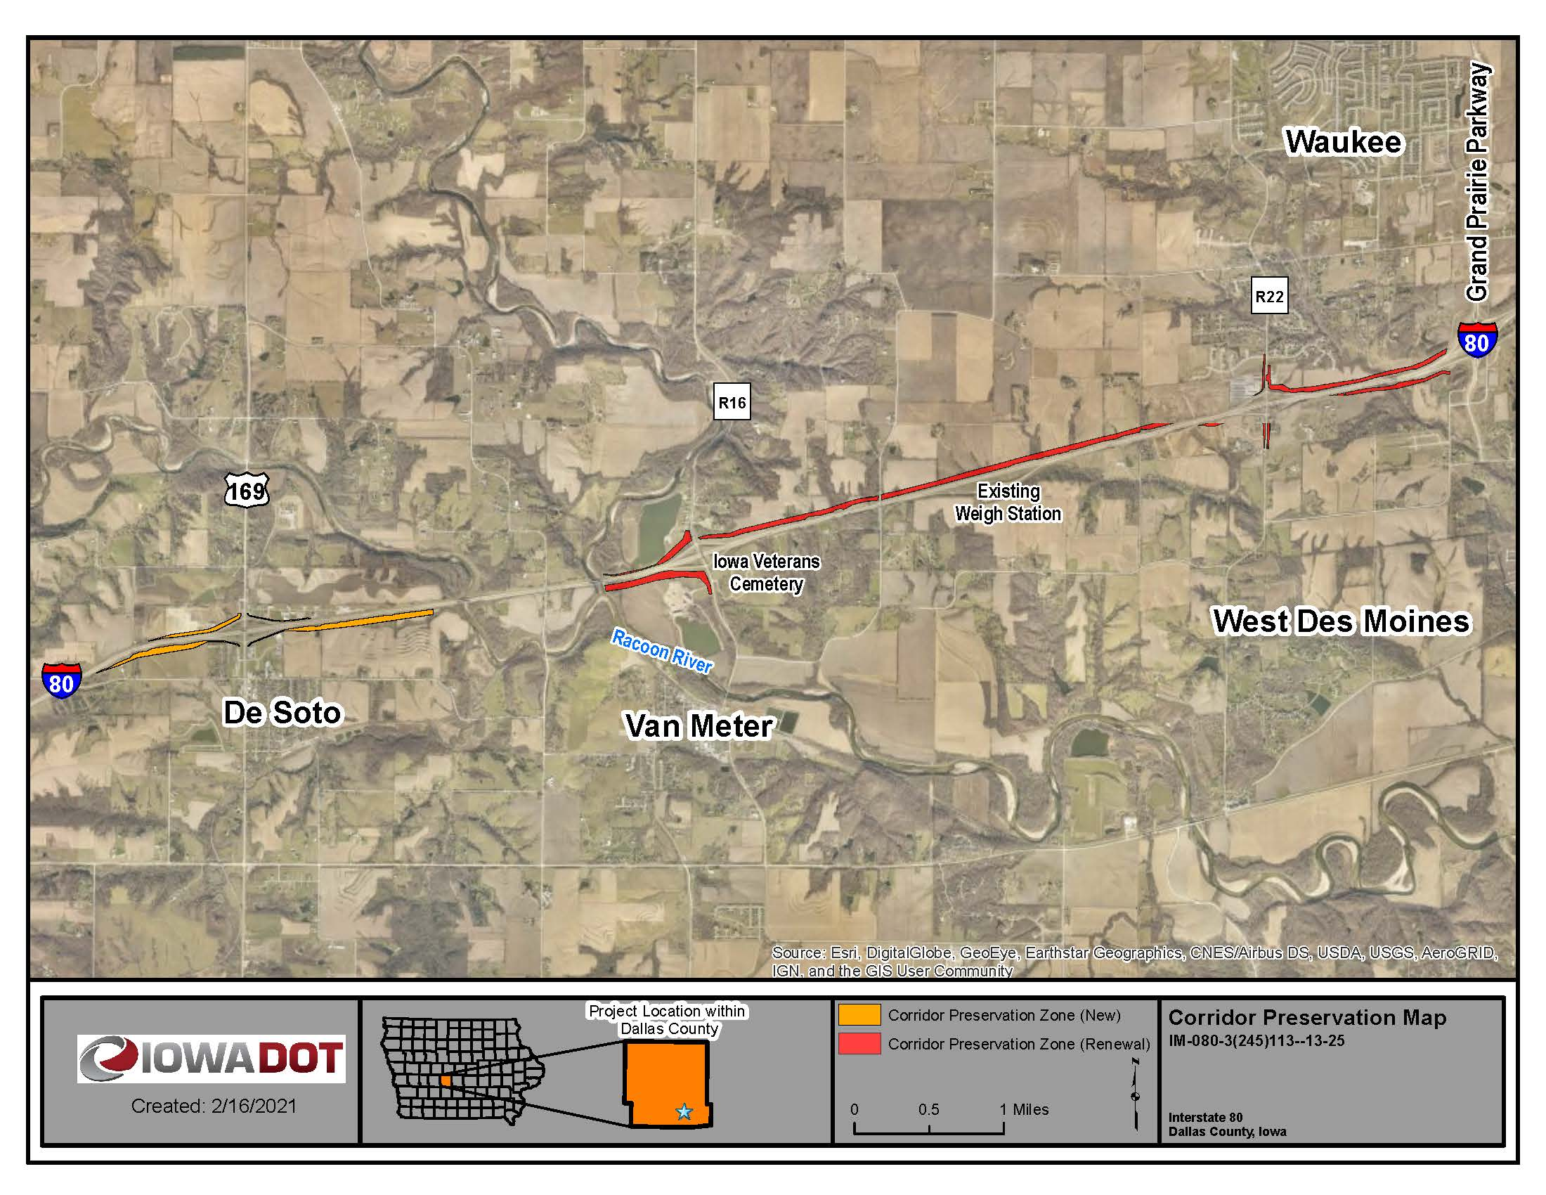
CPZ Renewal for I-80 in Dallas County

Slide 10
Next Steps (I-80 Dallas Co):
Seek renewal approval of existing CPZ area at the next monthly business meeting (April)
Request initial guidance for additional CPZ area (near De Soto)
Mail an initial written notice to the affected city or county and property owners
Affected cities or counties and property owners are given the opportunity to comment
After expiration of the 60 day comment period, we present the proposed CPZ to the Commission at the June monthly workshop
The proposed CPZ is presented to the Commission for formal action at the next monthly business meeting (July)
We send a final notice to affected property owners

Slide 11
Thank You

