Slide 1
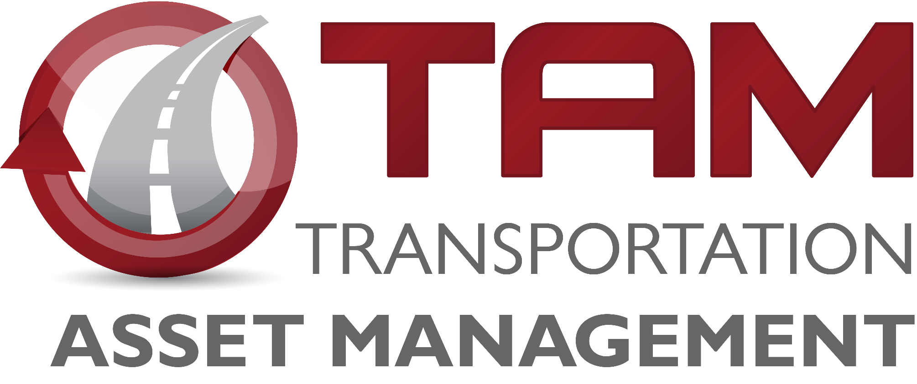
Transportation Commission Workshop
March 9, 2021
Matt Haubrich
Strategic Performance Division

Slide 2
Transportation Asset Management

Slide 3
Information to Inform Decisions
Nov-2020 – Integrated Corridor Management (ICM) study update
Dec-2020 – Interstate Plan and Prioritization Weighting
Jan-2021 – Bridge Management
Feb-2021 – Pavement Management
Mar-2021 – Program Trade-off Analysis
May-2021 – Draft Program Asset Management Summary

Slide 4
Program Trade-off Analysis

Slide 5
Cost Comparisons for Investment Options
$10M investment results in:
Not quite 1 mile of new expressway
4+ miles of 2-lane pavement reconstruction
21+ miles of pavement resurfacing
3+ bridge replacements
Notes:
Using average costs from the 2021 Office of Design “Transportation Construction Costs” fact sheet., Scott Neubauer gave bridge estimates (replacement = $3M each).

Slide 6
Program Summary
Table below adapted from program development materials presented in previous Commission workshops
Key assumptions:
Flat revenue in outer years
Interstate investment will be funded at approximately $330M per year
Program targets for future years will be adopted by future Commission action
Year | 2022 | 2023 | 2024 | 2025 | 2026 | 2027 | 2028 | 2029 | 2030 | 2031
Revenue (forecast from March 2020) | 675 | 701 | 694 | 686 | 686 | 686 | 686 | 686 | 686 | 686
Non-Interstate Pavement Modernization (3R) | 115 | 140 | 145 | 150 | 155 | 165 | 175 | 185 | 190 | 195
Non-Interstate Bridge Modernization (BR) | 65 | 101 | 110 | 126 | 140 | 155 | 170 | 185 | 190 | 195
Safety Specific (SR) | 25 | 25 | 25 | 25 | 25 | 25 | 25 | 25 | 25 | 25
Non-Interstate Stewardship | 205 | 266 | 280 | 301 | 320 | 345 | 370 | 395 | 405 | 415
Interstate Stewardship (4R) | 182 | 146 | 153 | 177 | 170 | 175 | 180 | 185 | 190 | 195
Major Interstate (MI) | 201 | 112 | 69 | 125 | 69 | 145 | 150 | 145 | 140 | 135
Interstate Programs | 383 | 258 | 222 | 302 | 239 | 330 | 330 | 330 | 330 | 330
Non-Interstate Capacity/Enhancement (NR) | 138 | 227 | 218 | 102 | 93 | 27 | 52 | 50 | 50 | 50
Total Expenditures | 726 | 751 | 720 | 705 | 652 | 702 | 752 | 775 | 785 | 795
Net | (51) | (50) | (26) | (19) | 34 | (16) | (66) | (89) | (99) | (109)
Notes:
Make sure to mention the assumptions

Slide 7
Stewardship Funding Summary
Notes:
Only difference is the Non-Interstate Stewardship

Slide 8
Stewardship Performance Comparison
Notes:
Removed the 75% scenario that we showed last year.

Slide 9
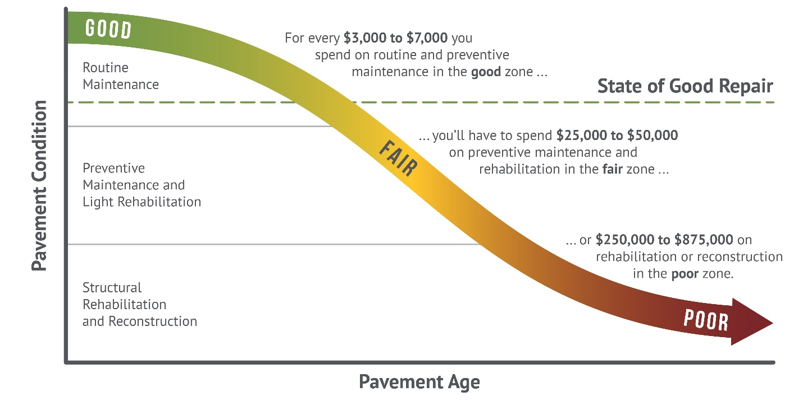
How We Set Targets
Good roads cost less. If we maintain assets in good condition, we can minimize their lifecycle cost. In the long run, this allows us to invest in other priorities.
Notes:
This graphic came from the Pavement LCP report done by HDR and APTech. It’s an update of the old Byron Shire Council graphic that we had been using.

Slide 10
Summary
From previous presentations:
We have a “wave” of bridges built in the 1960s and 1970s that are all getting to the point where major rehab or replacement is needed
At current replacement rates, we’re implicitly expecting pavements to last 120 years (40-year design life)
Significant deterioration of pavements and bridges is forecast to occur without steady growth in stewardship spending.

Slide 11
Recommendations
Target steady growth in overall stewardship spending in order to maintain a state of good repair across the primary highway system
Limit future capacity expansion to locations with forecast congestion that cannot be addressed effectively through operational improvements.
Notes:
Consistent with SLRTP – focus on stewardship and modernizing the system

