Slide 1
COVID-19 Transportation Funding Impact and
COVID Relief Funding Recommendation
Transportation Commission Workshop
March 9, 2021

Slide 2
Update
Economic Recovery Index
Travel trends
  US total rail carloads
  Commercial air service passenger counts
  Vehicular traffic
  Vehicle sales
Funding
  State Road Use Tax Fund
  Federal funding update
  COVID-19 Relief Allocation Recommendation and Comments

Slide 3
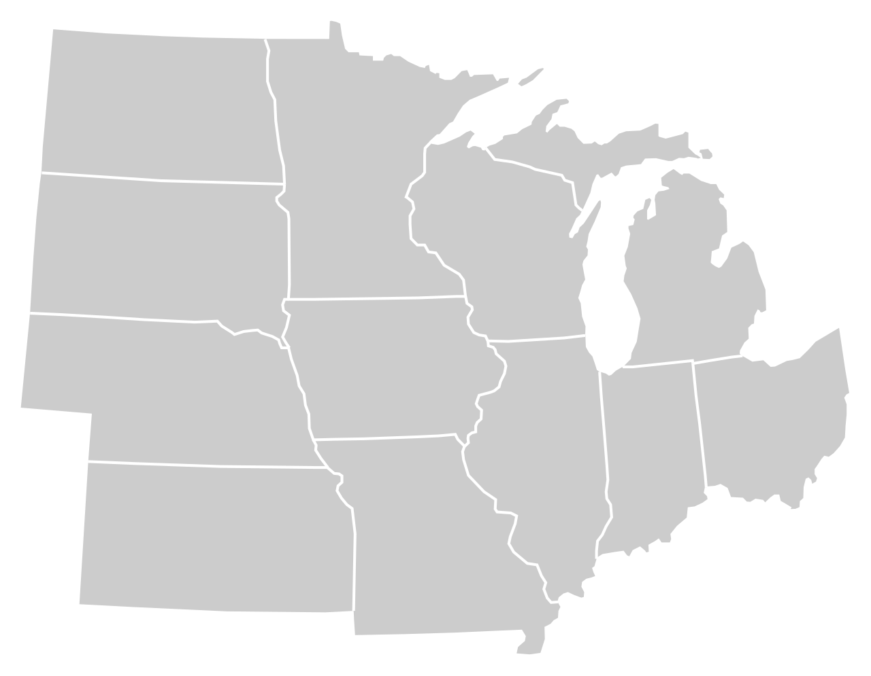
Moody’s/CNN Recovery Index - Midwest
(Pre-Pandemic = 100) As of 3/5/2021
82%
78%
92%
84%
82%
86%
(88% last month)
86%
83%
76%
85%
88%
84%
Nation is at 83% (82% last month)

Slide 5
Monthly Passenger Counts at Iowa’s Eight Commercial Service Airports
(through January 2021)

Slide 6
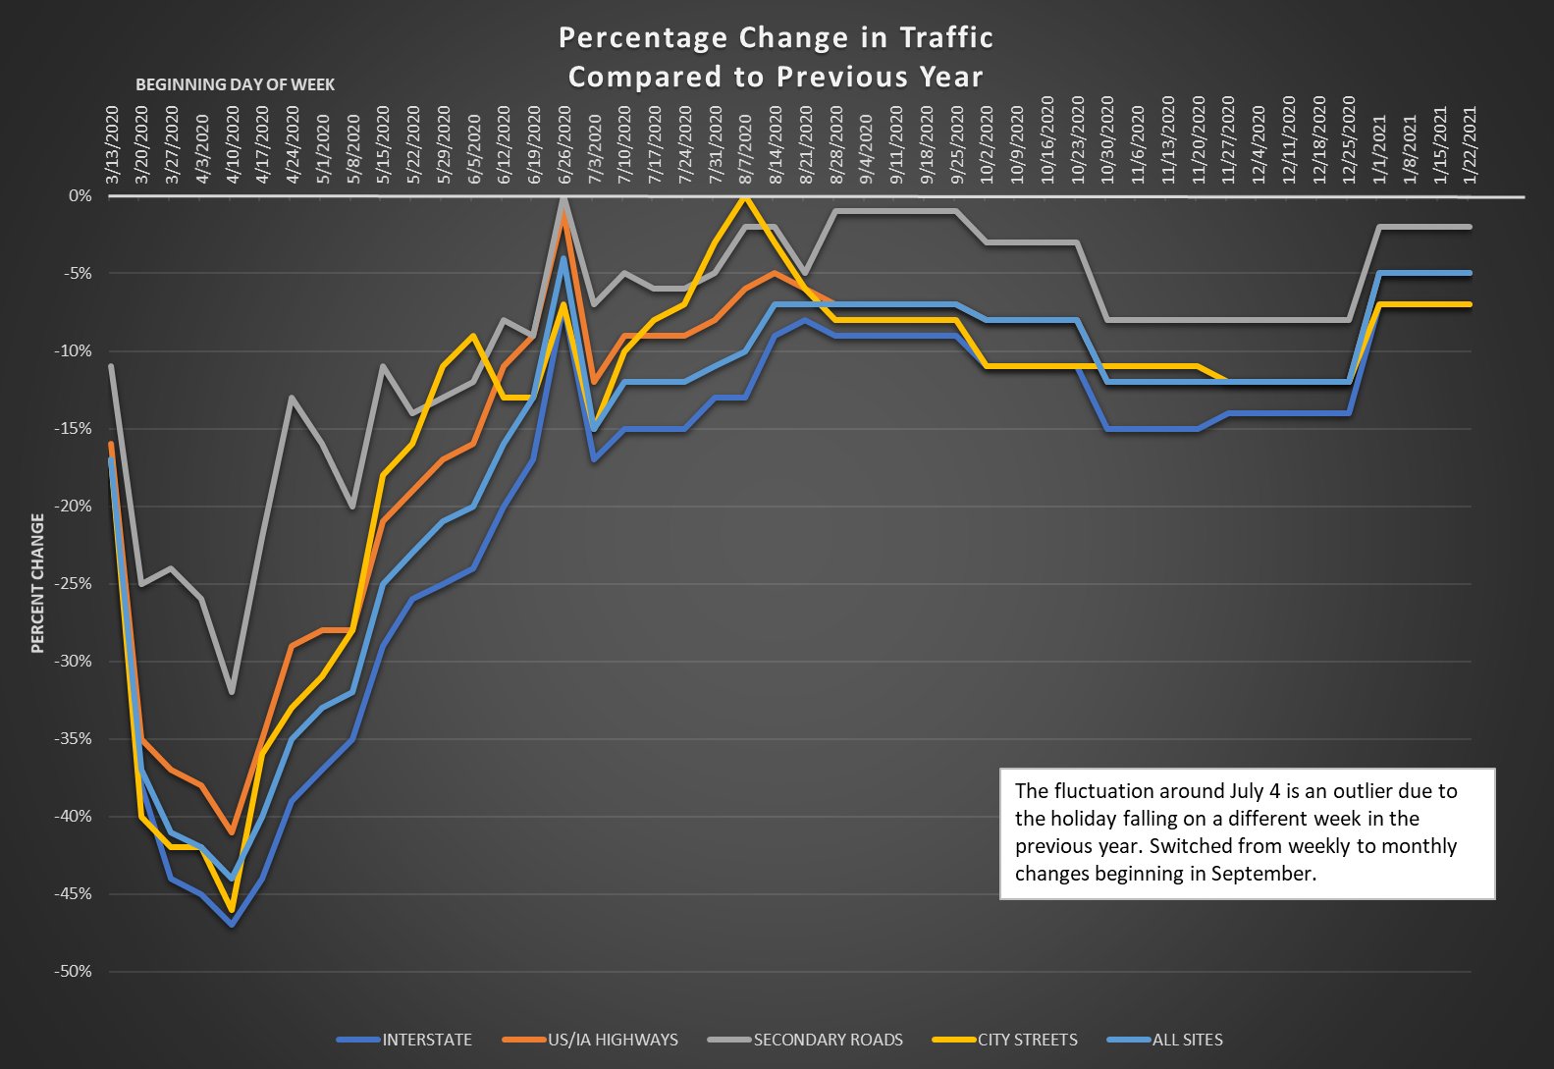

Slide 7
Road Use Tax Fund: COVID-19 Impacts by Funding Source
Fuel tax revenue
  Traffic down over 40 percent in mid-April but has grown since then.
  Traffic has leveled off around 10 percent below previous year
  Freight traffic has remained equivalent to 2019 or higher
Fee for New Registration revenue
  Vehicle sales down over 50 percent in April but has rebounded.
  Vehicle prices have been increasing.
  Basically no COVID-19 impact at this time
Annual vehicle registration revenue
  Was down very slightly early on – (Governor forgave late payment penalties)
  Basically no COVID-19 impact at this time

Slide 8
Road Use Tax Fund: COVID-19 Impacts
Overall, COVID-19 impacts have been significantly less than originally feared.
Estimated impact through June 2021: -$50 million
Long-term – estimate revenue will be down slightly due to reduced travel for an extended time period

Slide 9
Transportation Funding Impacts – COVID
HIGHWAY
Fuel tax receipts are down due to
travel impacts
Vehicle registration revenue is steady to growing (despite early drop in vehicle sales)
Estimated lost RUTF through June 2021
TRANSIT
Initial drop in State Transit Assistance revenue but that has rebounded
FY 2021 state vertical infrastructure appropriation lower due to reduced RIIF revenue
Dramatic drop in local revenue due to reduced ridership
AVIATION
State aviation fund revenue down about 40 percent due to lower aviation fuel tax
FY 2021 state vertical infrastructure appropriation lower due to reduced RIIF revenue
Dramatic drop in local revenue due to reduced passengers
TRAILS
FY 2021 state vertical infrastructure appropriations lower due to reduced RIIF revenue
- $50M

Slide 10
Federal Support – COVID
HIGHWAYS/BRIDGES IN IOWA
CARES Act: N/A
CRRSAA: $121.9 million
TRANSIT AGENCIES IN IOWA
CARES Act: $107 million
CRRSAA: $26.6 million
AIRPORTS IN IOWA
CARES Act: $70.5 million
CRRSAA: $13.4 million
FEDERAL APPROPRIATIONS
CARES Act - March 2020
Coronavirus Aid, Relief, and Economic Security Act
CRRSAA - Dec. 2020
Coronavirus Response and Relief Supplemental Appropriations Act of 2021

Slide 11
Federal Funding Update – FFY 21 Appropriation
Signed into law Dec. 27, 2020
Appropriation levels slightly less than FFY 2020
Formula Bridge Replacement and Rehabilitation
  FFY 2020: $42.8 million
    Allocated 50 percent Iowa DOT and 50 percent local jurisdiction
  FFY 2021: $35.6 million
    Recommendation: Allocate 48 percent Iowa DOT and 52 percent local (based on share of bridge deck area)
      Iowa DOT: $17.1 million
      Local jurisdictions: $18.5 million

Slide 12
Federal Funding Update – COVID-19 Relief
  Part of FFY 21 appropriation signed Dec. 27, 2020
  Highway funding allocation:
    Iowa share $121.9 m
    Specific allocation requirements for MPOs over 200,000 population (Council Bluffs, Des Moines, and Quad Cities)
    Intended to cover lost state revenues lost due to COVID-19
    Broad eligibility
      Typical FHWA eligibility (i.e. roads, bridges, trails)
      Added eligible activities (maintenance, operations, salary)
    100 percent federal share

Slide 13
Federal Funding Update – COVID-19 Relief
Recommended allocation priorities
  Meet congressional intent by allocating using Road Use Tax Fund Formula
    DOT: 47.5 percent
    County: 32.5 percent
    City: 20 percent
  Allocate to all cities and counties in Iowa
  No match requirements
  Get the funding out as quickly as possible
  Allocate a portion to address lost state revenue for trail development

Slide 14
Federal Funding Update – COVID-19 Relief
Recommended allocation process
  Modify Commission federal-aid swap policy to allow COVID-19 relief funds for local jurisdictions to be swapped on a dollar-for-dollar basis
  Allocate Primary Road Funds directly to the city and county road funds so every city and county in Iowa quickly gets their share of funds
  A direct opt-out of swap is not possible in this scenario but we can work individually with any jurisdiction that prefers federal instead of state funds. May involve the jurisdiction returning their allocation of Primary Road Funds
  DOT will spend federal COVID Relief funds on DOT projects – will coordinate with Transportation Management Areas
  Allocate a portion of funding for trails and award through a one-time application-based program

Slide 15
Federal Funding Update – COVID-19 Relief
Allocation
Category | Percent | Amount
Trails |  | $5.0 million
Highway
DOT | 47.5 percent | $55.5 million
County
Secondary Road Fund | 24.5 percent | $28.6 million
Farm-to-Market Fund | 8.0 percent | $9.4 million
City Street Fund | 20.0 percent | $23.4 million
Total |  | $121.9 million

Slide 16
Federal Funding Allocation – Summary of Comments
FFY 2021 Formula Bridge Replacement and Rehabilitation Funding Allocation
  Iowa County Engineers Association Executive Board accepts
  No other comments
COVID Relief Fund Allocation
  Eleven comments received – all in support
  Iowa Natural Heritage Foundation (trail allocation comments)
    Suggested increasing allocation to $10 million
    Suggested swapping funds, if possible
    Suggested prioritizing projects that complete major connections and serve major destinations
    Suggested minimizing match requirements
    Suggested increased promotion of trail project awards and project completion to amplify accomplishments and importance of trail funding

Slide 17
Next Steps
With across the board support, recommend Commission approval of funding allocation recommendations with no modifications
Request Commission approval at afternoon business meeting
Begin implementation
  Solicit trail project applications (see next slide)
  Work with State Treasurer’s Office to allocate funds to local governments – allocation expected to occur in April

Slide 18
COVID-19 Relief – Trail Funding Application Process
One-time competitive application deadline anticipated around May 15th for federal, state or local government project sponsors
Minimum grant amount of $500,000 and maximum grant amount of $1,250,000 per project/corridor
Application scoring emphasis: completing trail linkages in accordance with an adopted trail plan; project readiness; leveraging other public/private funds
Desired trail project completion within two years of funding award

Slide 19
Questions?

