Slide 1
April Commission Tour
Benchmark Assessment and Preview
Transportation Commission Workshop
March 9, 2021

Slide 2
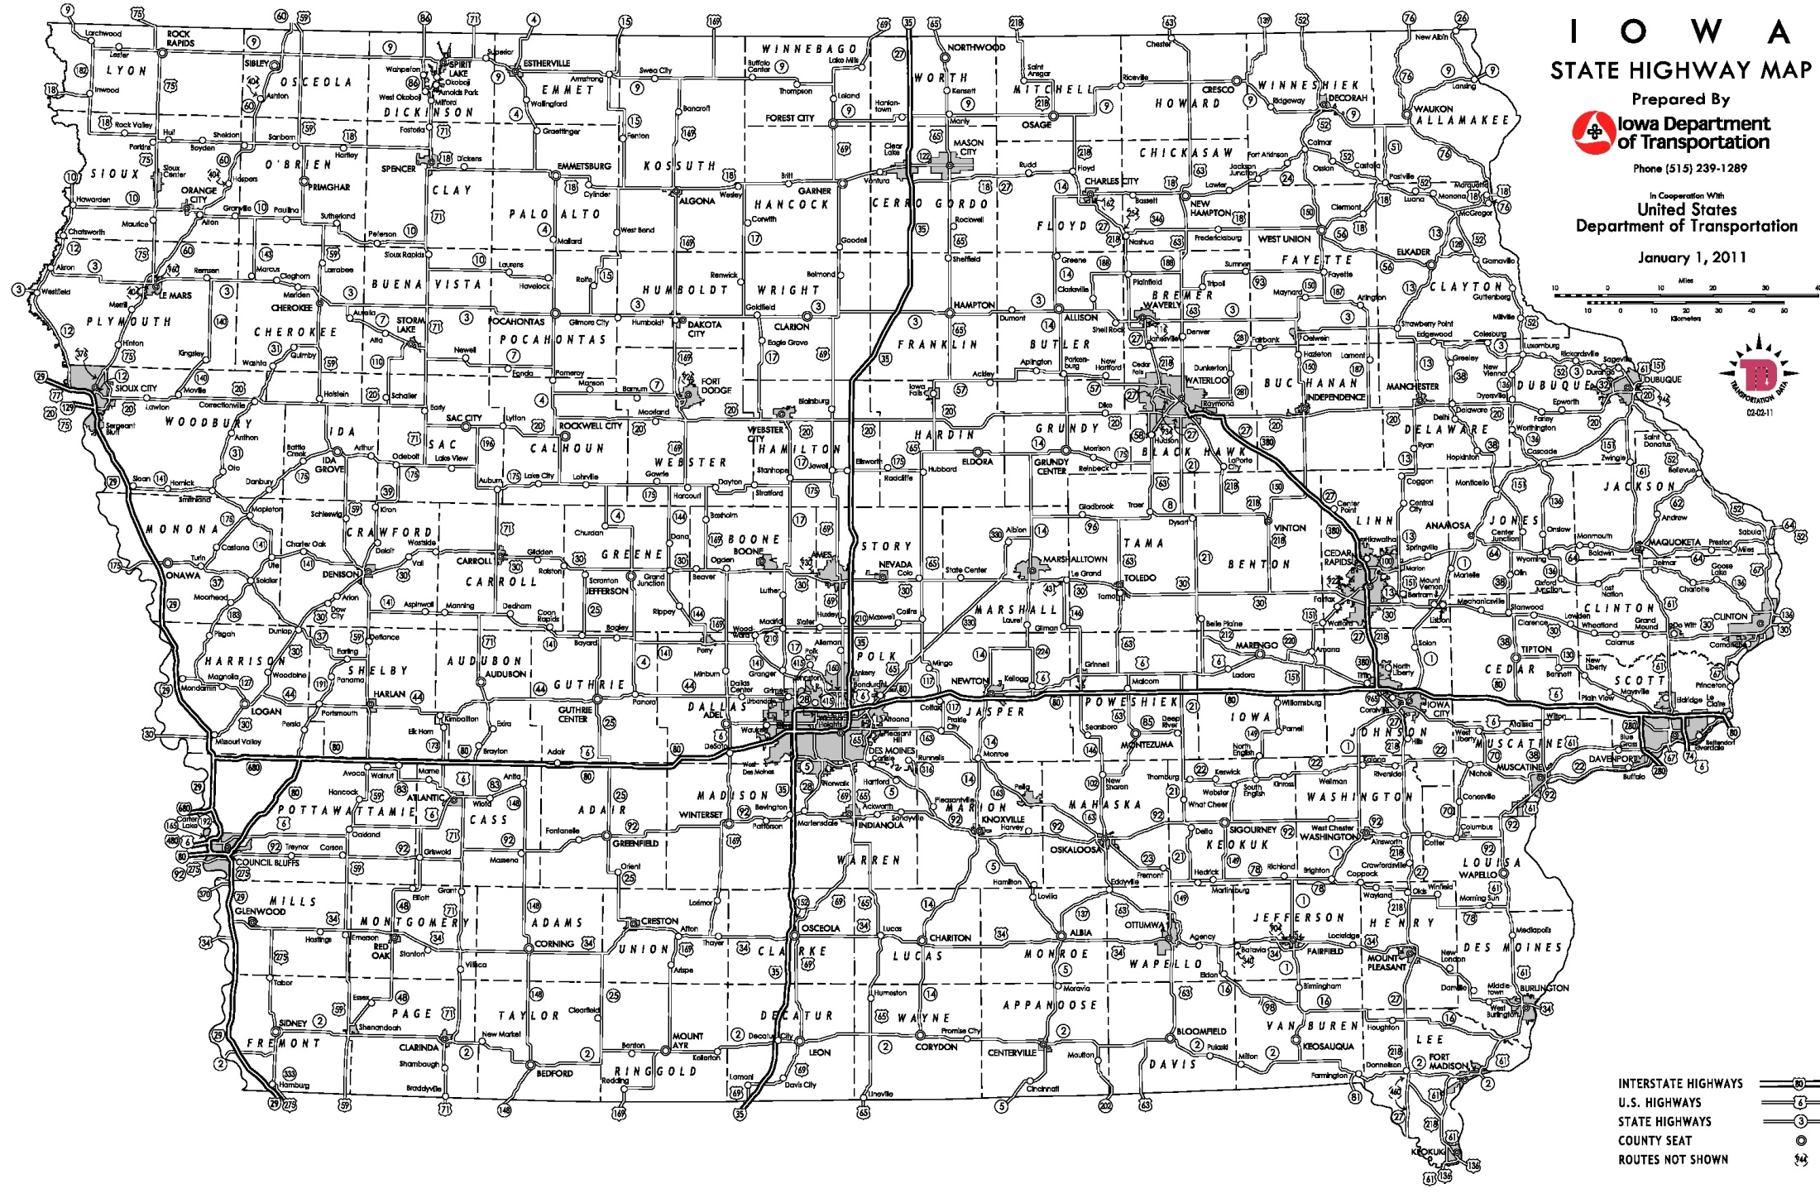
Possible 2021 Commission Tour Routes
December 2020
October-Waterloo
April-Dubuque
August-Carroll
June-Oskaloosa
= meeting location

Slide 3
April Tour/Meeting – Dubuque
Benchmark Analysis
Are there any Governor proclamations in place restricting/discouraging indoor public gatherings?
  Restrictions: None
  Recommendations:
    Encourage all vulnerable Iowans and those older than 65 to limit participation in gatherings of any size and any purpose. (Proclamation)
    Encourage gathering organizer to take reasonable measures to ensure the health of participants and members of the public (Proclamation)
Are there any CDC and/or Iowa Department of Public Health guidance restricting/discouraging indoor public gatherings?
  Restrictions: None
  Recommendations:
    Everyone should wear a mask when in public settings (IDPH guidance/CDC)
    Stay at least 6 feet away from others (IDPH guidance/CDC)
    Avoid crowds (CDC)
    While charter bus use is exempted, there is a federal mask requirement for most other bus use. Masks are required at all times (may be removed briefly for eating/drinking). (CDC)
Are there any local jurisdiction restrictions on indoor public gatherings? Dubuque has a local mask mandate in place
Is the COVID-19 seven-day positivity rate >= 15 percent in the host county for the Commission meetings? No – 2 percent as of March 8, 2021

Slide 4
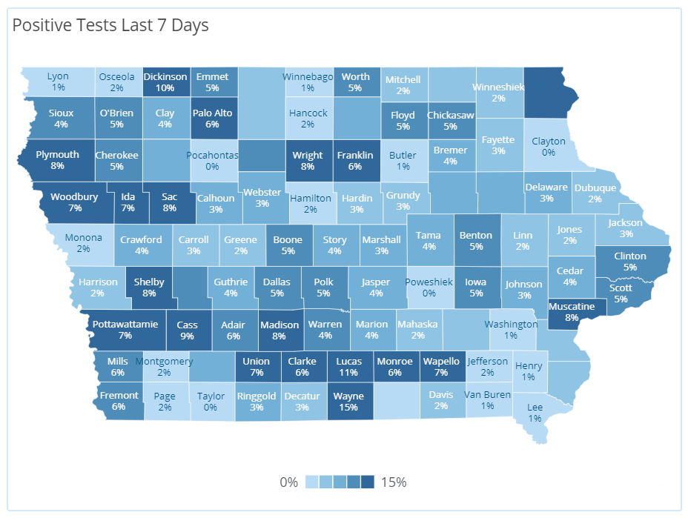




Sample Positivity Map (as of March 8, 2021)
https://coronavirus.iowa.gov/pages/case-counts

Slide 5
Tour Options
Virtual April Tour
Postpone tour and reassess in April for an in-person May tour – implications for remaining tours?
In-person April Tour
  Masks required on the bus
  Masks required in indoor public spaces in Dubuque
  Recommend limited in-person participation at public input meeting.

Slide 7
Questions?

