Slide 1
Revitalize Iowa’s Sound Economy Program
Iowa Transportation Commission Workshop
March 9, 2021

Slide 2
Revitalize Iowa’s Sound Economy Program
Created in 1985
Purpose: To promote economic development through roadway improvements.
Eligible development shall have value-adding activities that feed new dollars into the economy
Available to cities and counties through an application program

Slide 3
Available Funding and Application Summary
Available Funding
Funded annually with dedicated state motor fuel and special fuel tax revenues
Application Summary for SFY2021
Total number of projects awarded: 6
Total project costs: $10,441,887
Total amount awarded: $6,392,727
 | CITY | COUNTY
Average funding generated monthly | $970,179 | $485,089
SFY 2021 current Road Use Tax Revenue (as of 2/1/2021) | $6,425,022.21 | $3,212,511.11
Current Unobligated Balance (as of 2/1/2021) | $9,348,024.02 | $3,023,196.97

Slide 4
Local Development Project Evaluation Criteria
Development Potential (35 points)
Economic impact and Cost Effectiveness (20 points)
Local Commitment and Initiative (33 points)
Transportation Need and Justification (4 points)
Local Economic Need (6 points)

Slide 5
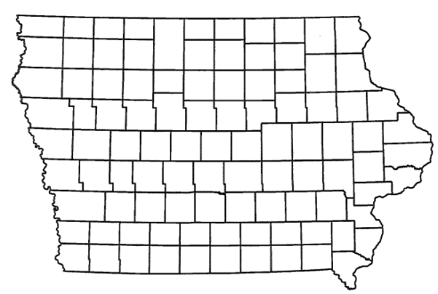
List of Local Development Applications Recommended
PROJECT NAME
SPONSOR
SCORE
TOTAL PROJECT COST
PERCENT PARTICIPATION
RECOMMENDED AMOUNT
Construction of approximately 1,638 feet of Snap-On Drive. | Algona | 42 | $1,464,025 | 50% | $732,013
Construction of approximately 825 feet of 10th Avenue South and paving of 530 feet of South 19th Street. | Estherville | 44 | $775,325 | 50% | $387,663

Slide 6
Algona
(Local Development)
Construction of approximately 1,638 feet of Snap-On Drive located on the northeast side of town. This project is necessary to provide access to six lots totaling more than 15 acres for heavy industrial purposes.
Total Cost: $1,464,025
Requested: $732,013 (50%)

Slide 7
Estherville
(Local Development)
construction of approximately 825 feet of 10th Avenue South and paving of 530 feet of South 19th Street located on the southeast side of town. This project is necessary to provide access to seven lots totaling more than 21 acres for heavy industrial purposes.
Total Cost: $775,325
Requested: $387,663 (50%)

Slide 8
QUESTIONS?
Craig Markley, Systems Planning Bureau
craig.markley@iowadot.us
515-239-1027

