Slide 1
Revitalize Iowa’s Sound Economy Program
Iowa Transportation Commission Workshop
March 8, 2022

Slide 2
Revitalize Iowa’s Sound Economy Program
Created in 1985
Purpose: To promote economic development through roadway improvements.
Eligible development shall have value-adding activities that feed new dollars into the economy
Available to cities and counties through an application program

Slide 3
Available Funding and Application Summary
Available Funding
Funded annually with dedicated state motor fuel and special fuel tax revenues
Application Summary for SFY2022
Total number of projects awarded: 8
Total project costs: $23,413,838
Total amount awarded: $12,909,488
 | CITY | COUNTY
Average funding generated monthly | $905,101 | $452,550
SFY 2022 current Road Use Tax Revenue (as of 1/31/2022) | $7,244,795.67 | $3,622,397.83
Current Unobligated Balance (as of 1/31/2022) | $2,914,290.00 | $362,384.41

Slide 4
Local Development Project Evaluation Criteria
Development Potential (35 points)
Economic impact and Cost Effectiveness (20 points)
Local Commitment and Initiative (33 points)
Transportation Need and Justification (4 points)
Local Economic Need (6 points)

Slide 5
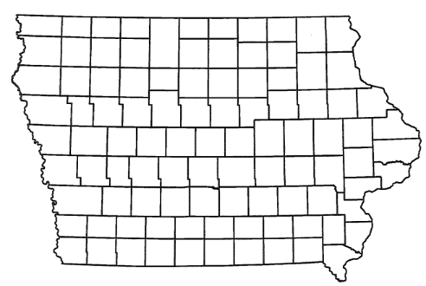
List of Local Development Applications Recommended
PROJECT NAME
SPONSOR
SCORE
TOTAL PROJECT COST
PERCENT PARTICIPATION
RECOMMENDED AMOUNT
Roadway improvements of approximately 1,800 feet of Forest Grove Drive, construction of 960 feet of Competition Drive and interchange improvements to Interstate 80. | Bettendorf | 52 | $7,554,119 | 35% | $2,676,669

Slide 6
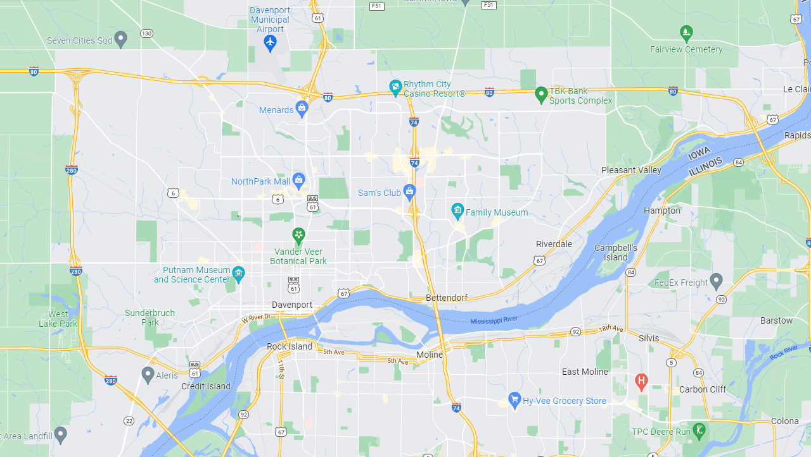
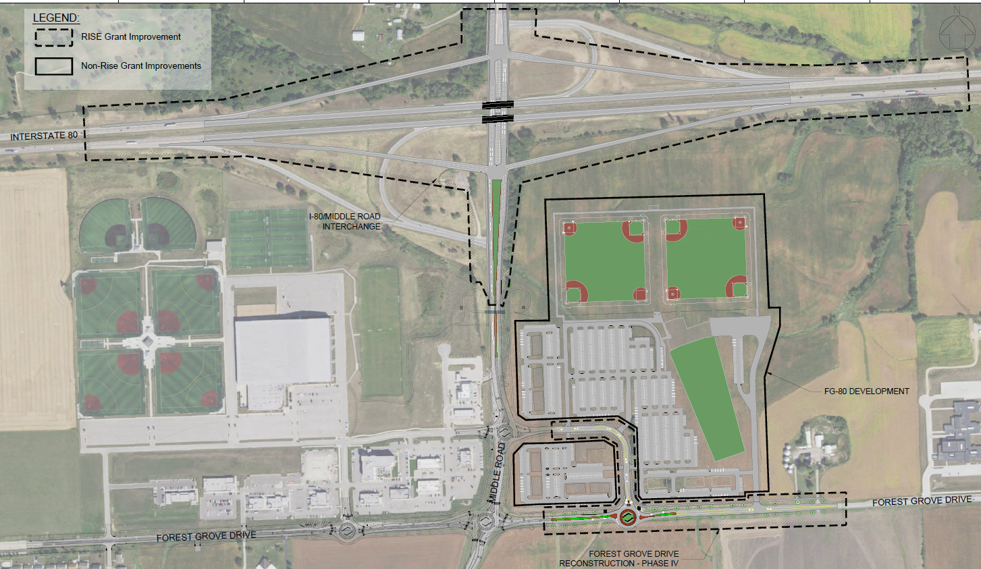
Bettendorf
(Local Development)
Roadway improvements of approximately 1,800 feet of Forest Grove Drive, construction of 960 feet of Competition Drive and interchange improvements to Interstate 80 located on the northeast side of town. This project will support tourism by providing improved access to the proposed golf entertainment venue developed by Middle & Forest Grove, LLC and expanded site of TBK Sports Complex.
Total Cost: $7,554,119
Requested: $2,676,669 (35%)

Slide 7
QUESTIONS?
Craig Markley, Systems Planning Bureau
craig.markley@iowadot.us
515-239-1027

