Slide 1
Corridor Preservation
US20 from Sundown Rd. to Cottingham Rd (Peosta)
IA 151 from Wendling Rd. past Springville
Transportation Commission Workshop
March 8, 2022

Slide 2
What is a corridor preservation?
Corridor preservation is not a legal encumbrance on the property or an exercise of eminent domain, but is instead a right of notice.
Corridor preservation avoids inconsistent development of property needed for highway right-of-way, by allowing us to receive notice of intended development of property within the proposed right-of-way and giving us the opportunity to take action to acquire it before the development occurs.

Slide 3
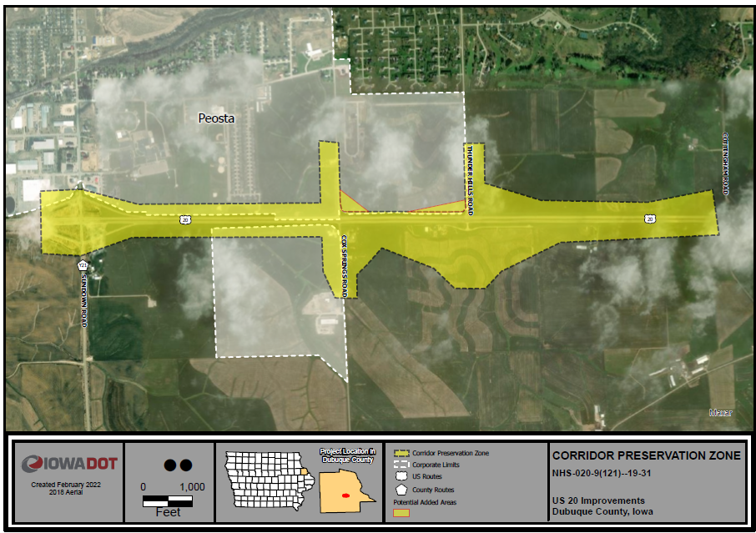
US 20 near Peosta
West of Swiss Valley Interchange project (Completed)
Growth in this corridor expected
Possible interchange at Thunder Hills Rd.

Slide 4
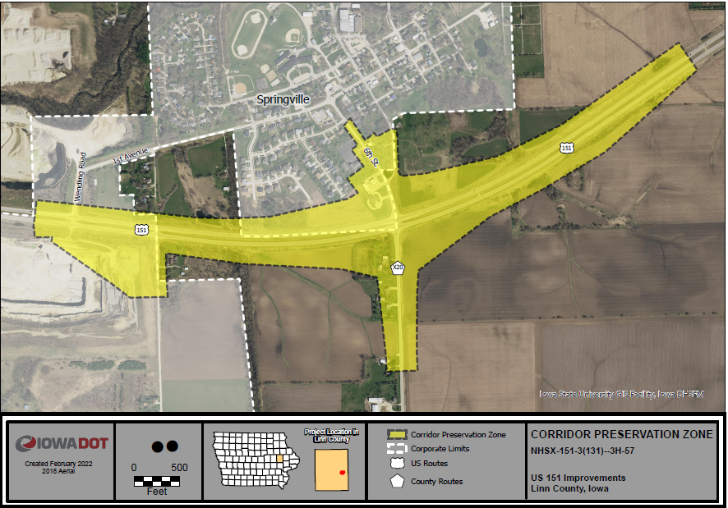
IA 151 near Springville future interchange

Slide 5
Next Steps:
Seek Commission input for new Corridor Preservation Zone (CPZ)
Mail an initial written notice to the affected city or county and property owners
Affected cities or counties and property owners are given the opportunity to comment
After expiration of the 60-day comment period, we present the proposed CPZ to the Commission at the June monthly meeting
The proposed CPZ is presented to the Commission for formal action at the July business meeting
We send a final notice to affected property owners

Slide 6
Thank You

