Slide 1
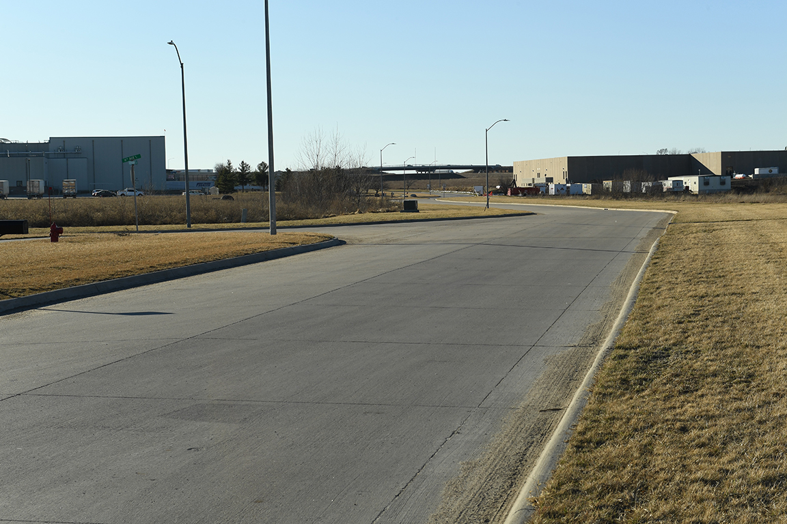
Revitalize Iowa’s Sound Economy Program
Iowa Transportation Commission Business Meeting
March 8, 2022

Slide 2
List of Local Development Applications Recommended
PROJECT NAME
SPONSOR
SCORE
TOTAL PROJECT COST
PERCENT PARTICIPATION
RECOMMENDED AMOUNT
Roadway improvements of approximately 1,800 feet of Forest Grove Drive, construction of 960 feet of Competition Drive and interchange improvements to Interstate 80. | Bettendorf | 52 | $7,554,119 | 35% | $2,676,669

