Slide 1
Revitalize Iowa’s Sound Economy Program
Iowa Transportation Commission Workshop
March 14, 2023

Slide 2
Revitalize Iowa’s Sound Economy Program
Created in 1985
Purpose: To promote economic development through roadway improvements.
Eligible development shall have value-adding activities that feed new dollars into the economy
Available to cities and counties through an application program

Slide 3
Available Funding and Application Summary
Available Funding
Funded annually with dedicated state motor fuel and special fuel tax revenues
Application Summary for SFY2023
Total number of projects awarded: 5
Total project costs: $15,488,682
Total amount awarded: $8,168,282
 | CITY | COUNTY
Average funding generated monthly | $905,101 | $452,550
SFY 2023 current Road Use Tax Revenue (as of 1/31/2023) | $7,149,327.96 | $3,574,663.98
Current Unobligated Balance (as of 1/31/2023) | $9,689,728.51 | ($53,103.02)

Slide 4
Local Development Project Evaluation Criteria
Development Potential (35 points)
Economic Impact and Cost Effectiveness (20 points)
Local Commitment and Initiative (33 points)
Transportation Need and Justification (4 points)
Local Economic Need (6 points)

Slide 5
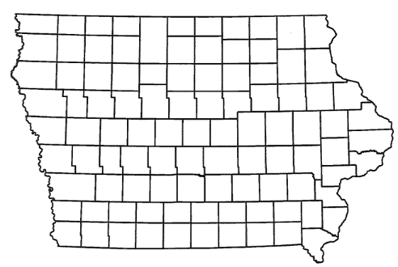
List of Local Development Applications Recommended
PROJECT NAME
SPONSOR
SCORE
TOTAL PROJECT COST
PERCENT PARTICIPATION
RECOMMENDED AMOUNT
Paving of approximately 2,625 feet of 240th Street located south of Le Mars | Plymouth County | 58 | $1,585,556 | 20% | $792,778

Slide 6
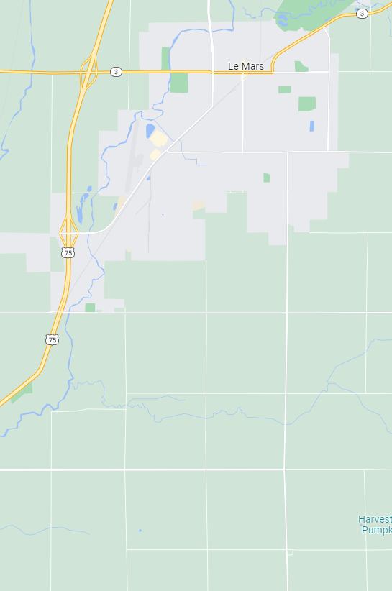
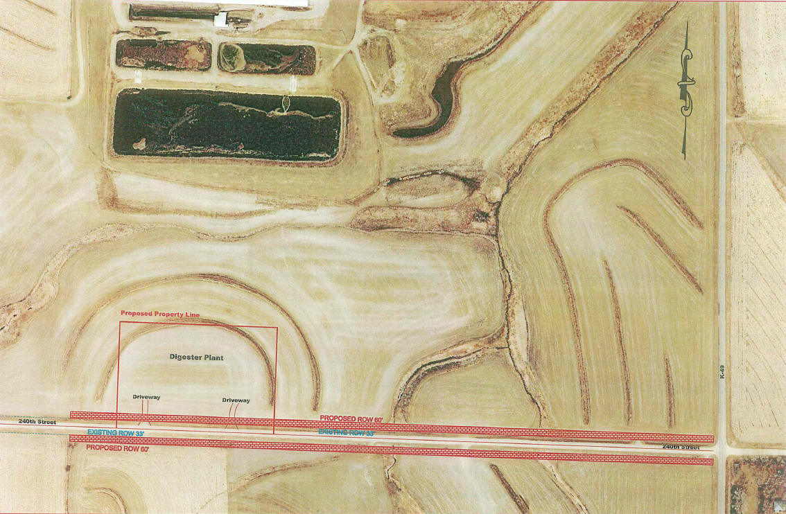
Plymouth County
(Local Development)
Paving of approximately 2,625 feet of 240th Street located south of Le Mars.
This project will provide access to five acres for industrial purposes.
Total Cost: $1,585,556
Requested: $792,778 (50%)

Slide 7
QUESTIONS?
Deb Arp, Systems Planning Bureau
Debra.Arp@iowadot.us
515-239-1681

