Slide 1
Potential 2023-2027 Iowa Transportation Improvement Program Amendment
Transportation Commission Workshop
March 14, 2023

Slide 2
Background
Excessive pavement damage due to winter weather is evident across the state.
Recommend considering amending the FY 2023 Highway Program to add $15 million to contract maintenance.
FY 2024 Highway Program revenue would be reduced by $15 million to account for the amendment

Slide 3
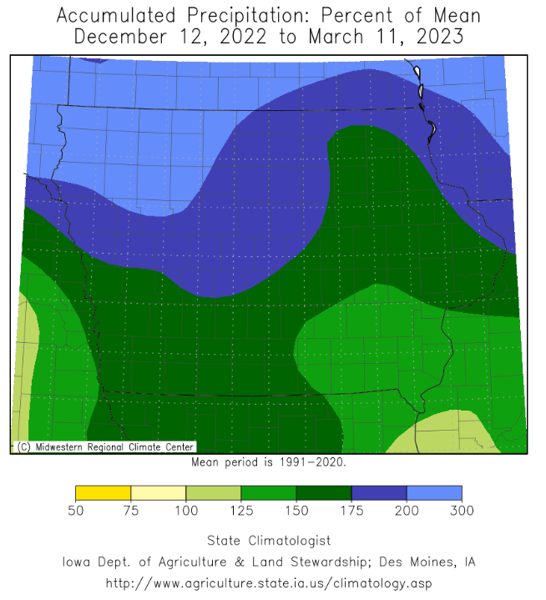

Slide 4
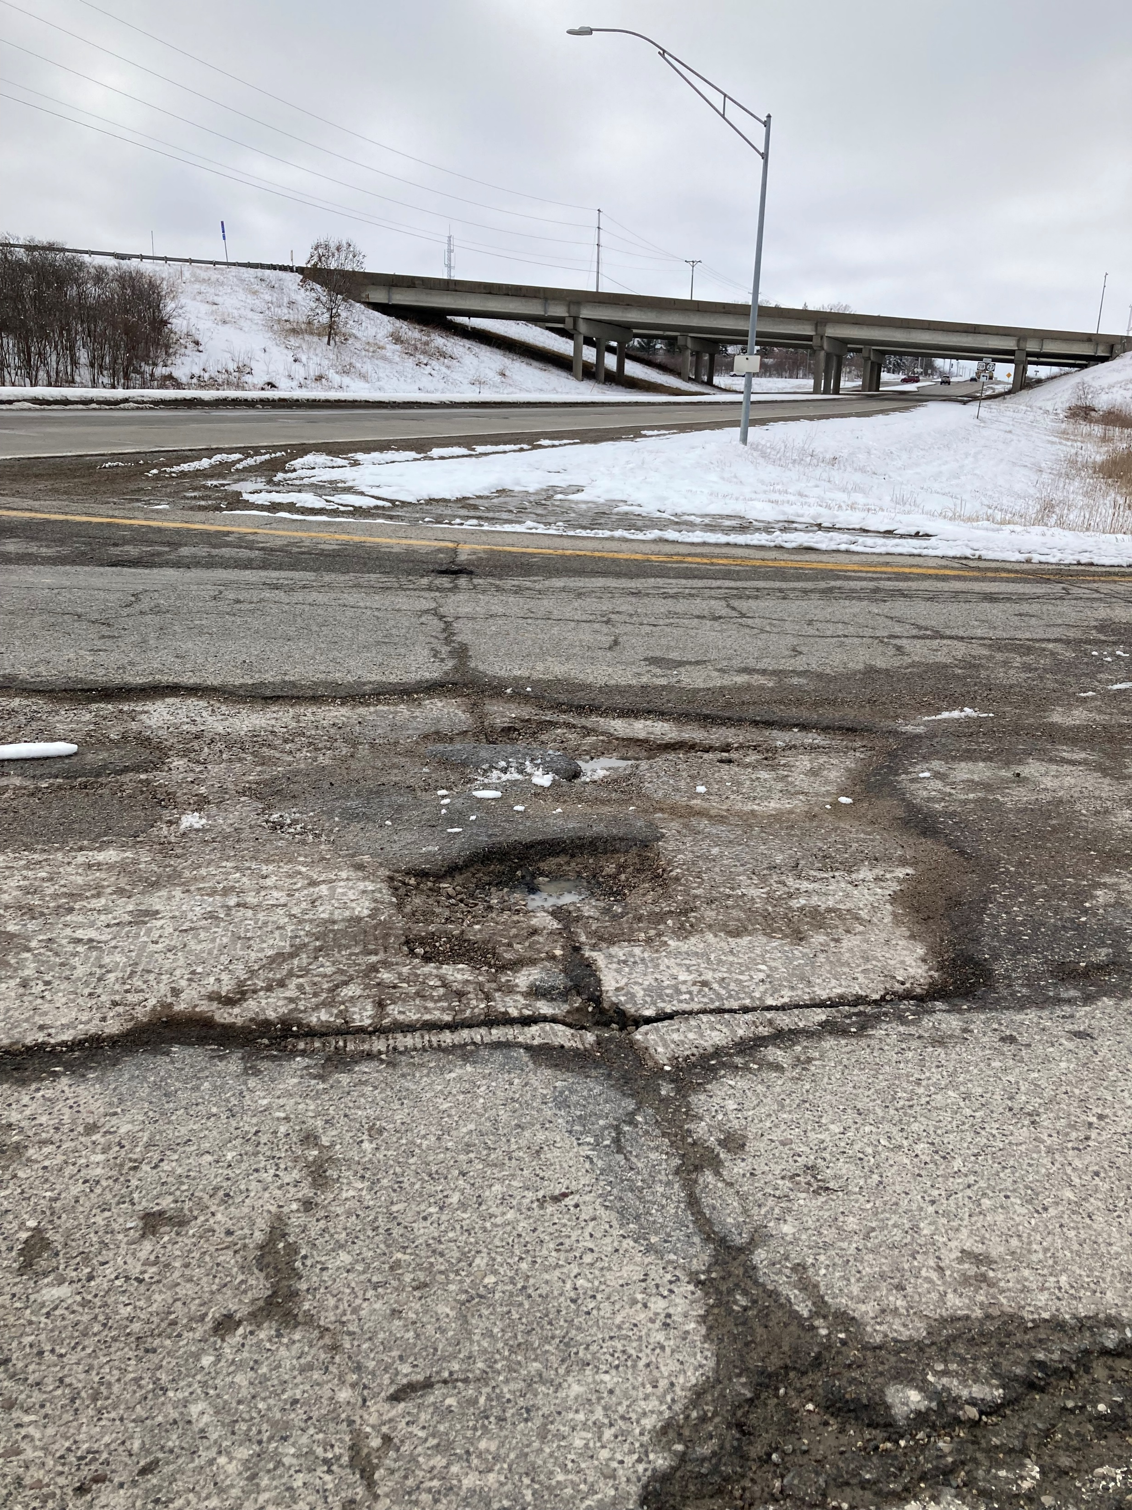
US 218 in Johnson County

Slide 5
US 75 in Sioux Center

Slide 6
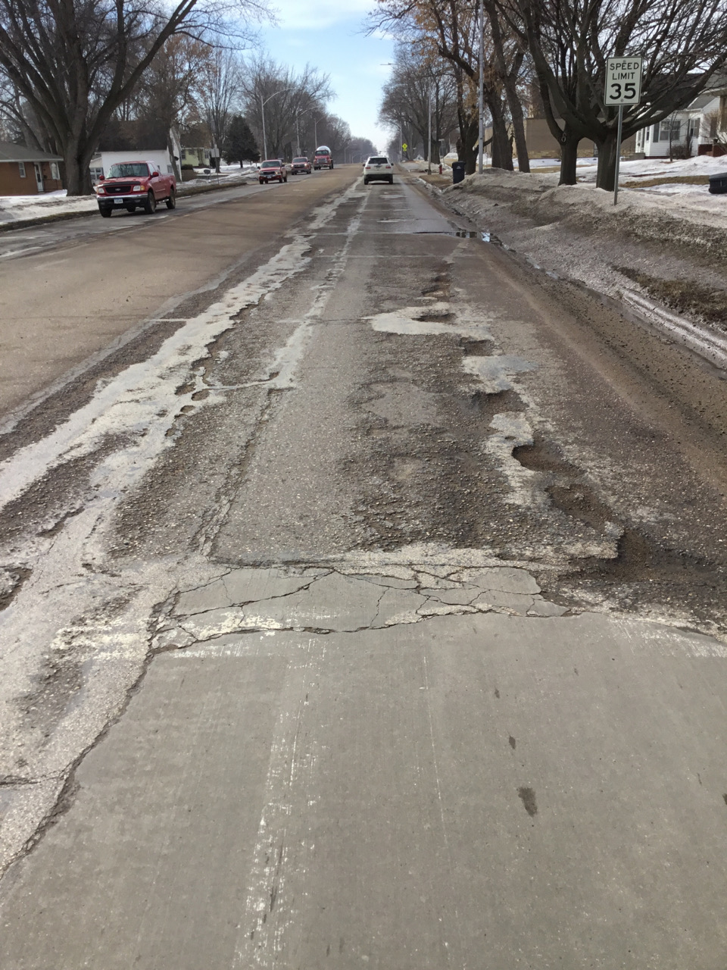
US 75 in Sioux Center

Slide 7
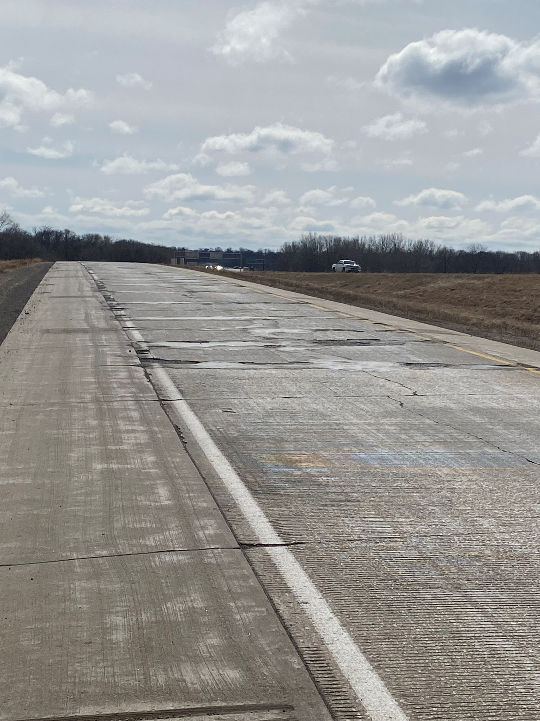
US 218/Broadway Ramp in Black Hawk County

Slide 8
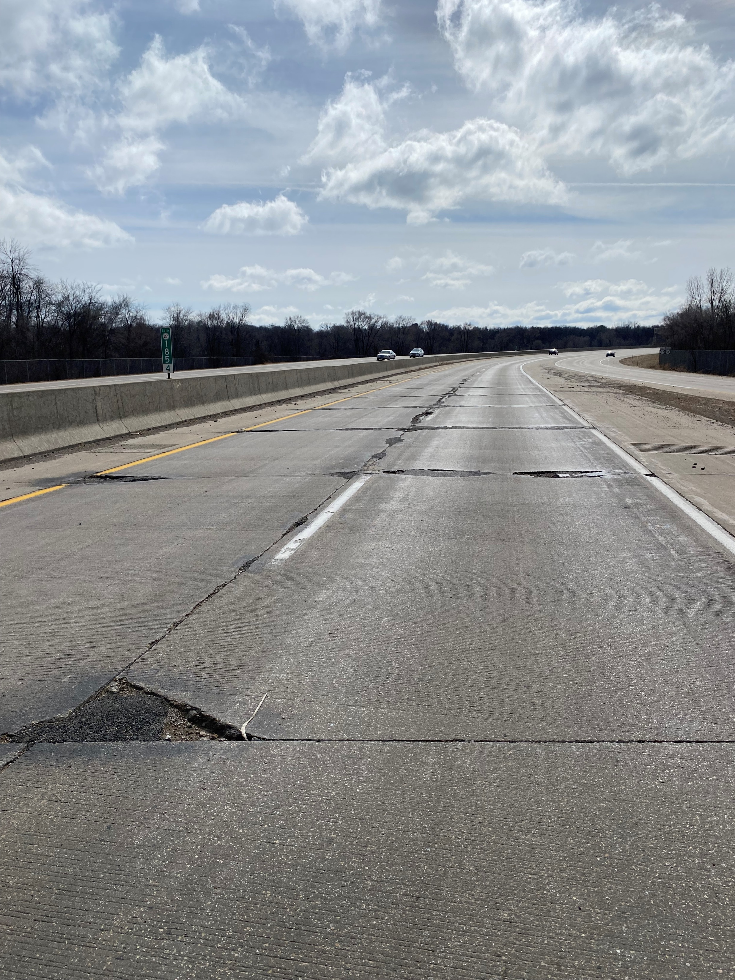
Iowa 27/Iowa 58 in in Black Hawk County

Slide 9
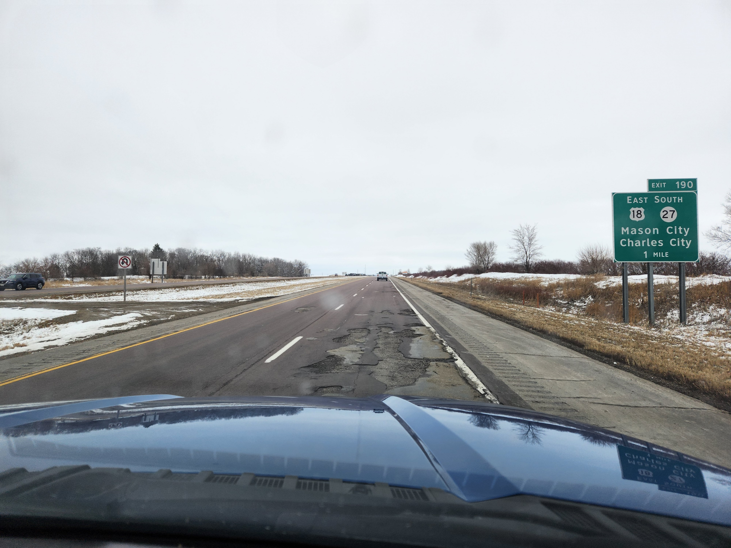
I-35 in Cerro Gordo County

Slide 10
Next Steps
Amendment is on the afternoon business meeting agenda for Commission consideration.
Commission can act on the action item or defer for future consideration

