Slide 1
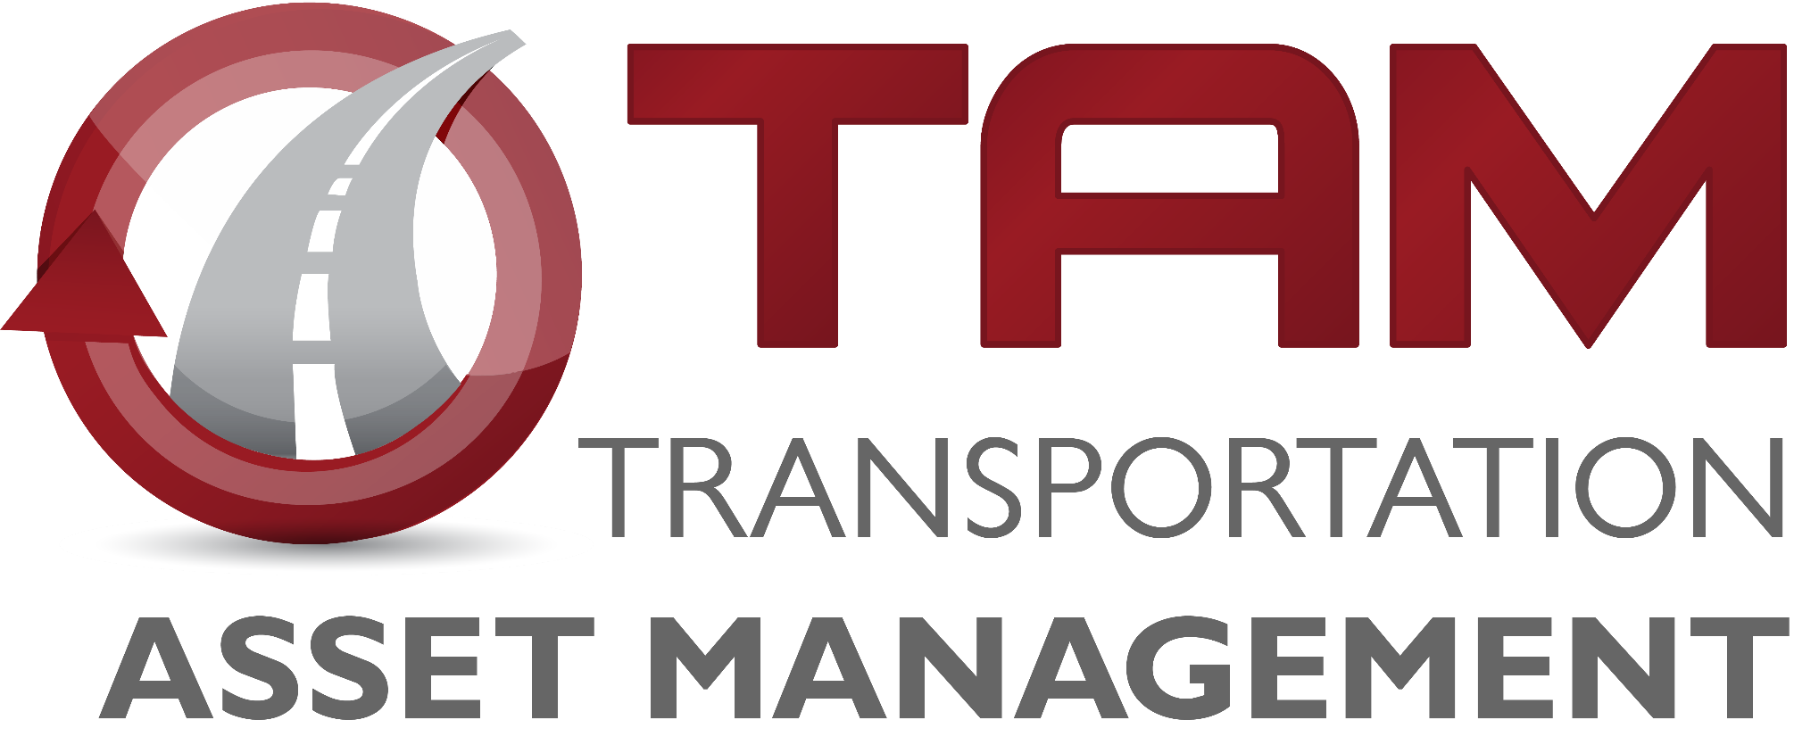
Asset Management Summary
March 14, 2023
Charlie Purcell
Deputy Director, Transportation Development Division

Slide 2
Why asset management is important?
Asset Type | How Many? | How Much?
Roads | 24,534 lane miles | $39 Billion
Bridges | 4,195 | $20 Billion
Total |  | $59 Billion

Slide 3
Information to Inform Decisions
Sep 2022 – Asset Management Overview
Dec 2022 – Interstate Plan Update
Jan 2023 – Pavement Management
Feb 2023 – Bridge Management
Mar 2023 – Asset Management Summary

Slide 4
Cost Comparisons for Investment Options
$10M investment results in approximately:
1 mile of new 4-lane expressway, or
3 miles of 2-lane pavement reconstruction, or
16 miles of pavement resurfacing, or
3 bridge replacements
Notes:
Using average costs from the 2022 “Transportation Construction Costs” fact sheet., Scott Neubauer gave bridge estimates (replacement = $3M each).

Slide 5
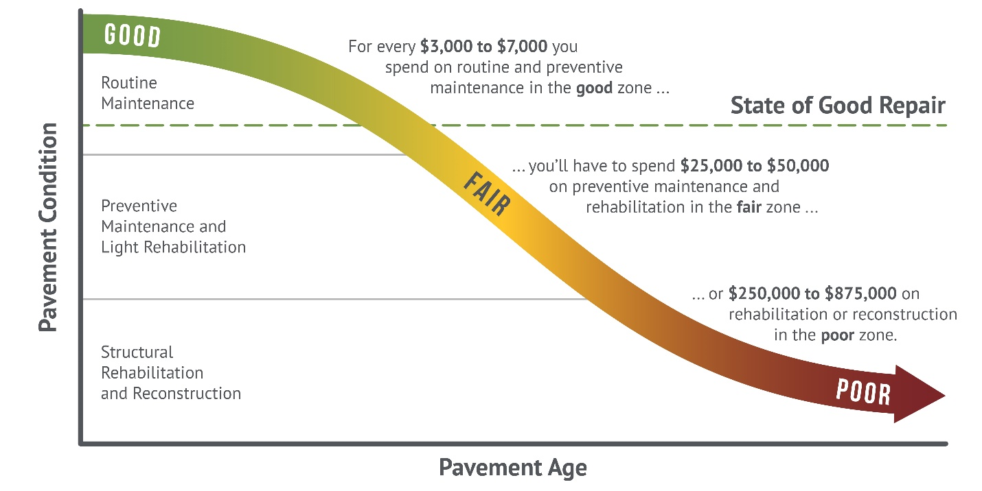
How We Set Targets
Good roads cost less. If we maintain assets in good condition, we can minimize their lifecycle cost. In the long run, this allows us to invest in other priorities.
Notes:
This graphic came from the Pavement LCP report done by HDR and APTech. It’s an update of the old Byron Shire Council graphic that we had been using.

Slide 6
Steps Toward a Focus on Stewardship
2017
Started current series of Asset Management workshop presentations connected to the 5-year program development process
2018
Increased Non-Interstate Bridge Modernization program
From $60M to $100M in 5th year of program
Recommended continued step increases in years 6+
Increased Non-Interstate Pavement Modernization program
Recommended continued step increases in years 6+
2022
$35M increase starting in 2027, targeted for pavement replacement
Additional $20M per year for bridges, starting in 2027
Increases to Statewide Contract Maintenance in multiple years
Notes:
Check dates

Slide 7
Growth in Stewardship Investments
Comparing the 2016-2020 and 2023-2027 Programs, Investment Has Shifted Toward System Stewardship Categories
Notes:
Only difference is the Non-Interstate Stewardship

Slide 8
Summary
We have a “wave” of bridges built in the 1960s and 1970s that are all getting to the point where major rehabilitation or replacement will be needed.
At current replacement rates, we would need pavements to last 120 years (we currently design for 40).
Significant deterioration of pavements and bridges is forecast to occur without steady growth in stewardship spending.
Right-sizing and operations strategies enable us to maximize our existing infrastructure investments

Slide 9
Recommendations
Continue supporting stewardship investment in order to maintain a state of good repair across the primary highway system.
Limit future capacity expansion to locations with forecast congestion that cannot be addressed effectively through operational improvements.
Notes:
Consistent with SLRTP – focus on stewardship and modernizing the system

