Slide 1
Revitalize Iowa’s Sound Economy Program
Iowa Transportation Commission Business Meeting
March 14, 2023

Slide 2
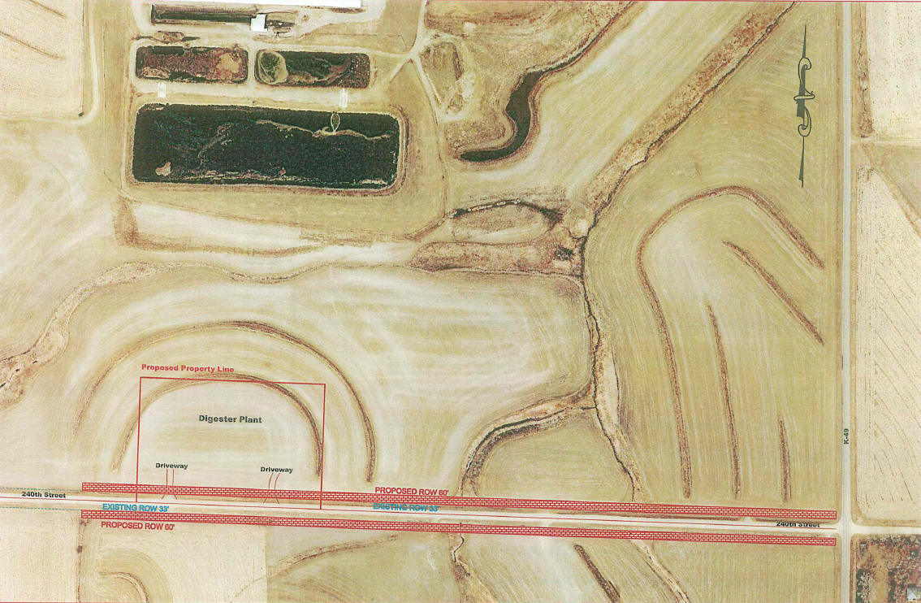
List of Local Development Applications Recommended
PROJECT NAME
SPONSOR
SCORE
TOTAL PROJECT COST
PERCENT PARTICIPATION
RECOMMENDED AMOUNT
Paving of approximately 2,625 feet of 240th Street located south of Le Mars | Plymouth County | 58 | $1,585,556 | 50% | $792,778

