Slide 1
Transportation Trends Update
Transportation Commission Workshop
March 14, 2023

Slide 2
Overview
US total rail carloads
Commercial air service passenger counts
Vehicular traffic
Public transit ridership

Slide 4
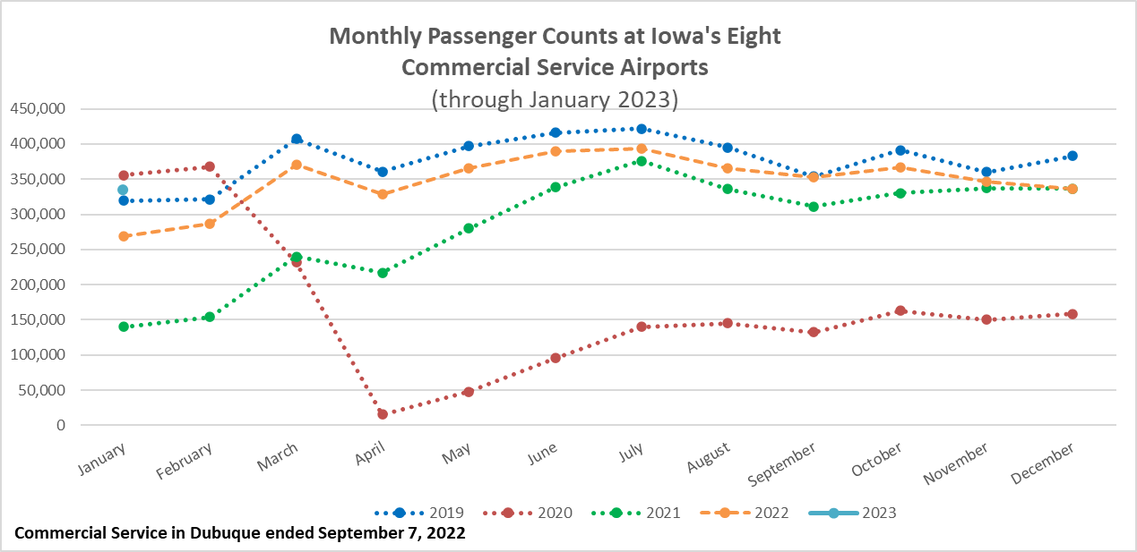

Slide 5
Monthly State Vehicle Miles of Travel
(through January 2023)

Slide 6
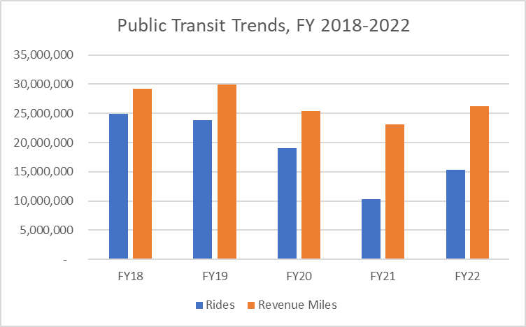

Slide 7
Questions?

