Slide 1
Revitalize Iowa’s Sound Economy Program
Iowa Transportation Commission Business Meeting
March 12, 2024

Slide 2
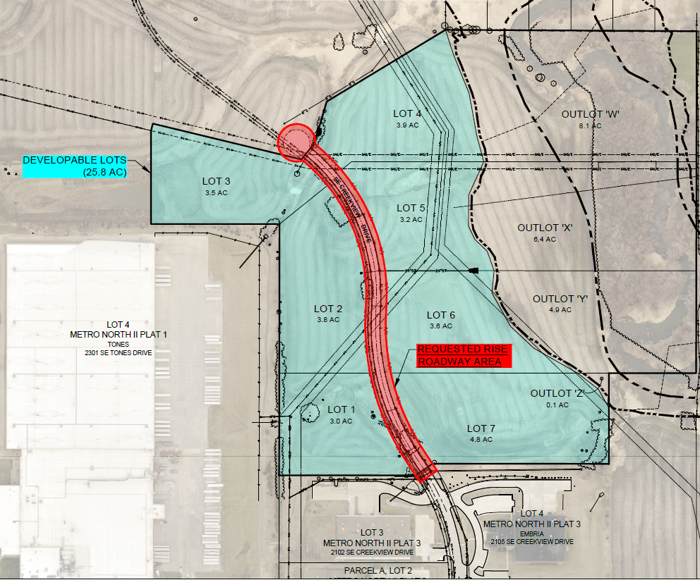
List of Local Development
Applications Recommended
PROJECT NAME
SPONSOR
SCORE
TOTAL PROJECT COST
PERCENT PARTICIPATION
RECOMMENDED AMOUNT
Construction of approximately 1,195 feet of SE Creekview Drive located on the southeast side of town | Ankeny | 43 | $1,535,279 | 50% | $767,640

Slide 3
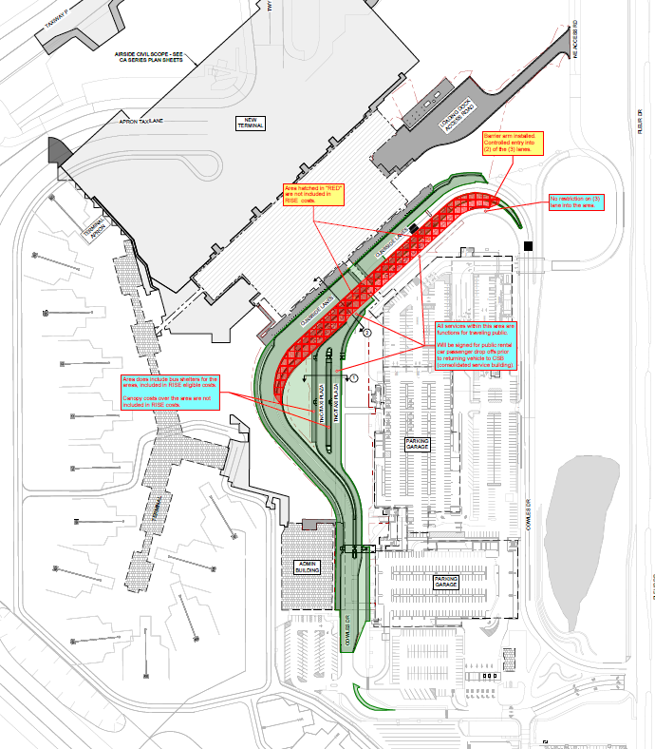
List of Local Development
Applications Recommended
PROJECT NAME
SPONSOR
SCORE
TOTAL PROJECT COST
PERCENT PARTICIPATION
RECOMMENDED AMOUNT
Provide additional roadway improvements to relocate the expanded main Des Moines Airport terminal (Amendment) | Des Moines | 73 | $7,026,700 | 50% | $3,513,350

Slide 4
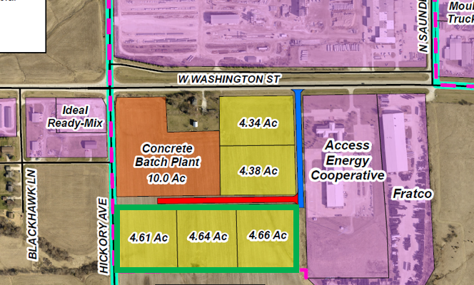
List of Local Development
Applications Recommended
PROJECT NAME
SPONSOR
SCORE
TOTAL PROJECT COST
PERCENT PARTICIPATION
RECOMMENDED AMOUNT
Construction of approximately 1,033 feet of Eugene Way located on the west side of town | Mount Pleasant | 43 | $487,188 | 50% | $243,594

Slide 5
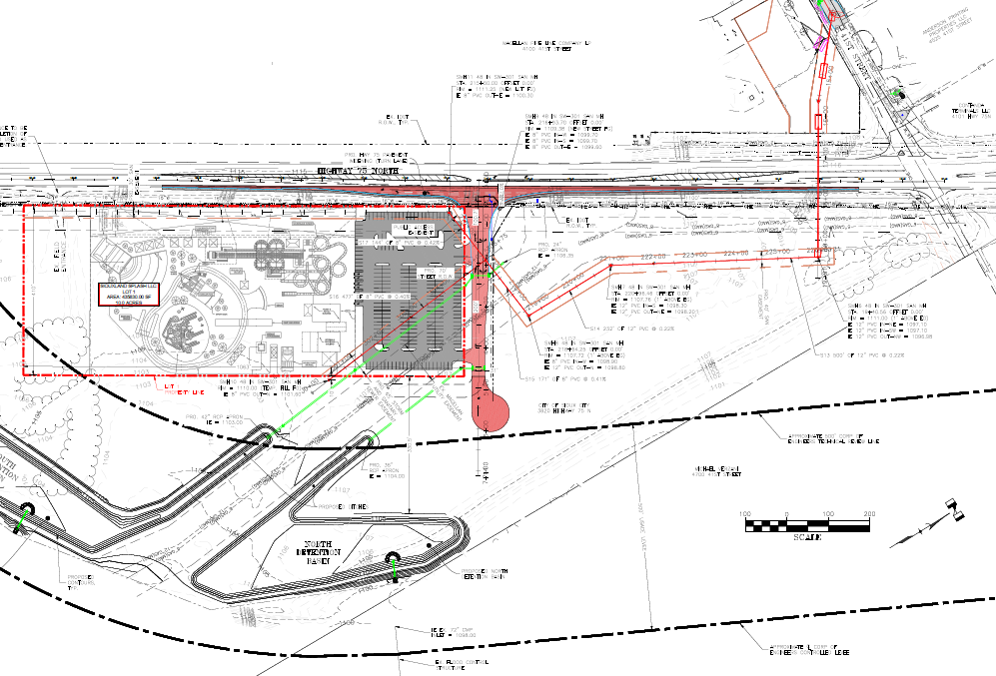
List of Local Development
Applications Recommended
PROJECT NAME
SPONSOR
SCORE
TOTAL PROJECT COST
PERCENT PARTICIPATION
RECOMMENDED AMOUNT
Construction of approximately 410 feet of new roadway and turn lanes on Business Highway 75 North | Sioux City | 62 | $2,501,913 | 50% | $1,250,957

