Slide 1
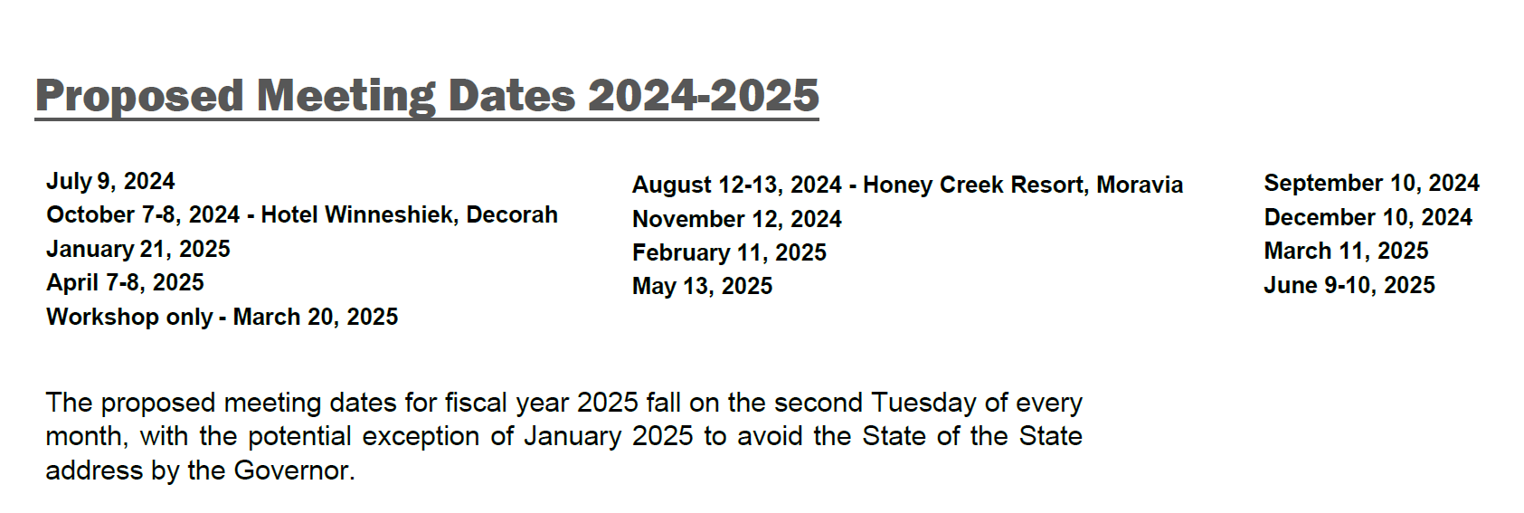
FY 24/25 Future Commission Meeting Dates
March 12, 2024
3/2/2023

