Slide 1



Transportation Trends Update
March 12, 2024
3/2/2023

Slide 2
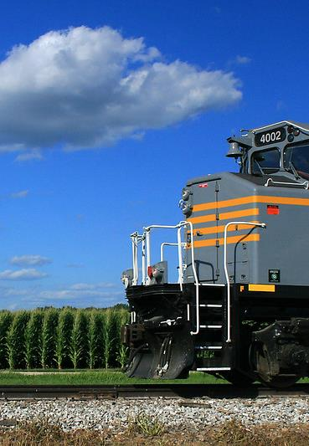

Agenda
US total rail carloads
Commercial air service passenger counts
Vehicular traffic
Mississippi River and Panama Canal

Slide 3
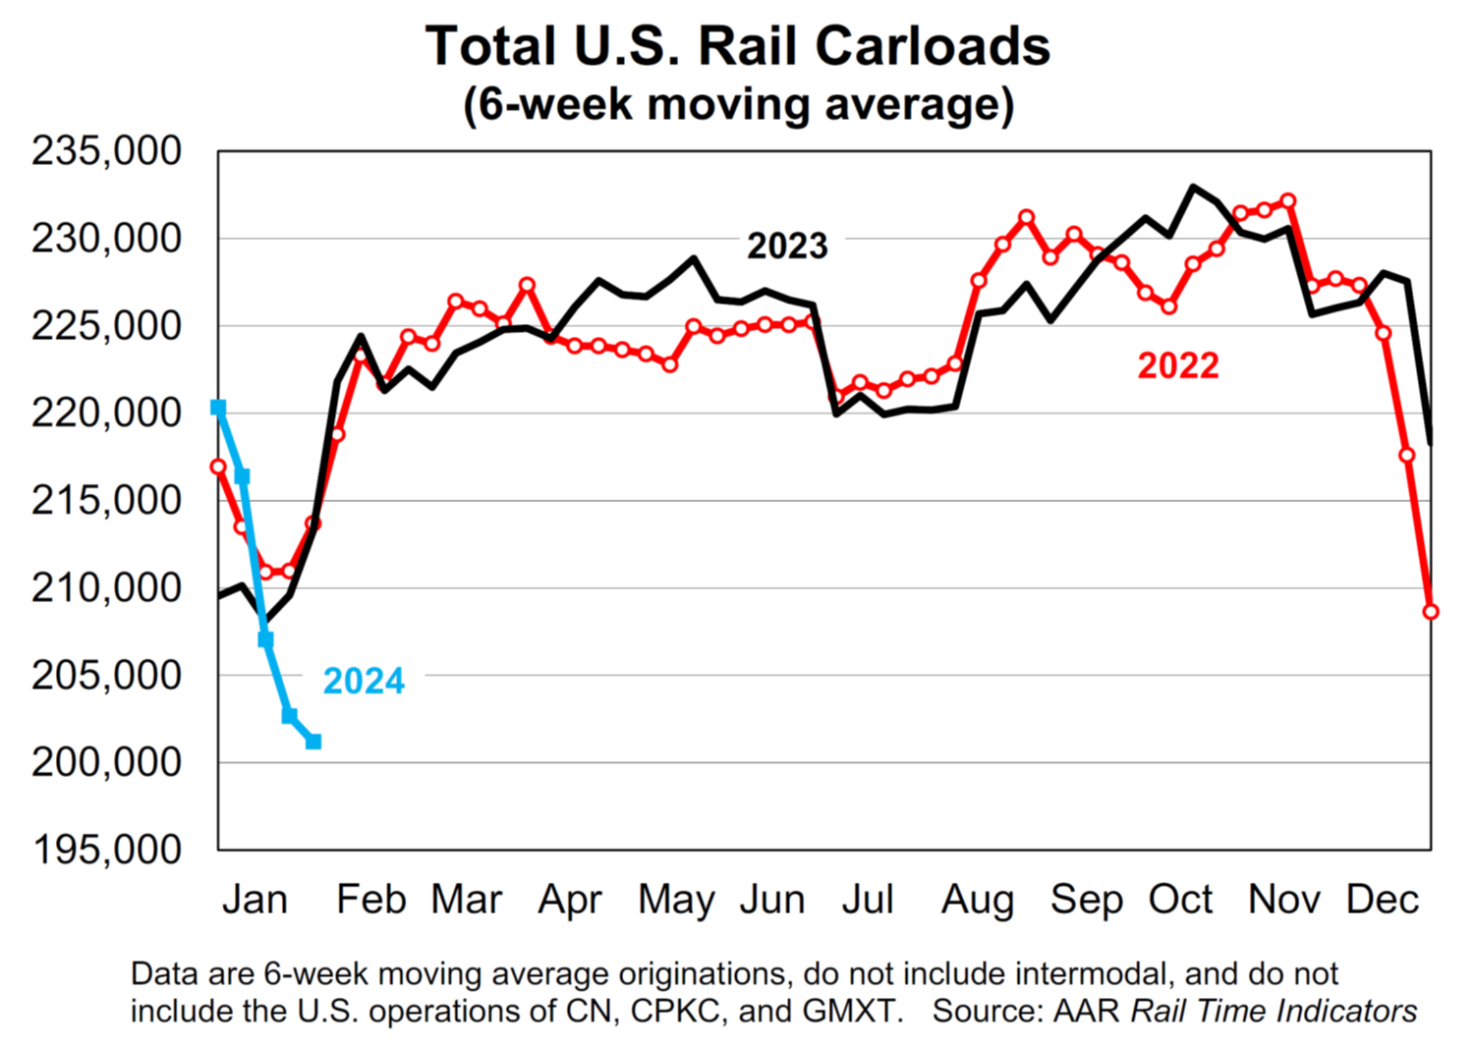

Slide 4
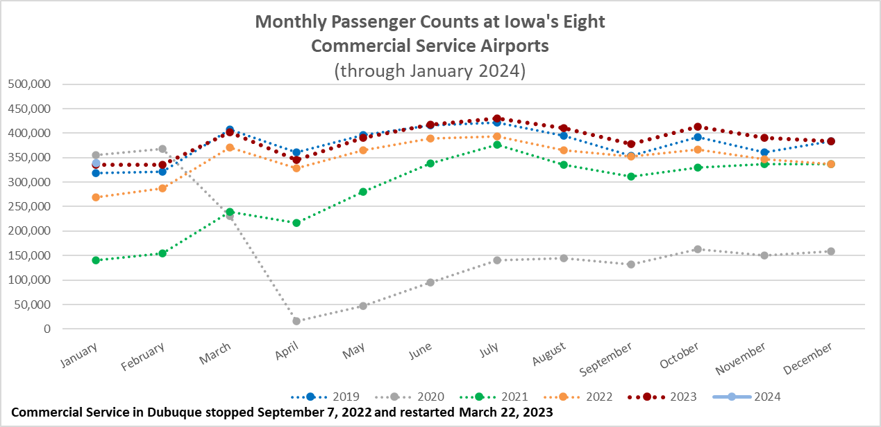

Slide 5
Monthly State Vehicle Miles of Travel
(through January 2024)

Slide 6
Water Transportation
Mississippi River
As of early February, the Corps of Engineers announced the end of drought conditions impacting the Mississippi River that began September 2022.
There are no draft restrictions and no dredges are operating.
Limited snow pack and ongoing drought conditions in the Upper Mississippi River basin could result in difficult conditions depending on spring rainfall.
Panama Canal
Drought has reduced the amount of freshwater available to use for the lock system
Through April, maximum ships per day is 24. Typical rains in May could permit an increase to normal levels - 36 to 38 ships per day.
Forty percent of all US container traffic travels through the Panama Canal

Slide 7
Questions?

