Slide 1
April Commission Tour Preview
March 12, 2024
3/2/2023

Slide 2
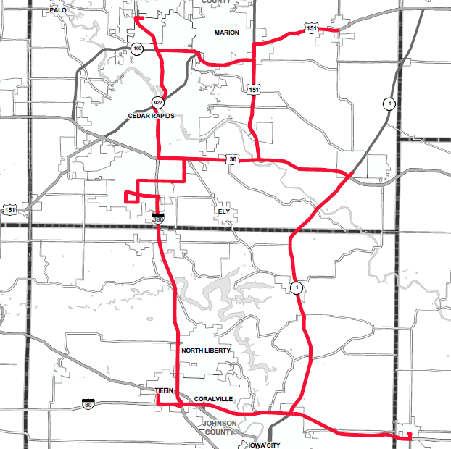
April Commission Tour Preview

Slide 3
April Commission Tour Preview
Begin tour at Doubletree by Hilton in Cedar Rapids
Mount Vernon and Lisbon Bypass
IA 1 Corridor
I-80 Corridor to West Branch (Six Lane)
I-80 First Avenue Interchange in Coralville
I-80/380 Systems Interchange
I-380 Forevergreen Rd Interchange (North Liberty)
I-380 Penn St Interchange (North Liberty)
I-380 Wright Bros. Blvd Interchange
Eastern Iowa Airport
I-380 Tower Terrace Interchange
US 151 Interchange in Springville

Slide 4
April Commission Tour Preview
Questions?
Shawn Majors
Shawn.majors@iowadot.gov​
iowadot.gov

