Slide 1
Revitalize Iowa’s Sound Economy Program
Iowa Transportation Commission Workshop
March 12, 2024

Slide 2
Revitalize Iowa’s Sound Economy Program
Created in 1985
Purpose: To promote economic development through roadway improvements.
Eligible development shall have value-adding activities that feed new dollars into the economy
Available to cities and counties through an application program

Slide 3
Monthly Program Financial Report
Funded annually with dedicated state motor fuel and special fuel tax revenues
 | City RISE Fund | County RISE Fund
FY2024 Projected Total RISE Road Use Tax Fund (RUTF) Revenue ¹ | $11,759,666 | $5,879,833
Actual RISE Revenue Received as of 1/31/2024 ² (% of FY2024 Projected Revenue) | $7,256,662 (61.7%) | $3,497,130 (59.5%)
FY2024 RISE Funds Awarded as of 1/31/24 (% of Projected Total RUTF committed) | $3,157,306 (26.8%) | $0 (0%)
Fund Balance as of 1/31/21 | $51,587,000 | $18,892,635
Outstanding Commitments as of 1/31/24 | ($36,587,921) | ($17,430,911)
Uncommitted Balance as of 1/31/24 | $14,999,079 | $1,461,724
¹ Calculation based on FY2023 average monthly RISE RUTF revenue of $979,972 to the city RISE fund and $489,986 to the county RISE fund. As of 1/31/2024, FY2024 is 58.3% complete.
² Actual RISE revenue includes RUTF revenue, loan repayments, and project settlements. These revenue sources are variable and are not included in projections.

Slide 4
Local Development Project Evaluation Criteria
Development Potential (35 points)
Economic Impact and Cost Effectiveness (20 points)
Local Commitment and Initiative (33 points)
Transportation Need and Justification (4 points)
Local Economic Need (6 points)

Slide 5
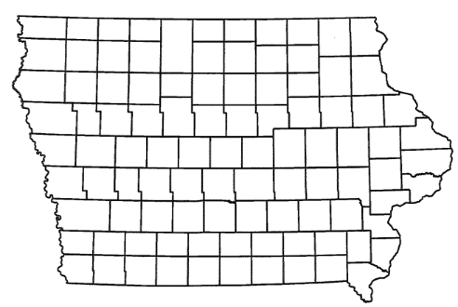
List of Local Development
Applications Recommended
PROJECT NAME
SPONSOR
SCORE
TOTAL PROJECT COST
PERCENT PARTICIPATION
RECOMMENDED AMOUNT
Construction of approximately 1,195 feet of SE Creekview Drive located on the southeast side of town | Ankeny | 43 | $1,535,279 | 50% | $767,640
Construction of additional roadway improvements to provide public access to a new Des Moines International Airport terminal (Amendment) | Des Moines | 73 | $7,026,700 | 50% | $3,513,350

Slide 6
List of Local Development
Applications Recommended
PROJECT NAME
SPONSOR
SCORE
TOTAL PROJECT COST
PERCENT PARTICIPATION
RECOMMENDED AMOUNT
Construction of approximately 1,033 feet of Eugene Way located on the west side of town | Mount Pleasant | 43 | $487,188 | 50% | $243,594
Construction of approximately 410 feet of new roadway and turn lanes on Business Highway 75 North on the northeast side of town | Sioux City | 62 | $2,501,913 | 50% | $1,250,957

Slide 7
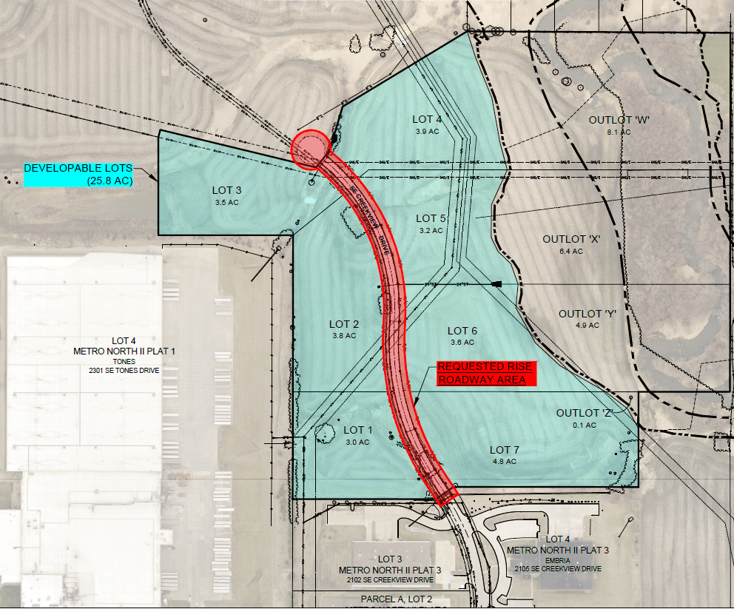
Ankeny
Local Development
Construction of approximately 1,195 feet of SE Creekview Drive located on the southeast side of town. This project is necessary to provide access to seven lots totaling more than 25 acres for light industrial purposes.
Total Cost: $1,535,279
Requested: $767,640 (50%)

Slide 8
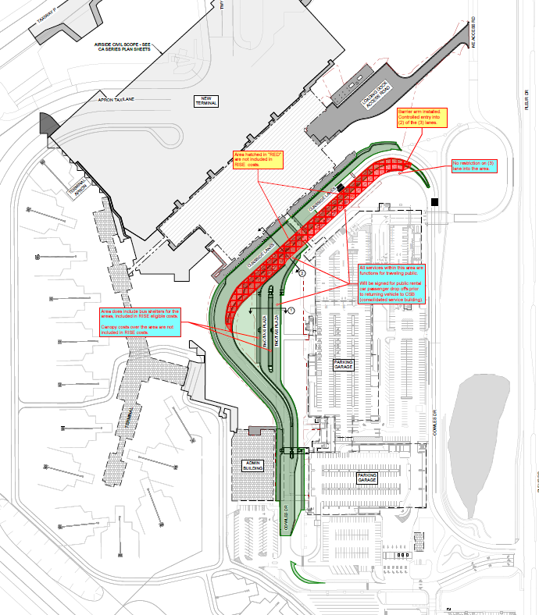
Des Moines
Local Development – Airport
(Amendment)
An amendment to the scope and grant award was requested to provide additional roadway improvements to provide public access (Phase 4) to a new Des Moines International Airport terminal.
Total Cost: $7,026,700
Requested: $3,513,350 (50%)
Awarded April 2020 (Phase 1)
Amended June 2021 (Phase 2&3)

Slide 9
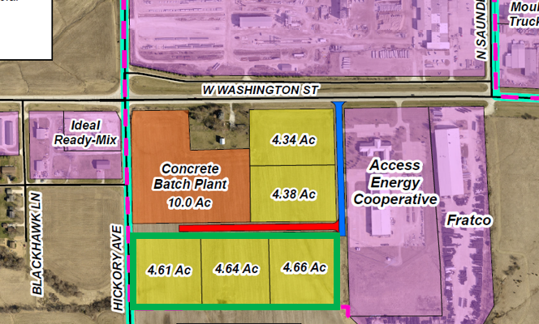
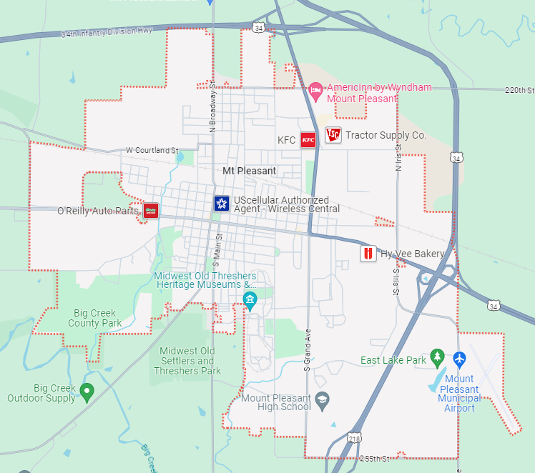
Mount Pleasant
Local Development
Construction of approximately 1,033 feet of Eugene Way located on the west side of town. This project is necessary to provide access to three lots totaling more than 13 acres for light industrial purposes.
Total Cost: $487,188
Requested: $243,594 (50%)

Slide 10
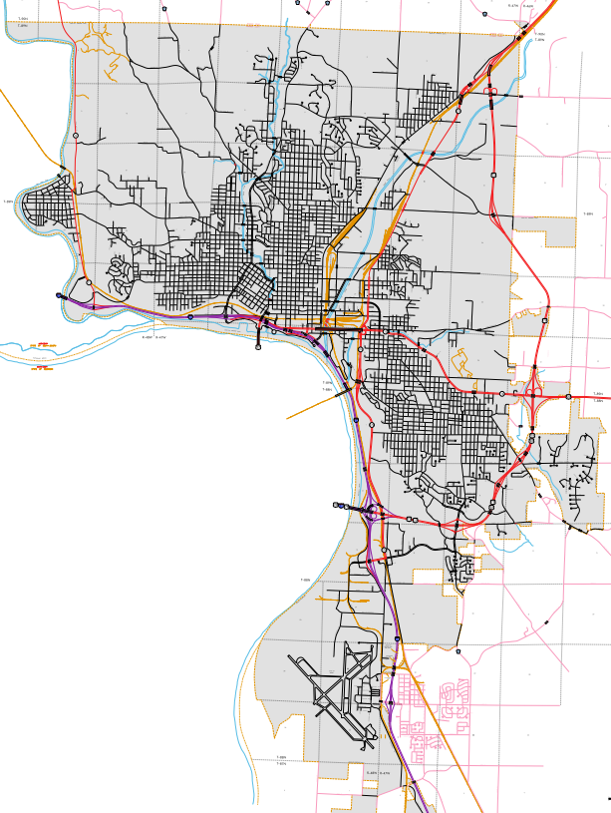
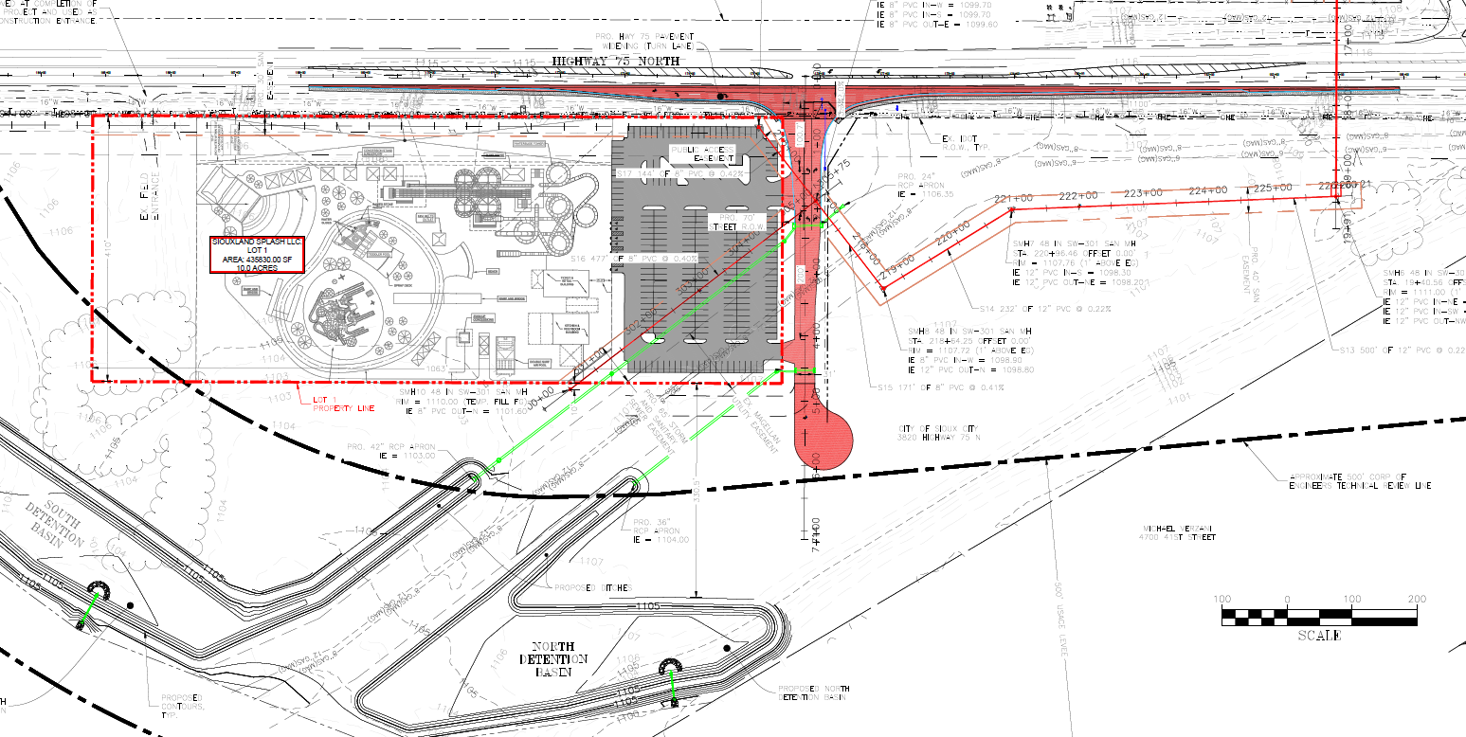
Sioux City
Local Development - Tourism
Construction of approximately 410 feet of new roadway and turn lanes on Business Highway 75 North on the northeast side of town. This project is necessary to support tourism by providing access to the proposed Siouxland Splash waterslide park development.
Total Cost: $2,501,913
Requested: $1,250,957 (50%)

Slide 11
RISE Cost Per Job Analysis
Due to a 22.1% Highway Construction Cost increase from 2021 to 2022, the maximum RISE Cost Per Job was increased from $13,000 to $14,000 in April 2023 for projects with high capital investment and/or high-quality wage rates/benefits that exceed normal applications.
The highway construction cost index from 2022-2023 has decreased by 1.3%.
No change recommended

Slide 12
QUESTIONS?
Jennifer Kolacia, RISE Program Manager
Jennifer.Kolacia@iowadot.us
515-239-1738

