Slide 1
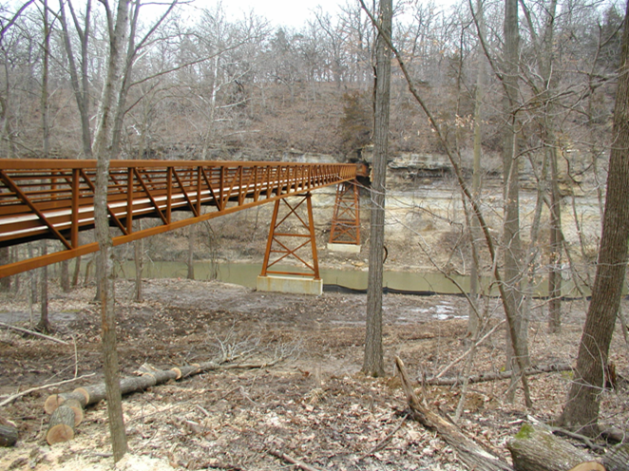

Statewide Transportation
Alternatives Set-aside Program
Funding Recommendation
March 12, 2024

Slide 2
Statewide Transportation Alternatives Set-aside Program
Current version of former Transportation Enhancement program that has existed since 1991
Majority of funding is distributed to Iowa’s MPOs and RPAs, but $5 million reserved for statewide projects annually with 20% target for Safe Routes to School projects
Eligible activities may include:
On-road and off-road non-motorized trail facilities, safe routes for non-drivers, conversion of abandoned rail corridors for trails, preservation/rehabilitation of historic transportation facilities among others
Federal Recreational Trails Program eligible activities
Infrastructure-related or non-infrastructure related Safe Routes to School Projects
Scenic Byways

Slide 3
Project Evaluation Criteria
Statewide or multi-regional impact of the project (25 points)
Connectivity and Completion of Trail Linkages (15 points)
Alignment with Local, Regional, or Statewide Planning Documents (15 points)
Federal-aid Highway Project Development Process, Understanding and Capacity (10 points)
Contribution Toward Safety for All Transportation Modes (10 points)
Enhancement of Statewide Tourism Benefits (10 points)

Slide 4
Project Evaluation Criteria (continued)
Leverage of other funding sources(10 points)
Need for the proposed project (10 points)
Addresses high-need areas (10 points)
Improve accessibility (5 points)
Long-term maintenance plan (5 points)
Project readiness (5 points)

Slide 5
Available Funding and Application Summary
Available Funding
Safe Routes to School (SRTS) Funding Target: $2,000,000
All Other Projects Funding Target: $8,000,000
Total Funding Available: $10,000,000
Application Summary
Total number of projects: 28
Total project costs: $50,078,218
Total amount requested: $20,962,374

Slide 6
Safe Routes to School Applications Recommended
PROJECT NAME | SPONSOR | SCORE | TOTAL PROJECT COST | REQUESTED AMOUNT (% of Total Project Cost) | RECOMMENDED AMOUNT (% of Total Project Cost)
Iowa Safe Routes Partnership | Iowa Northland Regional Council of Governments | 97 | $322,635 | $258,108 (80%) | $258,108 (80%)
Safe Routes to School & Recreational Trails Phase 1 | Logan | 80 | $1,193,761 | $652,212 (55%) | $652,212 (55%)
3rd Street Sidewalk Extension Project | Anamosa | 73 | $1,208,300 | $650,000 (54%) | $650,000 (54%)
Washington Avenue Safe Routes to School | Grinnell | 72 | $727,364 | $581,891 (80%) | $581,891 (80%)
Jump to applications not recommended for funding

Slide 7
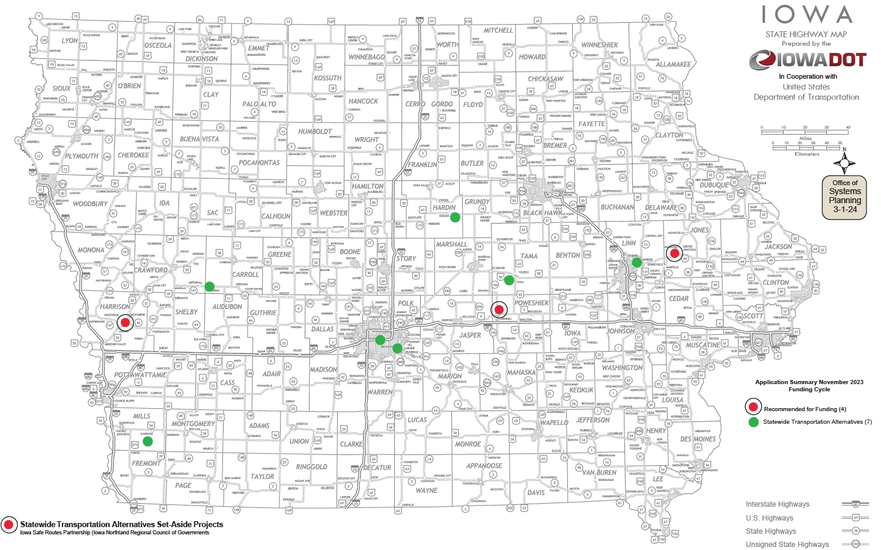
Safe Routes to School Applications Received

Slide 8
All Other Applications Recommended
PROJECT NAME | SPONSOR | SCORE | TOTAL PROJECT COST | REQUESTED AMOUNT (% of Total Project Cost) | RECOMMENDED AMOUNT (% of Total Project Cost)
Iowa River’s Edge Trail Surfacing and South Fork Bridge Replacement | Hardin County Conservation Board | 118 | $3,990,000 | $2,000,000 (50%) | $2,000,000 (50%)
Clear Creek Trail | Johnson County Conservation Board | 109 | $3,714,481 | $1,800,000 (48%) | $1,800,000 (48%)
Grant Street South Realignment | Bondurant | 102 | $3,251,000 | $500,000 (15%) | $500,000 (15%)
Hickman Interchange Bicycle/Pedestrian Facilities | Clive | 98 | $6,830,000 | $800,000 (12%) | $800,000 (12%)
Bentonsport Pedestrian Bridge Rehabilitation | Van Buren County Conservation | 96 | $2,039,500 | $1,612,500 (79%) | $1,612,500 (79%)
Mississippi River Trail Eagle Ridge Road to May Street | LeClaire | 95 | $1,268,542 | $1,014,833 (80%) | $1,014,833 (80%)
Jump to applications not recommended for funding

Slide 9
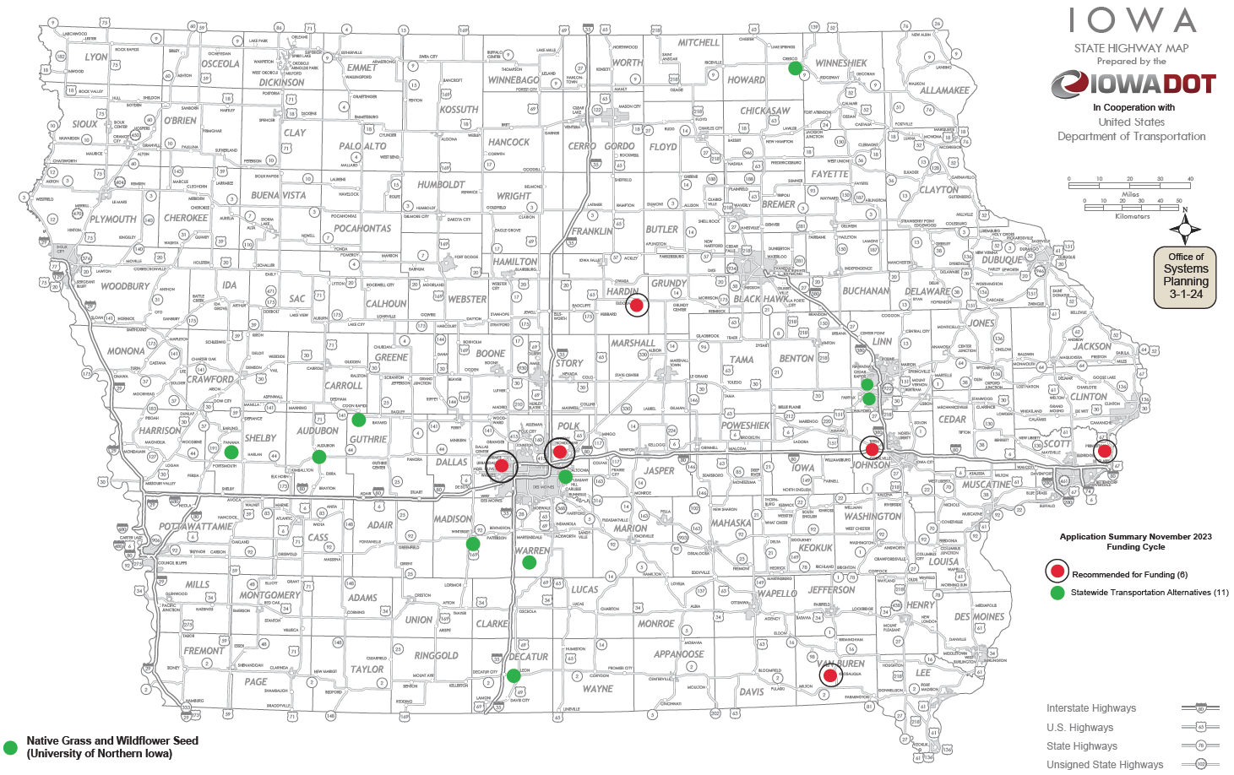
All Other Applications Received

Slide 10

QUESTIONS?
Susan Hollenkamp, Systems Planning Bureau
Susan.Hollenkamp@Iowadot.us
515-239-1810

Slide 11
Iowa Safe Routes Partnership (Iowa Northland Regional Council of Governments)
A comprehensive program that provides support to communities by implementing SRTS initiatives, including pedestrian and bicycle safety education through encouragement activities both inside and outside the classroom. The project is a collaboration among INRCOG, Upper Explorerland Regional Planning Commission (UERPC), and the Iowa Bicycle Coalition.
Total Cost: $322,635
Requested: $258,108 (80%)
Return to List of Applications Recommended

Slide 12
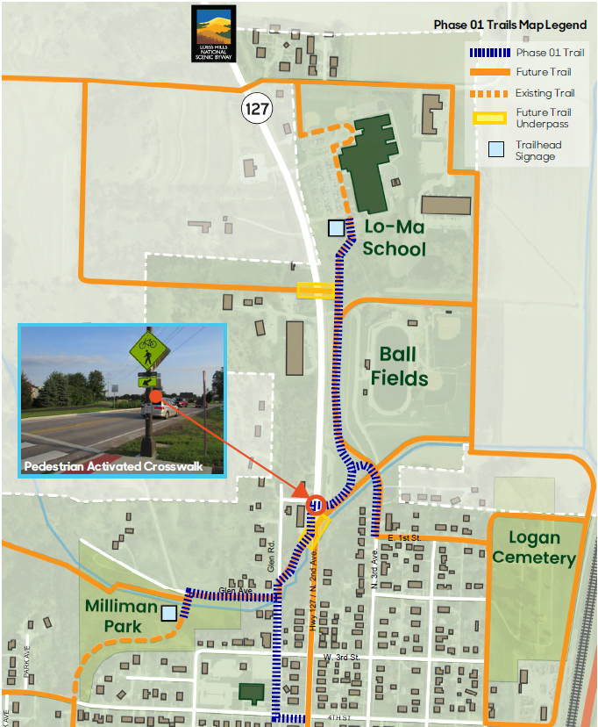
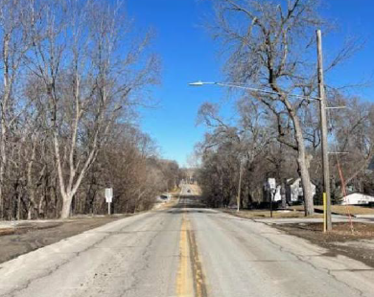
Safe Routes to School & Recreational Trails Phase 1 (Logan)
This project will construct a 0.81-mile trail and improvements to an at-grade crosswalk at Iowa 127 to improve connectivity between west and east sides of town and address a significant community concern of connectivity to Logan-Magnolia Community School District (Lo-Ma CSD), a Pre-K-12 school located on the north side of town. The project is the first phase of an over 5-mile planned trail in Logan.
Total Cost: $1,193,761
Requested: $652,212 (55%)
Return to List of Applications Recommended

Slide 13
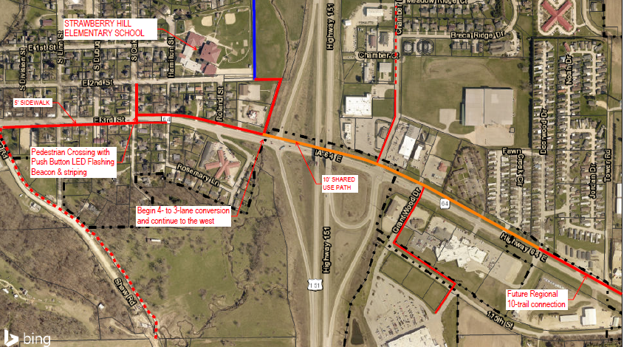
3rd Street Sidewalk Extension Project (Anamosa)
The 3rd Street Sidewalk Extension Project in Anamosa will connect students in east Anamosa with the schools located in west Anamosa across U.S. 151 by constructing sidewalk and trail segments approximately 1-mile in length and a pedestrian crossing of Iowa 64.
Total Cost: $1,208,300
Requested: $650,000 (54%)
Return to List of Applications Recommended

Slide 14
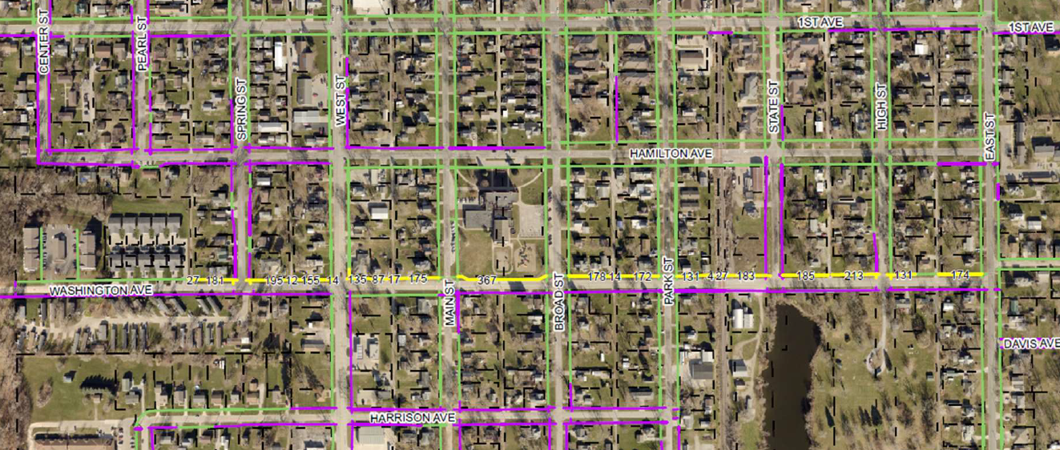
Washington Avenue Safe Routes to School (Grinnell)
This Project will add 0.6-mile of sidewalk on Washington Avenue allowing students to walk or bike to Davis Elementary school safely from both the east and west sides of Grinnell.
Total Cost: $727,364
Requested: $581,891 (80%)
Return to List of Applications Recommended

Slide 15
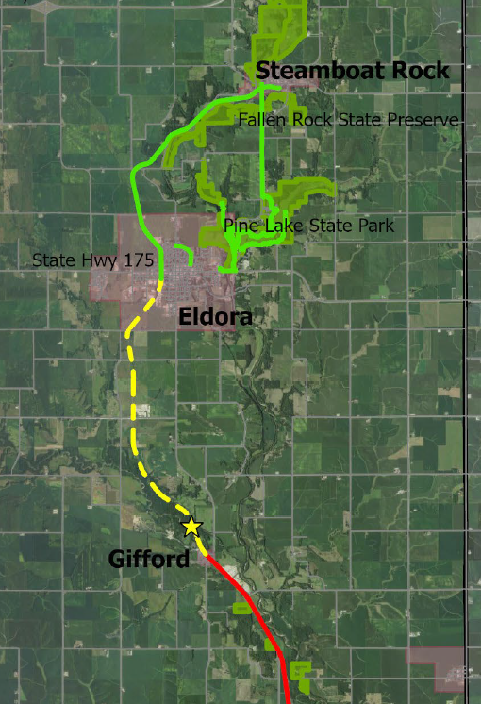
Iowa River’s Edge Trail Surfacing and South Fork Bridge Replacement (Hardin County Conservation Board)
This project phase will extend paving of the Iowa River’s Edge Trail 5.5 miles from Iowa 175 in Eldora, crossing 5 rehabilitated rail bridges, to 285th Street in Gifford. It will also rehabilitate a 235 linear foot bridge over the South Fork of the Iowa River. The Iowa River’s Edge Trail is a planned 34-mile trail connecting Steamboat Rock in Hardin County and Marshalltown in Marshall County.
Total Cost: $3,990,000
Requested: $2,000,000 (50%)
Return to List of Applications Recommended

Slide 16
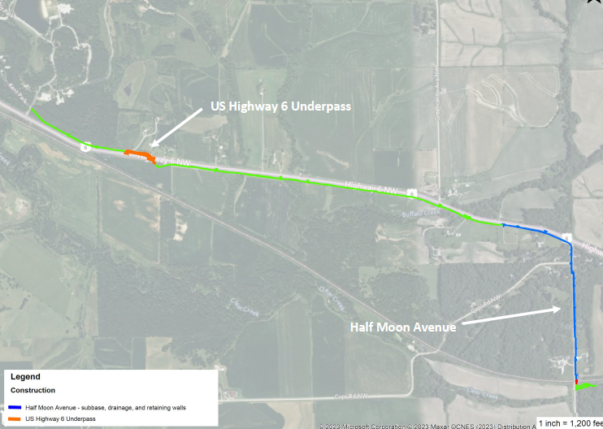
Clear Creek Trail to F.W. Kent Park (Johnson County Conservation Board)
This project includes trail construction along two segments of the Clear Creek Trail that will contribute to connecting Iowa City to F.W. Kent Park and eventually the Amana Colonies. Grading, excavation, retaining wall construction and subbase installation along Half Moon Avenue as well as an underpass of U.S. 6 near F. W. Kent Park will be completed.
Total Cost: $3,714,481
Requested: $1,800,000 (48%)
Return to List of Applications Recommended

Slide 17
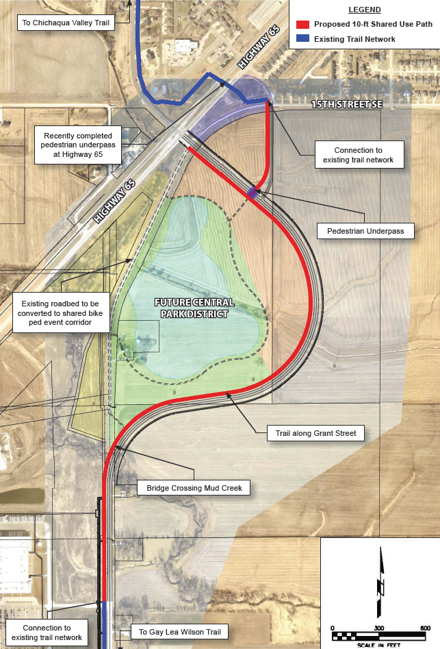
Grant Street South Realignment (Bondurant)
This project will construct a 6,200-foot trail parallel to realigned Grant Street South between U.S. 65 to the north and 32nd Street to the South as well as a pedestrian underpass connecting 15th Street South with realigned Grant Street South. The project contributes to a future connection between the Chichaqua Valley Trail and Gay Lea Wilson Trail.
Total Cost: $3,251,000
Requested: $500,000 (15%)
Return to List of Applications Recommended

Slide 18
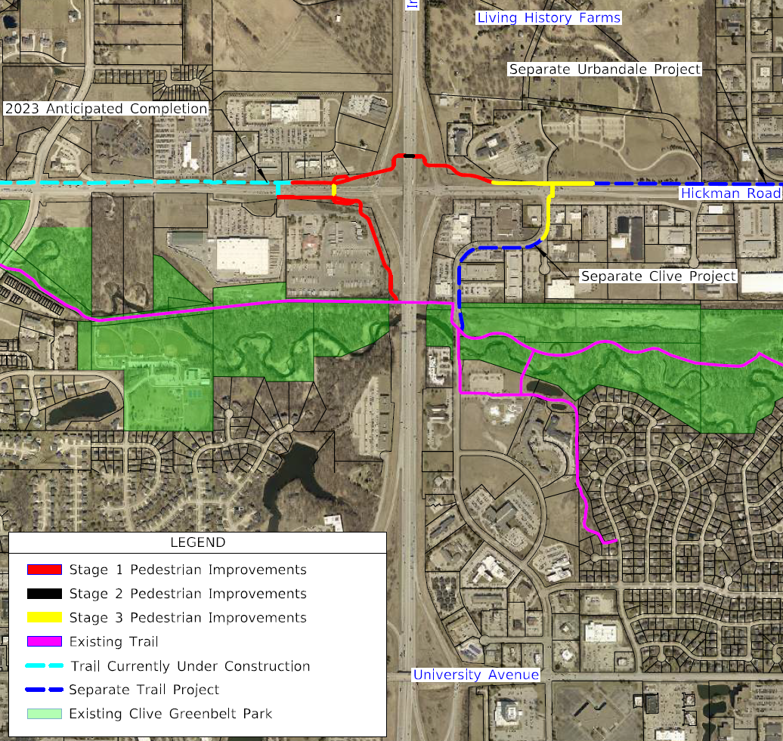
Hickman Interchange Bicycle/Pedestrian Facilities (Clive)
This project will construct bicycle and pedestrian facilities as part of the Interstate 35/80 and Hickman Road interchange reconstruction project. The project includes construction of a regional trail connection between the Raccoon River Valley Trail and the Clive Greenbelt Park and trail system.
Total Cost: $6,830,000
Requested: $800,000 (12%)
Return to List of Applications Recommended

Slide 19
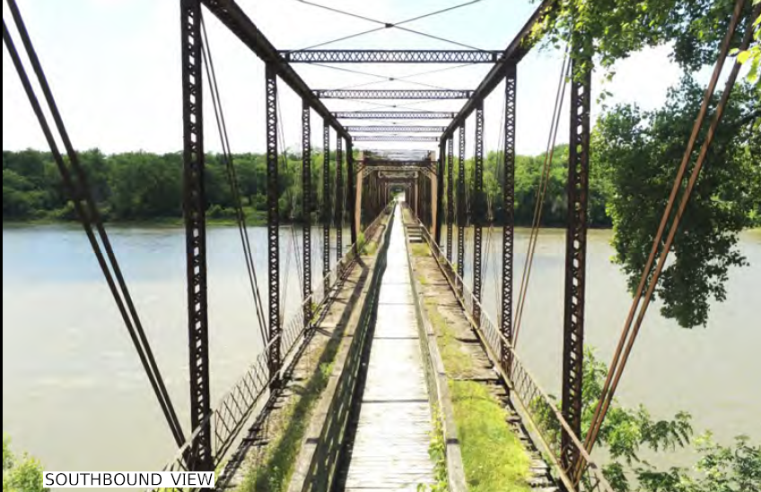
Bentonsport Pedestrian Bridge Rehabilitation (Van Buren County Conservation Board)
This project will repair and retrofit damaged iron members, tuckpoint stone supports, remove remnants of the old wood and asphalt roadbed, and replace the aging wood pedestrian walkway on the 1882 five-span Des Moines River truss bridge in the Bentonsport National Historic District.
Total Cost: $2,039,500
Requested: $1,612,500 (79%)
Return to List of Applications Recommended

Slide 20
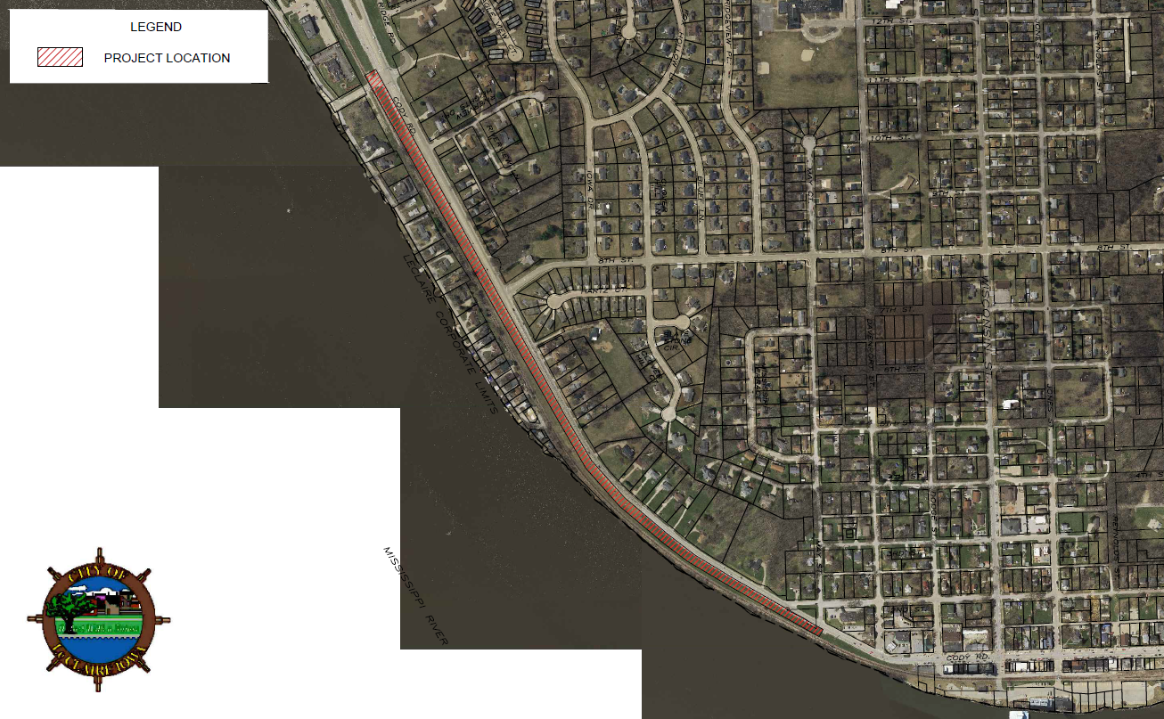
Mississippi River Trail Eagle Ridge Road to May Street (LeClaire)
This project will construct a 4,500-foot trail along U.S. 67 in LeClaire as part of the Mississippi River Trail connecting commercial districts from Eagle Ridge Road to May Street.
Total Cost: $1,268,542
Requested: $1,014,833 (80%)
Return to List of Applications Recommended

Slide 21
Safe Routes to School Applications Not Recommended for Award
PROJECT NAME | SPONSOR | SCORE | TOTAL PROJECT COST | REQUESTED AMOUNT (% of Total Project Cost) | RECOMMENDED AMOUNT (% of Total Project Cost)
Independence Trail | Manning | 67 | $636,000 | $508,800 (80%) | $0
Des Moines Metropolitan Safe Routes to School Project | Iowa Bicycle Coalition | 64 | $226,786 | $181,429 (80%) | $0
Eldora Safe Routes to School | Eldora | 62 | $311,000 | $248,000 (50%) | $0
Pedestrian Hybrid Beacon at W.16th Street and U.S. 63 | Tama | 54 | $210,000 | $168,000 (80%) | $0
Malvern Safe Route to School Wolverine Trail | Malvern | 50 | $529,183 | $303,680 (57%) | $0
Marion Schools Sidewalk Gap Infill | Marion | 45 | $562,520 | $402,000 (71%) | $0
Carlisle Safe Routes to School | Carlisle | 30 | $805,305 | $644,244 (80%) | $0
Return to List of Applications Recommended

Slide 22
All Other Applications Not Recommended for Award
PROJECT NAME | SPONSOR | SCORE | TOTAL PROJECT COST | REQUESTED AMOUNT (% of Total Project Cost) | RECOMMENDED AMOUNT (% of Total Project Cost)
Great Western Trail Rehabilitation Phase 2 | Warren County Conservation Board | 87 | $2,154,000 | $1,200,000 (56%) | $0
Wapsi Great Western Line Trail Renovation Elma to Acme | Howard County Conservation Board | 85 | $2,447,411 | $1,957,928 (80%) | $0
Native Grass and Wildflower Seed | University of Northern Iowa | 79 | $400,676 | $320,541 (80%) | $0
Little River Scenic Pathway Extension Phase 2 | Decatur County Conservation Board | 71 | $555,000 | $184,000 (33%) | $0
Ballpark to Ballpark Trail Phase 2 | Shelby County | 68 | $903,975 | $124,885 (14%) | $0
T‐Bone Trail Resurfacing Audubon to Hamlin | Audubon County Conservation Board | 64 | $1,170,000 | $936,000 (80%) | $0
Return to List of Applications Recommended

Slide 23
All Other Applications Not Recommended for Award
PROJECT NAME | SPONSOR | SCORE | TOTAL PROJECT COST | REQUESTED AMOUNT (% of Total Project Cost) | RECOMMENDED AMOUNT (% of Total Project Cost)
Adventureland Drive NW Reconstruction 17th Ave NW to 9th Ave NW Bicycle/Pedestrian Improvements | Altoona | 64 | $9,807,500 | $540,800 (6%) | $0
Morgan Creek Trail Phase 4 | Linn County Conservation Board | 63 | $1,910,000 | $1,280,000 (67%) | $0
Morgan Creek Trail Cedar River Bridge | Linn County Conservation Board | 63 | $500,000 | $400,000 (80%) | $0
Riverside Trail Rehabilitation | Coon Rapids | 59 | $1,174,000 | $804,800 (69%) | $0
Holliwell Covered Bridge Rehabilitation | Madison County | 58 | $1,229,280 | $887,424 (72%) | $0
Return to List of Applications Recommended

