Slide 1
Transportation Asset Management Summary
March 12, 2024
Charlie Purcell
Deputy Director, Transportation Development Division
3/2/2023

Slide 2
Asset Type | How Many? | How Much?
Roads (lane miles) | 24,534 | $31 billion
Bridges | 4,174 | $20 billion
Total |  | $51 billion
Why is asset management important?
TRANSPORTATION ASSET MANAGEMENT SUMMARY
Notes:
Even a 1% increase in efficiency yields $510M in savings over the entire asset lifecycle

Slide 3
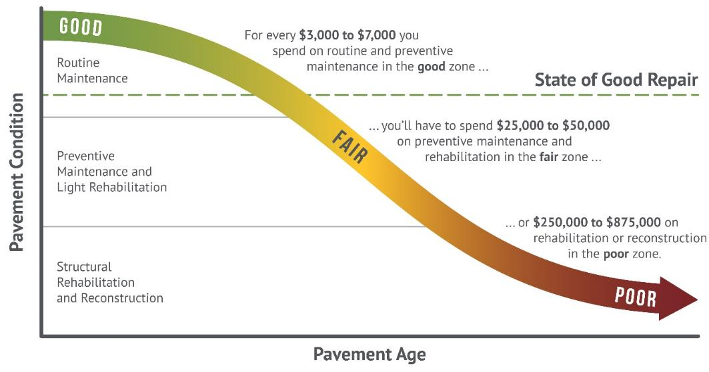
How we set targets
Targets are set to maintain a state of good repair
Maintaining assets in a state of good repair minimizes overall lifecycle costs (good roads cost less)

Slide 4
Cost Comparisons – what does $10 million buy?
1 mile of new 4-lane expressway, or
3 miles of 2-lane pavement reconstruction, or
16 miles of pavement resurfacing, or
3 bridge replacements

Slide 5
Previous presentations
Sep 2023 – Highway Planning Overview
Oct 2023 – Asset Management Overview
Dec 2023 – Interstate Plan Update
Jan 2024 – Pavement Asset Management
Feb 2024 – Bridge Asset Management

Slide 6
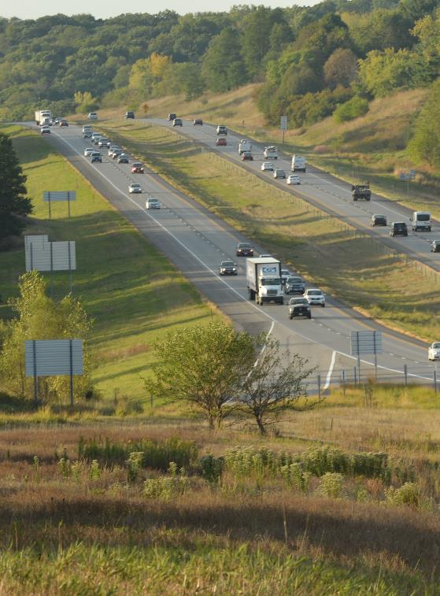
Key takeaways – Interstate Plan
Funding constraints have delayed many capacity expansion projects beyond 2050
Near term priorities for future capacity expansion remain unchanged
I-380 from Iowa City to Cedar Rapids
I-35 from Ankeny to Ames
I-80 from Iowa City to Cedar River
I-80 from Altoona to Mitchellville

Slide 7
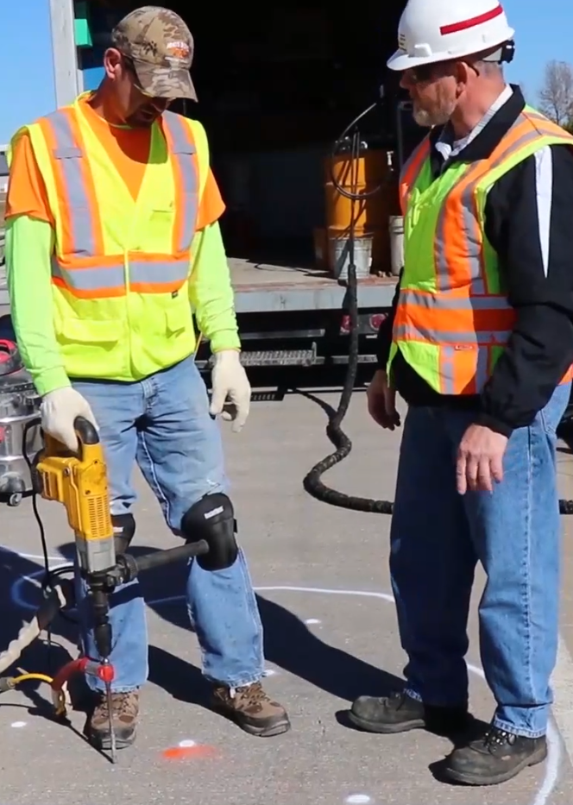
Key takeaways – Bridges
Good progress has been made reducing the number of poor bridges on the primary system
However, without continued increases to investments, this trend is likely to reverse due to the large number of aging bridges built in the 50’s, 60’s and 70’s.
Preventative maintenance investments are extending the life of our structures
Large bridges represent major capital investments that need to be planned far in advance
Notes:
Only 26 poor bridges on the state system, or about 0.6% of the total

Slide 8
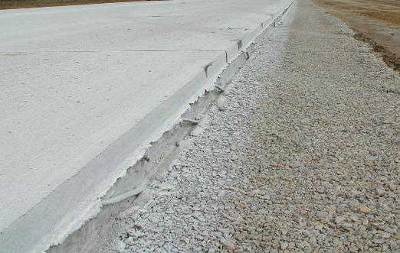
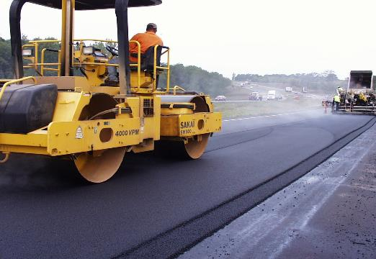
Key takeaways – Pavements
Need to increase our investments in both pavement rehabilitation and pavement replacement
Need to continue increasing the rate at which our pavements are replaced
Condition targets can be met in the short term, but without additional investment, conditions will decline over the long term
Notes:
Non-interstate pavements are only being replaced at about 0.1% per year.
If we assume the replacement cycle is 100 years, this needs to be at least 1%, but 100-year pavement life is not realistic right now

Slide 9
Steps towards a stewardship focus
2017
Started current series of Asset Management workshop presentations connected to the 5-year program development process
2018
Began steady increases to Non-Interstate Bridge Modernization targets
Began steady increases to Non-Interstate Pavement Modernization targets
2021
Added 500k/year to Statewide Contract Maintenance line item starting in FY21 and continuing

Slide 10
Steps towards a stewardship focus
2022
Increased Non-Interstate Pavement Modernization target by $35M/year for pavement replacements starting FY27 and continuing
Increased Non-Interstate Bridge Modernization target by $20M/year starting in FY27 and continuing
Increased Safety Specific target by $5M/year starting in FY27 and continuing
2023
Increased Statewide Interstate Rest Area maintenance target by 100k/year starting in FY25 and continuing
2024 (proposed)
Dedicate $55M annually for pavements within the Interstate Stewardship program target
Reserve $15M of this amount in Years 2-5 to account for unforeseen needs that will arise

Slide 11
Evidence of a stewardship focus
The percentage of the program devoted to stewardship has continued to increase

Slide 12
Summary recommendations
Continue increases in stewardship investments
Consider slight shifts in the rate of increase between pavement and bridge investments
Limit capacity expansions to a few prioritized interstate corridors

Slide 13
Questions?

