Slide 1
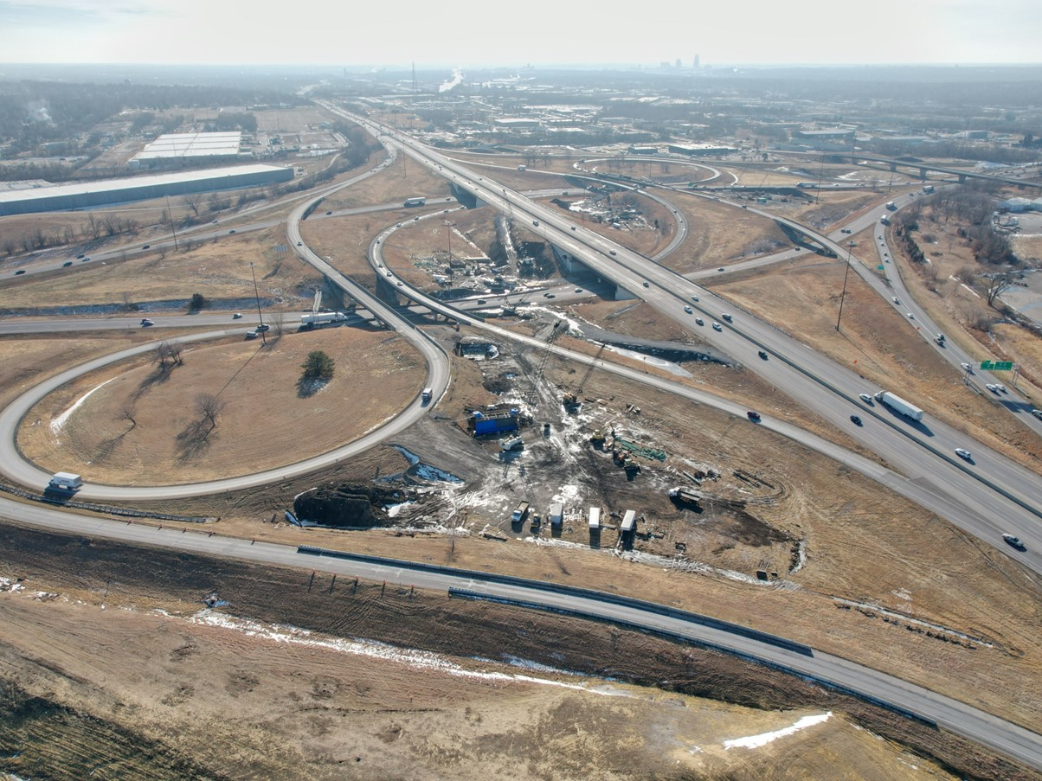


2025-2029 Highway Program Development
March 12, 2024
3/2/2023

Slide 2
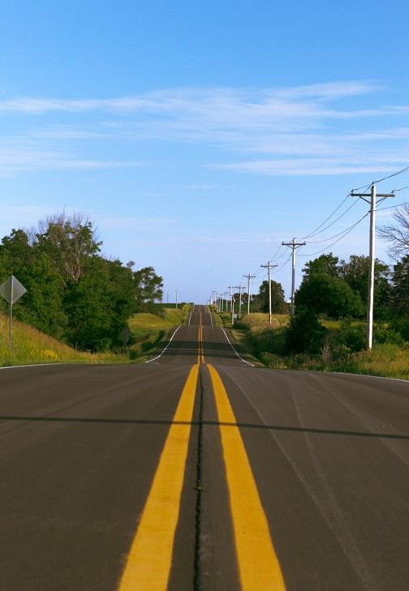

Agenda
TOPIC 1
2025-2029 Highway Program Funding
TOPIC 2
Statewide Line Items
TOPIC 3
Highway Program Analysis
TOPIC 4
Program Development Considerations
TOPIC 5
Determine Highway Program Objectives
TOPIC 6
Next Steps

Slide 3
March 12, 2024
Highway Program Development Schedule (2025-2029)
March 2024
Discuss 2025-2029 available Highway Program funding
Discuss 2025-2029 Highway Program options
Determine 2025-2029 Highway Program objectives
Action Item: Line Item Targets for Programming
April 2024
Develop the Draft 2025-2029 Highway Program
Action Item: 2025-2029 Highway Program objectives
May 2024
Present the Draft 2025-2029 Iowa Transportation Improvement Program to the public (including all previous Program approvals and Draft 2025-2029 Highway Program)
June 2024
Action Item: Approve the 2025-2029 Iowa Transportation improvement Program

Slide 4
March 12, 2024
2025-2029 Iowa Highway Program
Decision Points
Should projects in the 2025-2028 Program continue to be programmed with cost/schedule updates?
2. How should Program be balanced?

Slide 5
Topic 1
2025-2029 Highway Program Funding

Slide 6
March 12, 2024

Slide 7
March 12, 2024
2025-2029 Iowa Highway Program Funding Assumptions
RUTF/TIME-21
(For Highway Planning Purposes Only)
Overall forecast is conservative
Forecast continues to reflect expected reduction in fuel tax revenue
TIME-21 funding cap of $225 million has been met
Average combined RUTF/TIME-21 growth of 0.7% annually

Slide 8
March 12, 2024
Federal Funding Status
FFY 2024 Appropriation:
Bill signed into law on March xx, 2024
Highway Infrastructure Program bridge funding not included in FFY 2024 appropriations bill
August Redistribution expected to be large once again
Federal Funding forecast increased due to current estimates of August Redistribution to Iowa
Infrastructure Bill authorizes federal funding through September 30, 2026, leaving some funding uncertainty for the last three years of this Program.
Infrastructure Bill funding allocations based on Commission action in June 2022.
The next Highway Trust Fund cliff is in 2028.

Slide 9
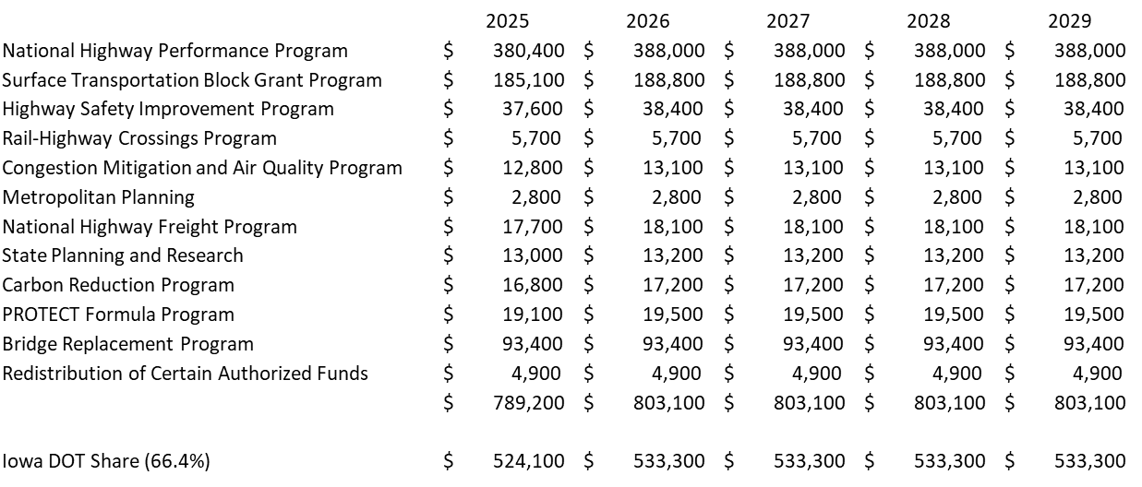
March 12, 2024
2025-2029 Forecast of Iowa Federal-Aid Formula Transportation Authorized Funds
(x $1,000)
(For Highway Planning Purposes Only)
Total Federal-Aid Formula Funds Forecast to DOT Programs
(x $1,000,000
2025 - ($524.1 @ 87.0% Obligation Authority = $456.0) + (August Redistribution $60.0) = $516.0
2026 - ($533.3 @ 87.0% Obligation Authority = $464.0) + (August Redistribution $30.0 + $18.4 HIP Bridge) = $512.4
2027 - ($533.3 @ 87.0% Obligation Authority = $464.0) + (August Redistribution $30.0 + $18.4 HIP Bridge) = $512.4
2028 - ($533.3 @ 87.0% Obligation Authority = $464.0) + (August Redistribution $30.0 + $18.4 HIP Bridge) = $512.4
2029 - ($533.3 @ 87.0% Obligation Authority = $464.0) + (August Redistribution $30.0 + $18.4 HIP Bridge) = $512.4

Slide 10
March 12, 2024
2025-2028 Highway Program Funding with Possible Changes That Could Impact Funds Available for ROW/Construction
($ in millions)
(For Highway Planning Purposes Only)
 |  | 2025 |  | 2025 |  | 2026 |  | 2026 |  | 2027 |  | 2027 |  | 2028 |  | 2028
 |  | (Mar '23) |  | (Mar '24) |  | (Mar '23) |  | (Mar '24) |  | (Mar '23) |  | (Mar '24) |  | (Mar '23) |  | (Mar '24)
 |  |  |  | change |  |  |  | change |  |  |  | change |  |  |  | change
Estimated Income
A. Primary Road Fund (PRF) |  | 775.1 |  | 42.5 |  | 783.6 |  | 43.1 |  | 787.1 |  | 43.7 |  | 793.7 |  | 44.6
B. Est. Time 21 Revenue to PRF |  | 135.0 |  |  |  | 135.0 |  |  |  | 135.0 |  |  |  | 135.0
C. Miscellaneous (State) |  | 25.0 |  |  |  | 25.0 |  |  |  | 25.0 |  |  |  | 25.0
D. Federal Aid (Formula) |  | 505.1 |  | 10.9 |  | 513.3 |  | -0.9 |  | 513.3 |  | -0.9 |  | 513.3 |  | -0.9
Estimated Income Total |  | 1440.2 |  | 53.4 |  | 1456.9 |  | 42.2 |  | 1460.4 |  | 42.8 |  | 1467.0 |  | 43.7
Allocations
E. Operations/Maintenance Budget (PRF) |  | 390.8 |  | 18.1 |  | 402.9 |  | 12.5 |  | 415.1 |  | 18.4 |  | 427.3 |  | 12.8
F. Back of Program Line Items and Rail Highway |  | 186.0 |  | 13.9 |  | 187.0 |  | 15.9 |  | 188.0 |  | 15.9 |  | 193.6 |  | 16.0
Allocations Total |  | 576.8 |  | 32.0 |  | 589.9 |  | 28.4 |  | 603.1 |  | 34.3 |  | 620.9 |  | 28.8
Funds Available for ROW/Construction |  | 863.4 |  | 21.4 |  | 867.0 |  | 13.8 |  | 857.3 |  | 8.5 |  | 846.1 |  | 14.9
Black: Previous discussion
Green: Changes since previous discussion

Slide 11
March 12, 2024
2025-2029 Highway Program Funding Available for ROW/Construction
($ in millions)
(For Highway Planning Purposes Only)
 |  | 2025 |  | 2026 |  | 2027 |  | 2028 |  | 2029
Estimated Income
A. Primary Road Fund (PRF) |  | 817.6 |  | 826.7 |  | 830.8 |  | 838.3 |  | 845.5
B. Est. Time 21 Revenue to PRF |  | 135.0 |  | 135.0 |  | 135.0 |  | 135.0 |  | 135.0
C. Miscellaneous (State) |  | 25.0 |  | 25.0 |  | 25.0 |  | 25.0 |  | 25.0
D. Federal Aid (Formula) |  | 516.0 |  | 512.4 |  | 512.4 |  | 512.4 |  | 512.4
Estimated Income Total |  | 1493.6 |  | 1499.1 |  | 1503.2 |  | 1510.7 |  | 1517.9
Allocations
E. Operations/Maintenance Budget (PRF) |  | 408.9 |  | 415.4 |  | 433.5 |  | 440.1 |  | 458.2
F. Back of Program Line Items and Rail Highway |  | 199.9 |  | 202.9 |  | 203.9 |  | 209.6 |  | 210.6
Allocations Total |  | 608.8 |  | 618.3 |  | 637.4 |  | 649.7 |  | 668.8
Funds Available for ROW/Construction |  | 884.8 |  | 880.8 |  | 865.8 |  | 861.0 |  | 849.1
Black: Previous discussion

Slide 12
Topic 2
Statewide Line Items

Slide 13
March 12, 2024
Draft 2025-2029 Iowa Highway Program Line Items
($ in thousands)
At what levels should the line item targets be programmed?
March Action Item:
Line Item Targets for Programming

Slide 14
Topic 3
Highway Program Analysis

Slide 15
March 12, 2024 as presented February 13, 2024
2025-2034 Highway Program Analysis
($ in millions)
(For Highway Planning Purposes Only)

Slide 16
March 12, 2024
2025-2034 Highway Program Analysis
($ in millions)
(For Highway Planning Purposes Only)

Slide 17
March 12, 2024
Stewardship Targets - Possible Adjustments
Non-Interstate Pavement Modernization
Pavement needs are increasing faster than current stewardship target increases
Increase 2027 target by $5m and 2028-2034 targets by $10m annually
Non-Interstate Bridge Modernization
Significant increases in stewardship investment and innovative preventative maintenance has resulted in significant progress in reducing Iowa’s primary system bridges in poor condition
Reduce the magnitude of future stewardship target increases by $5m in 2027 and $10m annually in 2028-2034.
Stewardship investment targets continue to grow through 2034 with this possible change
Safety Specific
Allow for quicker implementation of statewide centerline rumble strip program. Ninety-six percent implementation on two lane highways by end of 2025
One time increase of $1.5m in 2025 target

Slide 18
March 12, 2024
2025-2034 Stewardship Targets with Possible Changes
($ in millions)
(For Highway Planning Purposes Only)

Slide 19
March 12, 2024
2025-2034 Stewardship Targets
($ in millions)
(For Highway Planning Purposes Only)

Slide 20
March 12, 2024
Underfunded Projects with Possible Changes
($ in millions)
(For Highway Planning Purposes Only)

Slide 21
March 12, 2024
Underfunded Projects
($ in millions)
(For Highway Planning Purposes Only)

Slide 22
March 12, 2024
2025-2034 Highway Program Analysis
($ in millions)
(For Highway Planning Purposes Only)

Slide 23
March 12, 2024
Notable 2025-2028 Iowa Highway Program Changes
US 30 Missouri Valley Bypass
Decrease in program amount from $113.2m to $62.6m
Decrease due to changes in design
Removal of flood gates
Levee removal
US 61 Louisa County
Move project one year in program
Due to design changes

Slide 24
March 12, 2024
2025-2034 Highway Program Analysis
($ in millions)
(For Highway Planning Purposes Only)

Slide 25
March 12, 2024
2025-2034 Highway Program Analysis
($ in millions)
(For Highway Planning Purposes Only)

Slide 26
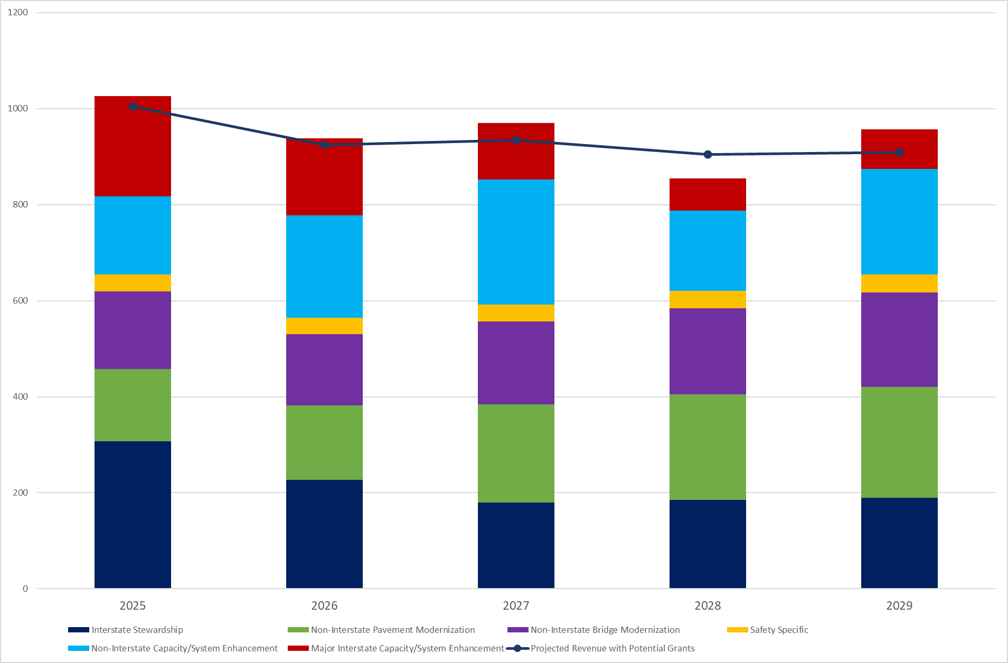
March 12, 2024
2025-2029 Highway Program Analysis
($ in millions)
(With Updated Revenue, FY 24 Projects Rescheduled, Project Cost and Schedule Updates)
(Updated Revenue includes Assumed Grant Awards)
(For Highway Planning Purposes Only)

Slide 27
March 12, 2024
2025-2034 Highway Program Analysis
($ in millions)
(For Highway Planning Purposes Only)
Proposed Highway Program Extended Highway Program
2025 2026 2027 2028 2029 2030 2031 2032 2033 2034
Highway Program Components
Interstate Stewardship 306.7 226.4 179.3 185.0 190.0 195.0 200.0 205.0 210.0 215.0
- Funds in years 2030 and beyond are placeholders (not programmed yet)
- Projects in 2025-2029 are specifically identified in the highway program and include the following major schedule changes and additions:
Adair I-80 bridges at Co Rd N54 delayed beyond 2029
Benton I-380 pavement rehabilitation advanced from 2026 to 2025
Cass I-80 bridges at 770th St delayed to 2029
Franklin I-35 pavement rehabilitation added to 2025
Iowa I-80 pavement rehabilitation advanced from 2027 to 2026
Mills I-29 pavement rehabilitation added to 2025
Polk I-80 Hickman Interchange work advanced from 2027 to 2026
Poweshiek I-80 US 63 Interchange delayed from 2028 to 2029
Poweshiek I-80 pavement rehabilitation added to 2025
Warren I-35 pavement replacement changed to pavement rehabilitation
Worth I-35 pavement rehabilitation advanced from 2027 to 2026

Slide 28
March 12, 2024
Changes to Rest Area Program
Rest Area Program was reevaluated since completion of 2024 Program
Emphasis placed on retaining/adding truck parking
Additions to I-29 prioritized to mitigate losses from Sergeant Bluff rest area closure
Delayed removals of parking only sites to end of rest area program
Addition of vault toilet facilities at parking only sites
Programmed rest area projects in the draft Program include:
2025
Linn I-380 SB parking (+14 spaces)
Iowa I-80 WB rest area building near Victor
2026
Monona I-29 NB parking near Onawa (+25 spaces)
Woodbury I-29 NB/SB rest area removal near Sergeant Bluff (-29 spaces)
2027
Monona I-29 NB rest area building near Onawa
Iowa I-80 WB parking near Victor (+16 spaces)
2028
Polk I-80 EB rest area building near Mitchellville
2029
Monona I-29 SB rest area building near Onawa
Polk I-80 EB parking near Mitchellville (+11 spaces)
2025-2029 Program will add 14 spaces on I-380, add 10 spaces on I-29*, and add 27 spaces on I-80
* Includes additional parking at reconstructed Salix weigh station

Slide 29
March 12, 2024
2025-2034 Highway Program Analysis
($ in millions)
(For Highway Planning Purposes Only)
Proposed Highway Program Extended Highway Program
2025 2026 2027 2028 2029 2030 2031 2032 2033 2034
Highway Program Components
Non-Interstate Pavement Modernization 151.2 155.0 205.0 220.0 230.0 235.0 240.0 245.0 250.0 255.0
- Funds in Years 2026 and beyond are placeholders (no specific projects identified except for 3R reconstruction)
- Projects in 2025 and 3R reconstruction projects in 2027-2029 will be specifically identified in the highway program (to be handed
out in April)
- Includes proposed adjustment to stewardship target.
Non-Interstate Bridge Modernization 160.9 148.9 172.8 179.6 197.0 200.0 205.0 210.0 215.0 220.0
- Funds in years 2030 and beyond are placeholders (not programmed yet)
- Projects in 2025-2029 will be specifically identified in the highway program (to be handed
out in April)
-Includes proposed adjustment to stewardship target.
Safety Specific 35.4 34.0 35.0 36.0 37.0 38.0 39.0 40.0 41.0 42.0
- Funds in Years 2026 and beyond are placeholders (no specific projects identified)
- Projects in 2025 will be specifically identified in the highway program (to be handed out in April)
-Includes proposed adjustment to 2025 Safety target

Slide 30
March 12, 2024
2025-2034 Highway Program Analysis
($ in millions)
(For Highway Planning Purposes Only)
Proposed Highway Program Extended Highway Program
2025 2026 2027 2028 2029 2030 2031 2032 2033 2034
Highway Program Components
Non-Interstate Capacity /
System Enhancement 163.3 213.1 260.4 166.7 220.5 106.6
- Funds in Years 2030 and beyond are project completion costs for projects already in Program
- Black Hawk US 218 delayed one year from 2025 to 2026
- Dubuque US 52/IA 3 delayed one year from 2024 to 2025
- Louisa US 61 delayed one year (ROW moves from 2025 to 2026 with corresponding changes in construction schedule)
Major Interstate Capacity /
System Enhancement 208.1 160.2 117.3 67.1 82.3 77.7 1.2
- Funds in years 2030 and beyond are project completion costs for projects already in Program
- Johnson I-80 advanced median grading from 2026 to 2025

Slide 31
March 12, 2024
Highway Program Studies/Requests
Route | County | Location | Purpose | Description | Consistent with SLRTP | Planning Status | Approx Cost
1 | Johnson/Linn | I-80 to US 30 | Mobility & Safety | Modernize 2-Lane | Y | --
6 | Scott | Kimberly Rd in Davenport from N Brady St to Elmore Ave | Operational & Safety | Construct Intersection Improvements | Y | --
12 | Woodbury | Gordon Dr Viaduct in Sioux City | Structurally Deficient | Replace Bridge | Y | Active | $150 M
18 | Clay / Palo Alto / Kossuth / Hancock | Spencer to Garner | Mobility & Safety | Modernize 2-Lane | Y | Complete
18 | Floyd / Chickasaw | Charles City to US 63 | Mobility & Safety | Modernize 2-Lane | Y | Begin in FY 24
18 | O'Brien / Clay | O'Brien Co Line to US 71 | Mobility & Safety | Modernize 2-Lane | Y | Begin in FY 24
20 | Dubuque | W of Old Highway Rd to Devon Dr in Dubuque | Operational & Safety | Access Control | Y | --
20 | Dubuque | Intersection with NW Arterial | Operational & Safety | Construct Intersection Improvements | Y | Complete
20 | Dubuque | Mississippi River Bridge | Functionally Obsolete | Add 2nd Bridge or Replace | Y | --
30 | Carroll / Greene / Boone | Co Rd N33 to E Jct US 169 | Mobility & Safety | Construct 4-Lane or Modernize 2-Lane | N/Y | -- | $265 M/ $130 M
30 | Tama | Intersection at Meskwaki Casino | Operational & Safety | Construct Interchange | NA | Begin FY 24
30 | Cedar/Clinton | Stanwood to Calamus | 4-Lane Continuity or Mobility | Construct 4-Lane or Modernize 2-Lane | N/Y | Complete | $100 M/ $50 M
30 | Clinton | Calamus to US 61 | 4-Lane Continuity or Mobility | Construct 4-Lane or Modernize 2-Lane | N/Y | Complete | $75 M/ $40 M
30 | Crawford / Carroll | Denison to Greene Co Line | Mobility & Safety | Modernize 2-Lane | Y | Begin in 24

Slide 32
March 12, 2024
Highway Program Studies/Requests
Route | County | Location | Purpose | Description | Consistent with SLRTP | Planning Status | Approx Cost
30 | Harrison / Crawford | E of Missouri Valley to E of Denison | Mobility & Safety | Modernize 2-Lane | Y | --
34 | Mills | RR Bridge 0.9 mi E of Co Rd L55 to Co Rd L66 | Mobility & Safety | Modernize 2-Lane | Y | Begin FY 24
34 | Mills/ Montgomery/ Adams | Co Rd L66 to E. Clark County Line | Mobility & Safety | Modernize 2-Lane | Y | --
34 | Union / Clarke / Lucas / Monroe / Wapello | E of Creston to W of Ottumwa | Mobility & Safety | Modernize 2-Lane | Y | Active
34 | Monroe / Wapello | E of Albia to W of Ottumwa | Mobility & Safety | Modernize 2-Lane | Y | Active
35 | Story | N of IA 315th St to 1.4 mi S of US 30 | Add Capacity | Construct 6-Lane | Y | Complete | $83 M
35 | Story | N of US 30 to 13th St in Ames | Add Capacity | Construct 6-Lane | Y | Complete
35 | Polk | Oralabor (IA 160) Interchange | Add Capacity and Improve Operations | Improve Interchange |  | --
35/80 | Polk | I-235 Interchange SW of Des Moines | Add Capacity and Improve Operations | Reconstruct Interchange and Add Lanes | Y | Complete | $300 M
35/80 | Polk | W of IA 415 to E of NE Mixmaster | Add Capacity and Improve Operations | Reconstruct and Add Lanes | Y | --
35/80/235 | Polk | SW to NE Mixmasters | Add Capacity and Improve Operations | Add, Modernize, and/or ICM Strategies | Y | Complete | Phase 1 - $90 M
63 | Davis / Wapello | Missouri St Line to Ottumwa | Mobility & Safety | Modernize 2-Lane | Y | Active
63 | Mahaska / Poweshiek | N of Oskaloosa to I-80 | Operational | Modernize 2-Lane | Y | --
63 | Poweshiek / Tama / Black Hawk | W Jct US 6 to Hudson | Mobility & Safety | Modernize 2-Lane | Y | Complete

Slide 33
March 12, 2024
Highway Program Studies/Requests
Route | County | Location | Purpose | Description | Consistent with SLRTP | Planning Status | Approx Cost
63 | Chickasaw / Howard | New Hampton to Minnesota St Line | Mobility & Safety | Modernize 2-Lane | Y | --
65/69 | Warren | Hillcrest Ave in Indianola to IA 5 | Operational & Safety | Improve Intersections | NA | --
67 | Scott | Mississippi River Bridge | Structurally Deficient | Replace Bridge (IL Lead) | Y | -- | $110 M
69 | Polk | Army Post Rd to I-80 | Operational & Safety |  | Y | Complete
71 | Carroll / Sac | IA 141 to W of IA 175 | Mobility & Safety | Modernize 2-Lane | Y | Begin FY 24
71 | Page / Montgomery / Cass / Audubon | Missouri St Line to Audubon Co Line | Mobility & Safety | Modernize 2-Lane | Y | --
74 | Scott | N of Lincoln Rd in Bettendorf to I-80 in Davenport | Add Capacity | Construct 6-Lane | N | Complete | $150 M
75 | Plymouth / Sioux | IA 60 in Le Mars to IA 10 | Operational | Modernize 2-Lane | Y | --
80 | Dallas | Co Rd R16 to W of Grand Prairie Parkway | Add Capacity | Construct 6-Lane | Y | Complete
80 | Polk / Jasper / Poweshiek / Iowa | Altoona to I-380 | Add Capacity | Construct 6-Lane | Y | Complete
80 | Cedar | West Branch to Cedar River | Add Capacity | Construct 6-Lane | Y | -- | $210 M
80 | Cedar / Scott | County Rd Y26 to W of I-280 | Add Capacity | Construct 6-Lane | Y | --
80 | Scott | W of I-280 to W of I-74 | Capacity and Operations | Construct 6-Lane | Y | Complete
80 | Scott | W of I-74 to W of Middle Rd in Bettendorf | Capacity and Operations | Construct 6-Lane | Y | Active

Slide 34
March 12, 2024
Highway Program Studies/Requests
Route | County | Location | Purpose | Description | Consistent with SLRTP | Planning Status | Approx Cost
80 | Scott | W of Middle Rd in Bettendorf to Mississippi River Bridge | Capacity and Operations | Construct 6-Lane | NA | Active
80 | Scott | Mississippi River Bridge in Le Claire | Add Capacity | Replace with Wider Bridge (Ill Lead) | Y | Active
100 | Linn | Collins Rd in Cedar Rpaids from W of Council St to 1st Ave | Add Capacity | Construct 6-Lane Local Lead) | Y | --
122 | Cerro Gordo | West Side of Mason City | Operational | Convert to Urban Section (Locally Led) | Y | Active
141 | Polk | Towner Dr Interchange in Grimes | Operational | Local Lead | Y | Active
150 | Benton / Buchanan / Fayette / Winneshiek | I-380 to N of Oelwein | Mobility & Safety | Modernize 2-Lane | Y | Active
151 | Benton/Iowa/Linn | Amana to SCL Fairfax | Mobility & Safety | Modernize 2-Lane | Y | Begin FY 24
150 / 52 | Fayette / Winneshiek | N of Oelwein to Minnesota State Line | Mobility & Safety | Modernize 2-Lane | Y | --
175 | Monona | Missouri River Bridge | Structurally Deficient | Evaluate Alternatives | Y | --
380 | Johnson | N of Swan Lake Rd to 120th St | Add Capacity | Construct 6-Lane | Y | Complete | $174 M
380 | Linn | S of US 30 to N of US 30 | Operational | Reconstruct Interchange/Construct 6-Lane | Y | --
380 | Linn | N of US 30 to Blairs Ferry Rd | Add Capacity | Construct 6-Lane | Y | --
380 | Linn | Blairs Ferry Rd to County Home Rd | Add Capacity | Construct 6-Lane | N | Complete | $47 M
380 | Linn | I-380 through Cedar Rapids | Operational | ICM Strategies | Y | --
Legend:
- SLRTP is State Long Range Transportation Plan
- Inactive means no planning study work has been done or previous work is currently obsolete
- Active means planning study work is in progress
- Complete means planning study work is completed and the project could start development
- NA means not addressed

Slide 35
March 12, 2024
2025-2033 Highway Program Candidates
($ in millions)
(For Highway Planning Purposes Only)
 | 2025 |  | 2026 |  | 2027 |  | 2028 |  |  | 2029 |  | 2030 |  | 2031 |  | 2032 |  | 2033 |  | Beyond |  | Total |  | Score |  | Rank
Major Interstate Capacity/System Enhancement (MI Funds)
I-35 Story: N of 315th St to E57/260th St |  |  |  |  |  |  |  |  |  | 2.0 |  | 6.0 |  | 38.3 |  | 37.0 |  |  |  |  |  | 83.3 |  | 38 |  | 1
I-380 Johnson: Segment 2 Swan Lake Rd to 120th St |  |  |  |  |  |  |  |  |  | 7.9 |  | 36.3 |  | 70.5 |  | 77.7 |  |  |  |  |  | 192.4 |  | 46 |  | 3
I-380 Linn: Blairs Ferry Rd to County Home Rd (add lanes) |  |  |  |  |  |  |  |  |  |  |  | 15.4 |  | 32.5 |  |  |  |  |  |  |  | 47.9 |  | 44 |  | 2
I-80 Cedar: West Branch to Cedar River |  |  |  |  |  |  |  |  |  |  |  | 4.9 |  | 4.7 |  | 65.3 |  | 68.7 |  |  |  | 143.6 |  | 48 |  | 4
I-80 Pottawattamie: Interchange with US 6 |  |  |  |  |  |  |  |  |  | 0.7 |  |  |  |  |  |  |  |  |  |  |  | 0.7 |  | 55 |  | 5
Mitigation (multiple locations statewide) | 0.3 |  |  |  |  |  |  |  |  |  |  |  |  |  |  |  |  |  |  |  |  | 0.3

Slide 36
March 12, 2024
2025-2033 Highway Program Candidates
($ in millions)
(For Highway Planning Purposes Only)

Slide 37
March 12, 2024
2025-2029 Iowa Highway Program
Decision Points
Should projects in the 2025-2028 Program continue to be programmed with cost/schedule updates?
What modifications to the Program should be considered?
Adjust non-Interstate pavement and bridge stewardship targets?
Add projects to the Program from the Program Candidates list?
How should Program be balanced?
Overall Program balances are reasonable, but some years may need adjustment (i.e. 2028 and 2029)
One option to balance 2028 and 2029 could be to advance some 2029 Interstate Stewardship projects to 2028?
What additional information would be helpful?
Come back with scenario(s) for March 21 Workshop

Slide 38
Topic 4
Program Development Considerations

Slide 39
March 12, 2024
Program Development Considerations
Construction cost inflation is moderating.
State road funding continues to come in higher than forecast.
The last three years of federal funding in this Program are not part of an authorization.
Continue to prioritize bridge and pavement stewardship investments on existing highway system.
Pursue grant funding opportunities.
Assess balance of pavement and bridge stewardship investments.
Balance capacity improvements with stewardship needs.
Address major river crossing needs.

Slide 40
Topic 5
Determine Highway Program Objectives

Slide 41
March 12, 2024
Potential 2025-2029 Highway Program Objectives
Safety
Maintain increasing funding levels for safety
Advance statewide centerline rumble strip implementation
Expand enhanced pavement markings to non-interstate highways
Sustainability
Maintain increasing Interstate funding levels for pavement reconstruction, modernization, bridges, pavement patching/maintenance, rest areas, and other miscellaneous projects
Maintain increasing funding levels for non-interstate pavement modernization
Maintain increasing funding levels for non-interstate bridge modernization
Invest in additional stewardship projects
Transfer jurisdiction of portions of primary roadways to cities and counties
Accessibility
Invest in truck parking at Interstate Rest Areas
Invest in vault toilets at parking only sites
Complete installation of adult changing stations at modernized rest areas
Invest in corridor improvements
Flow
Invest in intelligent transportation systems infrastructure
Invest in Super-2 improvements
Invest in operational and Integrated Corridor Management improvements

Slide 42
Topic 6
Next Steps

Slide 43
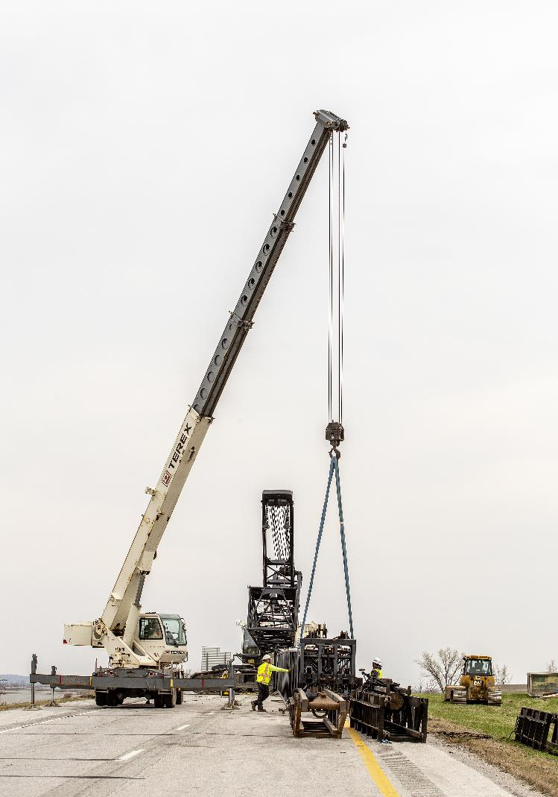
Next Steps
March Business Meeting - Action Item: Line-Item Targets for Programming
March 21 Workshop - Discuss 2025-2029 Highway Program Options
March 21 Workshop - Determine 2025-2029 Highway Program Objectives

Slide 44
Questions?

