Slide 1
Transportation Trends Update
Transportation Commission Workshop
March 8, 2022

Slide 2
Overview
Economic Recovery Index
Travel trends
  US total rail carloads
  Commercial air service passenger counts
  Vehicular traffic

Slide 3
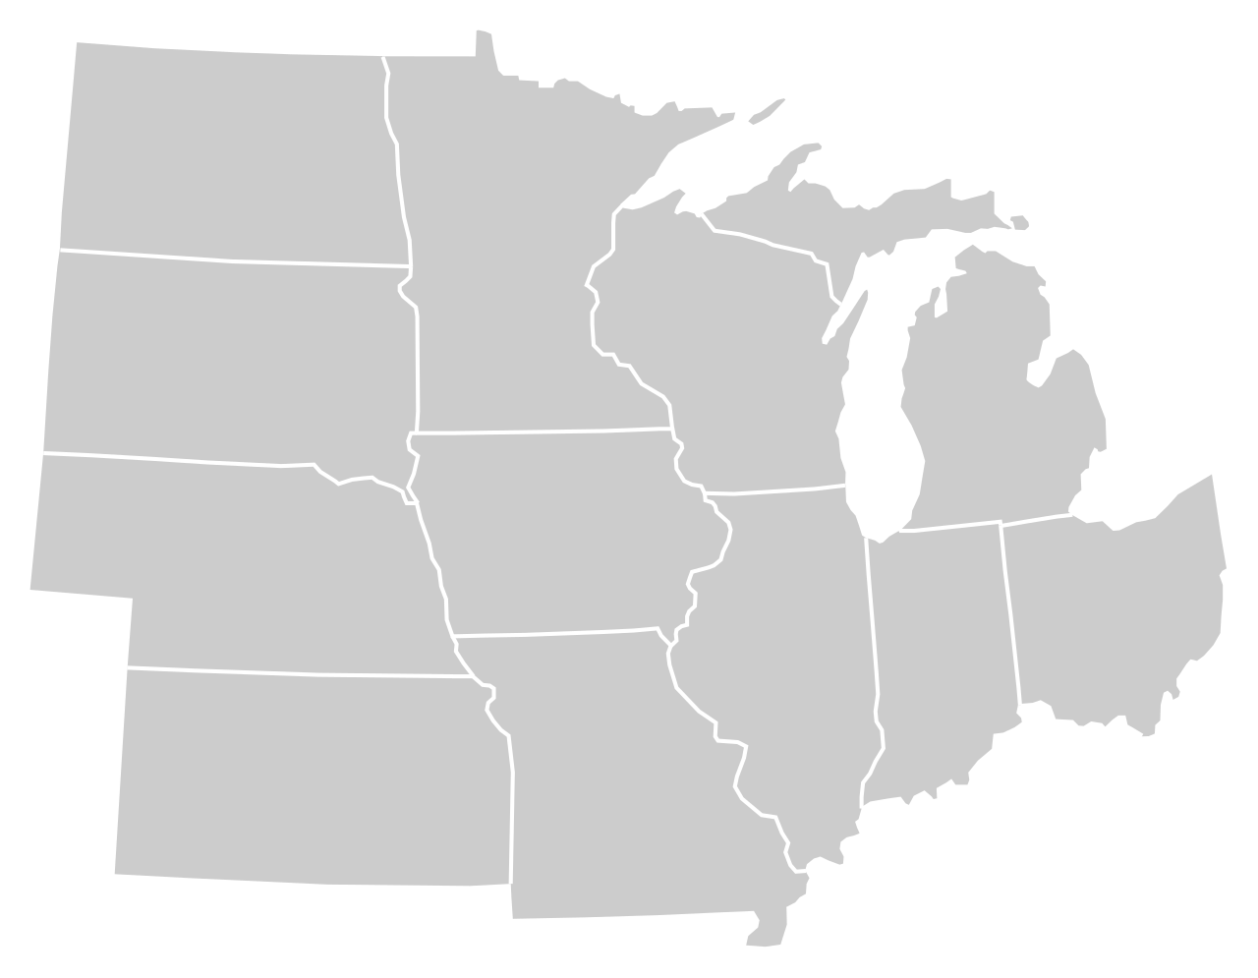
Moody’s/CNN Recovery Index - Midwest
(Pre-Pandemic = 100) As of 3/4/2022
91%
88%
99%
93%
91%
94%
(94% last month)
96%
94%
85%
94%
92%
90%
Nation is at 92% (91% last month)

Slide 5
Monthly Passenger Counts at Iowa’s Eight Commercial Service Airports
(through January 2022)

Slide 6
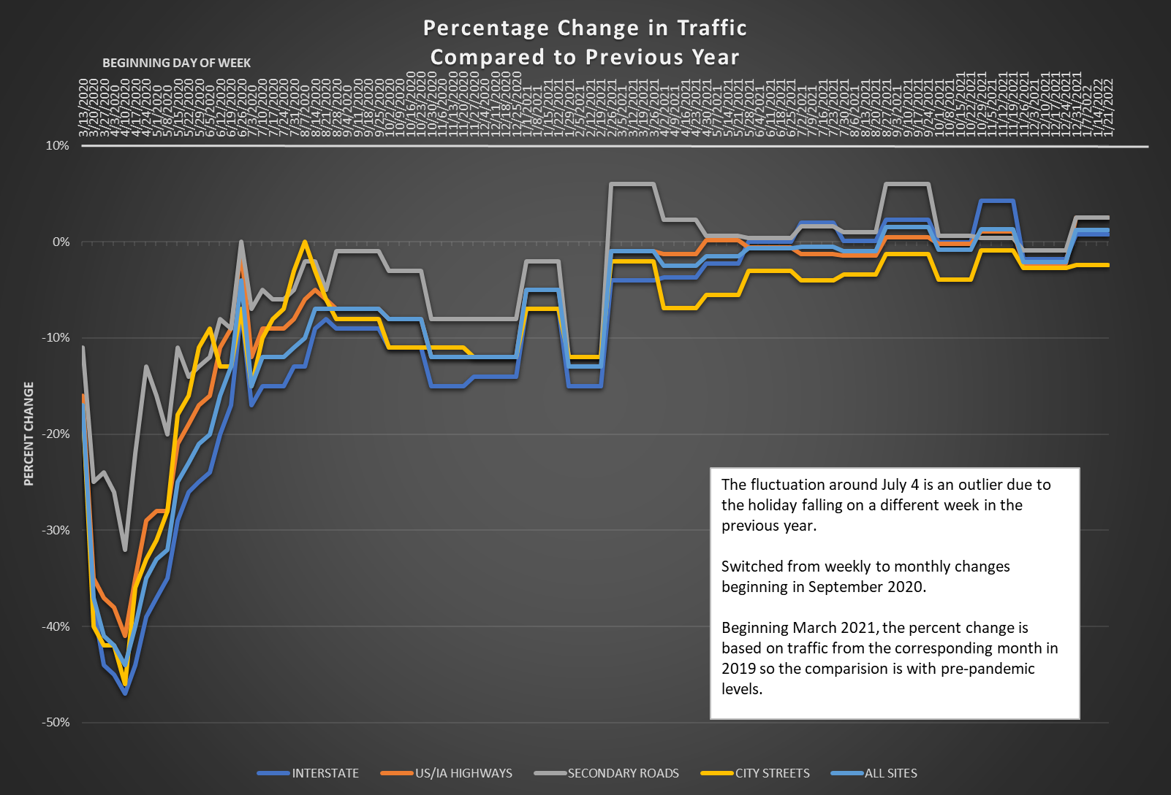

Slide 7
Questions?

