Slide 1
Revitalize Iowa’s Sound Economy Program
Iowa Transportation Commission Meeting
May 12, 2020

Slide 2
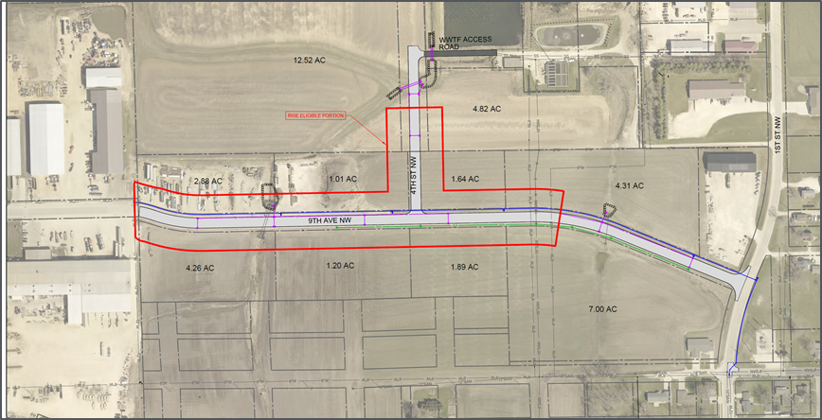
List of Local Development Applications Recommended
PROJECT NAME
SPONSOR
SCORE
TOTAL PROJECT COST
PERCENT PARTICIPATION
RECOMMENDED AMOUNT
Construction of approximately 1,514 feet of 9th Avenue NW and 400 feet of 4th Street NW. | Farley | 44 | $953,214 | 50% | $476,607

Slide 3
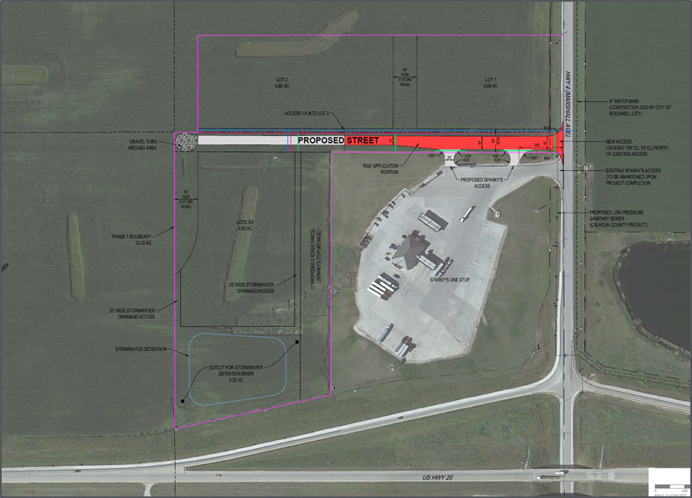
List of Local Development Applications Recommended
PROJECT NAME
SPONSOR
SCORE
TOTAL PROJECT COST
PERCENT PARTICIPATION
RECOMMENDED AMOUNT
Construction of approximately 747 feet of new roadway located northwest of Rockwell City. | Calhoun County | 36 | $522,488 | 50% | $261,244

