Slide 1
Revitalize Iowa’s Sound Economy Program
Iowa Transportation Commission Workshop
May 12, 2020

Slide 2
Revitalize Iowa’s Sound Economy Program
Created in 1985
Purpose: To promote economic development through roadway improvements.
Eligible development shall have value-adding activities that feed new dollars into the economy
Available to cities and counties through an application program

Slide 3
Available Funding and Application Summary
Available Funding
Funded annually with dedicated state motor fuel and special fuel tax revenues
Application Summary for SFY2020
Total number of projects awarded: 11
Total project costs: $29,796,529
Total amount awarded: $16,032,197
 | CITY | COUNTY
Average funding generated monthly | $997,556 | $498,778
SFY 2020 current Road Use Tax Revenue (as of 3/02/2020) | $8,012,354.46 | $4,006,177.26
Current Unobligated Balance (as of 3/02/2020) | $9,807,345.33 | $1,894,090.68

Slide 4
Local Development Project Evaluation Criteria
Development Potential (35 points)
Economic impact and Cost Effectiveness (20 points)
Local Commitment and Initiative (33 points)
Transportation Need and Justification (4 points)
Local Economic Need (6 points)

Slide 5
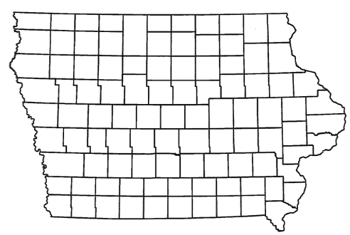
List of Local Development Applications Recommended
PROJECT NAME
SPONSOR
SCORE
TOTAL PROJECT COST
PERCENT PARTICIPATION
RECOMMENDED AMOUNT
Construction of approximately 1,514 feet of 9th Avenue NW and 400 feet of 4th Street NW. | Farley | 44 | $953,214 | 50% | $476,607
Construction of approximately 747 feet of new roadway located northwest of Rockwell City. | Calhoun County | 36 | $522,488 | 50% | $261,244

Slide 6
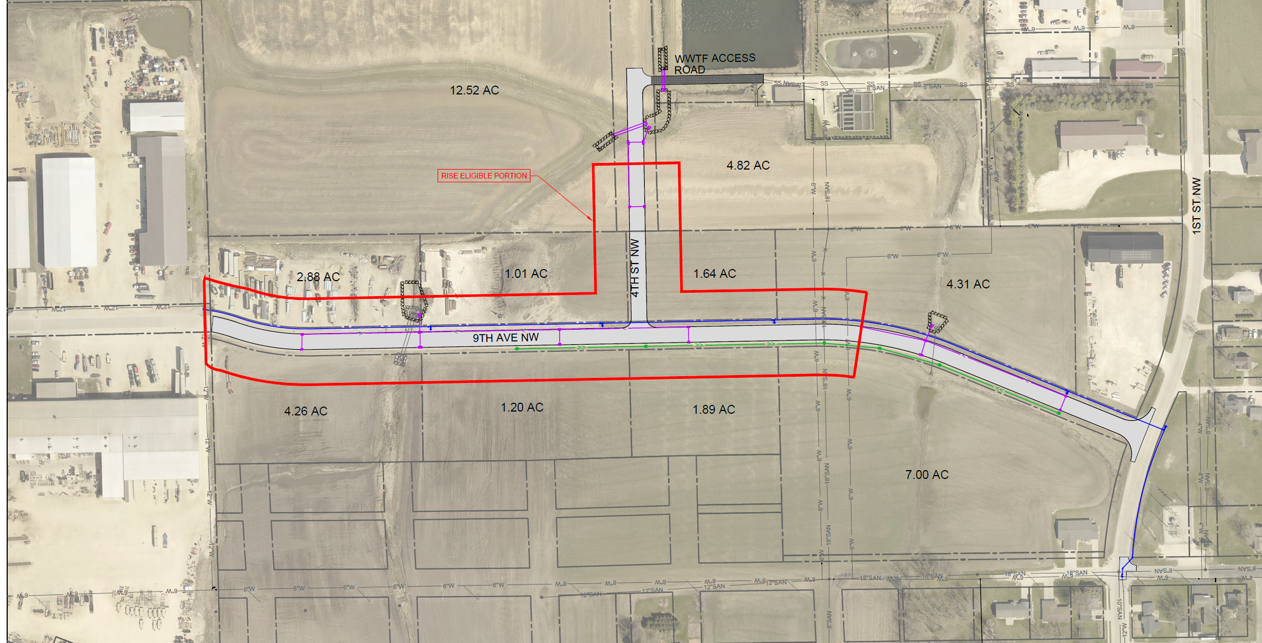
Farley
(Local Development)
Construction of approximately 1,514 feet of 9th Avenue NW and 400 feet of 4th Street NW located on the northwest side of town. This project is necessary to provide access to ten lots totaling more than 41 acres for industrial purposes.
Total Cost: $953,214
Requested: $476,607 (50%)

Slide 7
Calhoun County
(Local Development)
Construction of approximately 747 feet of new roadway located northwest of Rockwell City. This project is necessary to provide access to two lots totaling more than eight acres for warehousing and light industrial purposes.
Total Cost: $522,488
Requested: $261,244 (50%)

Slide 8
QUESTIONS?
Craig Markley, Systems Planning Bureau
craig.markley@iowadot.us
515-239-1027

