Slide 1
COVID-19 Transportation Funding Impact
Transportation Commission Workshop
May 11, 2021

Slide 2
Update
Economic Recovery Index
Travel trends
  US total rail carloads
  Commercial air service passenger counts
  Vehicular traffic
Funding
  Funding impacts
  Federal funding relief

Slide 3
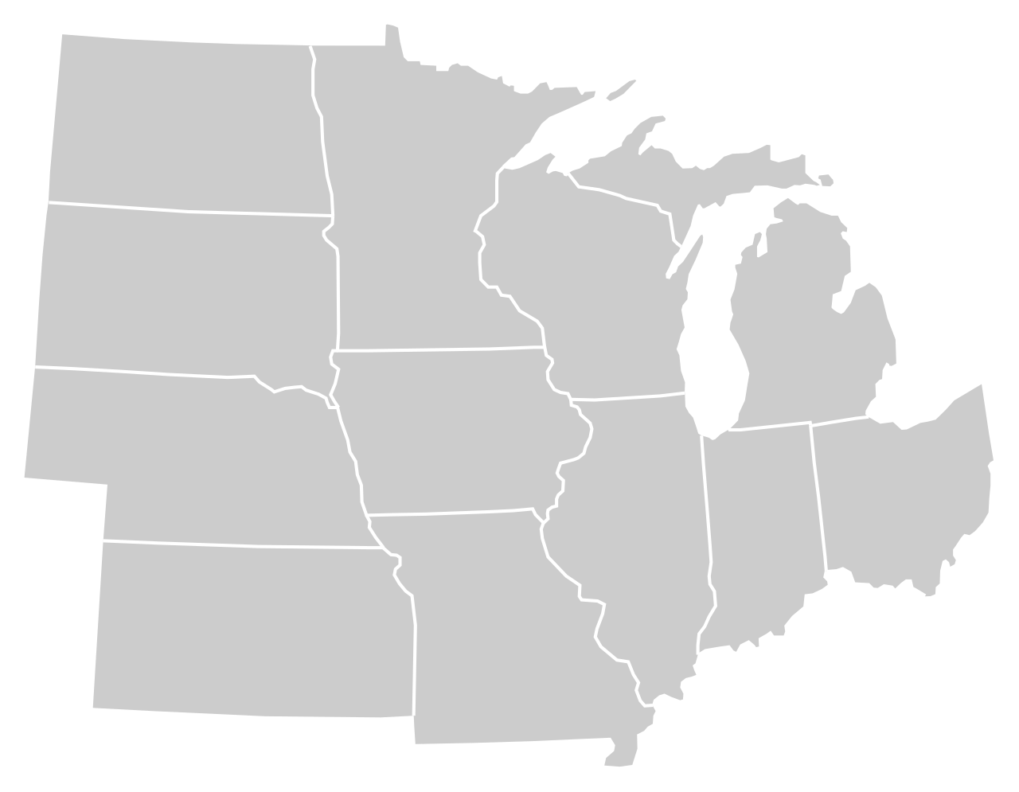
Moody’s/CNN Recovery Index - Midwest
(Pre-Pandemic = 100) As of 4/30/2021
88%
80%
98%
89%
85%
93%
(90% last month)
94%
90%
81%
91%
93%
87%
Nation is at 88% (87% last month)

Slide 4
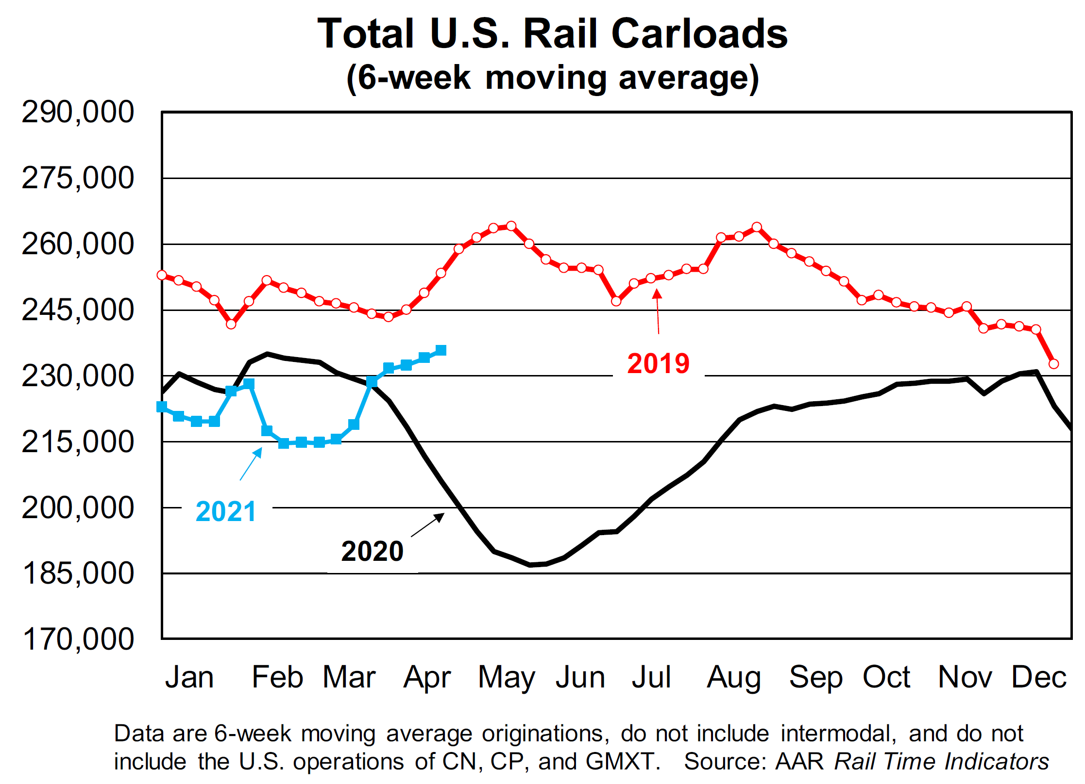

Slide 5
Monthly Passenger Counts at Iowa’s Eight Commercial Service Airports
(through February 2021)

Slide 6
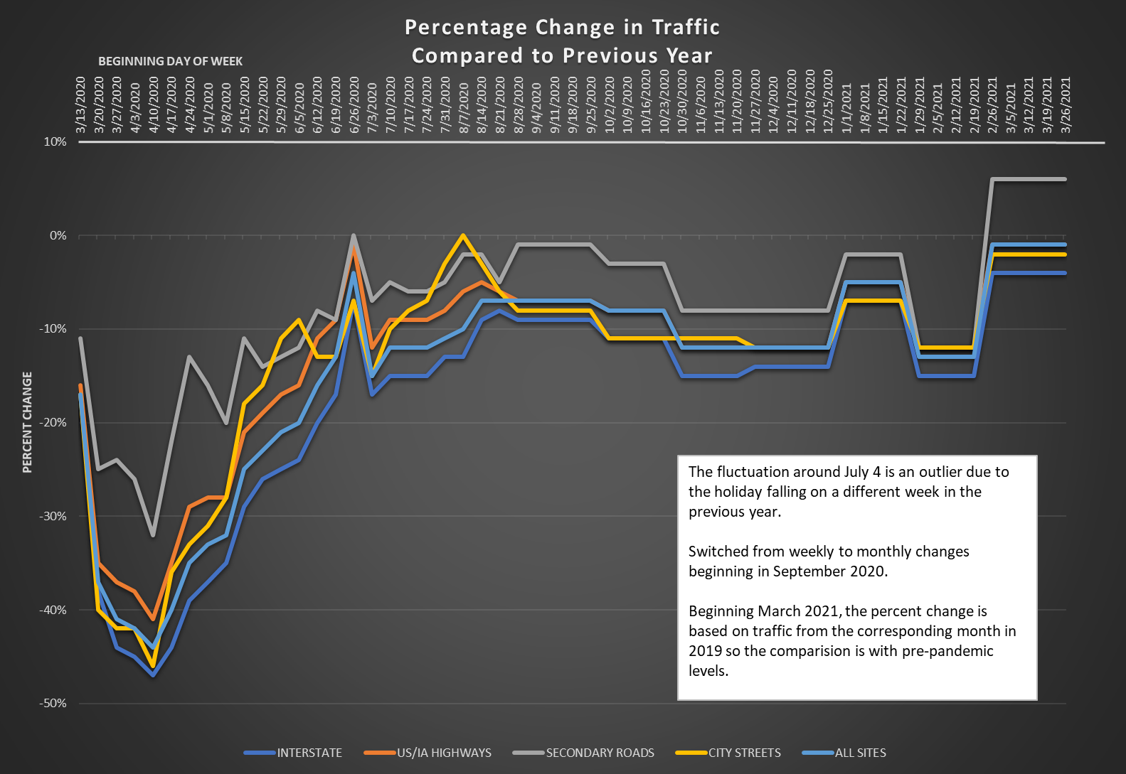

Slide 7
Transportation Funding Impacts – COVID
HIGHWAY
Fuel tax receipts are down due to
travel impacts
Vehicle registration revenue is steady to growing (despite early drop in vehicle sales)
Estimated lost RUTF through June 2021
TRANSIT
Initial drop in State Transit Assistance revenue but that has rebounded
FY 2021 state vertical infrastructure appropriation lower due to reduced RIIF revenue
Dramatic drop in local revenue due to reduced ridership
AVIATION
State aviation fund revenue down about 40 percent due to lower aviation fuel tax
FY 2021 state vertical infrastructure appropriation lower due to reduced RIIF revenue
Dramatic drop in local revenue due to reduced passengers
TRAILS
FY 2021 state vertical infrastructure appropriations lower due to reduced RIIF revenue
- $50M

Slide 8
Federal Support – COVID
HIGHWAYS/BRIDGES IN IOWA
CARES Act: None
CRRSAA: $121.9 million
ARP Act: No dedicated funding
TRANSIT AGENCIES IN IOWA
CARES Act: $107 million
CRRSAA: $26.5 million
ARP Act: $61.1 million
AIRPORTS IN IOWA
CARES Act: $70.5 million
CRRSAA: $13.4 million
ARP Act: waiting for final numbers
FEDERAL APPROPRIATIONS
CARES Act - March 2020
Coronavirus Aid, Relief, and Economic Security Act
CRRSAA - Dec. 2020
Coronavirus Response and Relief Supplemental Appropriations Act of 2021
ARP - March 2021
American Rescue Plan Act of 2021

Slide 9
Questions?

