Slide 1
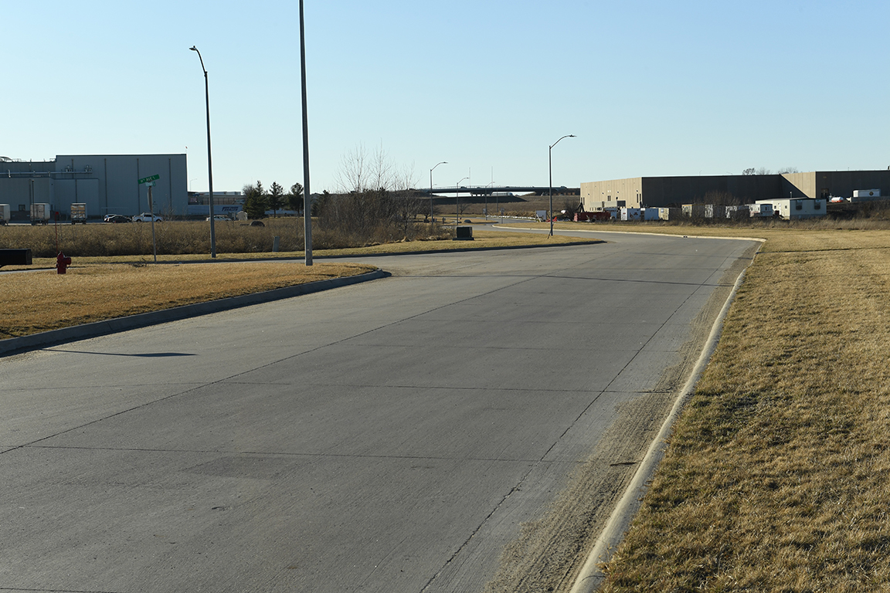

Revitalize Iowa’s Sound Economy Program
Iowa Transportation Commission Business Meeting
May 11, 2021

Slide 2

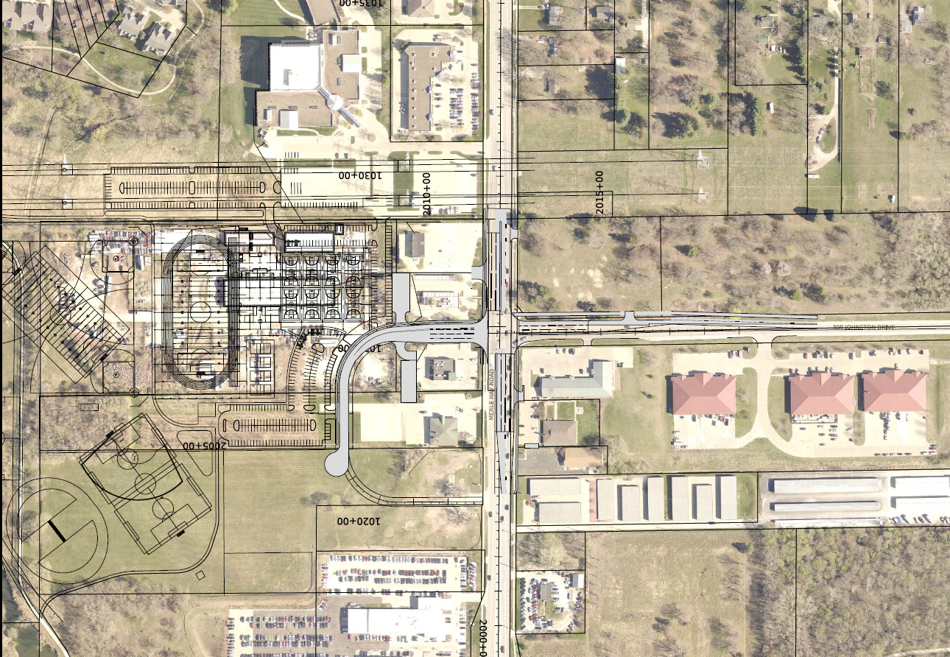
List of Local Development Applications Recommended
PROJECT NAME
SPONSOR
SCORE
TOTAL PROJECT COST
PERCENT PARTICIPATION
RECOMMENDED AMOUNT
Construction of intersection improvements at Merle Hay Road and Johnston Drive. | Johnston | 49 | $4,154,339 | 26.4% | $1,096,745

Slide 3
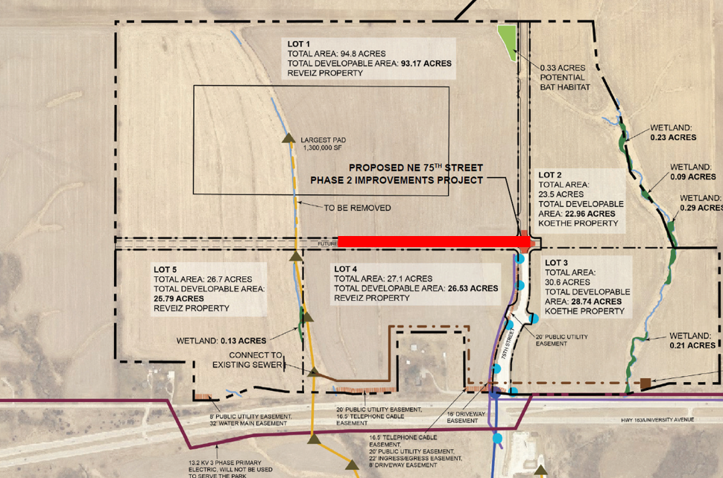
List of Local Development Applications Recommended
PROJECT NAME
SPONSOR
SCORE
TOTAL PROJECT COST
PERCENT PARTICIPATION
RECOMMENDED AMOUNT
Construction of approximately 1,395 feet of new roadway. | Pleasant Hill | 59 | $1,030,688 | 60% | $618,413

Slide 4
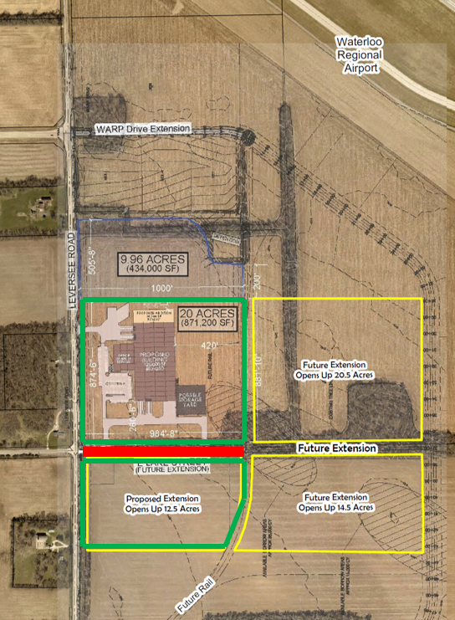
List of Local Development Applications Recommended
PROJECT NAME
SPONSOR
SCORE
TOTAL PROJECT COST
PERCENT PARTICIPATION
RECOMMENDED AMOUNT
Construction of approximately 1,025 feet of Lake Street. | Waterloo | 65 | $583,904 | 50% | $291,952

Slide 5
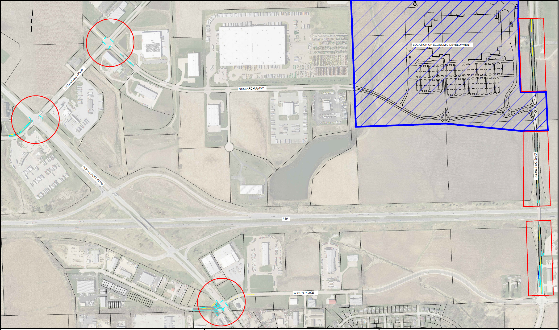
List of Local Development Applications Recommended
PROJECT NAME
SPONSOR
SCORE
TOTAL PROJECT COST
PERCENT PARTICIPATION
RECOMMENDED AMOUNT
Potential improvements to Hillandale Road, Research Parkway, Northwest Boulevard, 76th Street and North Division Street. | Davenport | TBD | TBD | 60% | TBD

