Slide 1
June Commission Tour Benchmark Assessment and Preview
Transportation Commission Workshop
May 11, 2021

Slide 2
June Tour/Meeting – Oskaloosa Benchmark Analysis
Are there any Governor proclamations in place restricting/discouraging indoor public gatherings?
Restrictions: None
Recommendations:
Encourage all vulnerable Iowans and those older than 65 to limit participation in gatherings of any size and any purpose. (Proclamation)
Encourage gathering organizer to take reasonable measures to ensure the health of participants and members of the public (Proclamation)
Are there any CDC and/or Iowa Department of Public Health guidance restricting/discouraging indoor public gatherings?
Restrictions: None
Recommendations:
Everyone should wear a mask when in public settings (IDPH guidance/CDC)
Stay at least 6 feet away from others (IDPH guidance/CDC)
Avoid crowds (CDC)
While charter bus use is exempted, there is a federal mask requirement for most other bus use. Masks are recommended at all times (may be removed briefly for eating/drinking). (CDC)
Are there any local jurisdiction restrictions on indoor public gatherings? No
Is the COVID-19 seven-day positivity rate >= 15 percent in the host county for the Commission meetings? No – Eight percent as of May 5, 2021

Slide 3
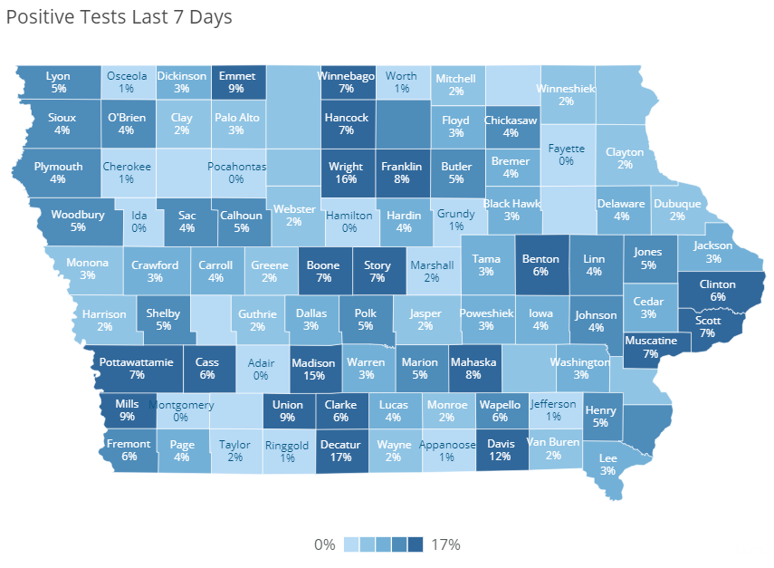

Positivity Map (as of May 5, 2021)
https://coronavirus.iowa.gov/pages/case-counts

Slide 4
Recommended Tour Plan
In-person June Tour
Masks required on the bus, except when eating/drinking
Masks are not required in indoor public spaces in Oskaloosa but recommend wearing masks in indoor public spaces. Allow masks to be removed when socially distant during the meetings.
Recommend limited in-person participation at public input meeting.

Slide 6
Questions?

