Slide 1
Revitalize Iowa’s Sound Economy Program
Iowa Transportation Commission Workshop
May 11, 2021

Slide 2
Revitalize Iowa’s Sound Economy Program
Created in 1985
Purpose: To promote economic development through roadway improvements.
Eligible development shall have value-adding activities that feed new dollars into the economy
Available to cities and counties through an application program

Slide 3
Available Funding and Application Summary
Available Funding
Funded annually with dedicated state motor fuel and special fuel tax revenues
Application Summary for SFY2021
Total number of projects awarded: 11
Total project costs: $19,694,425
Total amount awarded: $11,497,747
 | CITY | COUNTY
Average funding generated monthly | $970,179 | $485,089
SFY 2021 current Road Use Tax Revenue (as of 3/29/2021) | $8,226,077.31 | $4,113,038.65
Current Unobligated Balance (as of 3/29/2021) | $9,516,612.12 | $3,847,058.70

Slide 4
Local Development Project Evaluation Criteria
Development Potential (35 points)
Economic impact and Cost Effectiveness (20 points)
Local Commitment and Initiative (33 points)
Transportation Need and Justification (4 points)
Local Economic Need (6 points)

Slide 5
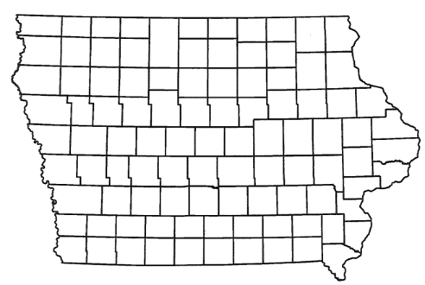
List of Local Development Applications Recommended
PROJECT NAME
SPONSOR
SCORE
TOTAL PROJECT COST
PERCENT PARTICIPATION
RECOMMENDED AMOUNT
Construction of intersection improvements at Merle Hay Road and Johnston Drive. | Johnston | 49 | $4,154,339 | 26.4% | $1,096,745
Construction of approximately 1,395 feet of new roadway. | Pleasant Hill | 59 | $1,030,688 | 60% | $618,413

Slide 6
List of Local Development Applications Recommended
PROJECT NAME
SPONSOR
SCORE
TOTAL PROJECT COST
PERCENT PARTICIPATION
RECOMMENDED AMOUNT
Construction of approximately 1,025 feet of Lake Street. | Waterloo | 65 | $583,904 | 50% | $291,952
Potential improvements to Hillandale Road, Research Parkway, Northwest Boulevard, 76th Street and North Division Street. | Davenport | TBD | TBD | 60% | TBD

Slide 7
Johnston
(Local Development)
Construction of intersection improvements at Merle Hay Road and Johnston Drive located on the southeast side of town. This project is necessary to support tourism by providing improved access to the proposed Ignit Sports Complex.
Total Cost: $4,154,339
Requested: $1,096,745 (26.4%)

Slide 8
Pleasant Hill
(Local Development)
Construction of approximately 1,395 feet of new roadway located on the northeast side of town. This project is necessary to provide access to the Pleasant Hill Commerce Park, an Iowa Economic Development Authority certified site of more than 213 acres.
Total Cost: $1,030,688
Requested: $618,413 (60%)

Slide 9
Waterloo
(Local Development)
Construction of approximately 1,025 feet of Lake Street located on the northwest side of town. This project is necessary to provide access to two lots totaling more than 32 acres for industrial purposes.
Total Cost: $583,904
Requested: $291,952 (50%)

Slide 10
Iowa’s Certified Sites – Existing Policy
Max. RISE participation awarded depends on the size of the Certified Site (50-499 acres; up to 60% RISE participation)
Process:
Iowa DOT recommends commitment of funding to Iowa Transportation Commission (Commission)
Commission commits funding
Iowa DOT continues to work through final details of scope & eligible costs with the applicant (or later convert to Immediate Opportunity)
Iowa DOT recommends modification of funding commitment
Commission approves modification

Slide 11
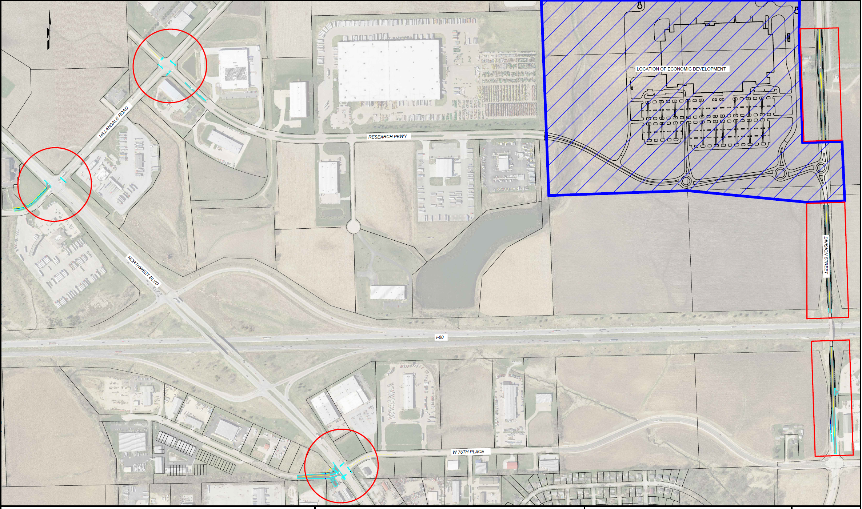
Davenport
(Local Development)
Potential improvements to Hillandale Road, Research Parkway, Northwest Boulevard, 76th Street and North Division Street located on the northwest side of town. This project is necessary to provide improved access to the Eastern Iowa Industrial Center, a potential new and recertified Iowa Economic Development Authority certified site of more than 158 acres.
Total Cost: TBD
Requested: TBD (60%)

Slide 12
QUESTIONS?
Craig Markley, Systems Planning Bureau
craig.markley@iowadot.us
515-239-1027

