Slide 1
FFY 2021 Transit Capital Programs

Slide 2
Section 5339 Grants for Bus and Bus Facilities Formula Program
Purpose: Federal Transit Administration (FTA) program that provides funding to states and transit agencies through a statutory formula to replace, rehabilitate and purchase buses and related equipment and to construct bus-related facilities

Slide 3
Section 5339 Grants for Bus and Bus Facilities Formula Program
5339 Direct Apportionments for FFY21:
Urban (50-200K population) – $1,119,636
Statewide – $3,500,000
Council Bluffs(NE/IA) – $951,374
Davenport (IA/IL) - $509,483
Des Moines – $791,157

Slide 4
Section 5339 Grants for Bus and Bus Facilities Formula Program
State Apportionments:
Urban (50-200K population) – $1,119,636
Two transit systems, three vehicles
Statewide – $ 3,500,000
Underruns – $75,682
Total Available $3,575,682
Thirteen transit systems, forty-five vehicles

Slide 5
Congestion Mitigation Air Quality Program (CMAQ)
Purpose: To fund transportation projects in non-attainment or maintenance areas of Clean Air Act Standards. States that have no nonattainment or maintenance areas receive a minimum apportionment of CMAQ funding for either air quality projects or other elements of flexible spending. Funds may be used for any transit capital expenditures otherwise eligible for FTA funding as long as they have an air quality benefit
FY 2021 allocation: $3,000,000
Eight transit systems, thirty vehicles

Slide 6
Summary
Total capital funds available: $7,695,318
Twenty-one transit systems will be able to purchase seventy-eight vehicles

Slide 7
Project Distribution Criteria
Funds are distributed for bus replacement based on the Public Transit Management System (PTMS) process and the availability of local match
Prioritizes vehicle replacements based on the degree to which each vehicle exceeds the useful life for that particular vehicle type in terms of both age and accumulated mileage
The age, vehicle type, and mileage are maintained for all vehicles within the PTMS database

Slide 8
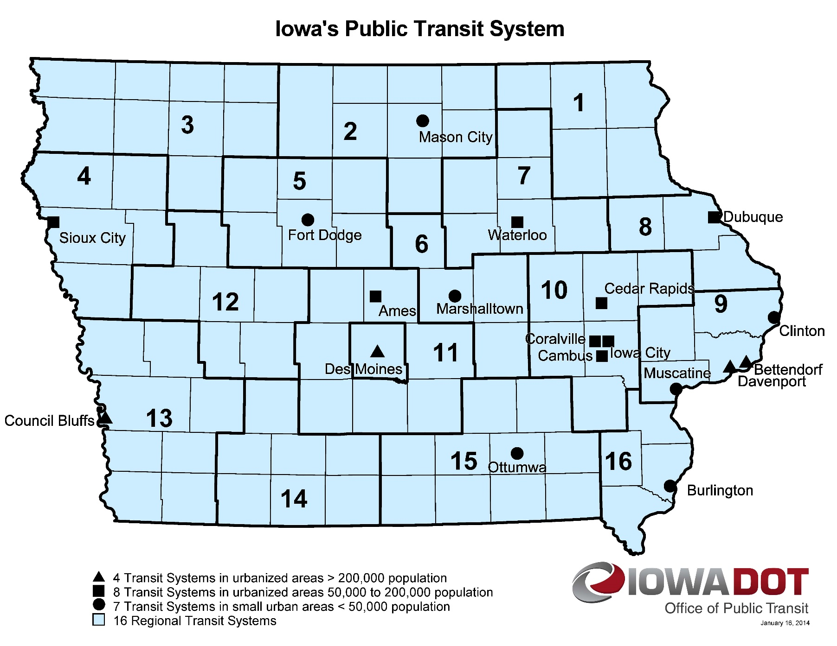
Transit System Vehicle Replacements
Notes:
18 Transit Systems

Slide 9
QUESTIONS?
For more information on Iowa’s public transit and intercity bus programs, visit
www.iowadot.gov/transit

