Slide 1
Transportation Commission Update #3
May 11, 2021

Slide 2
Agenda
Review 2020 Airport System Role Designations
Discuss Project Cost Estimating and Project Funding
Discuss System Recommendations
Next Steps and Wrap-Up

Slide 3
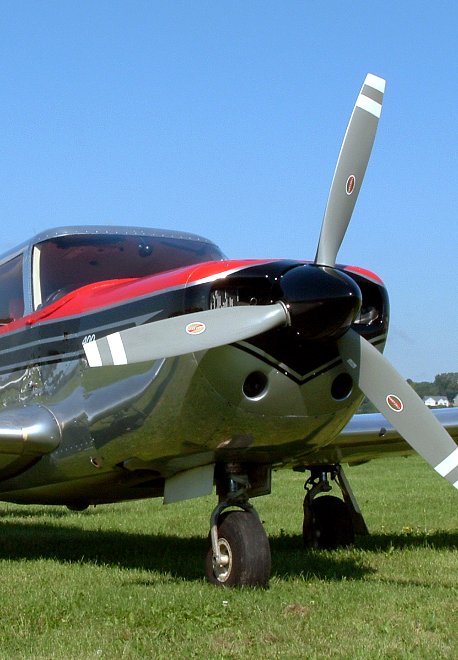
System Airport Roles
Based on the roles developed in 2010 plan
Used to assess system and develop facility and service objectives
Iowa’s 5 airport roles:
Commercial Service
Enhanced Service (5,000 ft rwys, jets)
General Service (4,000 ft rwys, mid-sized jets)
Basic Service (3,000 ft rwys, fuel)
Local Service (turf, limited services)

Slide 4
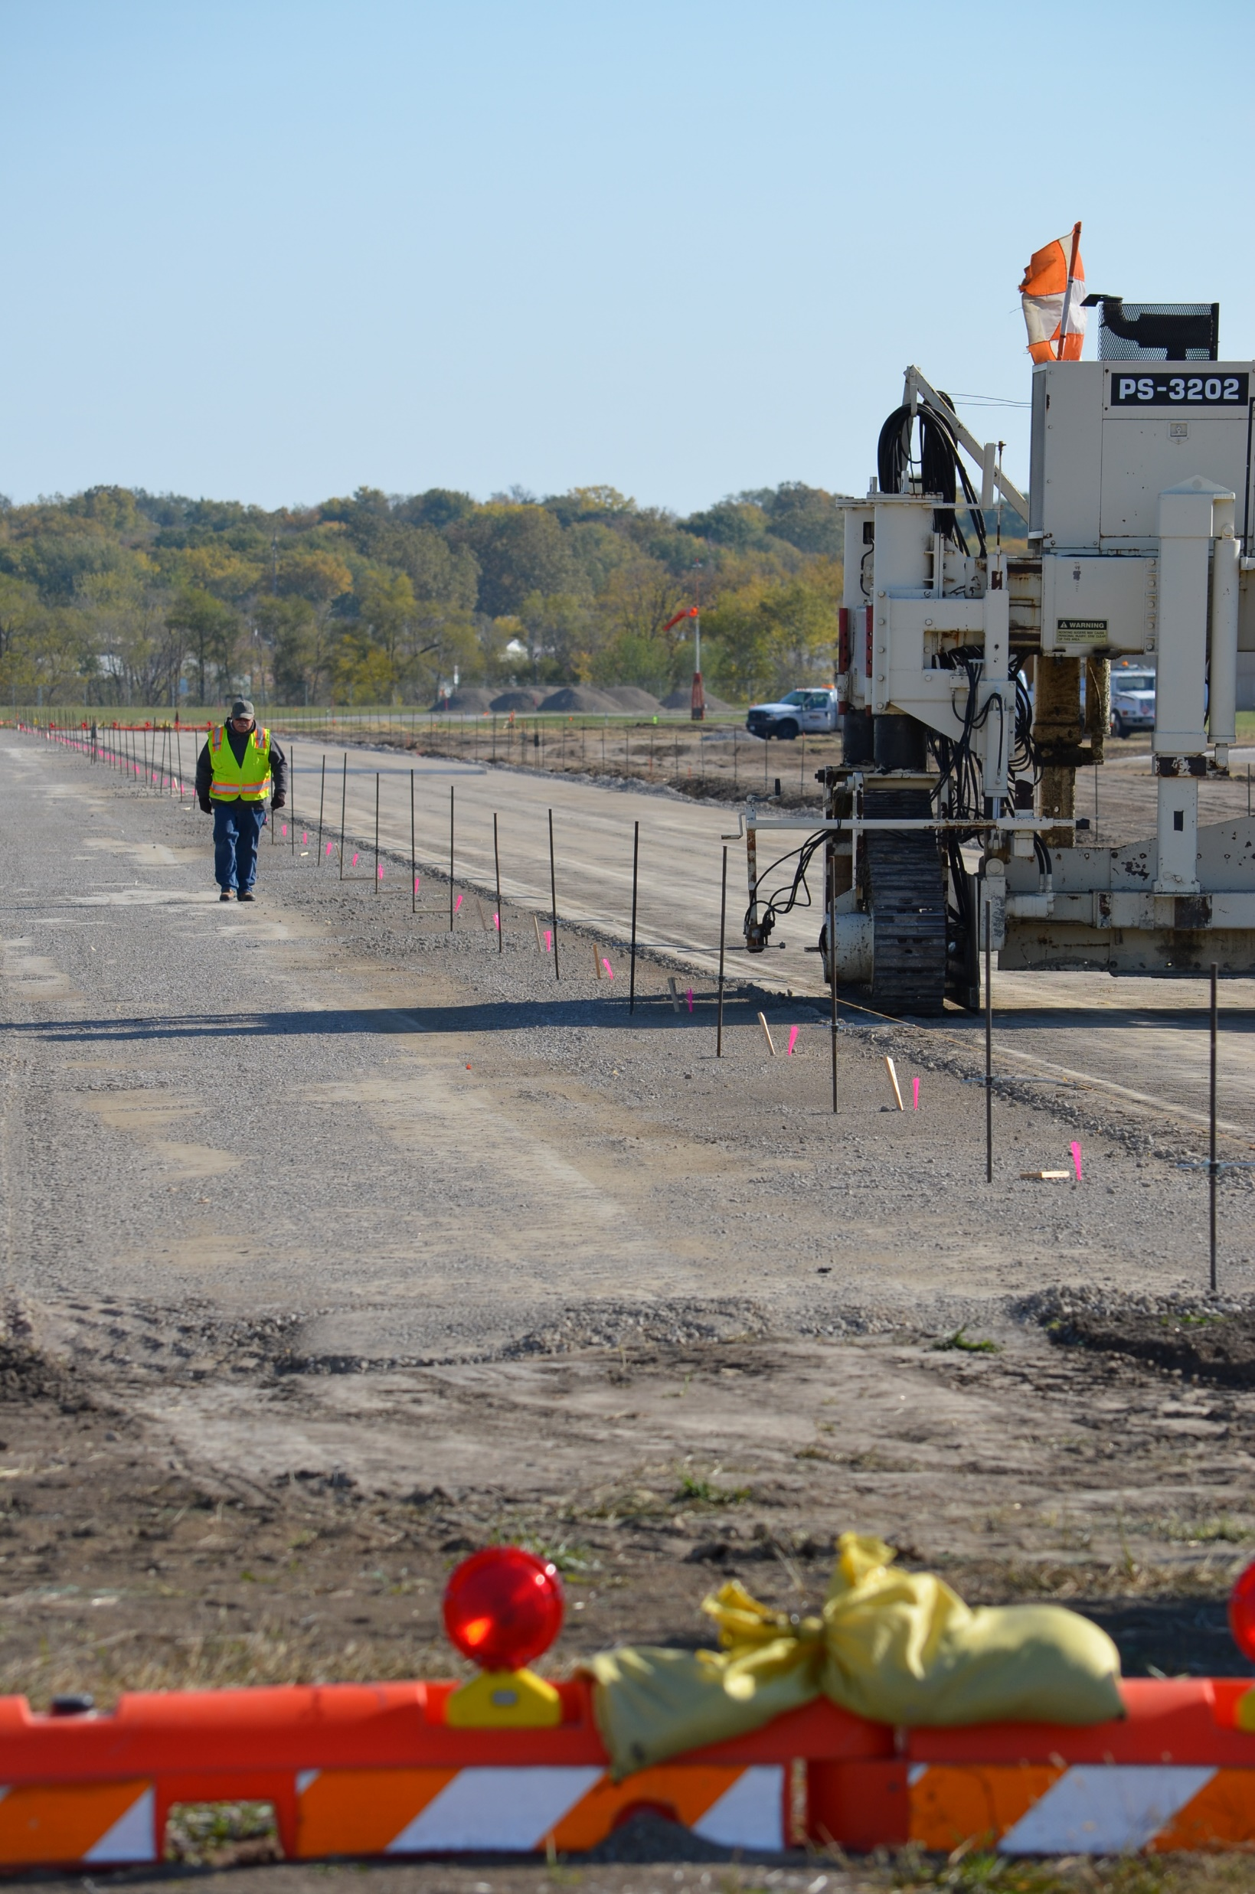
Cost Estimating and Project Funding
Explanation of cost estimating methodology
Projects derived from Facility and Service Objective shortfalls
Project costs based on planning level estimates including estimated quantities, historic bid tabs, and industry averages
Summary of costs associated with:
System Plan Recommendations
Airport Capital Improvement Plan (ACIP) Projects
Preventive Pavement Maintenance and Rehabilitation
Combined estimated development costs
Review of funding sources including the Federal Aviation Administration (FAA), Iowa DOT, and other sources

Slide 5
System Plan Project Costs
Projects derived from Facility and Service Objective shortfalls
Total Cost - $49.4 million
Commercial - $1.1 million
Enhanced Service - $28.3 million
General Service - $13.3 million
Basic Service - $4.7 million
Local Service - $2.0 million

Slide 6
Airport Capital Improvement Plan Costs – 2021 through 2030
Derived from FAA and airport data
Total Cost - $1.06 billion
Commercial - $701.3 million
Enhanced - $146.2 million
General Service - $139.9 million
Basic Service - $48.0 million
Local Service - $26.4 million

Slide 7
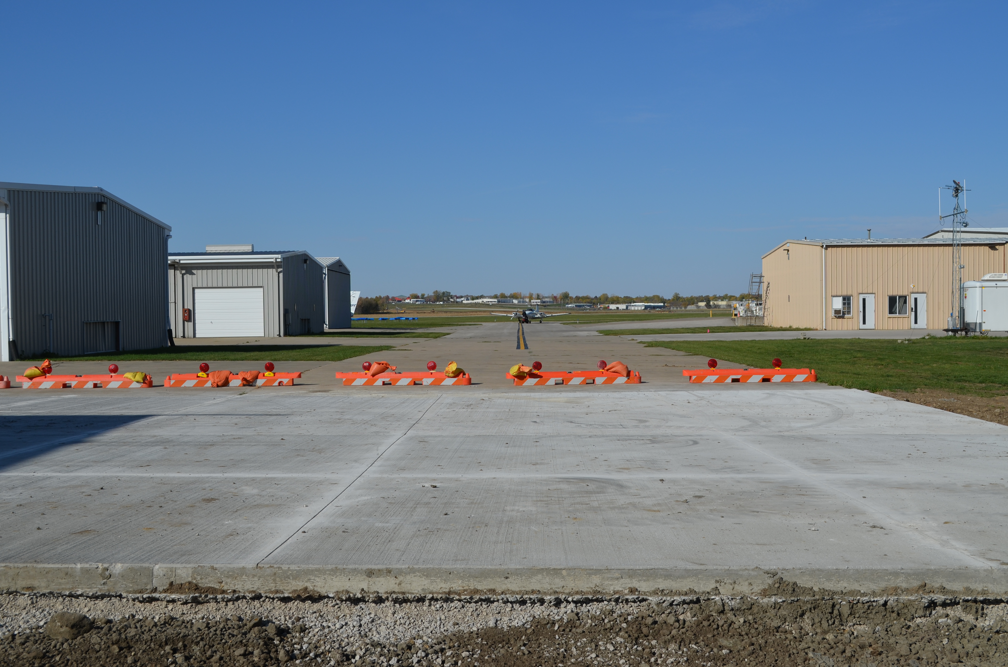
Preventative Pavement Maintenance and Rehabilitation
Derived from Airport Pavement Management System data
$84.4 million in APMS
Annual Average = $16.9 million

Slide 8
Combined Development Costs
 | Commercial Service | Enhanced | General | Basic | Local | Statewide | Costs Subtotal
System Plan Objective Costs | $1,125,000 | $20,593,610 | $8,061,900 | $3,139,900 | $1,987,200 | $0 | $34,907,610
Airport Capital Improvement Plan Cost Estimates | $701,258,666 | $146,230,636 | $139,894,581 | $48,030,233 | $26,443,292 | $675,000 | $1,062,532,408
Pavement Maintenance/Rehab Costs | $4,396,144 | $20,724,747 | $25,641,772 | $15,135,513 | $18,509,094 | $0 | $84,407,270
Total | $706,779,810 | $187,548,993 | $173,598,253 | $66,305,646 | $46,939,586 | $675,000 | $1,181,847,288
Percent | 59.8% | 15.9% | 14.7% | 5.6% | 4.0% | 0.1% | 100.0%

Slide 9
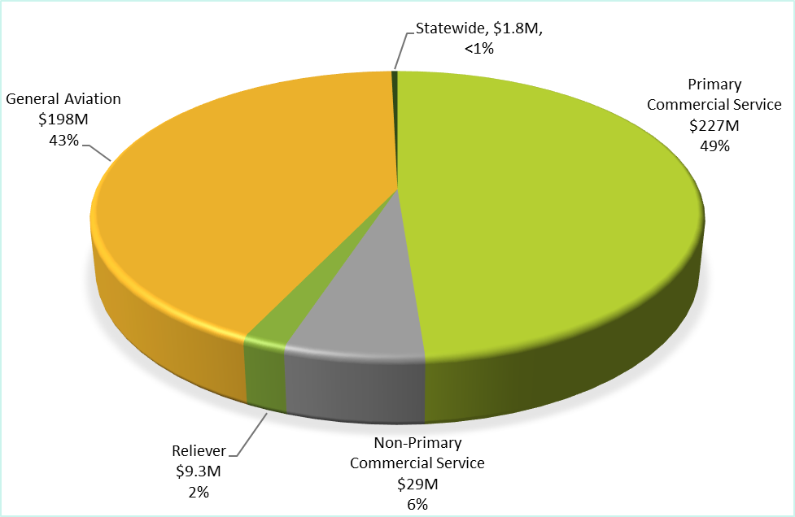
FAA AIP Funding in Iowa – 2010 - 2019
Funding by NPIAS Category
Funding by Grant Type
Average Annual FAA Funding - $46.5 million

Slide 10
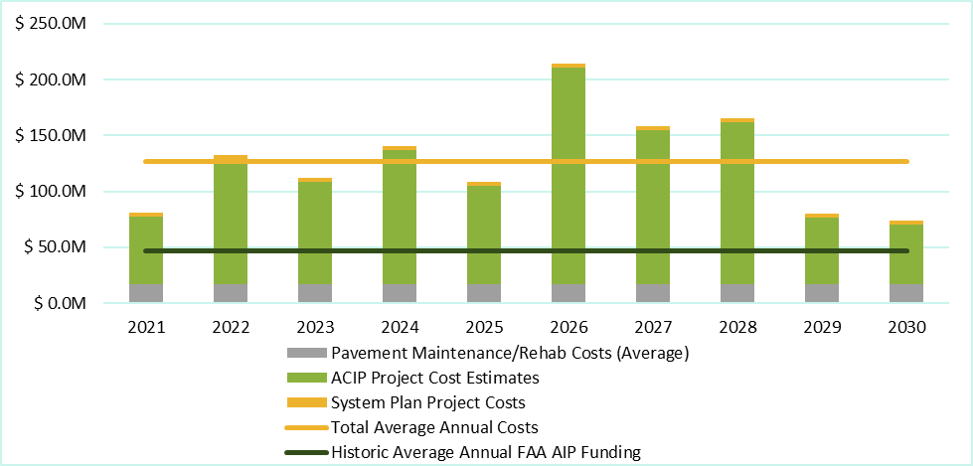
Combined Development Costs – All System Airports
Average Annual Project Costs
$126.6 million
Average Annual Historic FAA AIP Funding
$46.5 million

Slide 11
Iowa DOT State Aviation Funding Program
Historic Annual Average
AIP - $3.6 million
Commercial Service Vertical Infrastructure - $1.5 million
General Aviation Vertical Infrastructure - $800,000
Average Annual State Grant Funding - $5.9 million

Slide 12
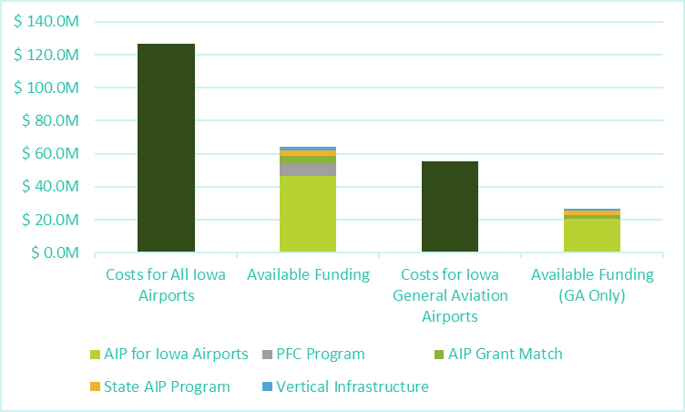
Funding Need vs. Funding Available
Historic Average Annual Funding - $64.4 million
FAA AIP - $46.5 million
PFC Program - $7.4 million
State AIP and Grants - $5.8 million
Local Grant Match - $4.7 million

Slide 13
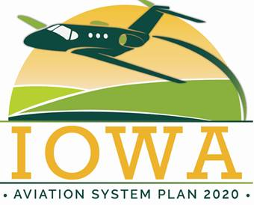
Public Private Partnerships
P3 Benefits and Challenges
Benefits
Financial risks are often shifted from the public sector to the private sector
Allows for private investment to accelerate important airport development
Challenges
Contracting becomes critical to ensure that the public entity retains some authority
Airports in the NPIAS must follow FAA grant assurances regarding property disposal, ground rent, and through the fence operations making the privatization of elements of the airport no longer in control of the Sponsor much more challenging

Slide 14
Public Private Partnerships Continued
P3 at Airports in Iowa
Marion Airport – Considered a unique occurrence
Other privately-owned, public use airports are all low activity Local Service facilities, so P3 unlikely
The privately owned, public use airports in Iowa maintain turf runways and currently meet facility objectives.
These airports are unlikely require any additional investment in runway facilities as the facility objectives for local service airports are to maintain the existing infrastructure.
Des Moines considered P3 for development opportunities

Slide 15
Iowa’s Recommended System
Built on 2010 SASP
Upgrade three airports
Shenandoah Municipal (Basic Service to General Service)
Lamoni Municipal (Local Service to Basic Service)
Waverly Municipal (Local Service to Basic Service)
Two additional airports
Sioux Regional (new)
Peltz Field
South Central Airport – Will replace Pella and Oskaloosa during the planning period

Slide 16
System Adequacy: Commercial + Enhanced Service
More than 75 percent of Iowa residents are within a 30-minute drive of business-jet capable airports

Slide 17
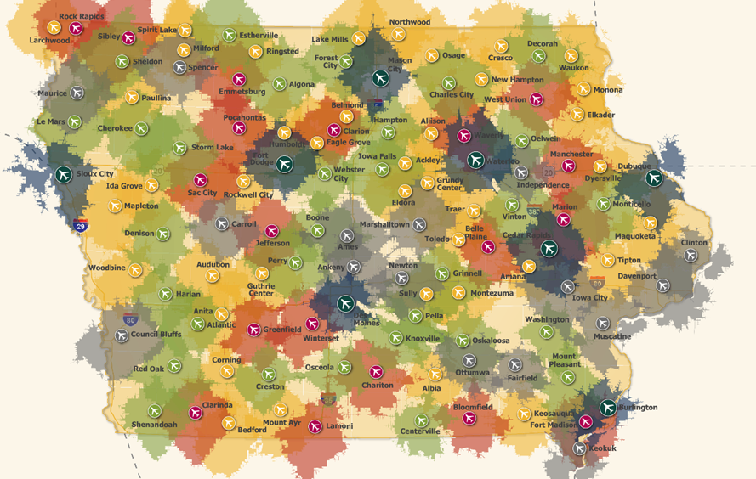
System Adequacy: All Airports
When all 114 system airports are considered, more than 97 percent of the state’s population is within a 30-minute drive of an airport.
Several airports in the system provide facilities and services that meet many of the next higher role recommendations. While no airports were specifically targeted for role upgrades during the planning period, information was provided to assist in evaluating future projects that could move an airport into a more demanding role.

Slide 18
Recommendations
Recommendation: Vertical Infrastructure
Support continued vertical infrastructure improvements by maintaining existing funding and identify additional funding sources for maintaining and improving terminal buildings and hangar infrastructure. Maintain coordination with airport sponsors regarding terminal building and hangar existing conditions and future need.
Recommendation: Security and Wildlife Fencing
Prioritize airfield security with 8-foot perimeter fencing at all Commercial and Enhanced Service airports. If an airport is planning to update or replace fencing, encourage 8-foot height.
Recommendation: Airport Attendance
Identify an airport contact for on-call operations at airports without after-hours arrangements or that are unattended.

Slide 19
Recommendations Continued
Recommendation: Planning Measures
Continue supporting the development and implementation of zoning ordinances and land use plans that protect Iowa airports.
Recommendation: Aircraft Services
Continue to support aviation services at system airports that will promote a strong aviation system including maintenance, flight instruction and aircraft rental services.
Recommendation: 24/7 Restroom Access
Incorporate 24/7 airside access to a restroom via a keypad.

Slide 20
Recommendations Continued
Recommendation: Pavement Maintenance
Encourage improved routine pavement maintenance practices and educate airport officials on the benefits of pavement maintenance and the existing PCI program.
Recommendation: Entryway and Parking Conditions
Encourage signage and adequate entrances and parking facilities.

Slide 21
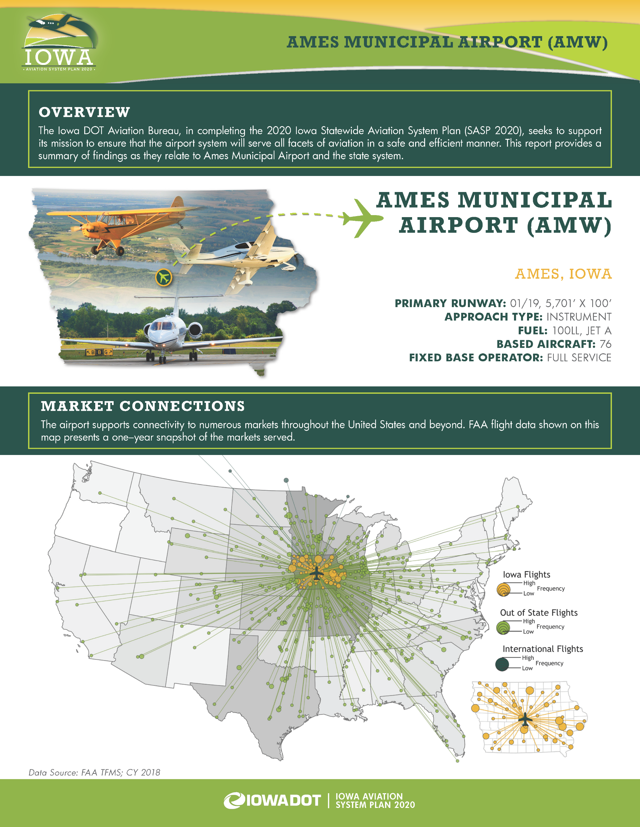
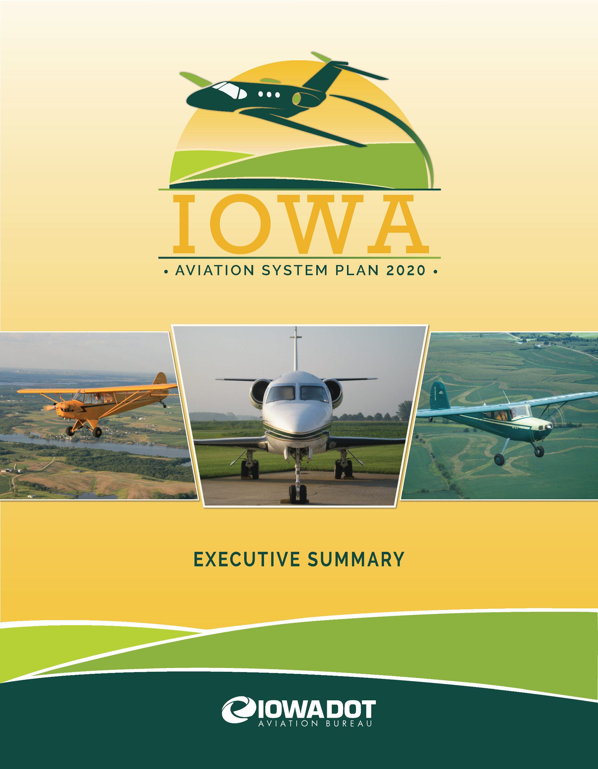
Deliverables: Individual Airport Summary and Executive Summary

Slide 22
Next Steps
Final revisions to technical report
Final revisions to various deliverables
Public webinar – TBD
Final presentation to Transportation Commission to conclude process

Slide 23
Thank you Any Questions?

