Slide 1
Iowa Transportation Commission
Future of Transportation
Preparing for an AT-Ready Iowa
May 11, 2021

Slide 2
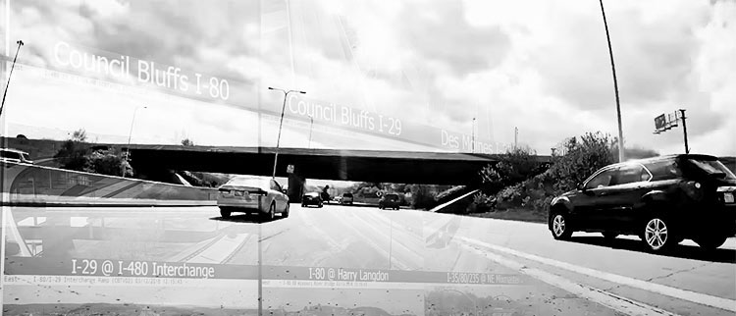
Presentation Overview
Automated Transportation (AT)
What, Why, Where, & When
AT-Readiness
Stakeholder Engagement
Visioning & Planning
Policy & Legislation
Research & Tactical Activities
Regional & National

Slide 3
Mary Barra, CEO, General Motors
“…to win in the future, you’ve got to win with electric and driverless vehicles. This is what we really believe is the future of transportation.”
Trends to Shape the Future of Transportation
Propulsion (e.g. electrification)
Autonomy
Connectivity
Sharing

Slide 4
Automated Transportation Overview

Slide 5
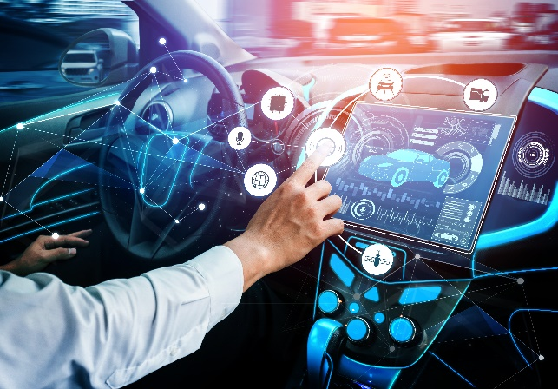
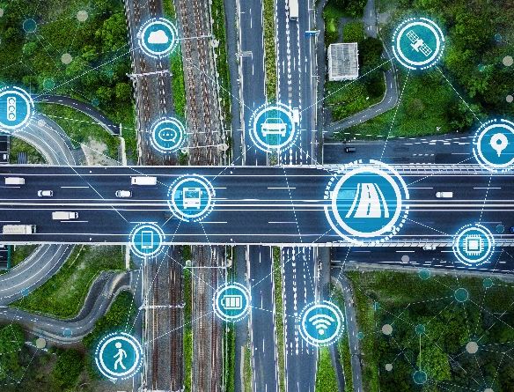
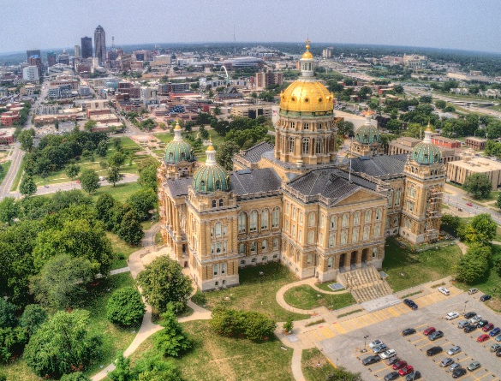
Cooperative Automated Transportation
All modes of transportation working together to improve safety, mobility, equity, and operations efficiency through interdependent vehicle and systems automation and information exchange
Source: AASHTO
Multi-Modal Systems
Connected & automated vehicles
Infrastructure Systems Digital and physical
Institutional Systems
Enabling policy and supporting services

Slide 6
Levels of Driving Automation
LEVEL 0 | LEVEL 1 | LEVEL 2 | LEVEL 3 | LEVEL 4 | LEVEL 5
No Automation Human Operates Everything | Driver Assist Acceleration or steering but not both | Partial Automation Acceleration, braking, or steering (two or more) Tesla Autopilot Cadillac Super Cruise Volvo Pilot Assist | Conditional Automation Vehicle can conduct more tasks including monitoring the environment Human ready to take control | High Automation Driver not required during defined use case | Full Automation No human driver
Advanced Driver Assistance Systems (ADAS)
Automated Driving Systems (ADS)
Definitions & Taxonomy: Society of Automotive Engineers & International Organization of Standardization
Image Source: ZF TRW / Mike Lemanski

Slide 7
Benefits of Automated Transportation
Accessibility & mobility
Economic & workforce development
System efficiency
Increased safety
Health & environment

Slide 8
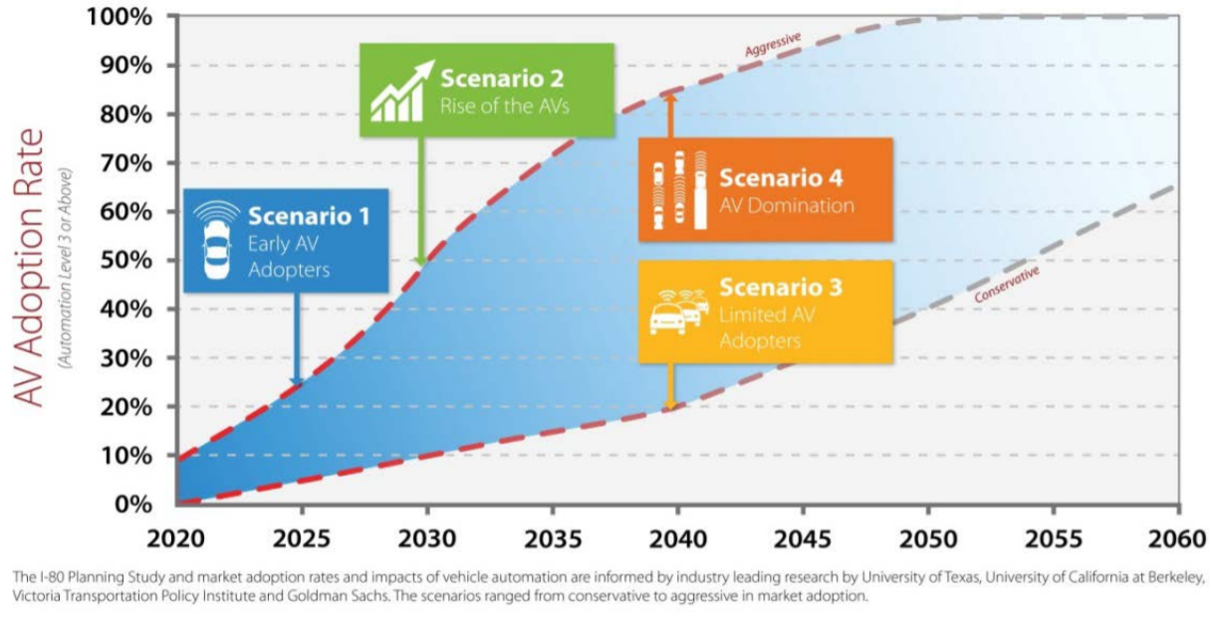
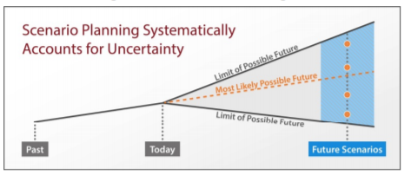
When will this happen?
Source: Iowa DOT I-80 Planning Study

Slide 9
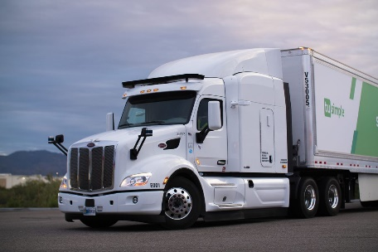
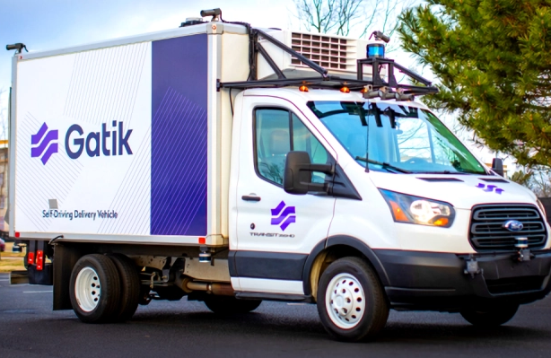
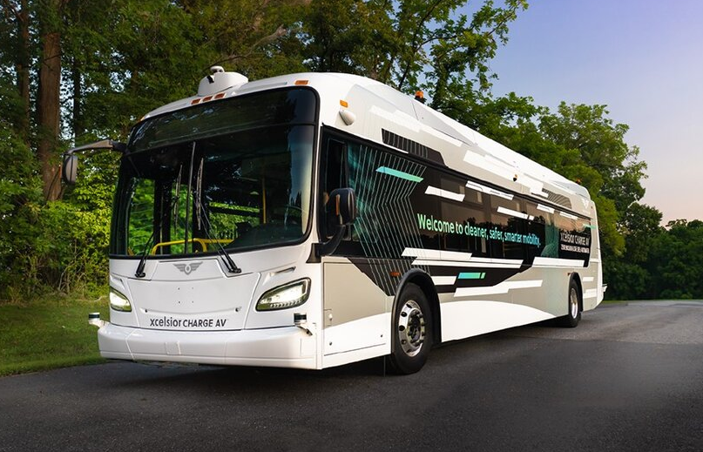
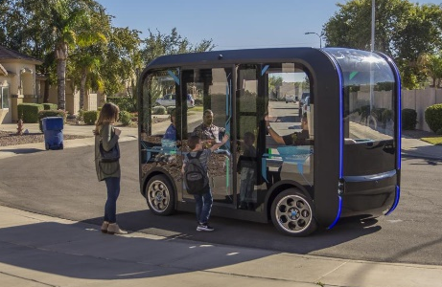
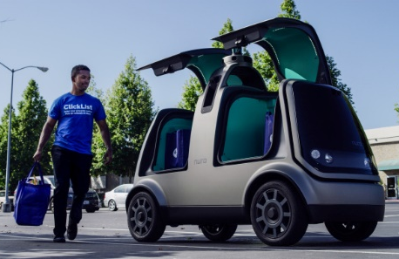
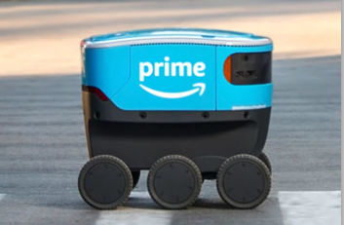
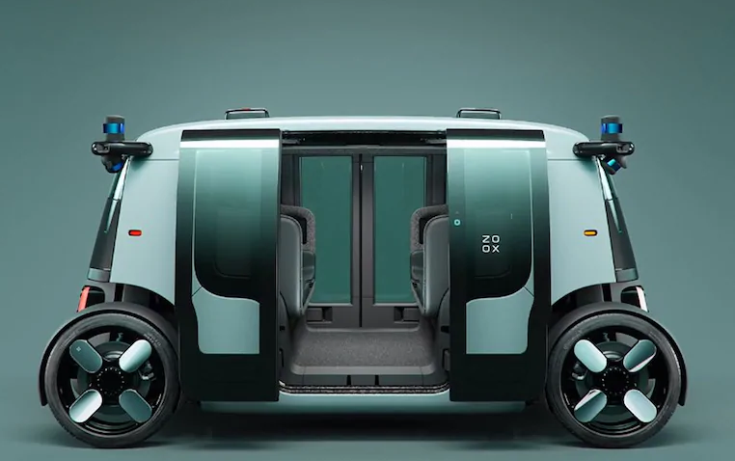
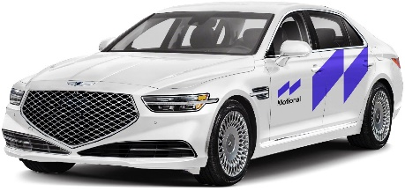
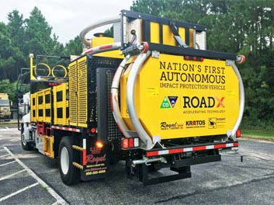
Vehicle Automation Use Cases
Transit: Fixed route bus and on-demand micro-transit
Freight & Packages: Long Haul, Local Delivery, Home Delivery
Agency Operations: Fleet Vehicles
Individual Travel: Robo-taxis and personal vehicles

Slide 10
Becoming
AT-Ready

Slide 11
AT Readiness: Stakeholder Engagement

Slide 12
Iowa Advisory Council on Automated Transportation
Vision
To create an AT-ready driving environment in Iowa for the safe movement of people and freight for a thriving Iowa economy
Mission
Lead, coordinate, and enable the advancement of automated transportation systems in Iowa.
Membership
Associated General Contractors of Iowa Federal Highway Administration, Iowa Division Federal Motor Carrier Safety Administration Freight Advisory Council Iowa Dept. of Agriculture and Land Stewardship Iowa Dept. of Public Safety Iowa Dept. of Transportation Iowa Economic Development Authority Iowa House of Representatives Iowa Insurance Division Iowa League of Cities Iowa Motor Truck Association Iowa Senate Iowa State Association of Counties Iowa State University National Highway Traffic Safety Administration Technology Association of Iowa University of Iowa
https://iowadrivingav.org/

Slide 13
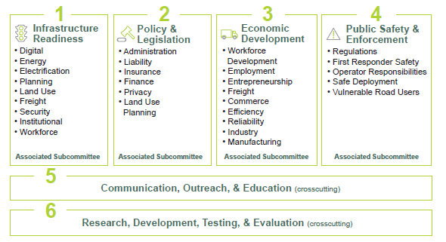
Iowa Advisory Council on Automated Transportation

Slide 14
AT Readiness: Visioning & Planning

Slide 15
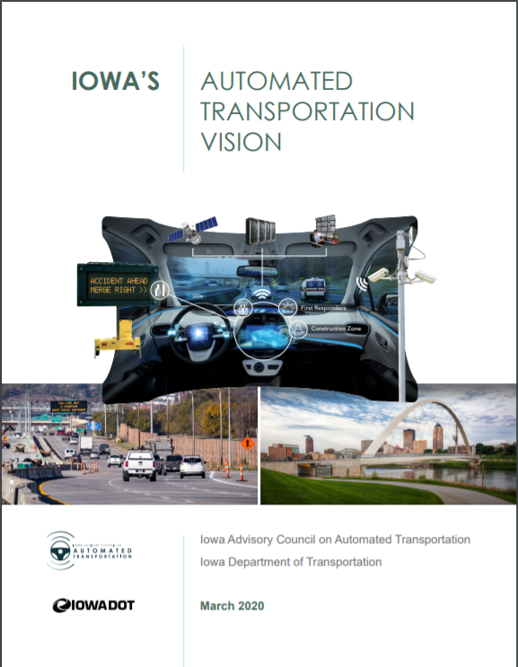
Visioning & Planning
https://iowadrivingav.org/pdf/ATC-Vision.pdf

Slide 16
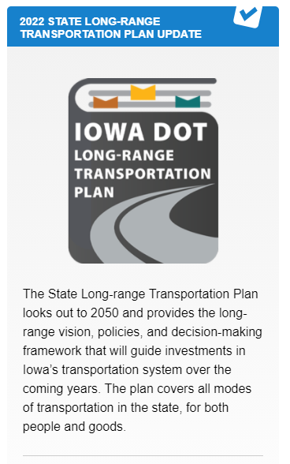
Visioning & Planning
No-Hype Summary
Rightsizing Policy
Possible Statewide Travel Demand Model Scenario
https://iowadot.gov/iowainmotion

Slide 17
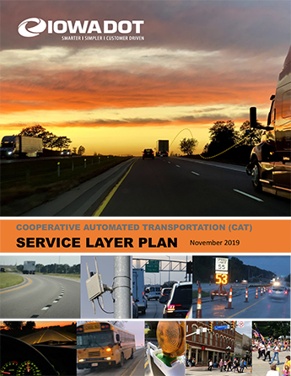
Visioning & Planning
Completed Nov. 2019
Aligns with the State Transportation Plan
Identifies 24, prioritized actions
https://iowadot.gov/TSMO/IowaCAT.pdf

Slide 18
AT Readiness: Policy & Legislation

Slide 19
Policy & Legislation
Following Distance (HF387 – 2019)
Removed the following distance requirements
300’ for motor trucks or a motor vehicle drawing another vehicle
500' for motor vehicles following another in convoy or caravan
Maintained reasonable and prudent distance requirement
Automated truck platooning operations are possible in Iowa

Slide 20
Policy & Legislation
Automated Driving Systems (ADS) Framework (SF302 - 2019)
Based on model legislation
Includes Passenger & Commercial Motor Vehicles
Iowa Code sections (321.514 to 321.519):
Definitions
Operation
Insurance
Accidents
On-demand driverless-capable vehicle network
Authority (Rulemaking)

Slide 21
Policy & Legislation
Personal Delivery Devices (PDDs) - HF 304 (2021 session) Enrolled
New Iowa Code Sections
Definitions
Applicable Law
Operators
Operation
Areas of Operation
Equipment
Regulation by local authorities
Insurance

Slide 22
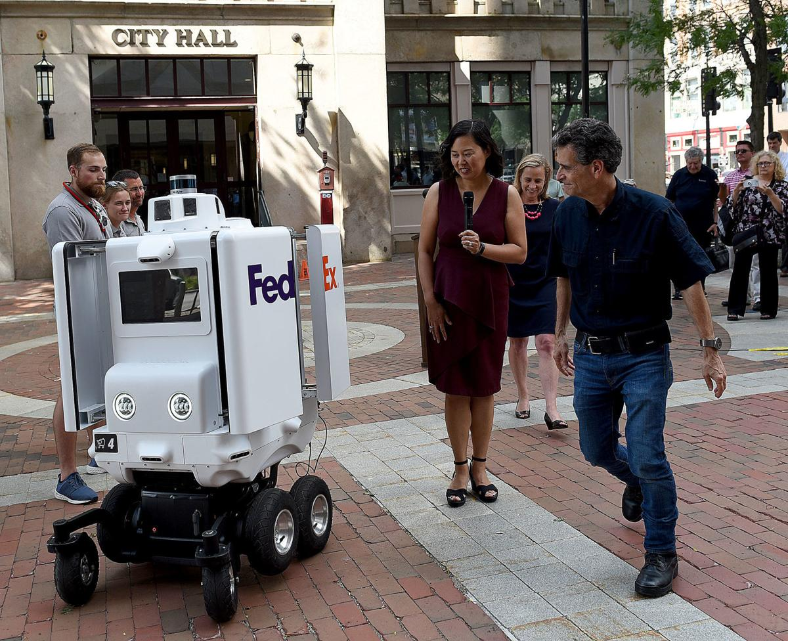
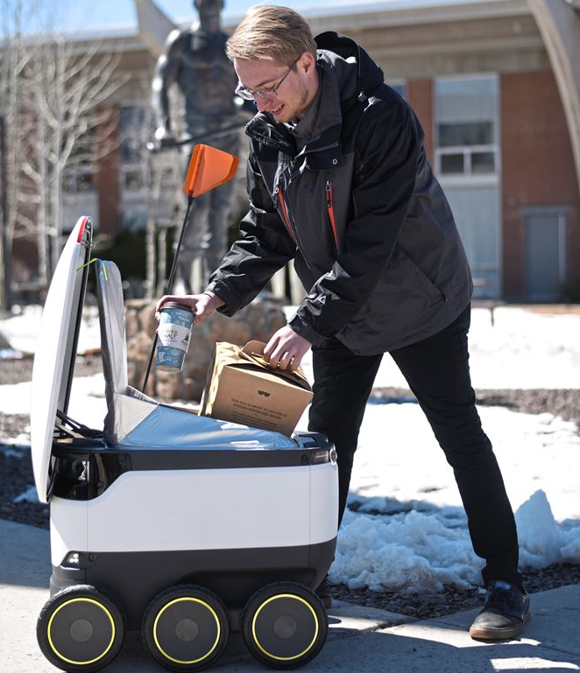
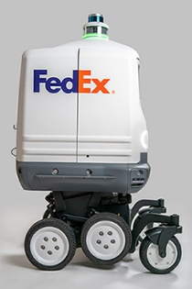
Personal Delivery Devices (PDDs)
Amazon Scout
FedEx Roxo
Starship Robot

Slide 23
AT Readiness: Research & Tactical Activities

Slide 24
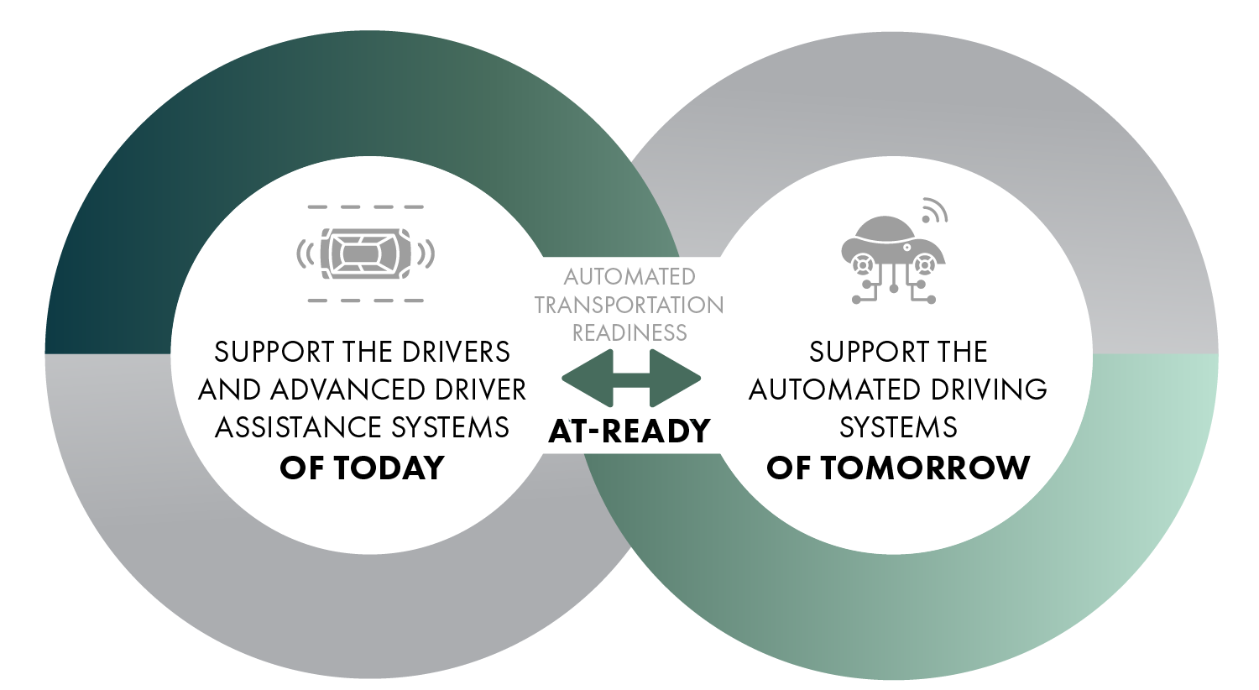
AT-READY

Slide 25
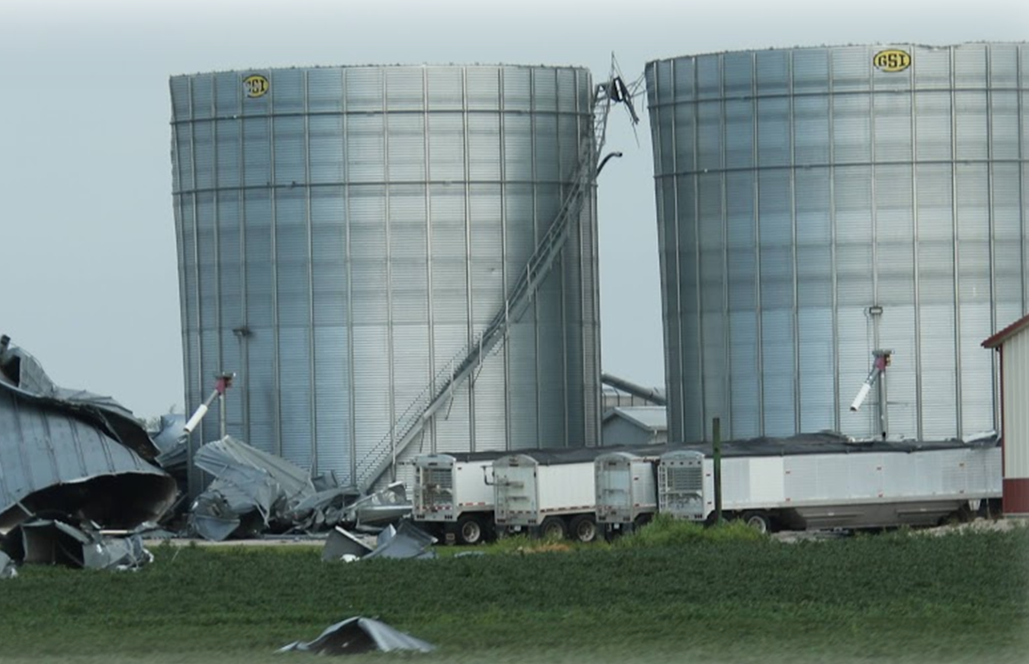
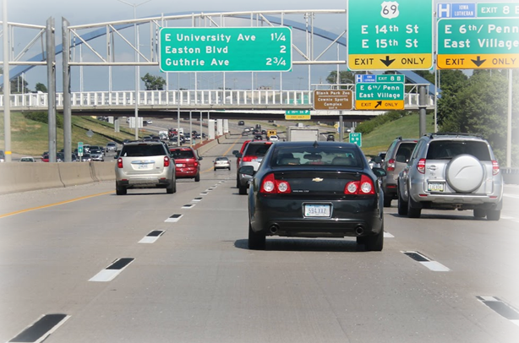
Infrastructure & Operational Readiness
Enhanced Weather Reporting (Pikalert)
Work Zone Data
Connected Signalized Intersections
Audible Warning System Automation
Pavement Markings

Slide 26
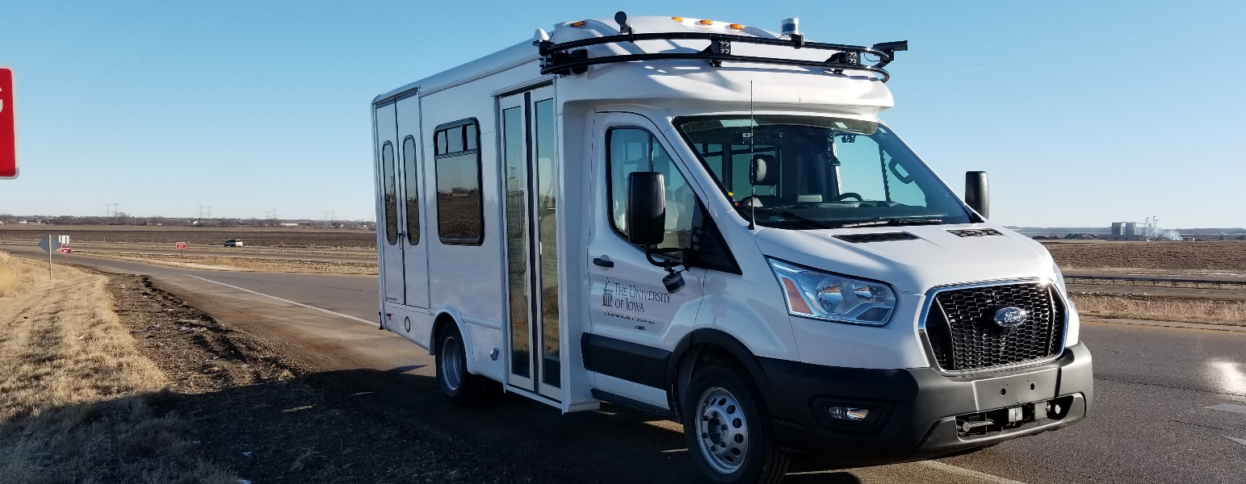
Project Goals
Improve safety on our nation’s roadways with ADS
Represent rural roads in ADS testing
Enhance mobility
Provide data
ADSforRuralAmerica.uiowa.edu

Slide 27
AT Readiness: Regional & National

Slide 28
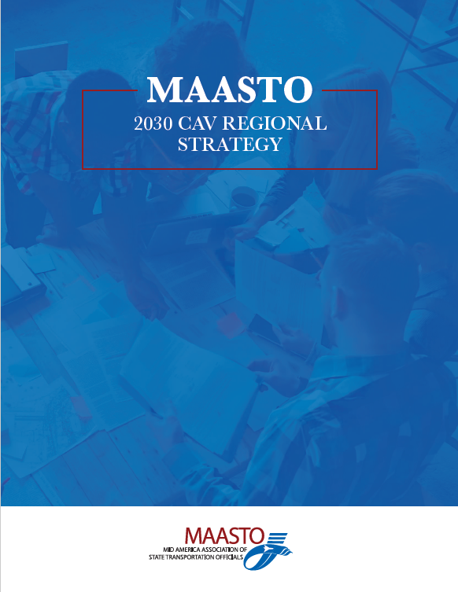
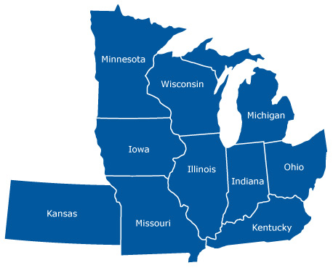
Regional & National
Completed March 2021
Identifies ten priorities to support CAV deployment by 2030
On-going
Short-term (<5 years)
Medium-term (5 to 9 yrs.)
Long-term (10+ yrs.)

Slide 29
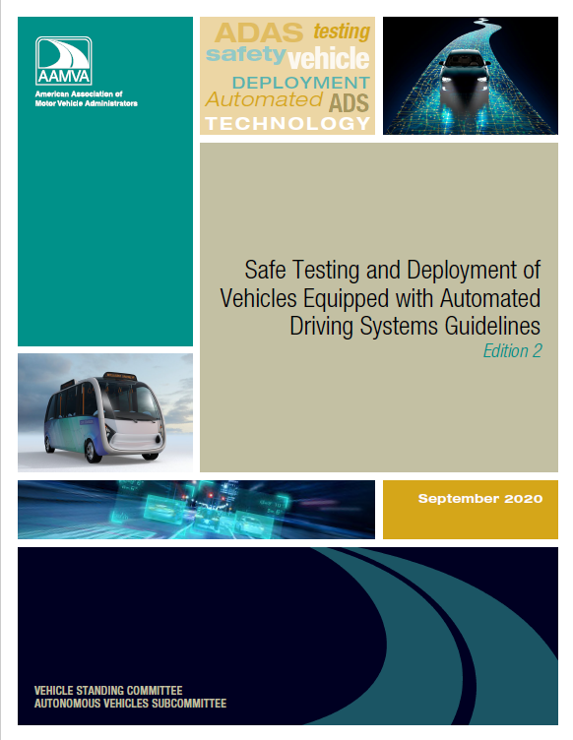
Regional & National
Completed Sept. 2020
Provides voluntary recommended guidelines for ADS testing and deployment
Used to support Iowa’s ADS administrative rules

Slide 30
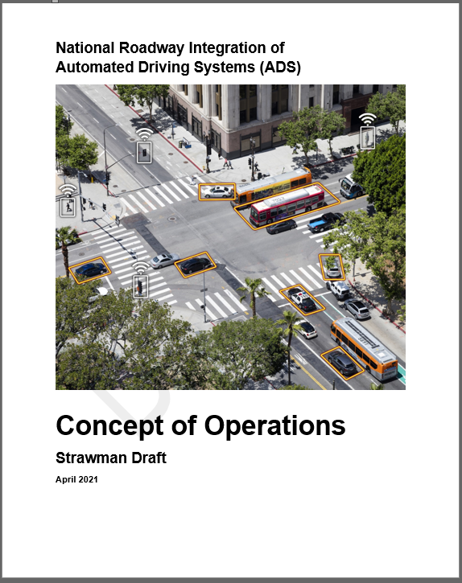
Regional & National
Expected Late 2021
Support the integration of ADS by 2035, in an anticipated mixed fleet environment
Living Document

Slide 31
AT-READY

Slide 32
THANK YOU!
Adam Shell
Automated Transportation Program Manager
Traffic Operations Bureau – Iowa DOT
adam.shell@iowadot.us

