Slide 1
Revitalize Iowa’s Sound Economy Program
Iowa Transportation Commission Workshop
May 10, 2022

Slide 2
Revitalize Iowa’s Sound Economy Program
Created in 1985
Purpose: To promote economic development through roadway improvements.
Eligible development shall have value-adding activities that feed new dollars into the economy
Available to cities and counties through an application program

Slide 3
Available Funding and Application Summary
Available Funding
Funded annually with dedicated state motor fuel and special fuel tax revenues
Application Summary for SFY2022
Total number of projects awarded: 11
Total project costs: $36,647,427
Total amount awarded: $18,425,892
 | CITY | COUNTY
Average funding generated monthly | $905,101 | $452,550
SFY 2022 current Road Use Tax Revenue (as of 3/31/2022) | $9,130,068.18 | $4,565,034.09
Current Unobligated Balance (as of 3/31/2022) | $2,810,485.09 | $1,346,259.63

Slide 4
Immediate Opportunity Project Evaluation Criteria
Growth Potential
Average wages meet at least 100% laborshed wage
Quality of Jobs
No pattern of violations
In-state suppliers
Impact on import substitution
Few Iowa competitors
Operating expenditures spent in Iowa
Out-of-state sales
Hiring preferences to Iowa residents

Slide 5
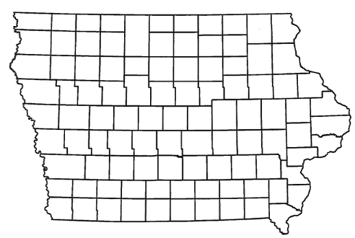
List of Immediate Opportunity Applications Recommended
PROJECT NAME
SPONSOR
JOBS
TOTAL PROJECT COST
PERCENT PARTICIPATION
RECOMMENDED AMOUNT
Constructing turn lanes and paving a median on Iowa 163 located northwest of Pella. | Marion County | 30 | $281,251 | 80% | $225,001

Slide 6
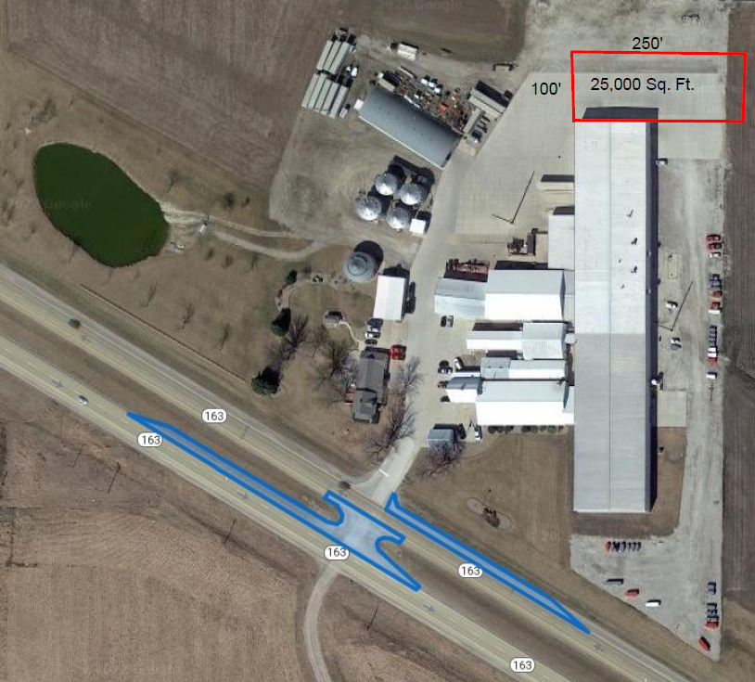
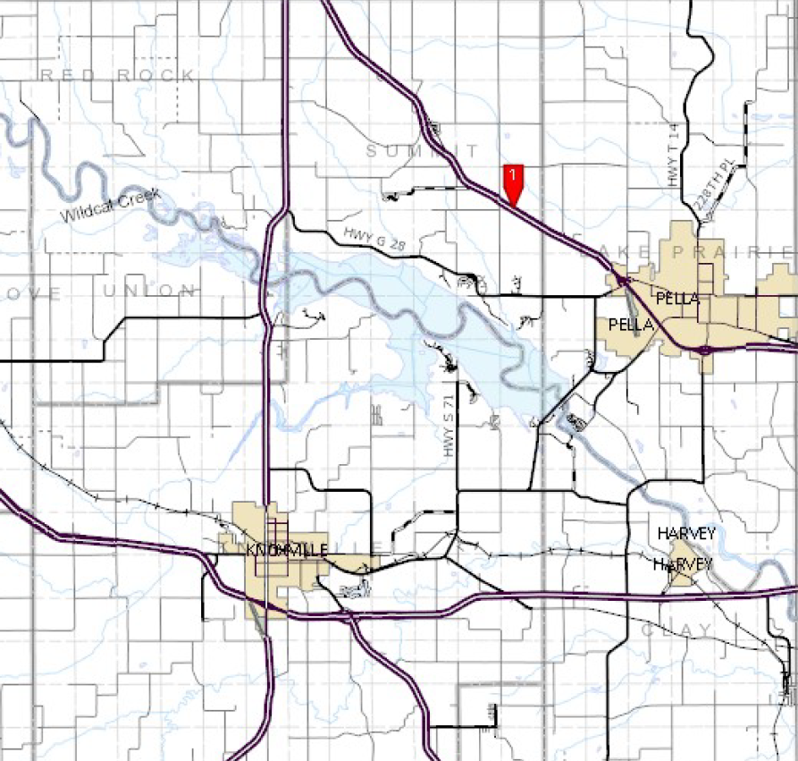
Marion County
(Immediate Opportunity)
Assist in constructing turning lanes and paving a median on Iowa 163 located northwest of Pella. These improvements are necessary to provide improved access to the proposed expansion of LDJ Manufacturing, Inc., a manufacturer of the Thunder Creek Equipment brand of mobile fueling solution targeting both the agriculture and industrial market.
Total Cost: $281,251 RISE Cost/Job Assisted: $7,500.03
Requested: $225,001 (80%) Capital Investment/RISE $: $11.39
Jobs Created: 30 Company Average Wages: $29.32 (150% of laborshed)

Slide 7
QUESTIONS?
Craig Markley, Systems Planning Bureau
craig.markley@iowadot.us
515-239-1027

