Slide 1
State Transportation Plan & State Freight Plan
2022 Updates
Commission Workshop
May 10, 2022

Slide 2
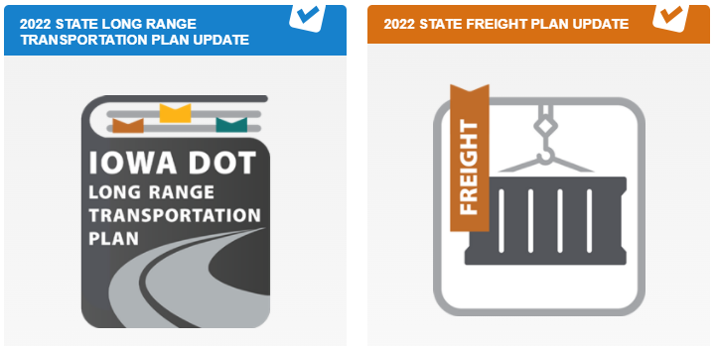
Discussion items
Orientation to final plan documents
Final steps

Slide 3
SLRTP chapter outline
(page 4) Introduction, overview of the plan and planning process
(page 14) Demographic and economic trends
(page 28) Overview of each mode and passenger and freight trends
(page 102) Vision for Iowa’s transportation system, objectives to help achieve it, and issues that influence transportation
(page 154) Analysis of current and future needs/risks by mode, implementation strategies, and Rightsizing Policy
(page 232) Projected annual costs and revenues by mode and considerations for addressing funding shortfalls
(page 250) Programming future investments and ongoing performance monitoring

Slide 4
SFP chapter outline
(page 8) Purpose of the plan, overview of federal transportation authorizations, and tie to national freight goals
(page 18) Inventory of the freight network and summary of condition, utilization, safety, and reliability of each freight mode
(page 60) Overview of freight-dependent industries, overall commodity movement, and primary supply chains in Iowa
(page 80) Freight-related trends, issues, and opportunities to consider in planning and programming
(page 98) Implementation strategies, improvements, performance measures, and Freight Investment Plan

Slide 5
Final steps
SLRTP:
Commission to consider adoption at this afternoon’s business meeting
SFP:
Will be forwarded to FHWA for USDOT review and approval

Slide 6
THANK YOU
Garrett.Pedersen@iowadot.us

