Slide 1
Revitalize Iowa’s Sound Economy Program
Iowa Transportation Commission Business Meeting
May 10, 2022

Slide 2
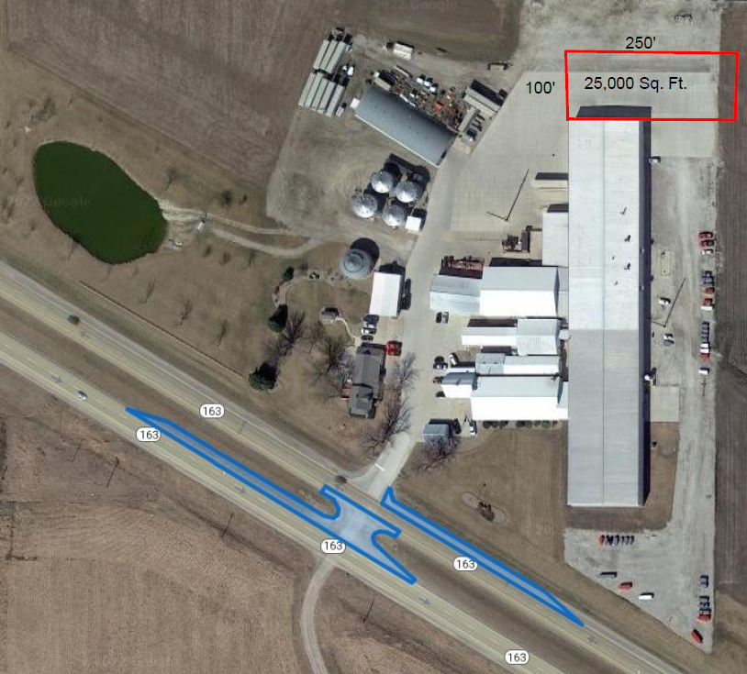
List of Immediate Opportunity Applications Recommended
PROJECT NAME
SPONSOR
JOBS
TOTAL PROJECT COST
PERCENT PARTICIPATION
RECOMMENDED AMOUNT
Constructing turn lanes and paving a median on Iowa 163 located northwest of Pella. | Marion County | 30 | $281,251 | 80% | $225,001

