Slide 1
Transportation Trends Update
Transportation Commission Workshop
May 10, 2022

Slide 2
Overview
Economic Recovery Index
Travel trends
US total rail carloads
Commercial air service passenger counts
Vehicular traffic

Slide 3
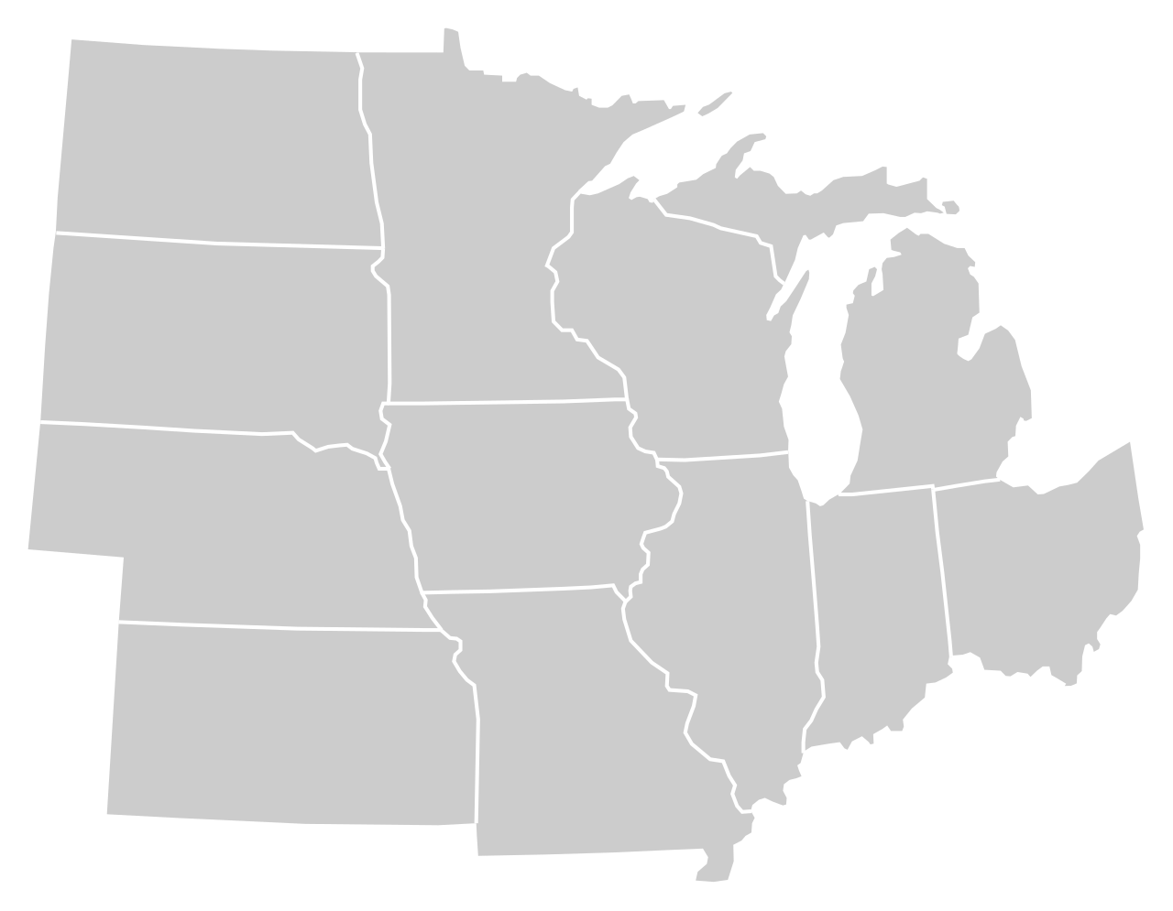
Moody’s/CNN Recovery Index - Midwest (Pre-Pandemic = 100) As of 5/6/2022
92%
90%
103%
92%
92%
95%
(98% last month)
97%
94%
86%
95%
93%
93%
Nation is at 93% (95% last month)

Slide 5
Monthly Passenger Counts at Iowa’s Eight Commercial Service Airports
(through March 2022)

Slide 7
Questions?

