Slide 1
Revitalize Iowa’s Sound Economy Program
Iowa Transportation Commission Business Meeting
May 9, 2023

Slide 2
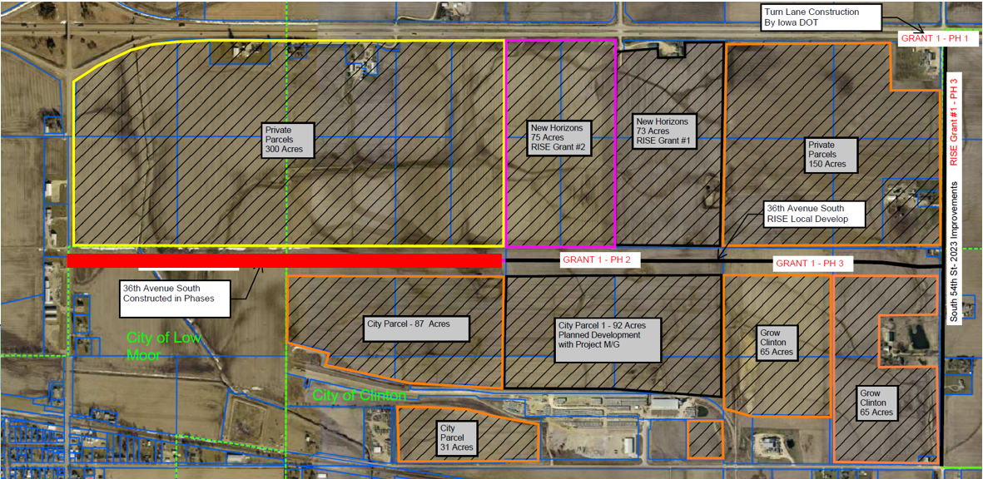
List of Local Development Applications Recommended
PROJECT NAME
SPONSOR
SCORE
TOTAL PROJECT COST
PERCENT PARTICIPATION
RECOMMENDED AMOUNT
Construction of approximately 4,650 feet of 36th Avenue South | Clinton | 75 | $4,866,250 | 60% | $2,919,750

Slide 3
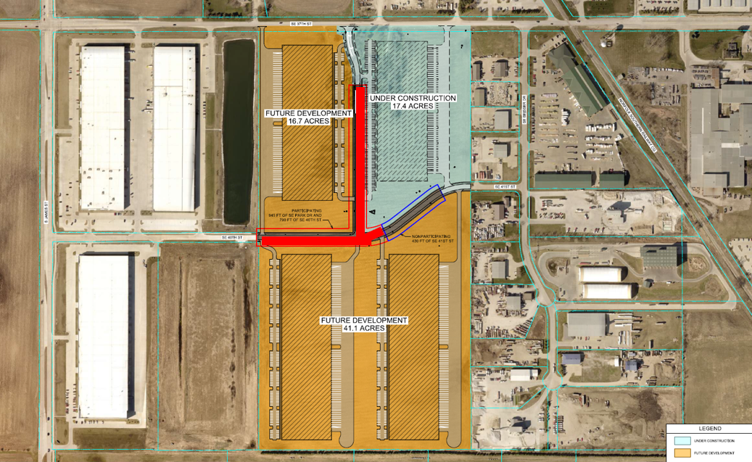
List of Local Development Applications Recommended
PROJECT NAME
SPONSOR
SCORE
TOTAL PROJECT COST
PERCENT PARTICIPATION
RECOMMENDED AMOUNT
Construction of approximately 945 feet of SE Park Drive and 790 feet of SE 40th Street | Grimes | 46 | $2,066,781 | 50% | $1,033,391

