Slide 1
Transportation Trends Update
Transportation Commission Workshop
May 9, 2023

Slide 2
Overview
US total rail carloads
Commercial air service passenger counts
Vehicular traffic
Upper Mississippi locks and dams

Slide 4
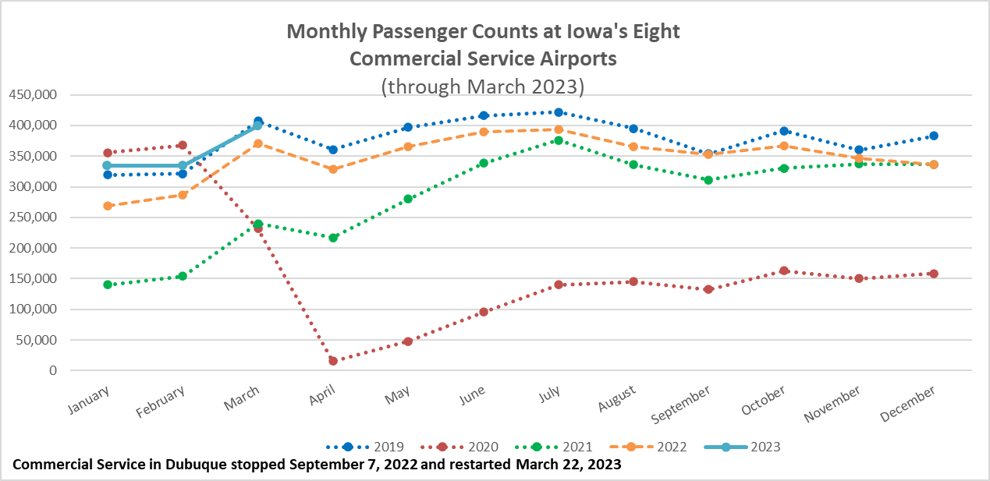

Slide 5
Monthly State Vehicle Miles of Travel
(through March 2023)

Slide 6
Upper Mississippi Locks and Dams
High winter snowfall and rapid warming has led to flooding
18 locks were shut down from the Twin Cities to Illinois/Missouri at the peak
Barge traffic shut down on the Upper Mississippi for a multi-week period
Impacts on shipping grain down river and fertilizer up river

Slide 7
Questions?

