Slide 1
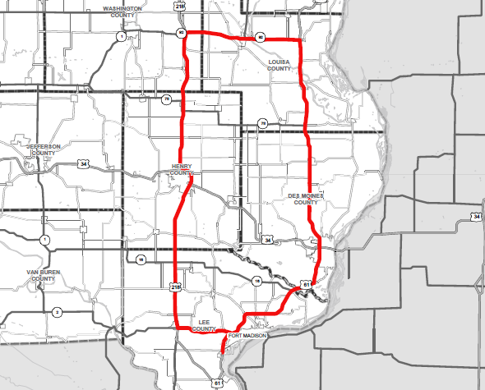
Iowa Transportation Commission Tour
Southeast Iowa
June 12, 2023

