Slide 1
Revitalize Iowa’s Sound Economy Program
Iowa Transportation Commission Workshop
May 9, 2023

Slide 2
Revitalize Iowa’s Sound Economy Program
Created in 1985
Purpose: To promote economic development through roadway improvements.
Eligible development shall have value-adding activities that feed new dollars into the economy
Available to cities and counties through an application program

Slide 3
Available Funding and Application Summary
Available Funding
Funded annually with dedicated state motor fuel and special fuel tax revenues
Application Summary for SFY2023
Total number of projects awarded: 6
Total project costs: $17,074,238
Total amount awarded: $8,961,060
 | CITY | COUNTY
Average funding generated monthly | $905,101 | $452,550
SFY 2023 current Road Use Tax Revenue (as of 3/31/2023) | $9,040,806.31 | $4,520,403.15
Current Unobligated Balance (as of 3/31/2023) | $11,581,206.86 | $99,858.15

Slide 4
Local Development Project Evaluation Criteria
Development Potential (35 points)
Economic Impact and Cost Effectiveness (20 points)
Local Commitment and Initiative (33 points)
Transportation Need and Justification (4 points)
Local Economic Need (6 points)

Slide 5
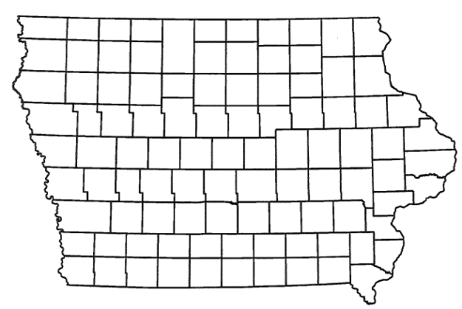
List of Local Development Applications Recommended
PROJECT NAME
SPONSOR
SCORE
TOTAL PROJECT COST
PERCENT PARTICIPATION
RECOMMENDED AMOUNT
Construction of approximately 4,650 feet of 36th Avenue South | Clinton | 75 | $4,866,250 | 60% | $2,919,750
Construction of approximately 945 feet of SE Park Drive and 790 feet of SE 40th Street | Grimes | 46 | $2,066,781 | 50% | $1,033,391

Slide 6
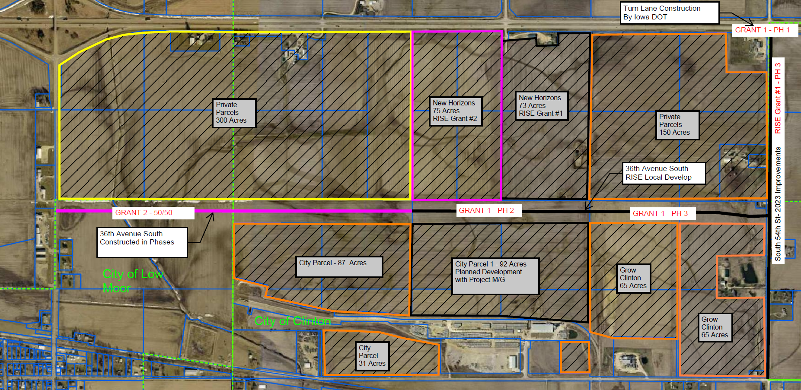
Clinton
(Local Development – Certified Site)
Construction of approximately 4,650 feet of 36th Avenue South located on the southwest side of town. This project is necessary to provide improved access to Lincolnway Industrial Rail and Air Park, an Iowa Economic Development Authority certified site of more than 375 acres.
Total Cost: $4,866,250
Requested: $2,919,750 (60%)

Slide 7
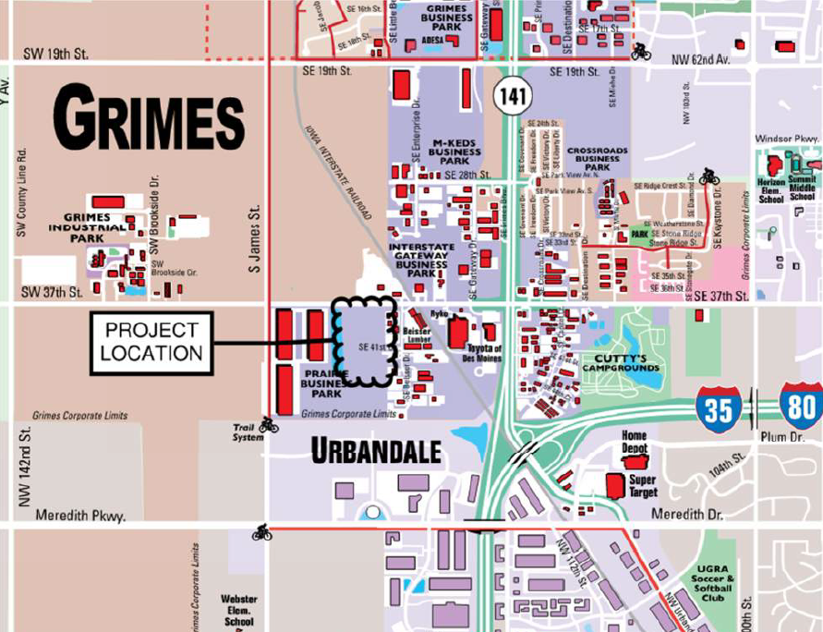
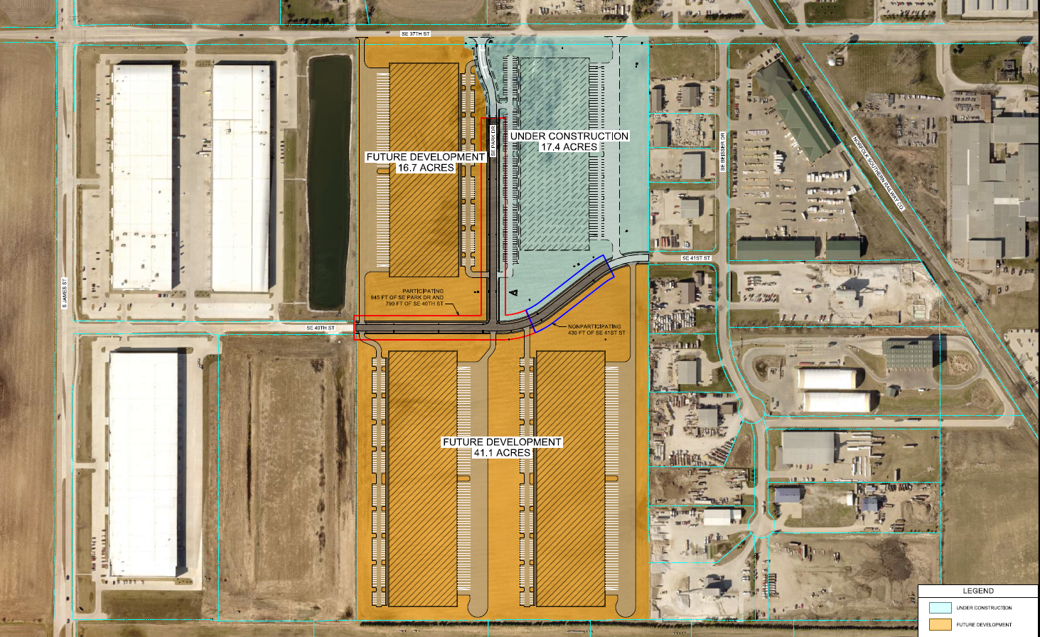
Grimes
(Local Development)
Construction of approximately 945 feet of SE Park Drive and 790 feet of SE 40th Street located on the south side of town. This project is necessary to provide improved access to three lots totaling more than 57 acres for office, distribution and warehousing purposes.
Total Cost: $2,066,781
Requested: $1,033,391 (50%)

Slide 8
QUESTIONS?
Debra Arp, Systems Planning Bureau
Debra.Arp@iowadot.us
515-239-1681

