Slide 1



Transportation Trends Update
May 14, 2024
3/2/2023

Slide 2
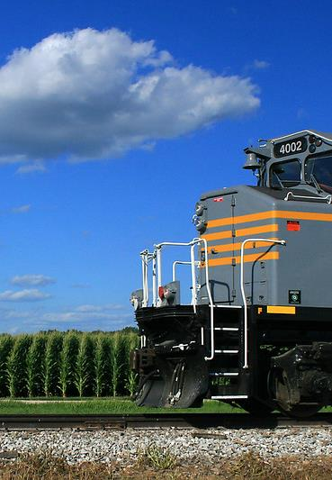

Agenda
US total rail carloads
Commercial air service passenger counts
Public transit ridership
Vehicular traffic
Mississippi River and Panama Canal

Slide 4
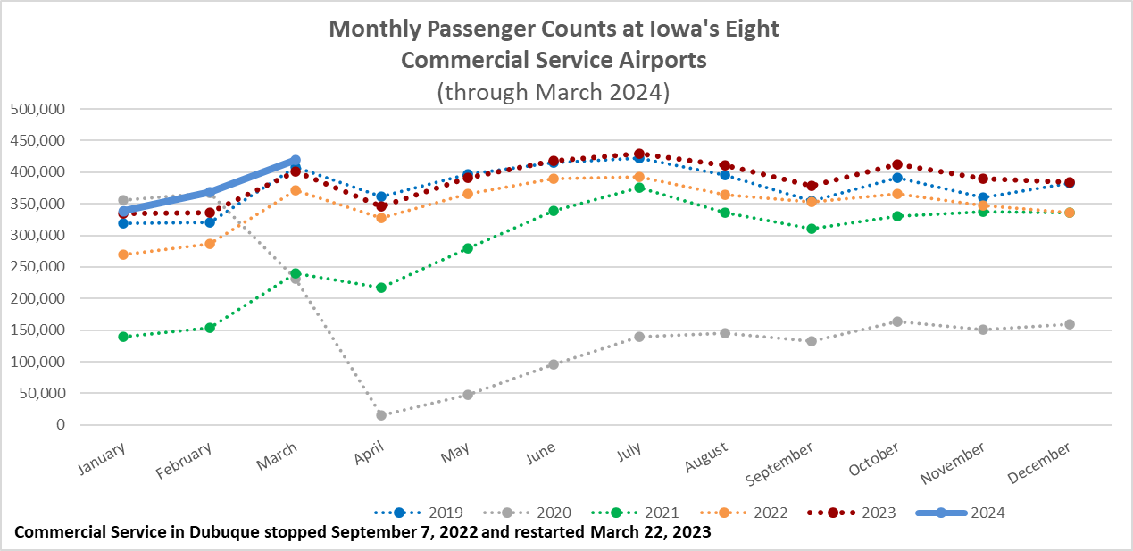

Slide 5
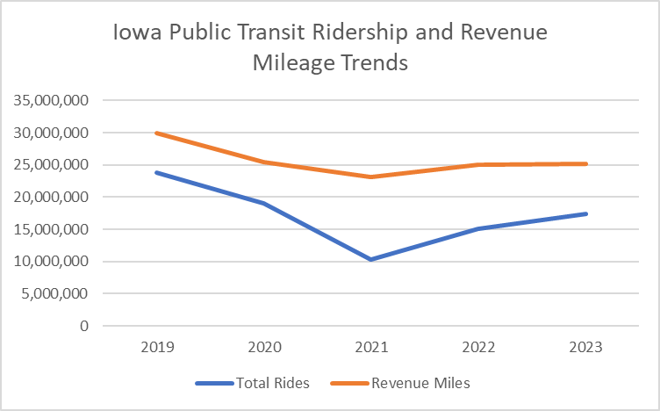

Slide 6
Monthly State Vehicle Miles of Travel
(through March 2024)

Slide 7
Water Transportation
Mississippi River
As of early February, the Corps of Engineers announced the end of drought conditions impacting the Mississippi River that began September 2022.
There are no draft restrictions and no dredges are operating.
Limited snowpack and ongoing drought conditions in the Upper Mississippi River basin could result in difficult conditions depending on spring rainfall.
Panama Canal
Drought has reduced the amount of freshwater available to use for the lock system. Drought was most likely caused by El Nino.
Rainy season has arrived as hoped.
Maximum ship transits per day is now 25 with slots scheduled in late May to increase to 31 and then 32 in June. Normal levels - 36 to 38 ships per day.
Forty percent of all US container traffic travels through the Panama Canal

Slide 8
Questions?

