Slide 1


June Commission Tour Preview
May 14, 2024
3/2/2023

Slide 2
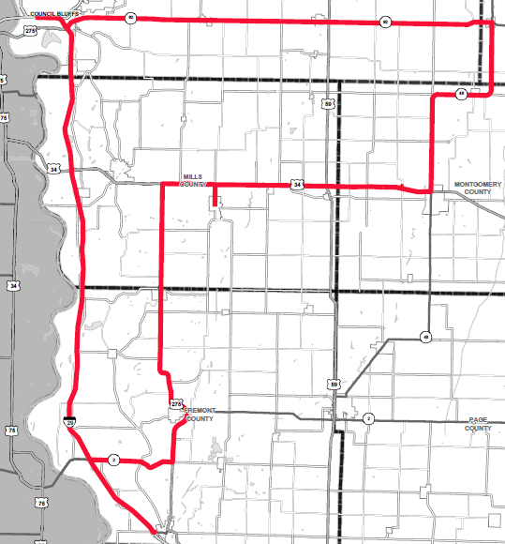
June Commission Tour Preview

Slide 3
June Commission Tour Preview
Begin tour at Courtyard by Marriott in Council Bluffs
Council Bluffs Interstate
I-29 Corridor
IA 333 Resiliency Project in Hamburg
Lunch in Malvern at Classic Cafe
US 34 Corridor
Madison Ave Interchange

Slide 4
April Commission Tour Preview
Questions?
Shawn Majors
Shawn.majors@iowadot.gov​
iowadot.gov

