Slide 1
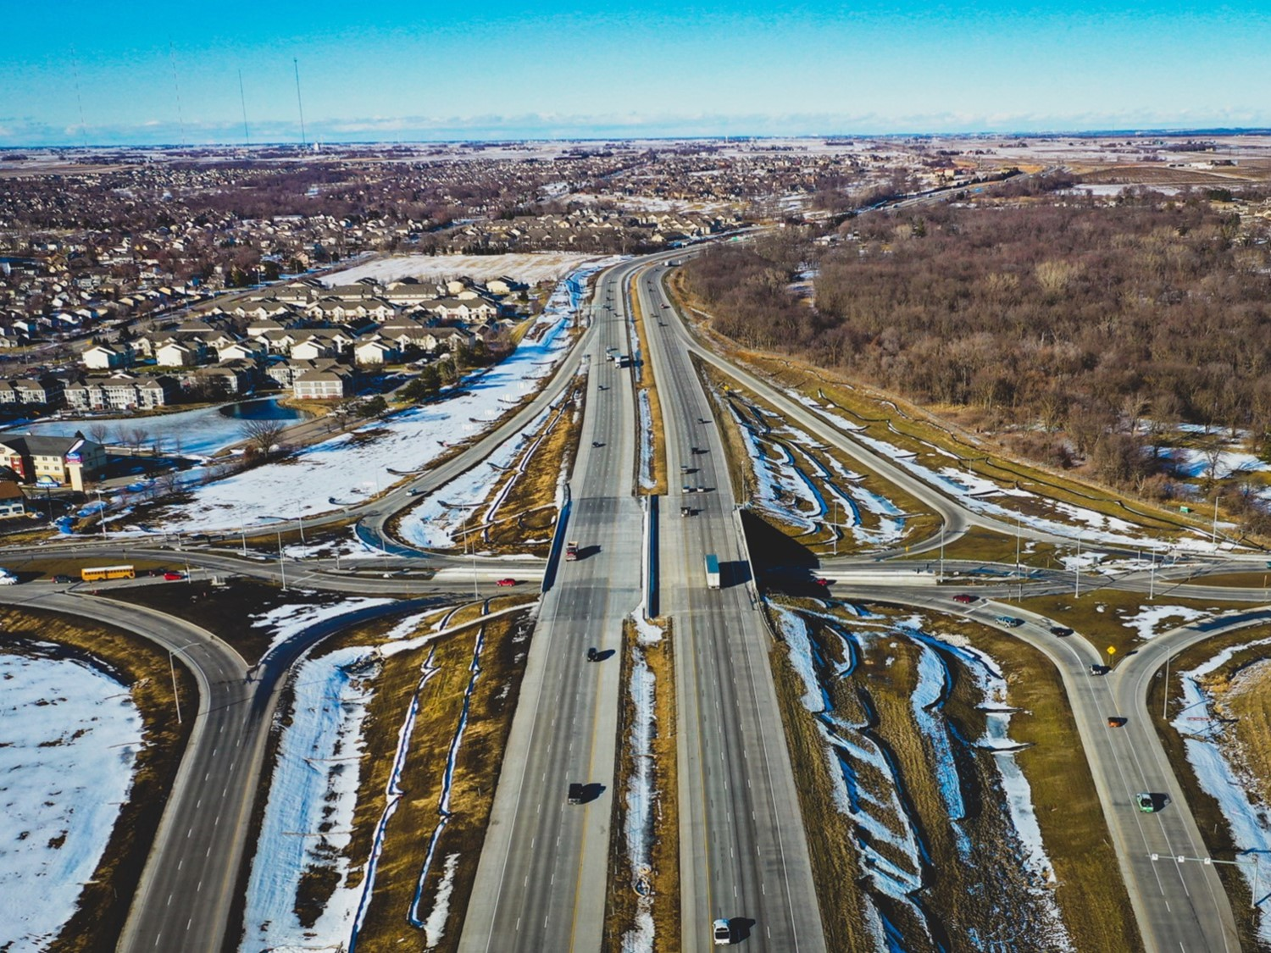
Corridor Preservation Renewal: I-380 from North of Swan Lake Road to North of County Road F12/120th
Iowa Transportation Commission Workshop - May 14, 2024
3/2/2023

Slide 2
Corridor Preservation Zone (CPZ)
New process (New and Renewal)
Present the proposed CPZ to the Commission at a monthly workshop for initial guidance.
If the Commission’s initial guidance is positive for the use of CPZ, we will request formal approval of the CPZ at the same month Commission business meeting.
If approved, official letters will be sent to city and county officials and property owners notifying them of the CPZ and requesting comments for the next two weeks. Notice will be published in the newspaper.
The comments received will be shared with the Commission before the next Commission meeting and the Commission can reassess CPZ decision-making, if necessary.

Slide 3
Corridor Preservation
Corridor preservation is not a legal encumbrance on the property or an exercise of eminent domain but is instead a right of notice.
Corridor preservation avoids inconsistent development of property needed for highway right-of-way, by allowing us to receive notice of intended development of property within the proposed right-of-way and giving us the opportunity to take action to acquire it before the development occurs.

Slide 4
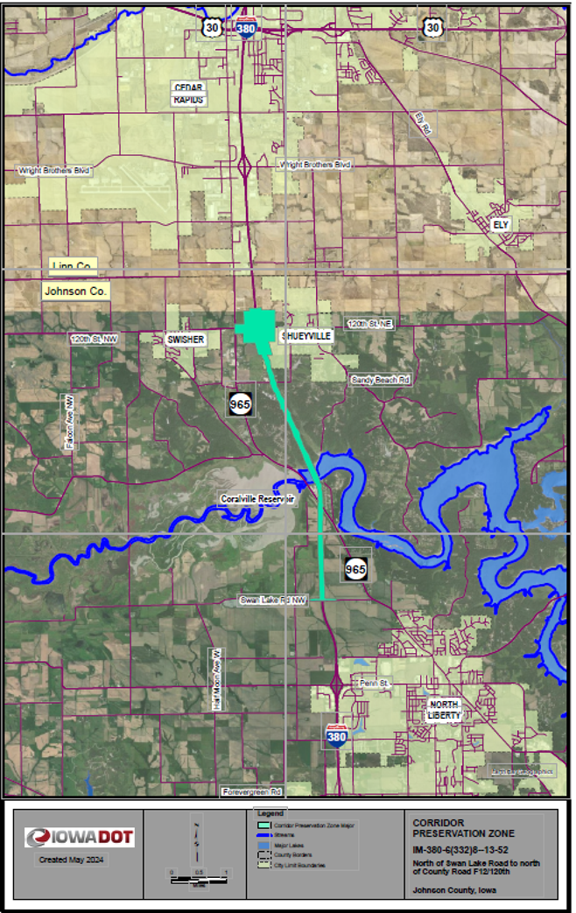
Corridor Preservation Zone Renewal: I-380 from north of Swan Lake Road to north of County Road F12/120th

Slide 5
Questions?
Recommendation: Renew the CPZ on I-380 from north of Swan Lake Road to north of County Road F12/120th.
Once established/renewed, a CPZ is valid for three years.
If there are no concerns, this renewal is an action item on the agenda for this afternoon.
Bryan Bradley
Location and Environment Bureau
Bryan.Bradley@iowadot.us
(515) 239-1787

