Slide 1
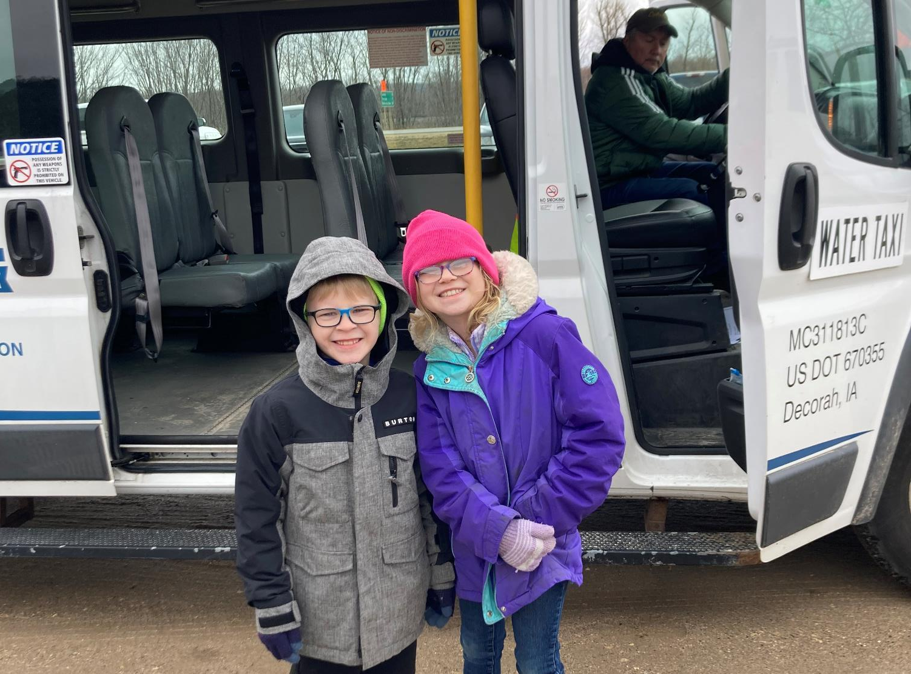
FFY 2023 Transit Program Amendment
(vehicle replacement)
3/2/2023
Brent Paulsen
Transit Programs Manager
Commission Workshop May 14, 2024

Slide 2
FFY 2023 Program Amendment Recommendation
Unobligated Congestion Mitigation Air Quality (CMAQ) Funds
FFY2021 - $35,761
FFY2022 - $2,176,927
FFY2023 - $44,009
Total Available Reprogram- $2,256,697
Notes:
At the January 2023 Commission Meeting we presented a unique issue that was affecting the public transit industry at the time where bus vendors notified transit systems they were unable to provide vehicles at the previously agreed upon prices. The Procurement included ‘Force Majeure’ clause and (1) The pandemic-related supply chain issues was deemed a Force Majeure, allowing the vehicle vendors to cancel contracts and update contract pricing, and (2) This type of cancellation happened to states and transit agencies nationwide. To fill the funding gap FY2022 Section 5339 Grants for Bus and Bus Facilities funds ($5,077,552), Congestion Mitigation Air Quality Program (CMAQ) Apportionment ($3,000,000), and underruns from closed contracts ($1,435,998) were utilized ($9,513,550).
Since January 2023, some transit agencies have “right-sized” their transit fleets to better match ridership needs. For example, some agencies have purchases smaller vans instead of larger buses, or reduced that number of vehicles in their fleet. This has resulted in an available balance in the original funding that was programmed to help with the increased prices of vehicles.
Over $2 Million of FFY 2022 CMAQ Apportionment was not needed for the increased vehicles costs, so unobligated CMAQ funds are available for other projects.
There is $2,176,927 in unobligated FFY2022 CMAQ funds available. FFY2021 and FFY2023 have smaller unobligated balances that are included for a total CMAQ funding availability of $2,256,697.
If asked about CMAQ funds: Purpose: To fund transportation projects in non-attainment or maintenance areas of Clean Air Act Standards. States that have no nonattainment or maintenance areas receive a minimum apportionment of CMAQ funding for either air quality projects or other elements of flexible spending. Funds may be used for any transit capital expenditures otherwise eligible for FTA funding as long as they have an air quality benefit

Slide 3
Project Distribution Criteria
Funds are distributed for bus replacement based on the Public Transit Management System (PTMS) process and the availability of local match
Prioritizes vehicle replacements based on the degree to which each vehicle exceeds the useful life for that particular vehicle type in terms of both age and accumulated mileage
The age, vehicle type, and mileage are maintained for all vehicles within the PTMS database

Slide 4
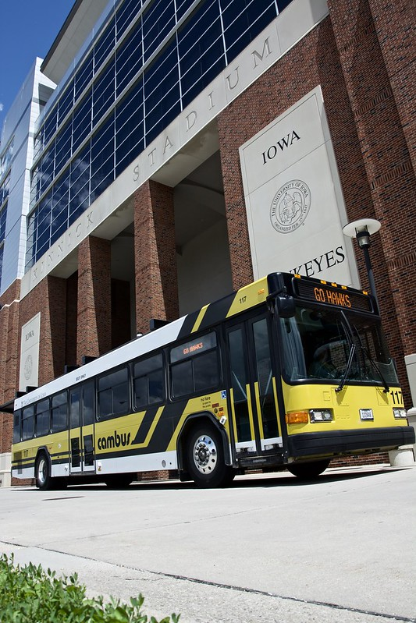
Recommendation
Total capital funds available and recommended for reprogramming: $2,256,697
4 transit systems will be able to purchase 7 vehicles
A list of vehicles is included in the Federal Fiscal Year (FFY) 2023 Transit Program Amendment (vehicle replacement) handout

Slide 5
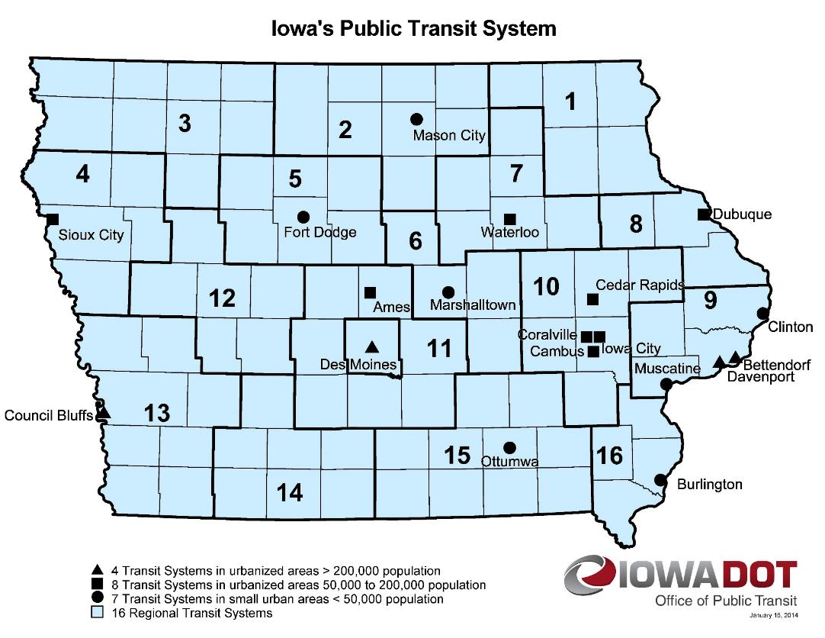
Questions?
CONTACT NAME
###-###-####
email@iowadot.gov​
iowadot.gov

Slide 6
Questions?
Brent Paulsen
515-239-1132
Brent.Paulsen@iowadot.gov​
iowadot.gov
For more information on Iowa’s public transit and intercity bus programs, visit
www.iowadot.gov/transit

