Slide 1
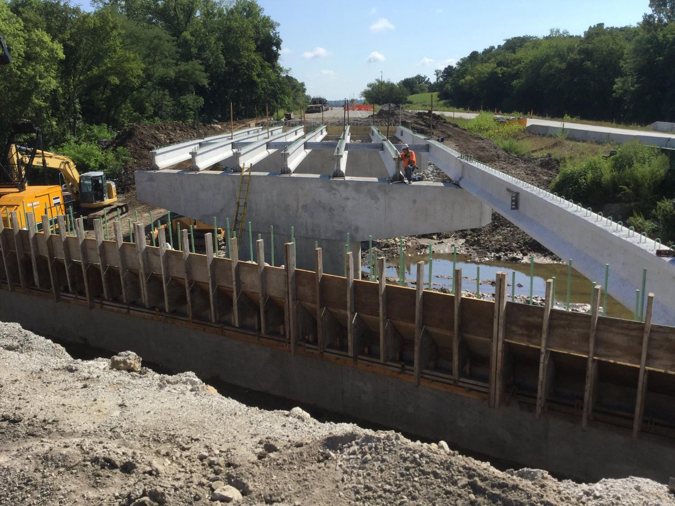


Rural Pavement/Bridge Project Funding and Identification
Iowa Transportation Commission Workshop - May 14, 2024
3/2/2023

Slide 2
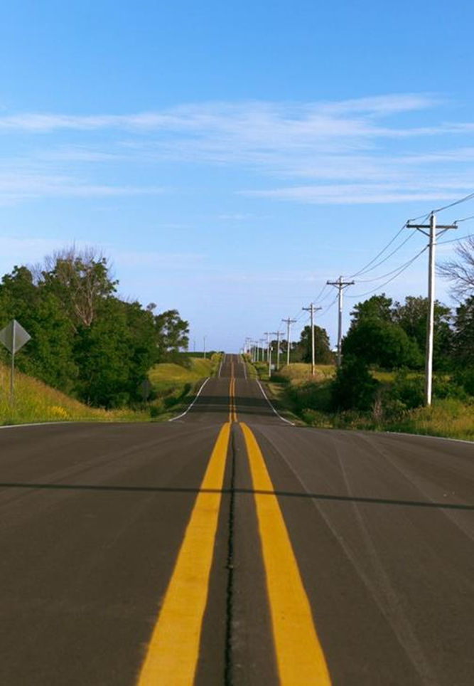

Agenda
Highway Program Funding Categories
Non-Interstate Pavement Modernization
Non-Interstate Bridge Modernization

Slide 3
Highway Program Funding Categories
Interstate Stewardship
Non-Interstate Pavement Modernization
Non-Interstate Bridge Modernization
Safety Specific
Non-Interstate Capacity/System Enhancement
Major Interstate Capacity/System Enhancement

Slide 4
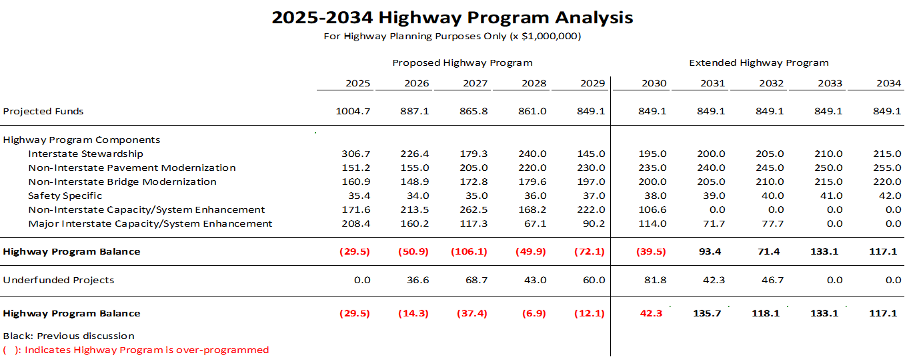
Highway Program Funding Categories

Slide 5
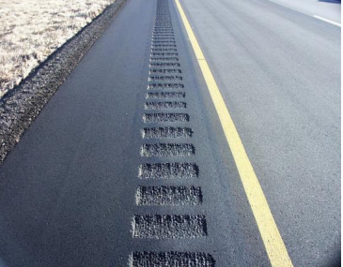
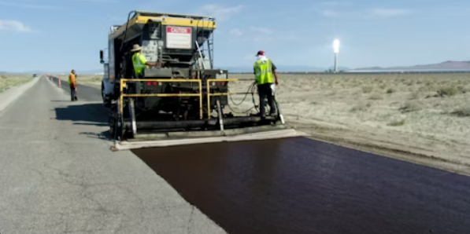
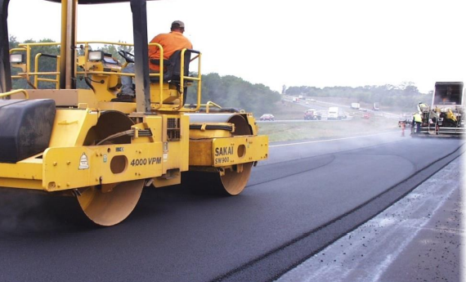
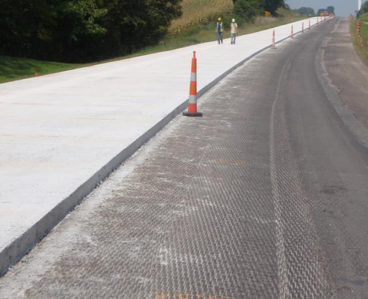
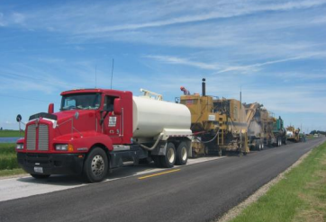
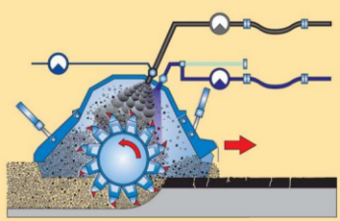
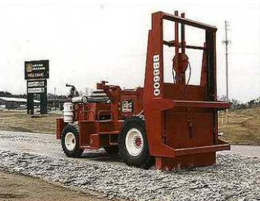

Non-Interstate Pavement Modernization
Safety
Paved Shoulders
Rumble Strips
Turn Lanes
Signing
Microsurfacing
HMA Milling & Resurfacing
PCC Overlay
PCC Rubblization
PCC Crack and Seat
Cold In-Place Recycling
Diamond Grinding

Slide 6
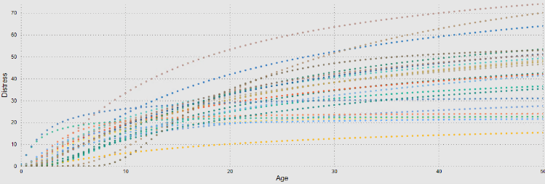
Non-Interstate Pavement Modernization
Pavement deterioration
  Climate
  Materials
  Loading (Trucks)
  Construction
Distress Collection
Structural Testing
Friction Collection
Forecast Models
Interstate = Annually
Non-Interstate = Bi-annually
~20% Network Annually
~20% Network Annually

Slide 7
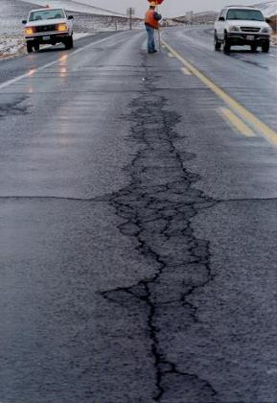
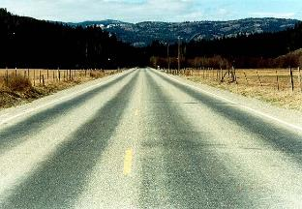
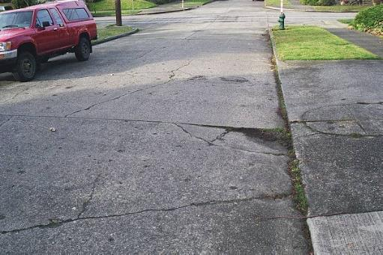
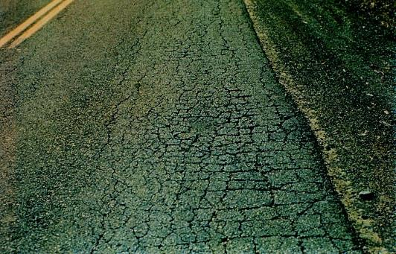
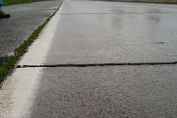
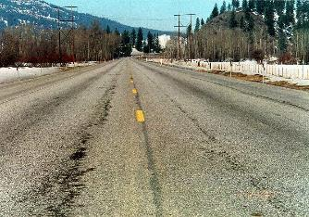
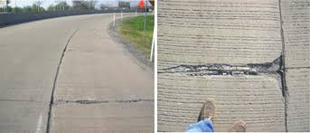
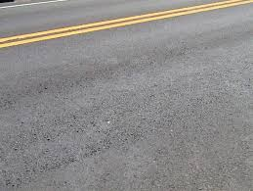
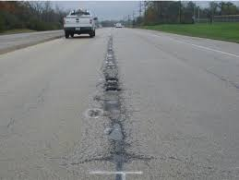
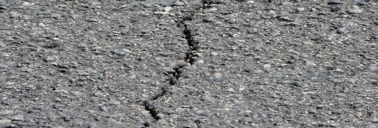
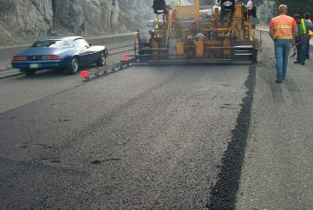
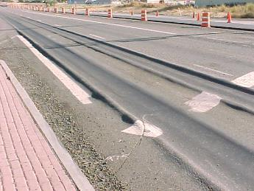
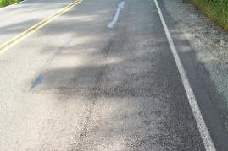
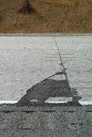
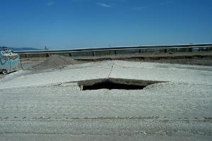
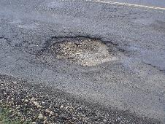
Non-Interstate Pavement Modernization
Causes of Distress
Load (Trucks)
Fatigue Cracking
Material
Stripping
Climate
Rutting
Construction
Roller marks
Bleeding
Durability Cracking
Oxidation
Blowups
Thermal Cracks
Pot holes (freeze thaw)
Longitudinal Joint
Polishing
Mat Tearing
Segregation
Corner Breaks
Faulting
Rutting

Slide 8
Non-Interstate Pavement Modernization
Environmental and traffic effects combine to cause distresses
  High temperatures with traffic loadings can cause rutting
  Freeze/thaw and trucks cause cracking
  Freeze/thaw and any traffic can cause potholes
  Fatigue cracking is caused by trucks (especially with weakened subgrades)
  Poor ride results from trucks and weak subgrades or freeze/thaw
In general, truck loads are more visibly noticeable in consuming pavement life, but environmental effects play a large role.

Slide 9
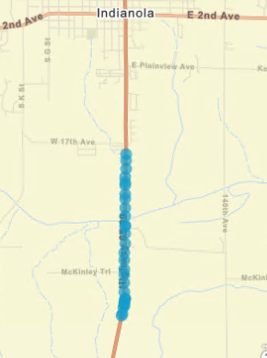
Non-Interstate Pavement Modernization
Why 1-Year Program?
  Conditions Change/Flexibility
  Locked into 5 years limits ability to respond to needs
  Example US 65
2021 Jump in Cracking
Accelerated Deterioration
Normal Deterioration
Notes:
Pavement condition changes. Locking in pavement selections 5 years out doesn’t allow engineers to respond to emerging needs due to harsh winters, increased traffic, local partnerships, etc. In this example on US 65, the normal deterioration was following the “gold” colored curve up to 2020. In 2021, we saw the highest 5-year snow total and the cracking jumped unexpectedly. Now this pavement is on a new curve which may trigger it for rehab sooner

Slide 10
Non-Interstate Pavement Modernization
Project Selection
Worst First
Right Now
Pavement Management
Right Time
Right Road
Right Treatment
Worst Road
Expensive
Economical

Slide 11
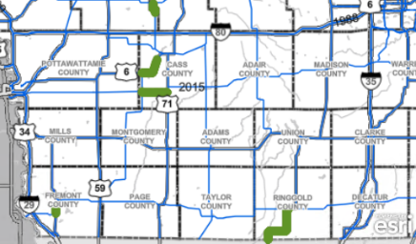
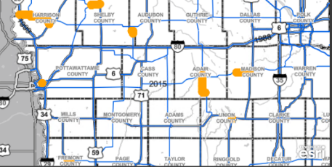
Non-Interstate Pavement Modernization
Project Selection
Optimization Software Makes Recommendations
Engineers Make Adjustments
Traffic
Field Staff Reviews
Drainage/Safety
Compare and Finalize
Life added >= Life Lost
# Lane Miles Treated
PCI Impact
Notes:
We have tools that tell us the most economical way to invest. Engineers take these recommendations and make adjustments based on local feedback and other non-pavement considerations (ie safety). We quantify the impacts of the Engineer’s decisions compared to the optimization tools so we can balance the trade-offs. We make sure we put as much life back as we take out each year through normal deterioration. We make sure our selections offer a similar impact to PCI as the optimization’s recommendations do.

Slide 12
Non-Interstate Pavement Modernization
Funding allocation by district
PCI=77.2
PCI=74.7
PCI=72.2
PCI=72.0
PCI=72.2
PCI=71.4
Notes:
3R has always been allocated to the 6 districts by their size and pavement condition. The approach for FY26 and beyond uses 50% size and 50% condition. The condition piece is based on the investment needed for all 6 districts to achieve the same PCI at the end of a 10-year investment analysis. Some districts are able to utilize other (non-3R) funding that helps their condition climb higher than other districts. These circumstances are captured in this allocation process, which is repeated annually.

Slide 13
Non-Interstate Pavement Modernization
Project Cycle
Fiscal Year
(Likeliest Construction Year)
November 2023
March 2024
FY25 Concepts Due
May 2024
2023 Pavement Data Published
November 2024
Road Reviews –
March 2025
FY26 Concepts Due
May 2025
2024 Pavement Data Published
…
Road Reviews –
Set FY26 Allocation
Set FY27 Allocation
FY26 Project Selection
FY27 Project Selection
Calendar Year
2025
2026
2027
2023
2024
2025
We Are Here
Notes:
Often times we’ll receive questions about why a road wasn’t selected and how soon it can be considered. This slide shows at any given time, we are selecting/developing projects that will be constructed 2 years out.

Slide 14
Non-Interstate Bridge Modernization
Includes all bridge repair, rehabilitation, and replacement activities
Projects are programmed for all five years of the Program

Slide 15
Non-Interstate Bridge Modernization
Project Identification
  All bridges and larger culverts are inspected at least every 24 months
  Based on inspection findings, initial project candidates are identified by Bridges and Structure Bureau (BSB) and District
  Annual meetings between BSB and each District to review and prioritize candidates
  Preliminary cost estimates are developed for priority projects

Slide 16
Non-Interstate Bridge Modernization
Project Identification (continued)
  At the end of the calendar year, a list of recommended projects for year 5 of the new Program is provided based on priorities and funding target.
  Updates to bridge projects in year 1 to 4 of the Program may also be provided due to updated costs estimates.
  Throughout the process, Bridge Management Software is utilized to assist identifying optimal project improvements/schedule, assessing future network condition, and assessing future needs.

Slide 17
Questions?

