Slide 1
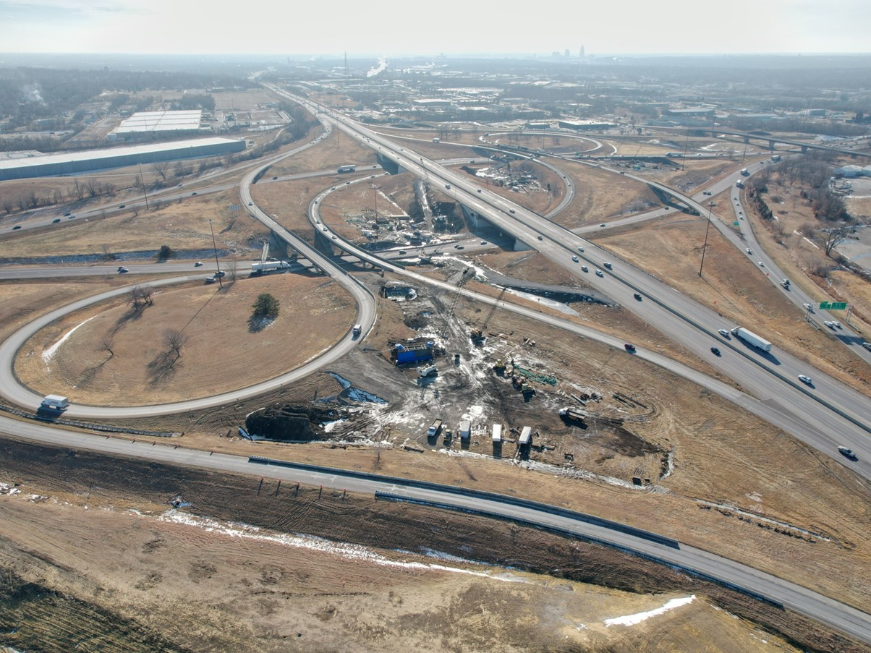


2025-2029 Highway Program Development
May 14, 2024
3/2/2023

Slide 2
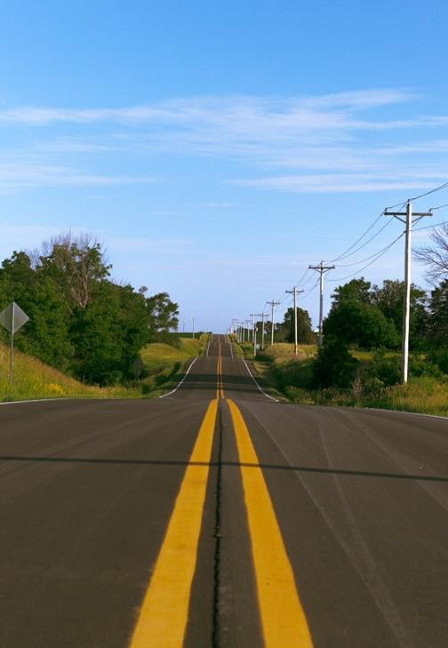

Agenda
TOPIC 1
Highway Program Analysis
TOPIC 2
Next Steps

Slide 3
April 8, 2024
Highway Program Development Schedule (2025-2029)
May 2024
  Present the Draft 2025-2029 Iowa Transportation Improvement Program to the public (including all previous Program approvals and Draft 2025-2029 Highway Program)
June 2024
  Action Item: Approve the 2025-2029 Iowa Transportation improvement Program

Slide 4
Topic 1
Highway Program Analysis

Slide 5
Underfunded Projects
($ in millions)
(For Highway Planning Purposes Only)
 |  | 2025 |  | 2026 |  | 2027 |  | 2028 |  | 2029 |  |  | 2030 |  | 2031 |  | 2032 |  | 2033 |  | 2034
Non-Interstate Capacity/System Enhancement
IA 58 Black Hawk Co. Greenhill Rd. Interchange |  |  |  |  |  |  |  | 43.0
IA 12 Woodbury Co. Gordon Dr. Viaduct |  |  |  |  |  |  |  |  |  | 60.0 |  |  | 60.0
Major Interstate Capacity/System Enhancement
I-80 Scott Co. Middle Rd. Interchange |  |  |  | 36.7
 |  |  |  | -0.1
I-35/I-235/I-80 Polk County Southwest Mixmaster |  |  |  |  |  | 68.3
 |  |  |  |  |  | 0.4
Black: Previous discussion
Green: Changes since previous discussion

Slide 6
Underfunded Projects
($ in millions)
(For Highway Planning Purposes Only)
 |  | 2025 |  | 2026 |  | 2027 |  | 2028 |  | 2029 |  |  | 2030 |  | 2031 |  | 2032 |  | 2033 |  | 2034
Non-Interstate Capacity/System Enhancement
IA 58 Black Hawk Co. Greenhill Rd. Interchange |  |  |  |  |  |  |  | 43.0
IA 12 Woodbury Co. Gordon Dr. Viaduct |  |  |  |  |  |  |  |  |  | 60.0 |  |  | 60.0
Major Interstate Capacity/System Enhancement
I-80 Scott Co. Middle Rd. Interchange |  |  |  | 36.6
I-35/I-235/I-80 Polk County Southwest Mixmaster |  |  |  |  |  | 68.7
I-380 Segment 2 Linn: N of Swan Lake Rd to N of Co Rd F12 |  |  |  |  |  |  |  |  |  |  |  |  | 21.8 |  | 42.3 |  | 46.7
Black: Previous discussion
Green: Changes since previous discussion

Slide 7
2025-2034 Highway Program Analysis
($ in millions)
(For Highway Planning Purposes Only)

Slide 9
Topic 2
Next Steps

Slide 10
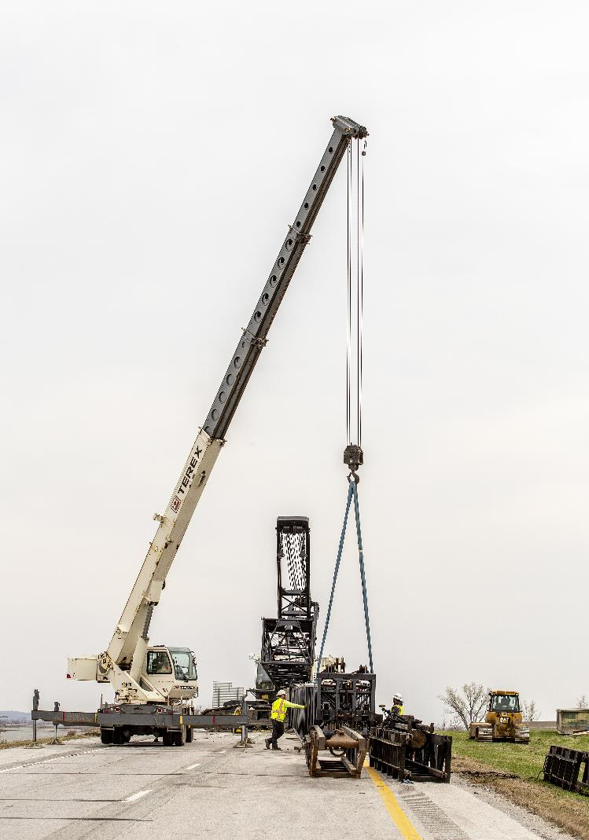
Next Steps
Action Item: Approve the 2025-2029 Iowa Transportation improvement Program

Slide 11
Questions?

