Slide 1
Revitalize Iowa’s Sound Economy Program

Slide 2
Revitalize Iowa’s Sound Economy Program
Created in 1985
Purpose: To promote economic development through roadway improvements.
Eligible development shall have value-adding activities that feed new dollars into the economy
Available to cities and counties through an application program

Slide 3
Available Funding and Application Summary
Available Funding
Funded annually with dedicated state motor fuel and special fuel tax revenues
Application Summary for SFY2020
Total number of projects awarded: 6
Total project costs: $9,395,570
Total amount awarded: $4,169,795
 | CITY | COUNTY
Average funding generated monthly | $997,556 | $498,778
SFY 2020 current Road Use Tax Revenue (as of 9/30/2019) | $2,949,094.26 | $1,474,547.15
Current Unobligated Balance (as of 9/30/2019) | $17,505,841.13 | $988,151.57

Slide 4
Local Development Project Evaluation Criteria
Development Potential (35 points)
Economic impact and Cost Effectiveness (20 points)
Local Commitment and Initiative (33 points)
Transportation Need and Justification (4 points)
Local Economic Need (6 points)

Slide 5
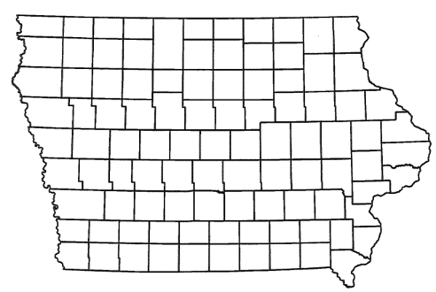
List of Local Development Applications Recommended
PROJECT NAME
SPONSOR
SCORE
TOTAL PROJECT COST
PERCENT PARTICIPATION
RECOMMENDED AMOUNT
Reconstruction of approximately 636 feet of Gifford Road. | Council Bluffs | 60 | $578,895 | 50% | $289,448
Construction of approximately 2,100 feet of Commerce Park Drive and a right-turn lane on 6th Street SW. | Cedar Rapids | 47 | $1,638,152 | 50% | $819,076

Slide 6
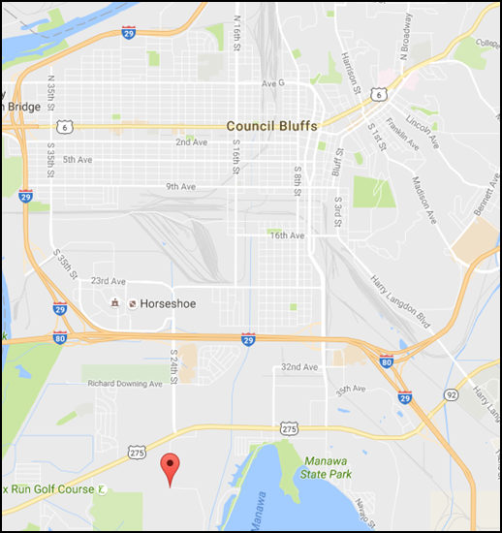
Council Bluffs
(Local Development)
Reconstruction of approximately 636 feet of Gifford Road located on the south side of town. This project will provide improved access to more than 69 acres for industrial and technology purposes.
Total Cost: $578,895
Requested: $289,448 (50%)

Slide 7
Cedar Rapids
(Local Development)
Construction of approximately 2,100 feet of Commerce Park Drive and a right-turn lane on 6th Street SW located on the southwest side of town. This project is necessary to provide access to five lots totaling more than 75 acres for warehousing and industrial purposes.
Total Cost: $1,638,152
Requested: $819,076 (50%)

Slide 8
QUESTIONS?
Craig Markley, Systems Planning Bureau
craig.markley@iowadot.us
515-239-1027

